Slide 1
Agritourism – What does Western Australia have to offer?
1.0 The process of making: input, process and output

Slide 2
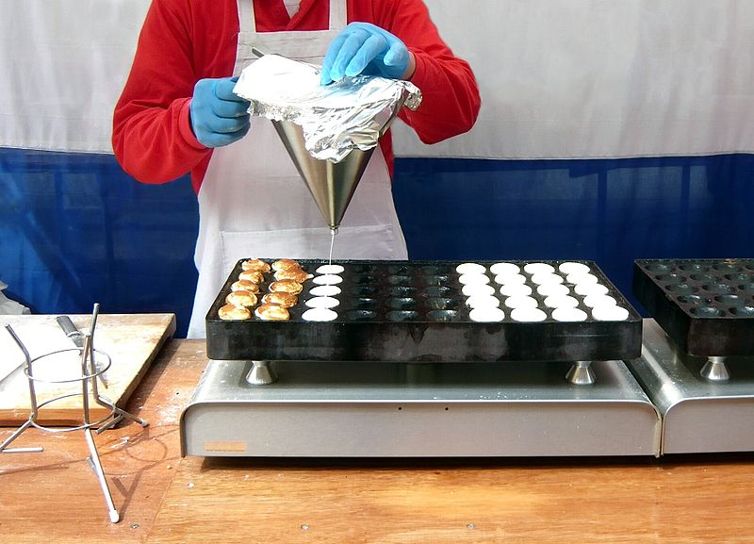
Making
Making – are we all familiar with this word?
Brainstorm: write down anything you can think of that has something to do with making.
Image 1.0.1

Slide 3
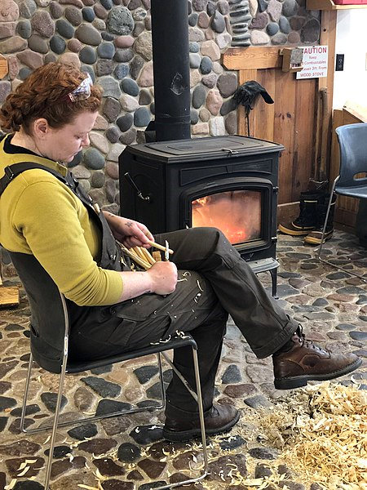
A definition: Making
The Oxford Learner’s Dictionaries defines making as the act or process of making or producing something.
Image 1.0.2

Slide 4
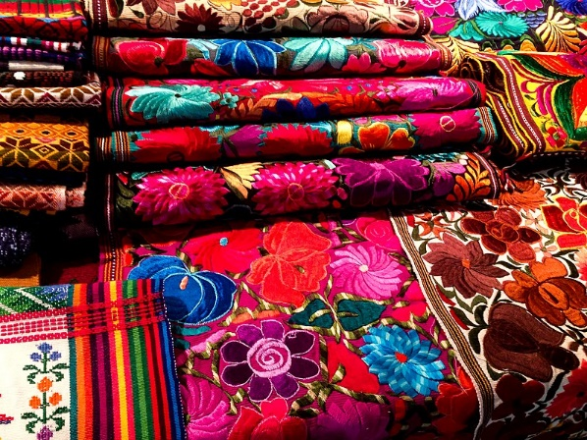
Making
When you make something,
you are creating a product!
Image 1.0.3

Slide 5
Making experience
Pair up.
Tell your partner about something that you have made.
It could be making a cake, a toy model or a vegetable garden.
Write down, in point form, what steps were undertaken.

Slide 6
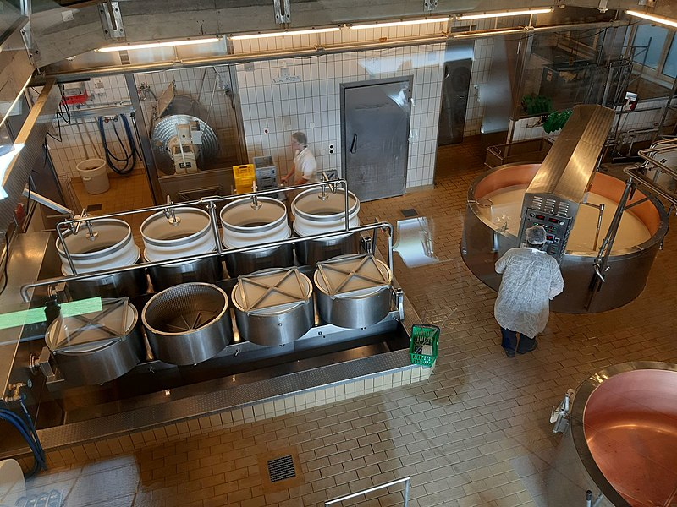
Making
Making is a process – it is a series of steps to create or prepare something.
Another word for making is production.
Image 1.0.4

Slide 7
A definition: Production
The Oxford University Press dictionary (Lexico.com) (2021) defines production as the action of making or manufacturing from components or raw materials, or the process of being so manufactured.

Slide 8
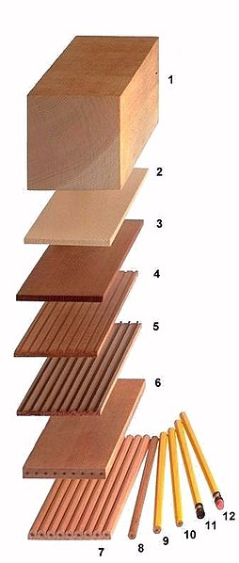
Production
Making vs Production
Are they exactly the same?
What do you think?
* Share your thoughts with the class.
Image 1.0.5

Slide 9
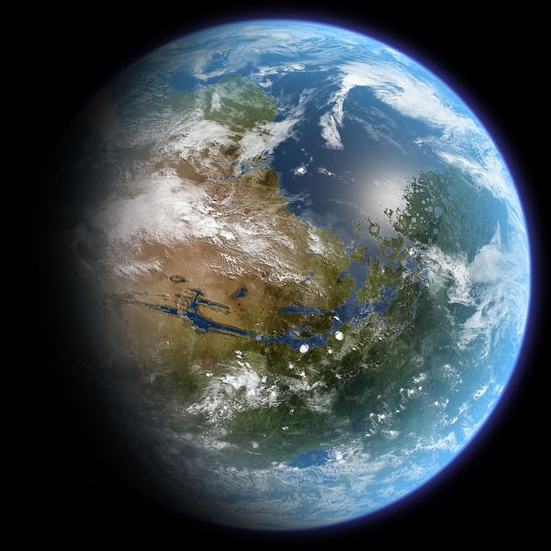
Global scale of production
How much “making” is happening worldwide?
Reflect on how many products there might be produced in the world every day.
From cars to pencils to muesli bars, thousands of products are made every day.
Did you know that just 10 companies produce a lot of what you eat and drink?
Open Link and View Image
Image 1.0.6

Slide 10
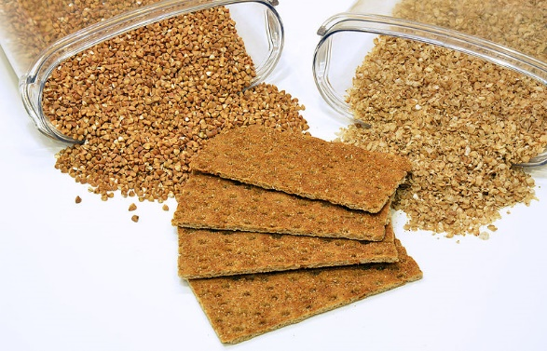
Time for IPO production
To help understand what happens when each one of these different products is made, we can organise production as:
input
process and
output.
Image 1.0.7

Slide 11
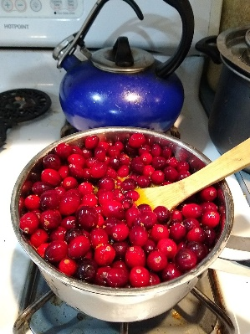
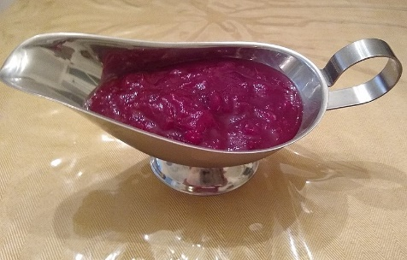
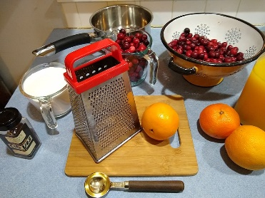
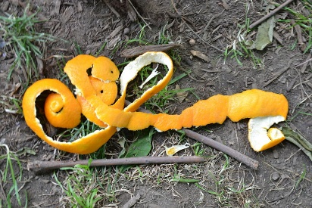
IPO
Input: what is going in – this includes everything that is needed, such as materials/equipment/labour and power.
Process: all the activities that happen, the steps taken to make a product.
Output: what is coming out (everything resulting from production) including by-products.
Making cranberry sauce
Images 1.0.8, 1.0.9, 1.0.10, 1.0.11

Slide 12
Your IPO
Pair up again with your partner.
Revisit your discussion about making something.
Look at the notes you made.
Identify what was:
  input
  process
  output.
Input
Process
Output

Slide 13
IPO explained
Input
The inputs are everything that is needed to make something, including materials, expertise and knowledge, equipment, facilities, labour, and energy.
Process
This is the series of operations that take place to create the final product. These steps convert the materials into the final product; the conversion process uses all the inputs identified above to generate something new.
Output
The output is the final result of the process of production. This includes everything, not only the finished products but also other by-products, waste and impacts, both intentional and unintentional
Input
Process
Output

Slide 14
IPO in action!
Using the following recipe, as a class prepare an IPO chart for home made Muesli Bars.
INPUTS
PROCESSES
OUTPUTS

Slide 15
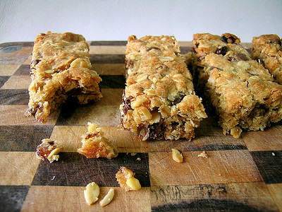
Muesli Bars
Recipe Adapted from Taste.com
Ingredients
1 cup rolled oats
1 cup cornflakes
2/3 cup self-raising flour
1/2 cup dried cranberries
1/3 cup shredded coconut
125g butter, chopped
1/4 cup brown sugar
1/4 cup honey
Method
Step 1
Preheat oven to 180°C/160°C fan-forced. Grease an 18cm x 28cm slice pan. Line base and sides with baking paper, extending paper 2cm from edge of pan.
Step 2
Combine oats, cornflakes, flour, cranberries and coconut in a large bowl. Combine butter, sugar and honey in a small saucepan over low heat. Cook, stirring for 3 to 4 minutes or until butter has melted. Add butter mixture to oat mixture. Stir until well combined.
Step 3
Press mixture into prepared pan. Bake for 20 to 22 minutes or until golden and just firm to touch. Cool completely in pan.
Step 4
Slice and serve.
Image 1.0.12

Slide 16
Student worksheet 1.1
Time to explore production.
Answer the questions in Student worksheet 1.1.
Make sure that you self-test your understandings and keep all your work. You will be applying the knowledge you gain today in the task later in this module.

Slide 17
Acknowledgements
References
Source: Oxford University Press (n.d) ‘Oxford Learner’s Dictionaries’ available at: <https://www.oxfordlearnersdictionaries.com/> accessed 30 July 2021
Walley, P. (2017) ‘Introduction to operations management’, in The Open University (2017) B207Readings Block 1: Big ideas in Organisations, Milton Keynes, The Open University.
Images
Slide 2
Image 1.0.1 WorldRidden (2011) ‘Making Profiteroles’ CC-BY-2.0 available at: <https://commons.wikimedia.org/wiki/File:Making_poffertjes-02-2.jpg> accessed 30 July 2021
Slide 3
Image 1.0.2 Terasaface (2019) ‘A Fireworker Whittling in Front of a Wood Stove’ CC-BY-SA 4.0 available at: <https://commons.wikimedia.org/wiki/File:A_Woodworker_Whittling_in_Front_of_a_Wood_Stove.jpg> accessed 30 July 2021
Slide 4
Image 1.03 Fran Hogan (27 July 2020) ‘Colourful fabrics of Ecuador’ CC-BY-SA-4.0 available at: <https://upload.wikimedia.org/wikipedia/commons/d/df/Colorful_fabrics_of_Ecuador.jpg> accessed 30 July 2021
Slide 6
Image 1.0.4 Svenkaj (12 April 2019) ‘Affoltern production of Emmentaler cheese 2019’ CC-BY-SA-4.0 available at: <https://commons.wikimedia.org/wiki/File:Affoltern_production_of_Emmentaler_cheese_2019.jpg> accessed 30 July 2021
Slide 8
Image 1.0.5 Svenkaj (26 October 2019) ‘Pencil’s production’ CC-BY-SA-4.0 available at: <https://commons.wikimedia.org/wiki/File:Pencil%27s_production.jpg> accessed 30 July 2021
Slide 9
Image 1.0.6 Daein Ballard (5 June 2007) ‘Terraformed Mars Globe Realistic’ CC-BY-SA-3.0 available at: <https://commons.wikimedia.org/wiki/File:TerraformedMarsGlobeRealistic.jpg> accessed 30 July 2021
Slide 10
Image 1.0.7 Andrey Korzun (26 July 2015) ‘Buckwheat and products from it 0.1’ CC-BY-SA-4.0 available at: <https://commons.wikimedia.org/wiki/File:Buckwheat_and_products_from_it_01.jpg> accessed 30 July 2021
Slide 11
Image 1.0.8 Mary Marck Ockerbloom (9 December 2020) ‘Making cranberry sauce – ingredients and tools’ CC-BY-SA-4.0 available at: <https://commons.wikimedia.org/wiki/File:Making_cranberry_sauce_-_ingredients_and_tools.jpg> accessed 30 July 2021
Image 1.0.9 Mary Marck Ockerbloom (9 December 2020) ‘Making cranberry sauce – stovetop’ CC-BY-SA-4.0 available at: <https://commons.wikimedia.org/wiki/File:Making_cranberry_sauce_-_stovetop.jpg> accessed 30 July 2021
1.0.10 Mary Marck Ockerbloom (26 November 2020) ‘Making cranberry sauce – ready to serve’ CC-BY-SA-4.0 available at: <https://commons.wikimedia.org/wiki/File:Making_cranberry_sauce_-_ready_to_serve.jpg> accessed 30 July 2021
1.0.11 SayCheeeeeese (24 June 2021) ‘Orange peel’ CC-1.0 available at: <https://commons.wikimedia.org/wiki/File:Orange_peels-02.jpg> accessed 30 July 2021
Slide 15
Image 1.0.12 Jamieanne (23 January 2011) ‘Betty Crocker Cookie-Based Muesli Bars’ CC-BY-ND 2.0 available at: <https://www.flickr.com/photos/jamieanne/5385741426
https://www.taste.com.au/recipes/cranberry-coconut-muesli-bars/8ea9ad1a-268d-494e-886a-7e7a108c94c1> accessed 30 July 2021

