Slide 1
2.0 Food and fibre frontiers: Emerging technologies
Food and fibre challenges

Slide 2
“The global demand for food and fibre is expected to increase by 70 to 100 percent by 2050 as a result of a number of additional influences.”
Source: Foresight. The Future of Food and Farming (2011) Final Project Report. The Government Office for Science, London.

Slide 3
What do you think are the biggest challenges we face today, related to the production and consumption of food and fibre?
Image 2.0.1 Vignette

Slide 4
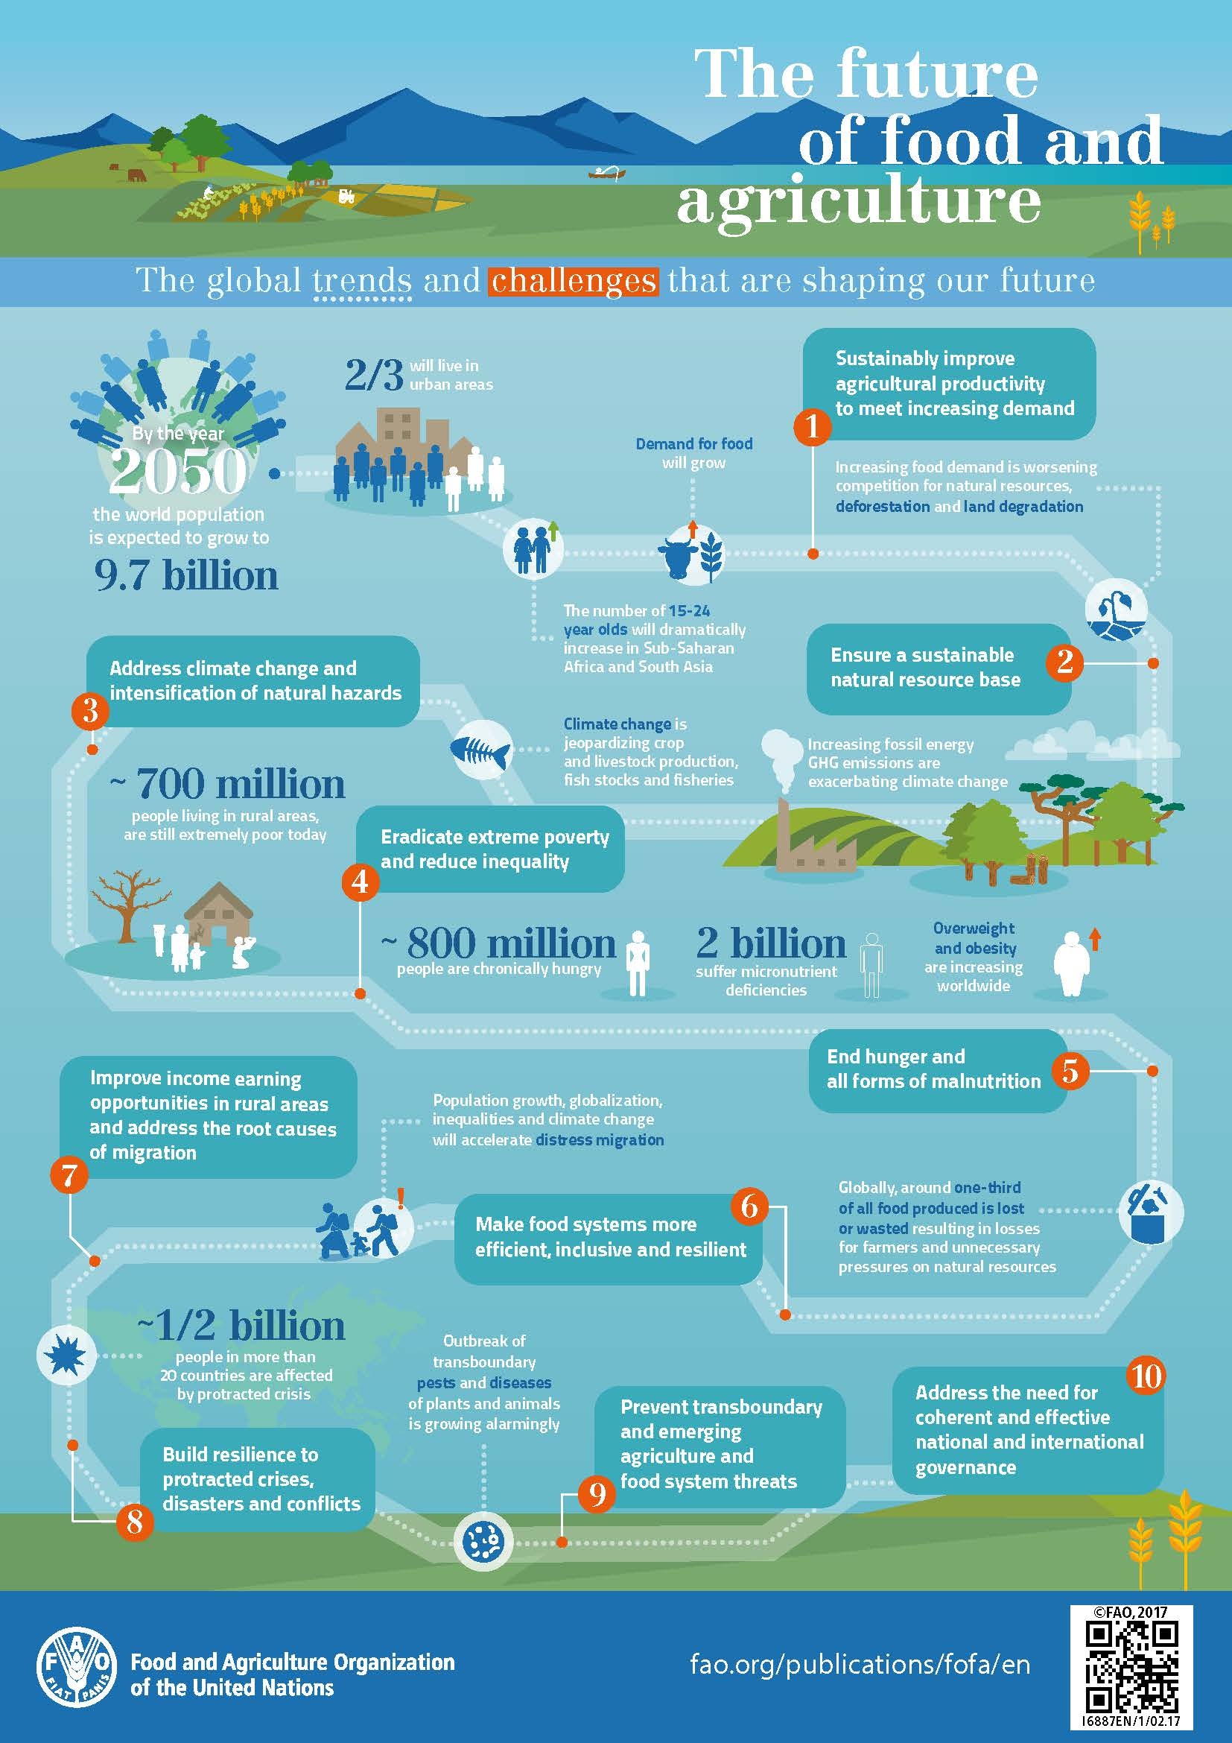
Food and Agriculture Organization of the United Nations is a specialised agency that leads international efforts to defeat hunger and improve nutrition and food security.
Image 2.0.2 The future of food and agriculture

Slide 5
The Challenges
Population growth
Food security
Changes in dietary preferences
Competition for land and water resources
Climate change
Pollution and land degradation
Ethical food and fibre production
Image 2.0.3 Earth

Slide 6
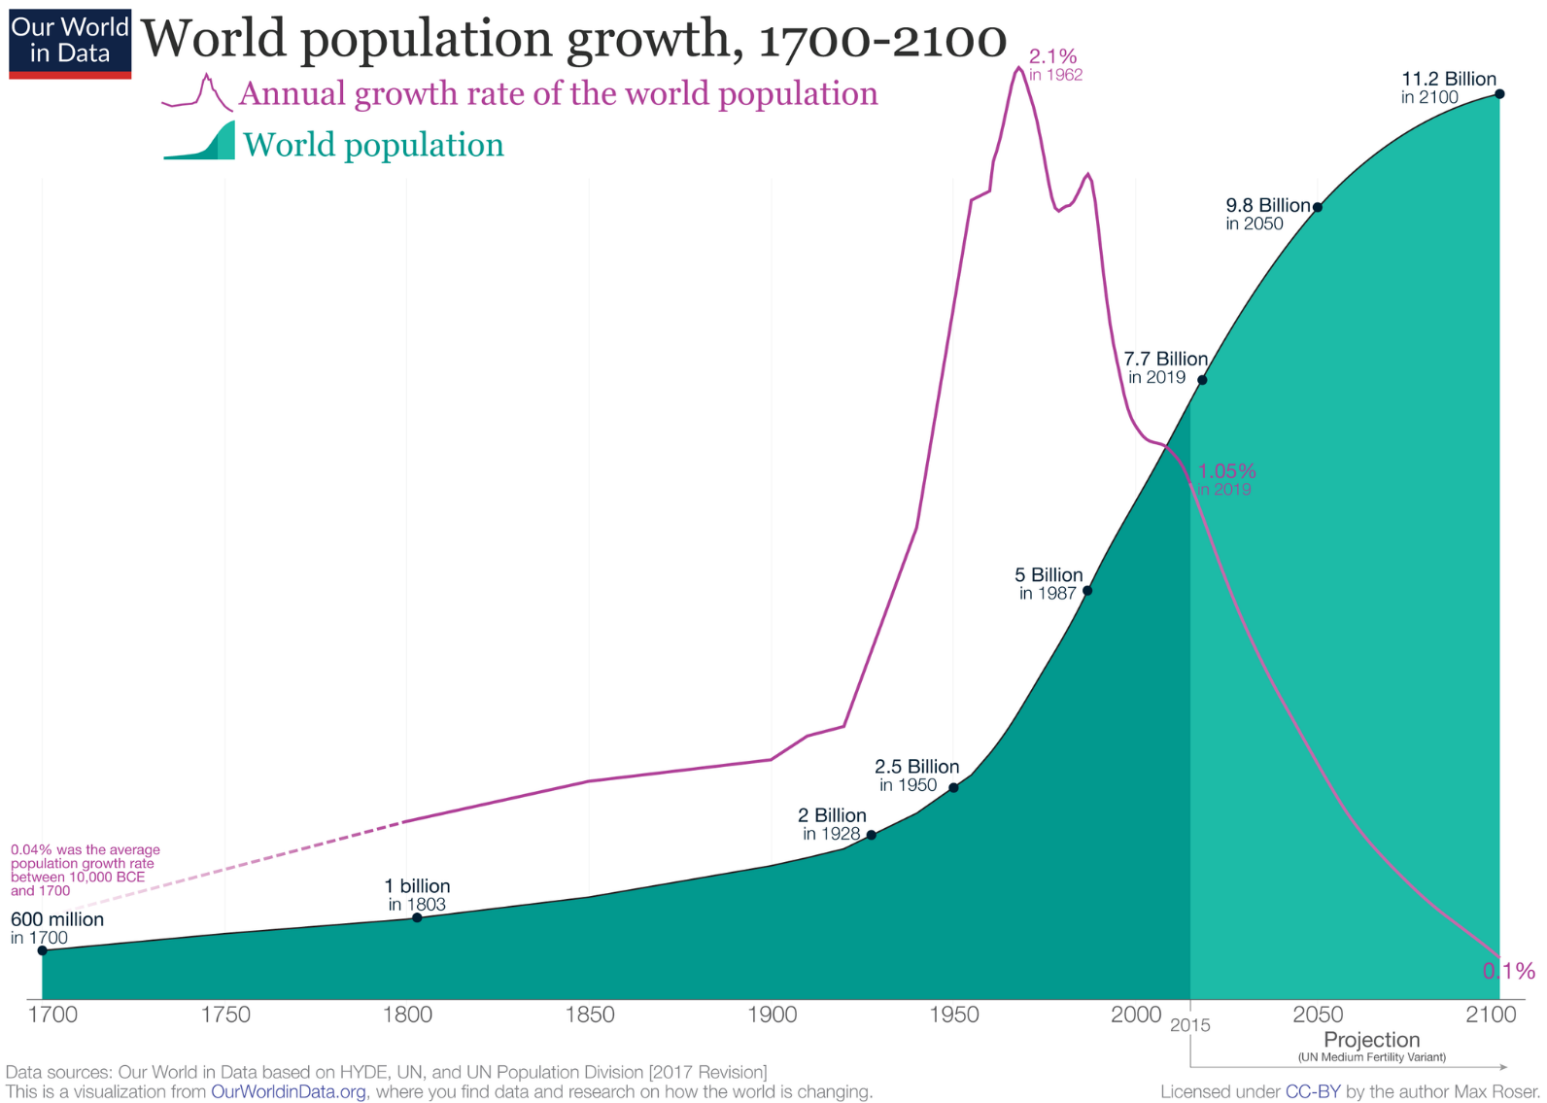
Let’s explore and discuss population growth together
WATCH
Human Population Growth – Crash Course Ecology #3
Image 2.0.4 World population growth 1700-2100

Slide 7
Webquest
Using reliable sources of online information, research one of the following challenges related to food and fibre production.
Explain the challenge and its impact on future food and fibre production.
Food security
Changes in dietary preferences
Sustainability of land and water resources
Climate change
Pollution and land degradation
Ethical food and fibre production
Biosecurity
Get prepared to share what you
find!

Slide 8
Acknowledgements
References
Barlow. S, Australian Academy of Technological Sciences and Engineering (ATSE) (March 2014) Food and Fibre Australia's Opportunities PDF, available at < https://www.atse.org.au/wp-content/uploads/2019/01/food-and-fibre-report.pdf>, accessed on 3 September 2021
Foresight. The Future of Food and Farming (2011) Final Project Report. The Government Office for Science, London, available at < https://assets.publishing.service.gov.uk/government/uploads/system/uploads/attachment_data/file/288329/11-546-future-of-food-and-farming-report.pdf >, accessed on 3 September 2021
CrashCourse (20 November 2012) ‘Human Population Growth - Crash Course Ecology #3’, YouTube, available at: <https://www.youtube.com/watch?app=desktop&v=E8dkWQVFAoA&list=RDLVE8dkWQVFAoA&start_radio=1&rv=E8dkWQVFAoA&t=13> accessed 27 August 2021
Images
2.0.1 ‘Vignette’ Free image by Pxfuel Available at < https://www.pxfuel.com/en/free-photo-jwqzv#google_vignette >, accessed on 3 September 2021
2.0.2 ‘The future of food and agriculture’ Food and Agricultural Organization of the United Nations (n.d) available at: http://www.fao.org/3/i6887e/i6887e.pdf accessed 3 September 2021
2.0.3 ‘Earth’ Darkmoon_Art from Pixabay at <https://pixabay.com/tr/photos/k%C3%BCre-el-bulutlar-cennet-d%C3%BCnya-3423700/> accessed 3 September 2021
2.0.4 ‘World population growth 1700-2100’ Max Roser, CC BY-SA 4.0 via Wikimedia Commons, available at < https://commons.wikimedia.org/wiki/File:World_Population_Growth_1700-2100.png >, accessed on 6 September 2021

