Slide 1
Food and fibre frontiers: Emerging technologies
Solving problems through research and development

Slide 2
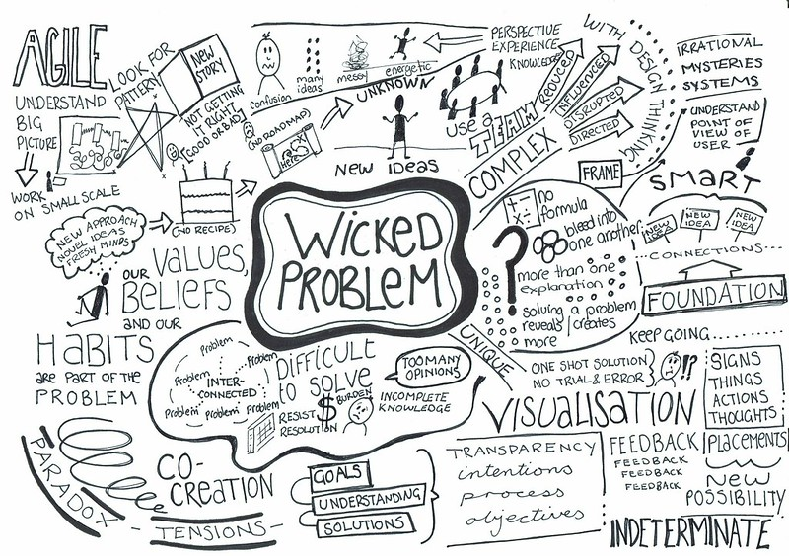
Watch the video Wicked Problems
Write down at least two points from this video that explains what a wicked problem is.

Slide 3
As a class brainstorm the ideas from the video.
Can you think of any examples of a wicked problem we face today?

Slide 4
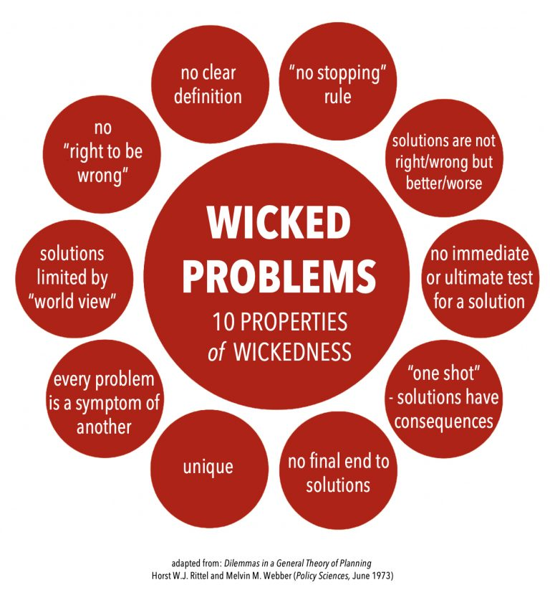
In 1973, design theorists Horst Rittel and Melvin Webber introduced the term ‘wicked problem’. Wicked problems are issues so complex that it is hard to grasp exactly what the problem is or how to tackle it​.
Wicked problems include:​
Poverty​
Climate change​
Homelessness​
Sustainability​
Food security​
Biosecurity​
Use the notes from the video and the 10 properties of wickedness to write your own definition of wicked problems.
3.0.1 Wicked problems

Slide 5
What has to be done to address some of these wicked problems?
Addressing wicked problems requires:
Research across disciplines
Collaboration with all stakeholders, including end users, industry members, policy-makers, practitioners and other researchers
Show and tell – speeding up technology adoption through demonstration
Early adoption of new technology
Sharing of ideas and experience by all researchers and practitioners

Slide 6
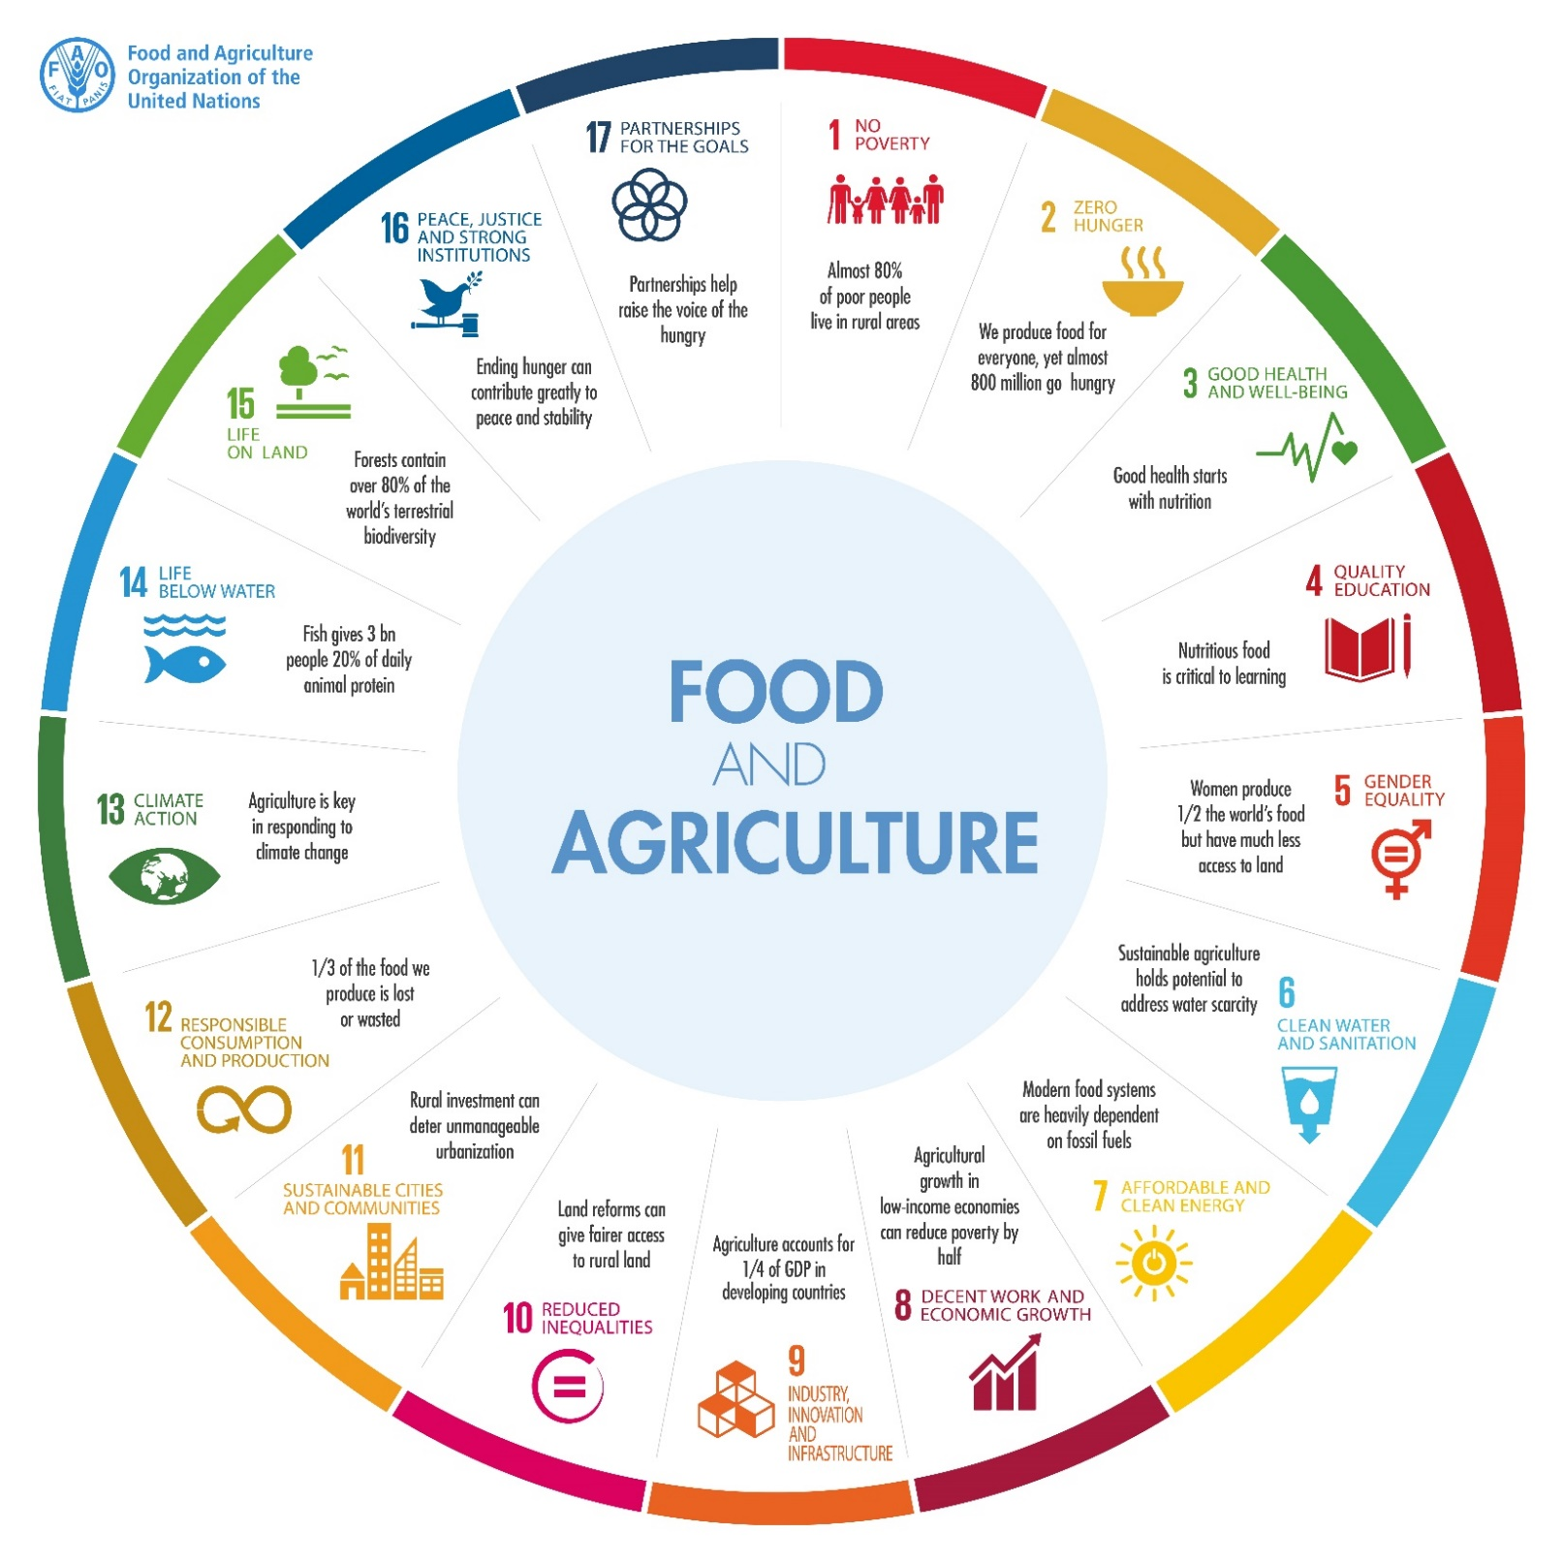
The Sustainable Development Goals are the blueprint to achieve a better and more sustainable future for all. They address the global challenges we face, including poverty, inequality, climate change, environmental degradation, peace and justice. Food and agriculture plays a huge role in achieving the Global Sustainable Development Goals.
Strategies for addressing global challenges
3.0.2 ‘Food and agriculture’
© Department of Education WA 2021

Slide 7
What is Design Thinking? How can it be used to address wicked problems?
Watch
The Design Thinking Process (Explained By An Expert)
EMPATHISE
IDEATE
DEFINE
PROTOTYPE
TEST
The Design Thinking Process

Slide 8
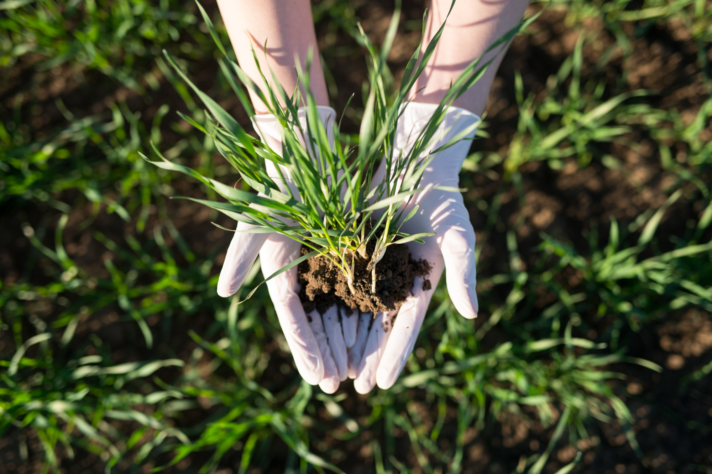
Research and development
The Oxford University Press dictionary (Lexico.com) (2021) defines research and development as (in industry) work directed towards the innovation, introduction and improvement of products and processes.
3.0.3 Fertile soil
"Australian needs to be able to adapt and respond to new issues. Innovation is the key. It drives growth, sustainability and resilience."
Source: Department of Agriculture, Water and the Environment

Slide 9
What role does research and development play in the future of primary industries in WA?
“ Every dollar spent on research and development delivers $4.80 in productivity value to Western Australia’s primary industries. It therefore goes without saying that the state’s primary industries and food sector – which has an annual worth of more than $10.3 billion – must have a dynamic and vibrant research, development and innovation environment to protect its major position in the Western Australian economy and capture real growth and job creation opportunities.” RALPH ADDIS, DPIRD DIRECTOR GENERAL
3.0.4 Primary Industries Development Research Highlights 2021

Slide 10
Who is involved in research and development in primary industries in WA?
Federal Government, State Government, Private Enterprise, Industry Partners and Primary Producers all play a role in research and development in primary industries in WA.
“Investment in research and development (R&D) and innovation is vital for ongoing growth and improvement in the productivity, profitability, competitiveness and sustainability of Australia’s agriculture, fisheries, forestry and food industries.”
Source: Australian Government, Department of Agriculture, Water and the Environment.
Government Departments Involved in Primary Industries Innovation
Australian Government
Department of Agriculture, Water and the Environment
Western Australian Government
Department of Primary Industries and Regional Development
Department of Jobs, Tourism, Science and Innovation
Forest Products Commission
Australia’s Rural Research and Development Corporations (RDCs) have helped drive agricultural innovation since 1989. They allow Australian government and primary producers to co-invest in research and development (R&D). This benefits industry and regional communities.
There are currently 15 RDCs:
5 Commonwealth statutory bodies – which are Australian Government entities with a board of directors appointed by the Minister of Agriculture
10 industry-owned companies (IOCs) – are industry owned research and development companies

Slide 11
Research and Development Corporations (RDCs)
5 Commonwealth statutory bodies | 10 industry-owned companies (IOCs)
Rural Industries Research and Development Corporation (Trading at AgriFutures Australia) Grains Research and Development Corporation Fisheries Research and Development Corporation Cotton Research and Development Corporation Wine Australia | Australian Egg Corporation Limited Australian Livestock Export Corporation Limited (LiveCorp) Australian Meat Processor Corporation Australian Pork Limited Australian Wool Innovation Limited Dairy Australia Limited Forest and Wood Products Australia Horticulture Innovation Australia Limited Meat and Livestock Australia Sugar Research Australia Limited

Slide 12
Acknowledgements
De Almeida Kumlien. A & Coughlan. P (18 October 2018) Wicked problems and how to solve them, The Conversation, available at <https://theconversation.com/wicked-problems-and-how-to-solve-them-100047>, accessed on 6 September 2021
Career Foundry (11 October 2018) The Design Thinking Process (Explained By An Expert) Video, available at https://www.youtube.com/watch?v=FrsQSplB_Cg&t=397s , accessed on 6 September 2021
Department of Agriculture Water and the Environment (26 June 2020) Research and innovation, available at <https://www.agriculture.gov.au/ag-farm-food/innovation>, accessed on 7 September 2021
Department of Agriculture Water and the Environment (12 August 2021) Rural Research and Development Corporations, Available at < https://www.agriculture.gov.au/ag-farm-food/innovation/research_and_development_corporations_and_companies#industryowned-companies >, accessed on 14 September 2021
Images
3.0.1 ‘Wicked Problems’ by LoraCBR. CC BY 2.0 available at <https://www.flickr.com/photos/loracbr/20806910920>
3.0.1 ‘Food and Agriculture’ ( 2017) The future of food and agriculture, Food and Agriculture Organizations of the United Nations, available at < http://www.fao.org/resources/infographics/infographics-details/en/c/471471/ >, accessed on 3 September 2021
3.0.3 ‘Fertile soil’ by Freepik.com, available at <https://www.freepik.com/free-photo/farmer-s-hands-holding-crops-with-fertile-soil-field_11133954.htm#page=1&query=plant%20research&position=17 > accessed 31 August 2021
3.0.4 ‘Primary Industries Development Research Highlights 2021’ Department of Primary Industries and Regional Development (18 August 2021) available at: <https://www.agric.wa.gov.au/primary-industries-development-research-highlights-2021> accessed 31 August 2021

