Slide 1
Agritourism – What does Western Australia have to offer?
3.0 The primary attraction

Slide 2
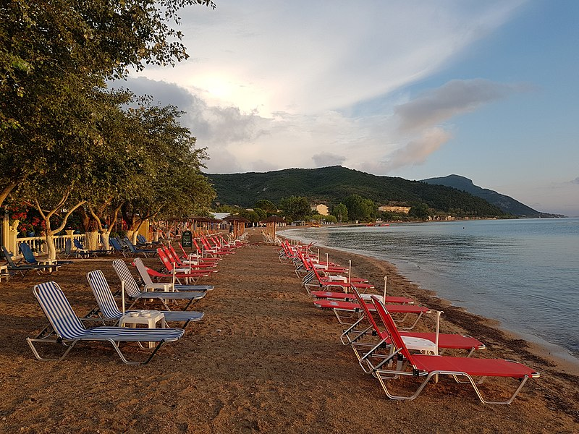
Let’s go on holiday!
What do you look for on a holiday?
Image 3.0.1

Slide 3
What do people say?
Relax and party | 22%
Soak up the local culture | 40%
Family fun | 13%
Visit family and friends | 15%
Adventure (and all that entails) | 9%
Source: https://iwantthatflight.com.au/x630-What-do-you-look-for-in-a-Holiday.aspx

Slide 4
What do people say?
You need to destress, unwind and basically stop thinking about work for a week.
You need to spend quality time with your partner and kids.
You need something to look forward to.
Holidays are good for the body.
Travelling broadens your mind and can also inspire you.
https://thetravelexpert.ie/travel-tips/five-good-reasons-why-we-all-need-holidays/

Slide 5
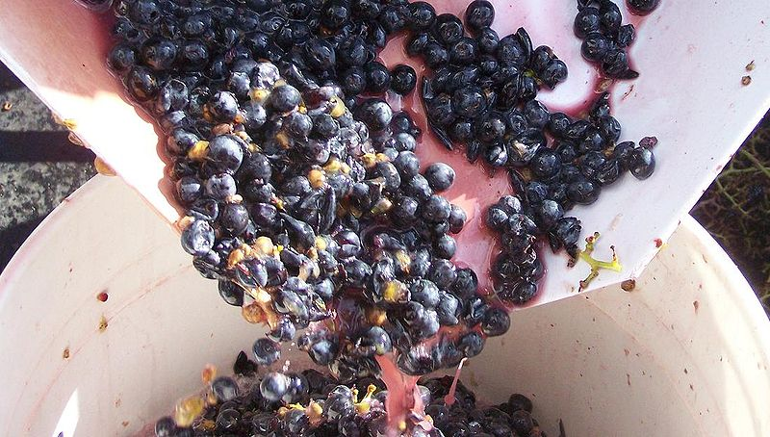
A tourist experience
Holidays are about relaxing, getting away from work (or school).
But also…
Tourists like to see something different; to have a new experience; to broaden their mind.
This can be in their own country or abroad.
Image 3.0.2

Slide 6
A tourist experience
Have you had a holiday where you experienced something different?
Did you find out about something new?

Slide 7
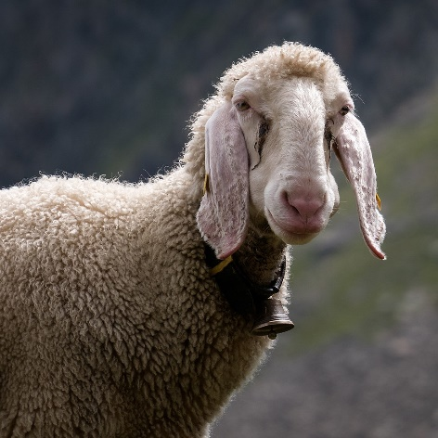
We’re going on a food and fibre holiday
Seriously! Would tourists be interested in experiences that involve food and fibre production?
Image 3.0.3

Slide 8
Production and tourism
Between 2015 and 2016, over 1.5 million tourists visited Australian farms.
Tourists are increasingly in search of an authentic and compelling experience, and agribusinesses prove a destination with physical characteristics that enhance visitor experiences.
Source: Holliday, R., Martinus, K.* and Boruff, B. (2020) Agritourism in Southwest Western Australia. Cooperative Research Centre for Honey Bee Products, Perth, Western Australia.

Slide 9
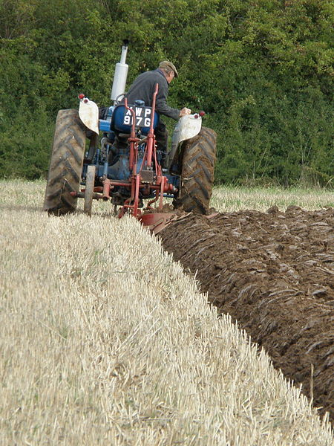
It’s called agritourism!
Many primary industry businesses offer the opportunity for people to visit onsite and engage with production firsthand.
This growing sector in Western Australia and Australia is referred to as agritourism.
Tourists can not only purchase food and fibre products but can also be participants in the process of producing these raw materials.
Image 3.0.4

Slide 10
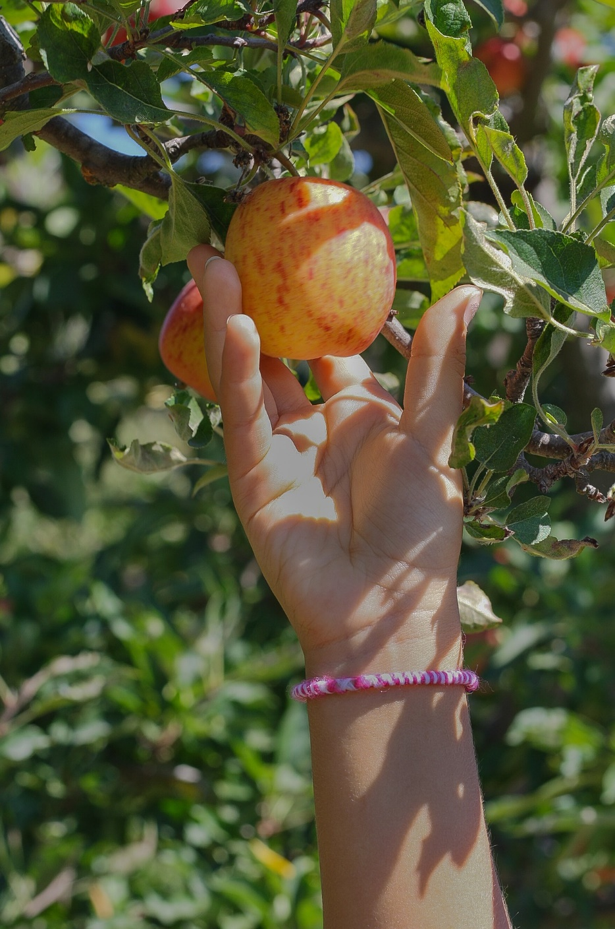
“Agritourism is an activity that can supplement agricultural production where tourists are guests participating in educational and interactive experiences which promote farm produce and regional lifestyles.”
Source: Holliday, R., Martinus, K.* and Boruff, B. (2020) Agritourism in Southwest Western Australia. Cooperative Research Centre for Honey Bee Products, Perth, Western Australia.

Slide 11
IPO the agritourist
Can we use the IPO model to help us see why?
Input – the people, the location/region, the raw materials, the technology.
Processing – the steps and operations being used to make the product.
Output – the final product, the different types of products produced, the sustainable practices, the environment.
Discuss interesting experiences that tourists could potentially have for each of these aspects.

Slide 12
Production and tourism
Input – the personal experience of meeting the people involved, visiting the location, exploring a new region, engaging with the materials that are being used: the raw materials, the land and the environment,
Process – getting involved in primary production operations, taking part and hearing about things firsthand, watching and experiencing the transformation to the final product.
Output – sampling and hearing about the different products produced, seeing firsthand where products come from, experiencing sustainable practices, engaging with environmental management.

Slide 13
What experiences can agritourism offer?
Learning
The nature of the educational experience provided and how it is delivered
What will I learn and how?
Formal presentation (lecture style)
Location
The location of experience/activities
Where is the experience?
On-farm
Length of Stay
The availability of on-site accommodation
How long can I stay?
Overnight or extended visits
Authenticity
Will visitor experiences reflect actual agricultural activities carried out on property
How staged is the experience?
Actual working farm activities
Interaction
How visitors are involved in the experience
What type of involvement and engagement will be required?
Observation of tasks * No coordinated activities
Instructional (interactive) – One off session
Instructional (interactive) – Program of study
Self-guided learning (sign posted/AR informative tours)
Full emersion (a day in the life)
Self-guided involvement (bush walking or bike riding on farm)
Staged working farm activities
Sales or non-farm activities
Off-farm
In-situ (on-farm activities, which are separate to agricultural operations)
Day visit
Practical/physical tasks (pick strawberries/feed animals/make soap from produce)
Adapted from: Holliday, R., Martinus, K.* and Boruff, B. (2020) Agritourism in Southwest Western Australia. Cooperative Research Centre for Honey Bee Products, Perth, Western Australia.

Slide 14
What does agritourism offer visitors and providers?
Image 3.0.6

Slide 15
Adapted from Ecker. S, Clarke. R, Cartwright. S, Kancans. R, Please. P and Binks. B Drivers of regional agritourism and food tourism in Australia

Slide 16
Student worksheet 3.1 and 3.2!
Time to explore the food and fibre tourist perspective.
Work individually to answer the questions in Student worksheet 3.1 The primary attraction
In a group, answer the questions in Student worksheet 3.2 Exploring the primary attraction.
Make sure you self-test your understandings and keep all your work. You will be applying your knowledge gained today in the task later in this module.

Slide 17
Acknowledgements
Holliday, R., Martinus, K.* and Boruff, B. (2020) Agritourism in Southwest Western Australia. Cooperative Research Centre for Honey Bee Products, Perth, Western Australia <http://www.crchoneybeeproducts.com/wp-content/uploads/2020/06/Agritourism-Report_FINAL-with-CRCHBP-cover.pdf>
Slide 2 Image 3.0.1 CC image available at: <https://commons.wikimedia.org/wiki/File:2018-06-17_Messonghi_Beach_Holiday_Resort_(Corfu)_3.jpg>
Slide 5 Image 3.0.2 CC image available at: <https://commons.wikimedia.org/wiki/File:Mthomebrew_crushed_grapes.JPG>
Slide 7 Image 3.0.3 CC image available at: <https://commons.wikimedia.org/wiki/File:Stubai_-_Tiroler_Bergschaf_-BT-_01.jpg>
Slide 9 Image 3.0.4 CC image available at: <https://commons.wikimedia.org/wiki/File:Tractor_with_two-furrow_plough.jpg>
Slide 10 Image 3.0.5 by Aline Ponce from Pixabay available at https://pixabay.com/photos/apple-picking-fruit-farm-harvest-1572647/
If the link above does not work, try copying the link into the address bar of your browser.
Slide 13 Image 3.0.6 Holliday, R., Martinus, K.* and Boruff, B. (2020) Agritourism in Southwest Western Australia. Cooperative Research Centre for Honey Bee Products, Perth, Western Australia available at <http://www.crchoneybeeproducts.com/wp-content/uploads/2020/06/Agritourism-Report_FINAL-with-CRCHBP-cover.pdf>
Slide 14 https://www.agriculture.gov.au/abares/research-topics/social-sciences/human-dimensions https://www.agriculture.gov.au/sites/default/files/abares/documents/agritourism-2010-report-11a.pdf

