Slide 1
1.1 Culture and Multiculturalism
The multicultural history of Australia
D25/1142095

Slide 2
Activity 1: Australia’s multicultural history

Slide 3
When do you think Australia became a multicultural society?
Australia’s multicultural history began over 65,000 years ago with different Aboriginal cultural groups and the emergence of unique cultures.

Slide 4
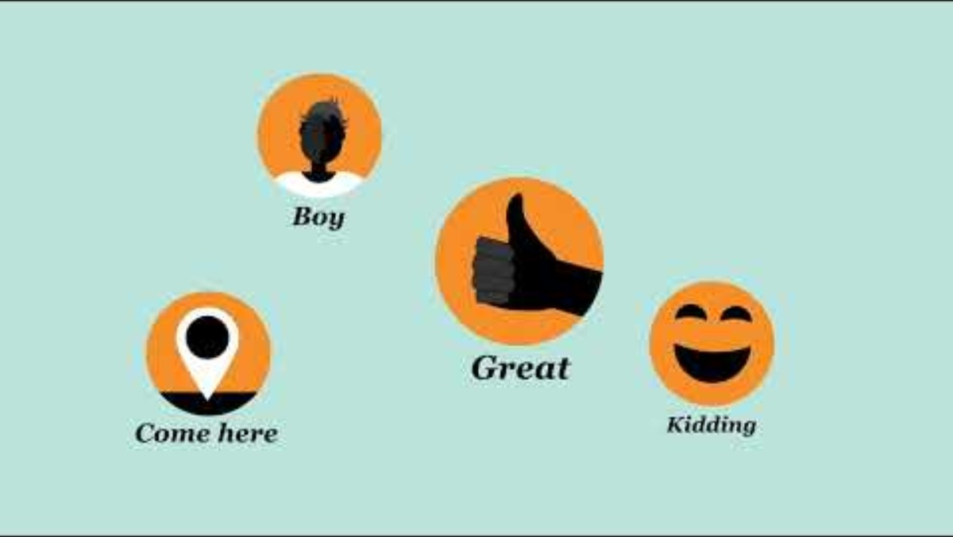
Who are Aboriginal and Torres Strait Islanders? SBS Inclusion Program
Notes:
https://www.youtube.com/watch?v=Vz18n5p0oVU
Note: Aboriginal and Torres Strait Islander people are 2 distinctly different cultural groups whilst both may refer to themselves as Indigenous Australians.

Slide 5
Australia’s multicultural history through language
The AIATSIS map of Australia was created in 1996 as a visual reminder of the richness and diversity of Aboriginal and Torres Strait Islander Australia.
      The map shows language, social or nation groups based on published sources available up to 1994.
    Aboriginal and Torres Strait Islander people come from ~250 distinct languages group, speaking around 800 dialects.
      Each language is specific to a particular place and people.
  Today, 120 languages are spoken.
Notes:
https://www.education.wa.edu.au/aboriginal-languages

Slide 6
The significance of language – why is it important?
'Language is part of our songlines, stories, spirituality, law, culture, identity and connection. Language transfers important knowledge passed down from our Ancestors and Elders that guides us.’
Lynnice Church, Ngunnawal
‘Language is important because it is an identity and a belonging to a group. You’ve got to know who you are and where you are from. I think language is part of that.’
Wendy Ranger
Notes:
https://aiatsis.gov.au/explore/languages-alive

Slide 7
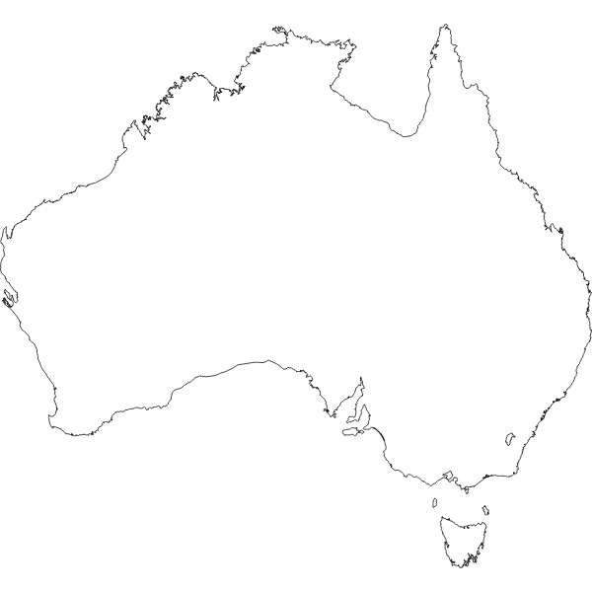
Gambay languages map
“Gambay is the first Australian map that allows Aboriginal and Torres Strait Islander communities control over the way their languages are publicly represented. It showcases over 780 traditional languages.
Developed by First Languages Australia, Gambay is an interactive map that displays and promotes the diversity of Australia’s Aboriginal languages and Torres Strait Islander languages.
The word ‘gambay’ means ‘together’ in the Butchulla language of the Hervey Bay region in Queensland.”
Your Task
Explore and label languages and place names using the interactive map.
Explain why you think it is important to preserve languages.
Notes:
Note: Regional language centres and programs working directly with language communities have contributed the data included on the map.
Optional walk through video: https://vimeo.com/658505937?fl=pl&fe=ti

Slide 8
Activity 2: Continuity and change

Slide 9
Timeline answers
# | Event | Date
1 | Aboriginal cultures begin | 65,000 BCE
2 | Cave of El Castillo, Spain (first European cave paintings) | 40,000 BCE
3 | Last Ice Age ends | 10,000 BCE
4 | Agricultural communities in Mesopotamia | 8000 BCE
5 | Stonehenge built | 3000 – 1600 BCE
6 | First Egyptian pyramids of Giza built | 2589 BCE
7 | Persepolis founded - Persian (Achaemenid) Empire | 518 BCE
8 | Shang Dynasty (China) | 1600 – 1000 BCE
9 | Kofun period in Japan | 250 – 538 CE
10 | Roman Empire | 27 BCE – 476 CE
11 | Industrial Revolution | 1750 – 1900 CE
12 | British colonisation of Australia (First Fleet) | 1788 CE

Slide 10
Innovation and change – Your Task
While watching the clips on fish traps and Indigenous watercrafts, take notes on the uses, locations, materials and differences mentioned.
Research boomerangs and didgeridoos, noting the history, uses and changes.
Be prepared to share how you think the 4 examples demonstrate multiculturalism, and continuity and change for Aboriginal and Torres Strait Islander people.

Slide 11
Reflection
    Why is important to recognise Aboriginal and Torres Strait Islander multiculturalism?

Slide 12
Thank you

