Slide 1
2.1 Diversity and stereotypes
Appreciation of multiculturalism
7 / 8 HASS
D25/1142110

Slide 2
Activity 2:
Australian entrepreneurs

Slide 3
Entrepreneurs
What does the word ‘entrepreneur’ mean?
An entrepreneur is a person who sets out to build a successful business in a new field. An entrepreneur’s methods are sometimes regarded as ‘ground-breaking’ and innovative.
What are the characteristics of entrepreneurs?
Innovative, create opportunities, take risks, resilient, creative, problem solvers
Name Australian entrepreneurs that you know

Slide 4
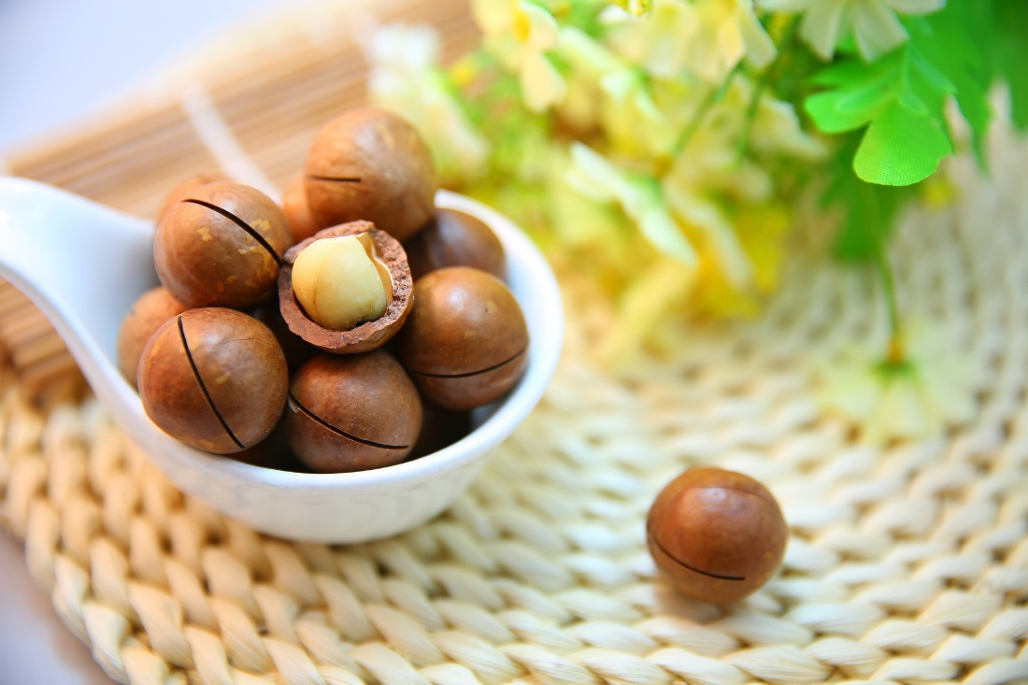
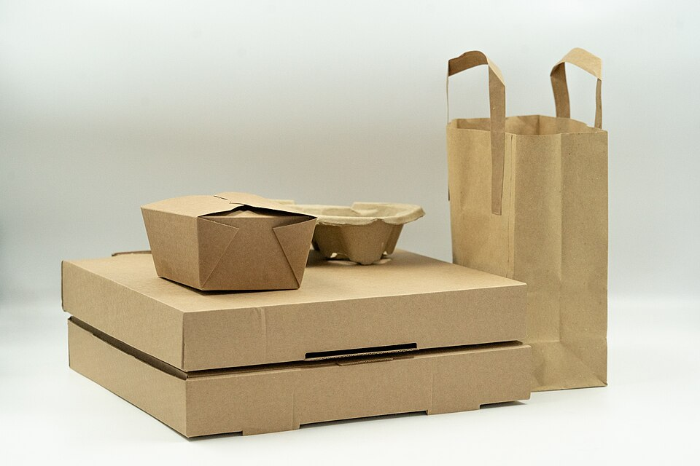
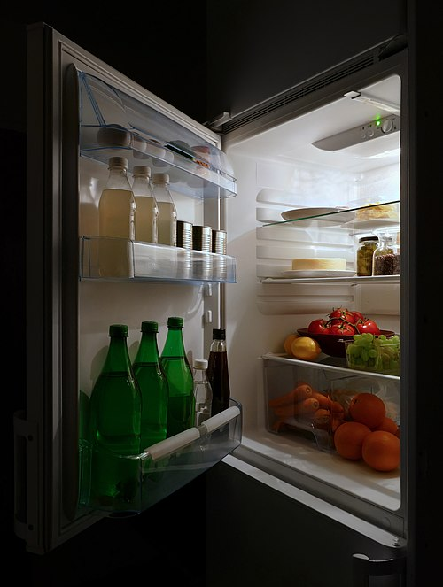
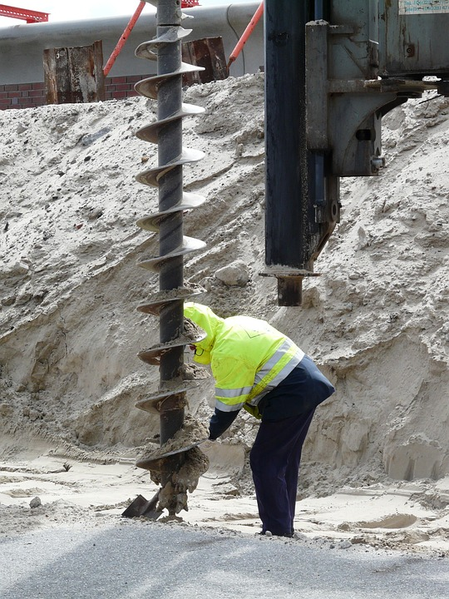
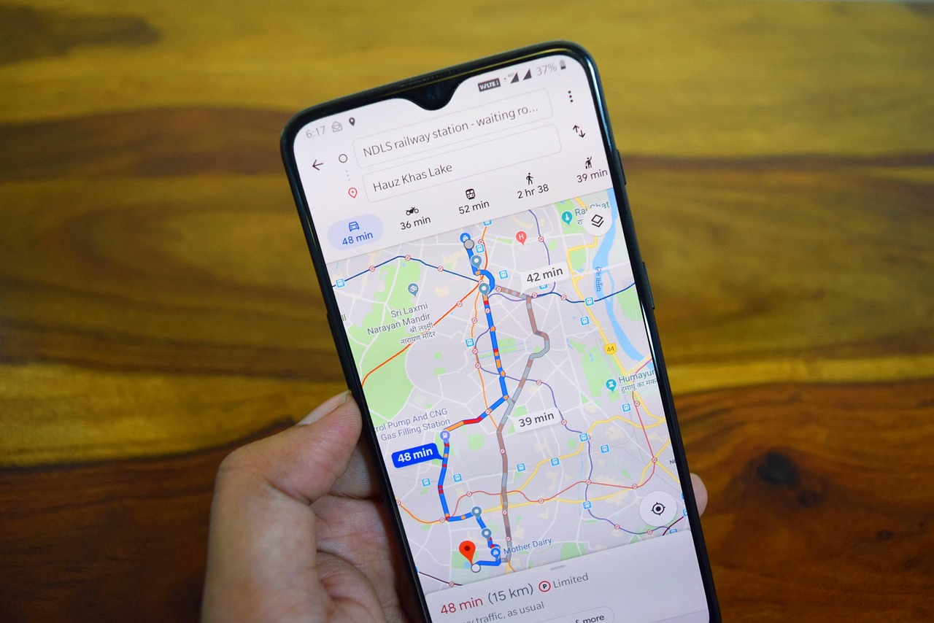
What do these have in common?
Notes:
Macadamia: https://pixabay.com/photos/macadamia-nuts-nuts-food-snack-1098170/
Drill: https://pixabay.com/photos/drill-construction-device-57557/
Google Maps: https://pixabay.com/photos/maps-google-maps-navigation-4237764/
Fridge: https://commons.wikimedia.org/wiki/File:Open_refrigerator_with_food_at_night.jpg
Cardboard packaging: https://commons.wikimedia.org/wiki/File:Eco-friendly_cardboard_packaging_for_takeaways.jpg

Slide 5

Hale’s story
Watch Hale’s story and answer the questions while viewing.
Why did the Australian government encourage people to emigrate from Turkey?
Do you think it was easy for the first group of Muslim people to live in Australia? What clues does Hale give about this?
According to Hale, why do immigrants often stay within their own communities when they arrive in a new country?
Do you consider Hale’s parents to be entrepreneurs? Explain your answer.
Notes:
https://www.abc.net.au/education/digibooks/creating-a-nation-modern-immigration-stories/101748456?vcOpensOnLoad=true&vcPageId=102644450

Slide 6
All invented by Australian migrants!
Who | Innovation
James Harrison was born in Scotland, moved in 1837 | Harrison patented the Ether vapour compression refrigeration system in 1885
Arthur James Arnot was born in 1889 in Scotland | Patented the world’s first electric drill for drilling through rock faces and coal shafts with William Brain – paved the way for portable hand drills.
Henry Bell was born in New Zealand, moved to Queensland in 1955 | In 1975, Hidden Valley Plantations, a small macadamia business in the Sunshine Coast started a macadamia breeding program. In 1988, owner Henry Bell applied for plant breeder's rights in Australia for his Hidden Valley A4 variety.
Two Danish brothers, Lars and Jens Eilstrup Rasmussen, and Australian born Noel Gordon and Stephen Ma | The brothers started the Sydney-based company Where 2 Technologies from an apartment bedroom in early 2003. The company and product was sold to Google, becoming Google Maps.
Richard Pratt and his family moved to Australia from the Polish city of Gdansk in 1938 as refugees. | Founded Visy, a paper, packaging and recycling company in 1948.
Notes:
https://www.ipaustralia.gov.au/understanding-ip/types-of-ip/ip-in-history#fx-tabs-0-panel-0

Slide 7
Entrepreneurial migrants in Australia
From a 2021 report, migrant-owned businesses:
employ over 1.4 million Australians
contribute ~$46.9 billion annually to Australia’s economy.
From a 2018 report:
83% of migrant business owners started their first business venture after moving to Australia
recent arrivals and Gen Y migrant business owners were more likely to have been impacted by racism or discrimination, or to feel their background hindered their success.
23% started their business to try out an innovative or new idea, in comparison to 16% of non-migrants.
51% of migrant small business leaders are have a bachelor degree or higher.
Notes:
2021 report by the Federation of Ethnic Communities' Councils of Australia (FECCA)
2018 CGU Migrant Small Business Report

Slide 8
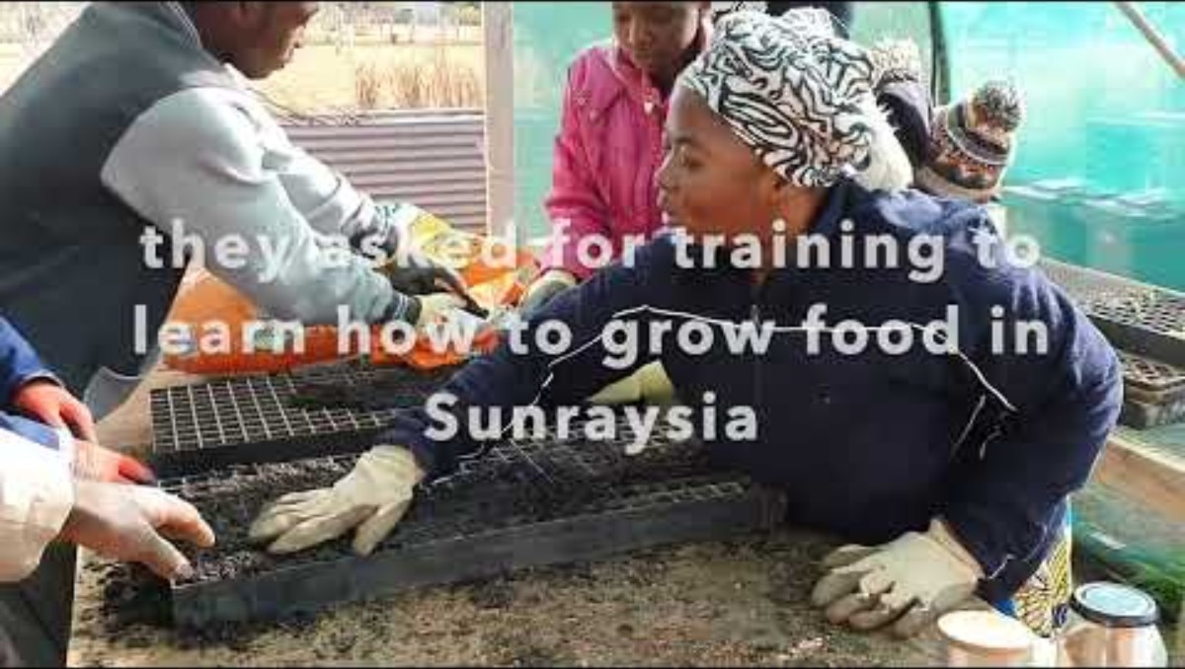
Food Next Door Co-op story
Notes:
https://www.youtube.com/watch?v=1Xqaml2eZEo

Slide 9
Entrepreneurs and innovators research task
Name | Notes
Frank Lowy | Westfield Group Co-founded one of the world’s largest shopping centre chains.
Harry Triguboff | Meriton (Apartments)
Ruslan Kogan | Kogan.com One of Australia’s largest online retailers.
Tan Le | Emotiv (Neurotechnology) Co-founded a company pioneering consumer EEG headsets.
Thuy Nguyen | Came to Australia as an international student and received a PhD in Biomedical Engineering. Her research on cancer treatment innovations has received international recognition.
Bao Hoang | Founded the Vietnamese food franchise “Roll’d”.
Melanie Perkins | CANVA Founder

Slide 10
Thank you

