Slide 1
2.2 Challenging perceptions – sense of belonging and cultural identity
Diversity in Australian Citizenship
7 / 8 HASS - Civics and Citizenship
D25/1142124

Slide 2
Activity 1: What does it mean to be an upstander?

Slide 3
"Have you ever witnessed someone being excluded or treated unfairly? How did you feel, and what did you do?"

Slide 4

2022 Ashes’ celebration: An example of belonging and cultural identity:
Notes:
https://www.youtube.com/watch?v=Bd1Vl_eksSw
For more information
https://www.abc.net.au/news/2022-01-17/why-australias-cricket-team-stopped-ashes-celebration/100761016
Ask students why this was an important moment.

Slide 5
Write down your own definition for:
Bystander
Upstander

Slide 6
Definitions
Bystander: someone who is present at an event or situation but does not take part or get involved, especially when their action or inaction could influence what happens
Upstander: a person who speaks or acts in support of an individual or cause, particularly someone who intervenes on behalf of a person being attacked or bullied.
How do these definitions compare to yours?

Slide 7

Changing Our World One Act at a Time | Ava Tian TEDxYOUTH’
Notes:
Changing Our World One Act at a Time | Ava Tian TEDxYOUTH’ (https://www.youtube.com/watch?v=_IEfO6CtZs0)
Discuss the impact of both behaviours on individuals and the community and how Ava and her mother are examples of ‘change makers’ by acting as upstanders and making changes in their communities.

Slide 8
Bystander / Upstander scenarios

Slide 9
Scenario 1
During a class discussion, a student makes a derogatory (a disrespectful) comment about another student's race.
What would a bystander do in this situation?
What would an upstander do in this situation?

Slide 10
Scenario 1 - situation
During a class discussion, a student makes a derogatory (a disrespectful) comment about another student's race.
What would a bystander do in this situation?
What would an upstander do in this situation?

Slide 11
Scenario 1
Bystanders may…
hear the comment but do not react or report it
laugh along with others.
Upstanders may…
immediately address the comment, explaining why it is inappropriate and hurtful
support the affected student by reporting the incident to a teacher.

Slide 12
Scenario 2 - situation
A student is not included in a sports team because of their religious practices, such as wearing a hijab or taking time for prayer.
What would a bystander do in this situation?
What would an upstander do in this situation?

Slide 13
Scenario 2
Bystanders may…
notice the student isn’t included but doesn’t speak up.
Upstanders may…
speak to the coach and team members about the importance of inclusion and respect for religious practices, advocating for the student's right to participate
check in on the student to make sure they are okay and offer support.

Slide 14
Scenario 3 - situation
A student receives hateful messages online targeting their race or religion.
What would a bystander do in this situation?
What would an upstander do in this situation?

Slide 15
Scenario 3
Bystanders may…
see the messages but choose not to report them or say anything or offer support.
Upstanders may…
report the messages to the platform and teacher or staff at school
reach out to the victim to offer support and solidarity.

Slide 16

What is one action you can take to be an upstander?

Slide 17
Activity 2: Participating in Australia’s democracy through direct action

Slide 18
Class discussion
What does democracy mean?
What does direct action mean?
Why is citizen participation important?

Slide 19
Key terms
Democracy is a system of government based on the people of an entity, that is, ‘government by the people;’ a form of government where the supreme power is vested in the people and exercised directly by them or by their elected representatives under a free and fair electoral system.
Direct action is people participating in-person and directly on issues they seek to change, within the bounds of the law.

Slide 20
What are examples of direct action?
How can they help make change?
1. Protests and demonstrations
Public gatherings can raise awareness and influence public opinion.
2. Petitions
Collecting signatures can show widespread support for an issue and prompt government action.
3. Strikes and boycotts
Refusing to work or buy certain products can pressure businesses or governments to change policies.
4. Social media campaigns
Digital platforms can help to organise and amplifying direct action efforts by making people aware.
Can you think of strengths, weaknesses and examples for each action?
Notes:
If using the accompanying worksheet (resource #1) students can add the methods to the table.
The next slide has examples for the worksheet.

Slide 21
Direct action methods – strengths, weaknesses and examples
Method | Strengths | Weaknesses | Examples
Protests and demonstrations | Bring visible attention to issues often ignored by mainstream politics (e.g., deaths in custody) Can lead to policy reforms or public inquiries (e.g., 1967 Referendum) | Can provoke counter-protests or negative media coverage Protesters may face arrest, fines, or legal restrictions May inconvenience the public (e.g., blocked roads) | NSW Freedom Rides (1965) Black Lives Matter Rallies (2020–2023) Aboriginal Tent Embassy (1972–present)
Petitions | Easy for large numbers to participate (and can be online). Large numbers can pressure governments to act (e.g., 1967 Referendum campaign) Less confrontational, means lower risk of legal trouble or backlash. | May be ignored if not backed by other forms of action or media attention. Online petitions can be dismissed as “slacktivism.” | 1967 Referendum Petitions National Anti-Racism Framework (2024): Developed after public submissions, including petitions
Strikes and boycotts | Can force employers or governments to negotiate (e.g., Wave Hill Walk-Off) Build unity among affected groups and allies. | Strikers may lose income or face retaliation. Can alienate the public if seen as too disruptive. | Wave Hill Walk-Off (1966) Palm Island Strike (1957)
Social media campaigns | Can spread awareness and organise action quickly. Allows those affected to share stories Anyone can participate, regardless of location. | Campaigners may face abuse. Issues can be quickly forgotten as trends move on. Risk of spreading false or misleading information. | #BlackLivesMatter Australia #ChangeTheDate

Slide 22
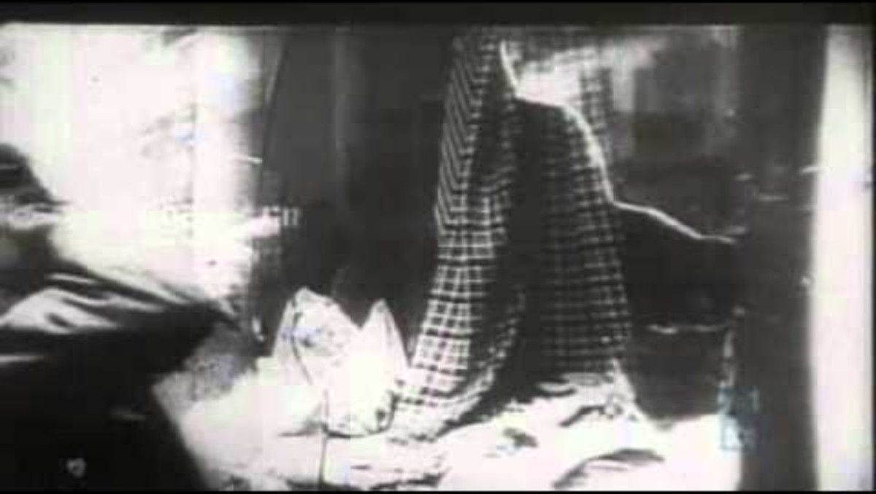
A walk to remember | ABC News (Australia) – William Cooper
Notes:
A walk to remember – ABC News (Australia)
https://www.youtube.com/watch?v=-8sSOsV4zJ4

Slide 23
Additional information
William Cooper went on to be one of the organisers of the Aboriginal Day of Mourning on 26 January 1938, the 150th anniversary of British colonisation.
The Day of Mourning was the first time that Aboriginal activist groups from different states had worked together to organise an event.
The group protested the violence, dispossession and discrimination that Aboriginal people had experienced since 1788.
It became an annual event for Aboriginal people and their supporters, before evolving later into NAIDOC week (held in July).
Notes:
Further information:
https://aiatsis.gov.au/explore/day-of-mourning
https://www.nma.gov.au/defining-moments/resources/day-of-mourning

Slide 24

William Cooper and shared responsibility
Shared responsibility is where all involved parties have a role in achieving a common goal.
Notes:
Lead a discussion on why students think Cooper, an Aboriginal man fighting for his own people's rights, stood up for Jewish people thousands of kilometres away.
Ask students to consider the benefits of direct action. Can it create a sense of belonging?
Discuss the significance of Cooper’s actions and the concept of shared responsibility. Ask students their opinions on ‘shared responsibility.’
Divide students into small groups and ask them to discuss how learning about William Cooper's actions makes them think about being upstanders. Prompts include:
How can you stand up against injustice in your school or community?
What qualities did William Cooper demonstrate that you can emulate?
Who is a current changemaker like William Cooper?

Slide 25
Activity 3: Challenging perceptions through direct action

Slide 26
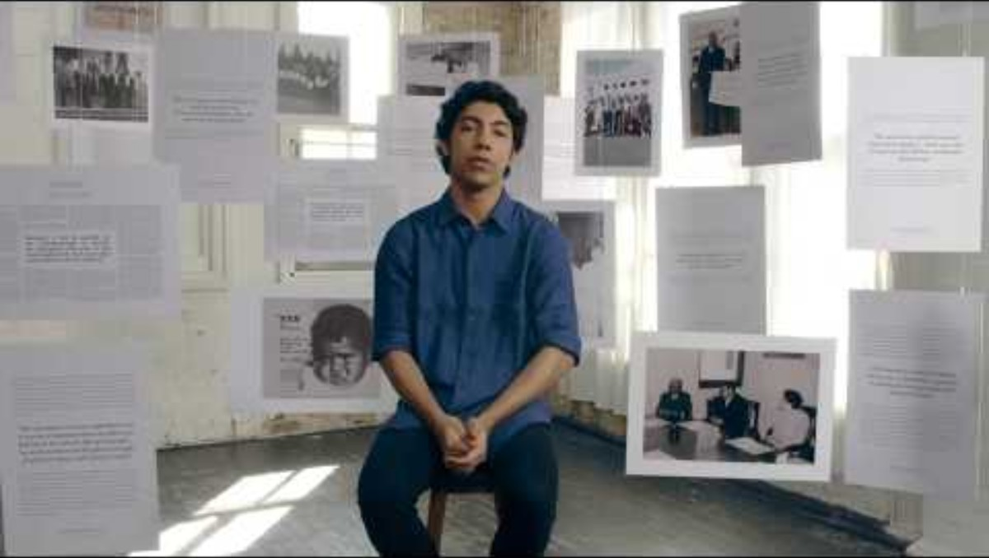
What prompted the 1967 Referendum? Direct action democracy
Notes:
https://www.youtube.com/watch?v=jEzzURvJGCw
Yes: The Ongoing Story of the 1967 Referendum

Slide 27
Direct-action research
Research a notable instance of direct action in Australian history such as:
the 1965 Freedom Ride
Aboriginal Tent Embassy
the 2020 Black Lives Matter Protests.
The National Library of Australia website is a helpful place to start: https://www.library.gov.au/research/research-guides-0/protest-and-dissent

Slide 28
Reflection
After learning about William Cooper and other examples from Australia’s history, how important is direct action for Australia?
How can direct action help those involved and affected by issues feel a sense of belonging and connection to Australia?

Slide 29
Thank you

