Slide 1
1.2 Nationality and Citizenship
9 / 10 HASS
Activity 1: Democracy and change
D25/1142253
Notes:
This resource can be used with Year 9 or 10 students (with closer links to the Year 10 curriculum) with the accompanying worksheets.
Curriculum addressed (Year 10)
The safeguards that protect Australia's democratic system and society, including shared values and the right to dissent within the bounds of the law (ACHCK094)
The background to the struggle of Aboriginal and Torres Strait Islander Peoples for rights and freedoms before 1965, including the 1938 Day of Mourning and the Stolen Generations (ACDSEH104)
The significance of one of the following for the civil rights of Aboriginal and Torres Strait Islander Peoples: 1962 right to vote federally; 1967 referendum; reconciliation; Mabo decision; Bringing Them Home Report (the Stolen Generations); the Apology (ACDSEH106)
Methods used by civil rights activists to achieve change for Aboriginal and Torres Strait Islander Peoples, and the role of one individual or group in the struggle (ACDSEH134)

Slide 2
Please be aware that this presentation contains material that may be culturally sensitive, including records and images of people who have passed away and information about land dispossession, and laws and policies affecting the community.

Slide 3
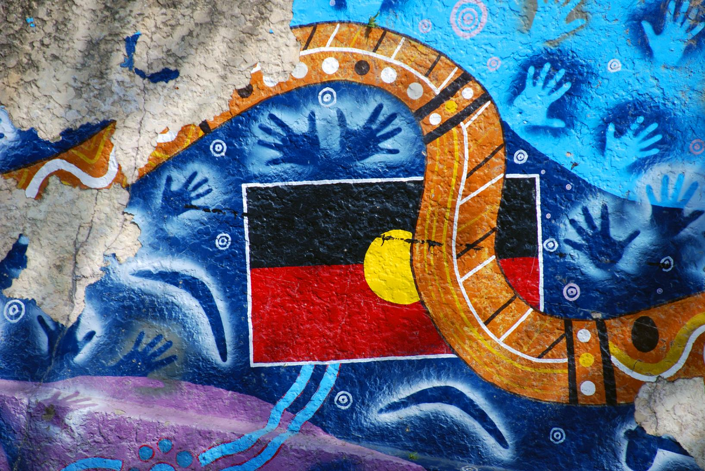
Acknowledgement
Street art of the Australian Indigenous flag and culture on Brunswick Street in Fortitude Valley, Brisbane in 2009. Accessed from: https://www.flickr.com/photos/mythoto/4227603729
Notes:
“I respectfully acknowledge the past and present traditional custodians of this land on which we are meeting, the <traditional name(s)> people. It is a privilege to be standing on <traditional name> country. I also acknowledge the contributions of Aboriginal Australians and non-Aboriginal Australians to the education of all children and people in this country we all live in and share together – Australia.”

Slide 4
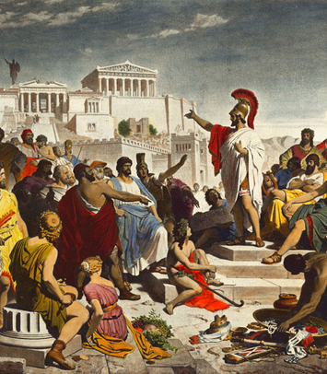
Democracy
Democracy comes from the ancient Greek words:
‘demos’ (the people)
‘kratos’ (to rule).
Rule by the people
Democracy is defined as:
A system of government based on the people of an entity, that is, ‘government by the people’; a form of government where the supreme power is vested in the people and exercised directly by them or by their elected representatives under a free and fair electoral system.
What is a representative democracy?
Where citizens choose representatives to make decisions on their behalf.
This Photo by Unknown Author is licensed under CC BY-SA
Notes:
Optional kahoot: https://create.kahoot.it/details/quiz-7-getting-involved-in-parliament/e00da54b-4db1-4efa-b6e9-47d4851bd5a6
There are many ways that people and organisations can get involved in the political process. This 10-question quiz is designed to test student understanding of the ways they can have a say and contribute to the work of the Australian Parliament.
File:Discurso funebre pericles.PNG - Wikimedia Commons

Slide 5
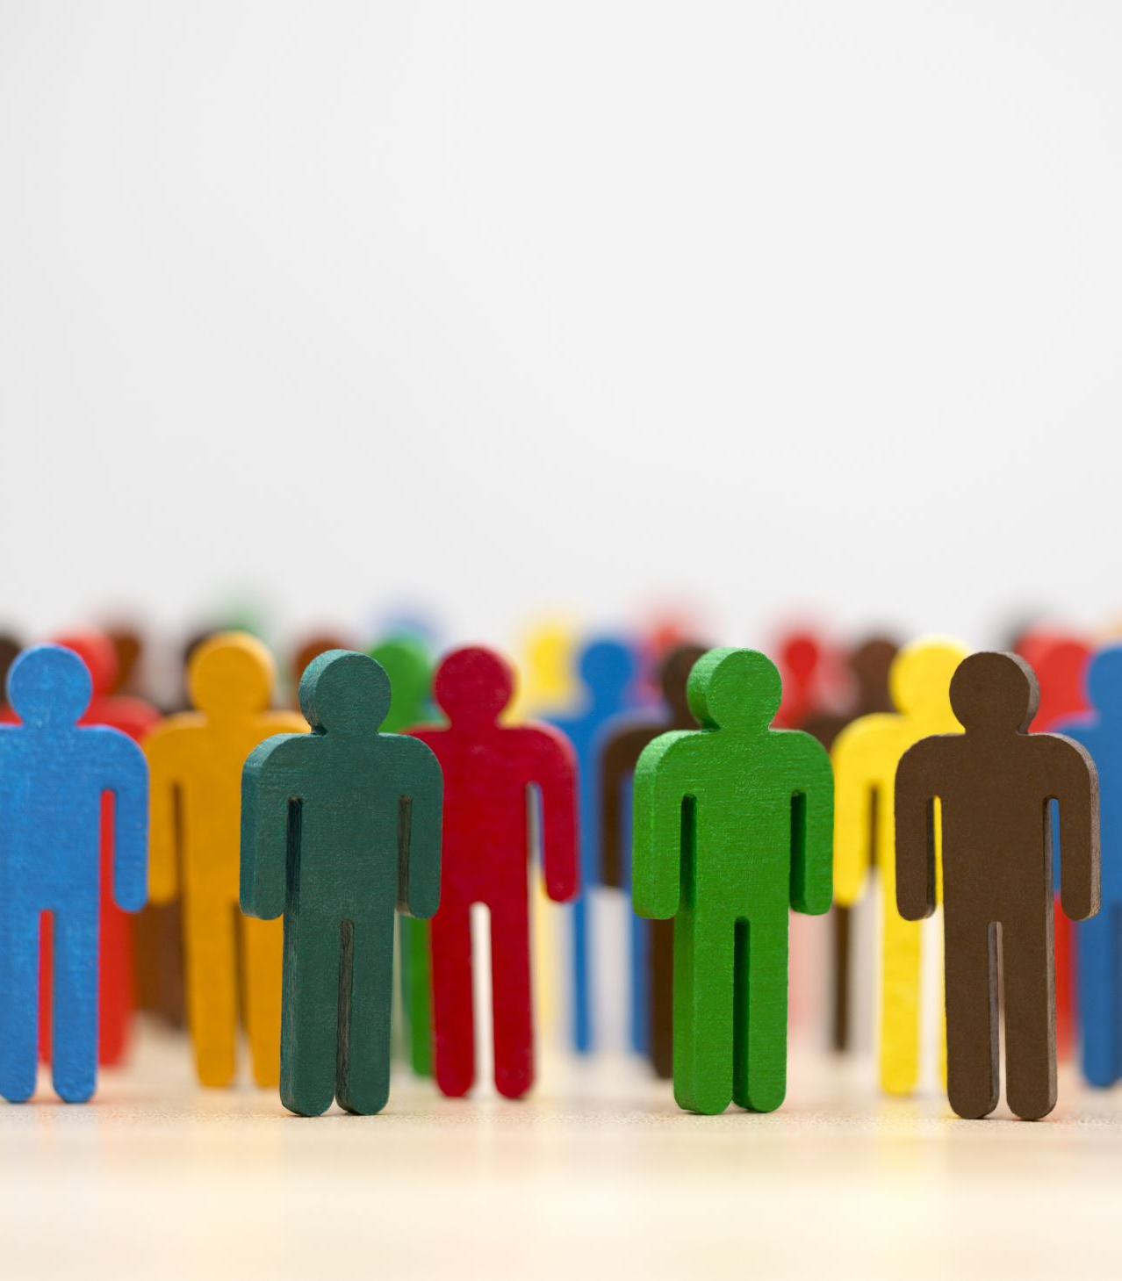
Four key ideas of Australian democracy
Active and engaged citizens
An inclusive and equitable society
Free and franchised elections
The rule of law for both citizens and the government
Discussion activity on the 4 key ideas
Notes:
Active and engaged citizens
People have a voice and can make changes in society.
People can participate by getting involved in their community. This might be by joining a charity, a political party or a community group.
Everyone can get involved in the work of Parliament through contacting members of parliament, the work of committees, protesting and petitioning.
An inclusive and equitable society
People work towards a society where everyone is respected and free, where everyone is valued and supported to reach their full potential.
People have freedom of speech, association, movement and belief.
Our society supports the development and well-being of individuals and their right to make their own choices.
Opposing ideas are tolerated and respected. People listen to different points of view in Parliament and society.
Free and franchised elections
People can stand for elections and choose who makes decisions on their behalf.
Voting is done in secret so people can make their choice without pressure or intimidation.
Elections are run by an independent organisation­—the Australian Electoral Commission.
The rule of law for both citizens and the government
Everyone is equal before the law and must follow the law, including the people who make laws.
Laws should be fair, clearly written and protect people's rights.
After discussing these key ideas – students should work in pairs or small groups on the worksheet with the 4 ideas. They should choose 2 questions for each key idea and discuss their answers with a peer.

Slide 6
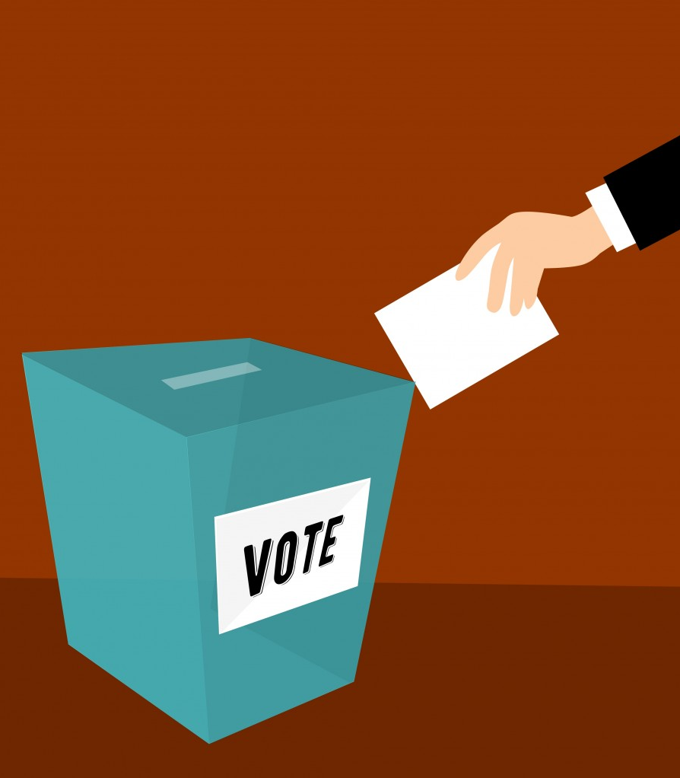
What are benefits of democracy?
There are ways to resolve different views and conflicts peacefully
Respect for human dignity
People have freedom to act, speak and think freely (as long as it does not stop others doing the same)
Equality before the law
Safe and secure community
Government that is transparent, responsive and accountable to the people
Ability to hold elected representatives accountable
This Photo by Mohamed Hassan is licensed under Public Domain
Notes:
Have students share ideas
https://peo.gov.au/understand-our-parliament/how-parliament-works/system-of-government/democracy
There is a knowledge quiz on the above website (at the bottom of the page) that students can complete independently or as a class if projected on the board.
https://www.stockvault.net/photo/253669/election-day-illustration

Slide 7
Activity 2: The 1967 Referendum and ongoing rights

Slide 8
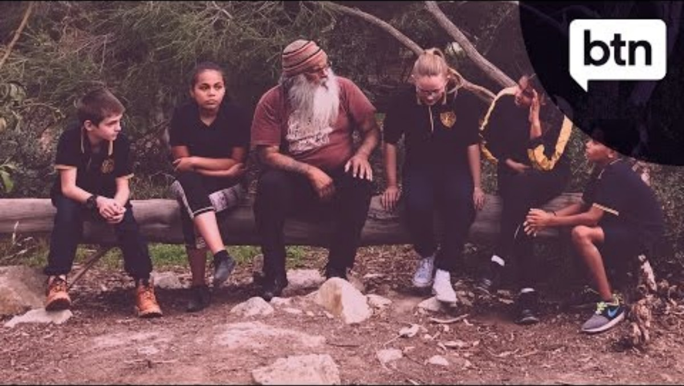
Talking about the 1967 Referendum – Behind the News
Notes:
https://www.youtube.com/watch?v=My0YO6hNcnU
(2:15)
List examples of:
- restrictions placed on Aboriginal people (not allowed on school buses, ask permission to get married)
- how people got involved for equality in the lead up to the referendum (demonstrations, men refused to work as a protest – ‘sit ins’)

Slide 9
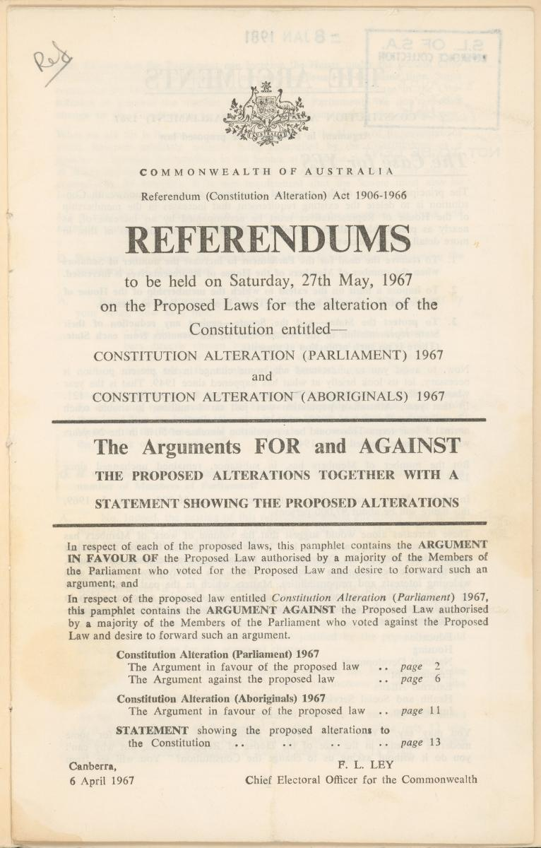
Promoting societal and political change through referendums
What do you remember or already know?
Notes:
Check student prior knowledge of Referendums. This was covered in the Year 7 Civics & Citizenship HASS curriculum. This could be done through:
Teacher-led questioning
A PEO Kahoot: https://create.kahoot.it/share/quiz-3-australian-constitution/998268e8-c29e-496b-b7f3-41bc738790ab
A quiz on the PEO’s website: https://peo.gov.au/teach-our-parliament/education-resources/quizzes/australian-constitution
Image: public domain - https://www.flickr.com/photos/state_library_south_australia/32912666030

Slide 10
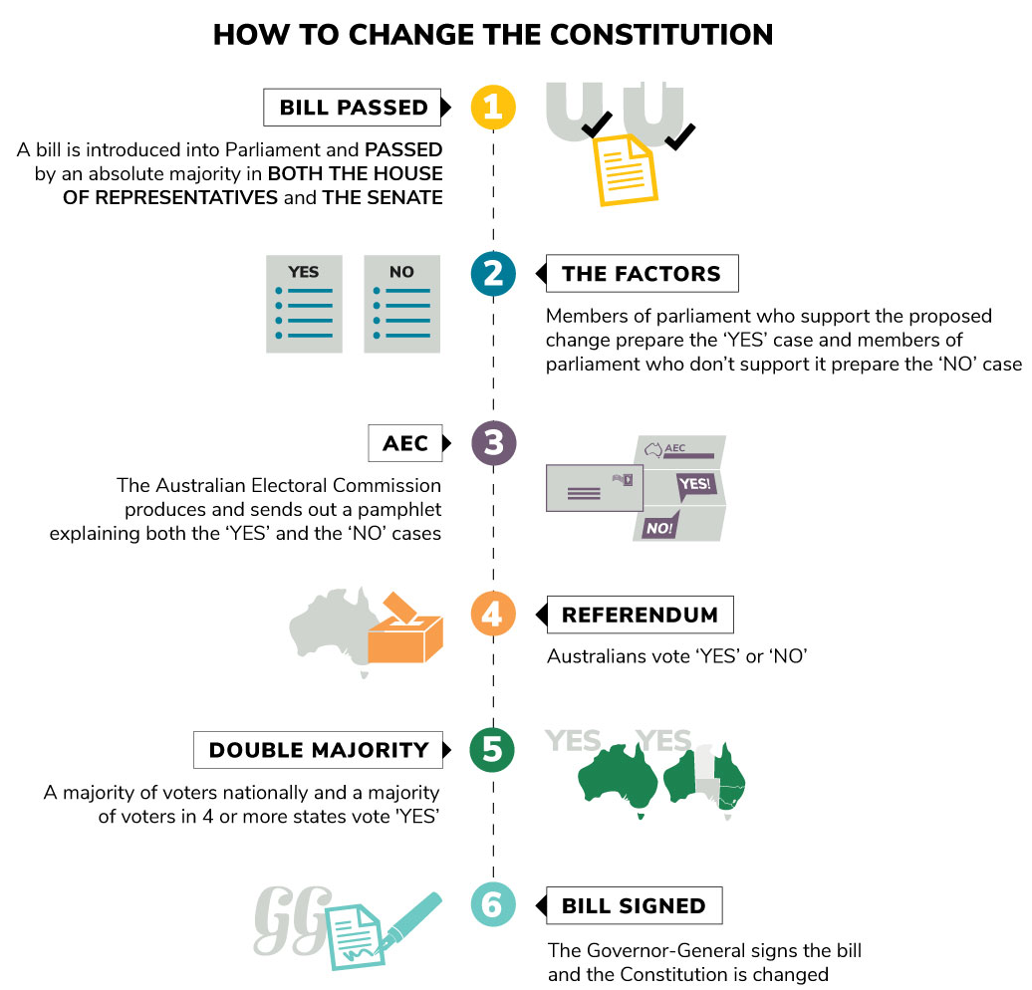
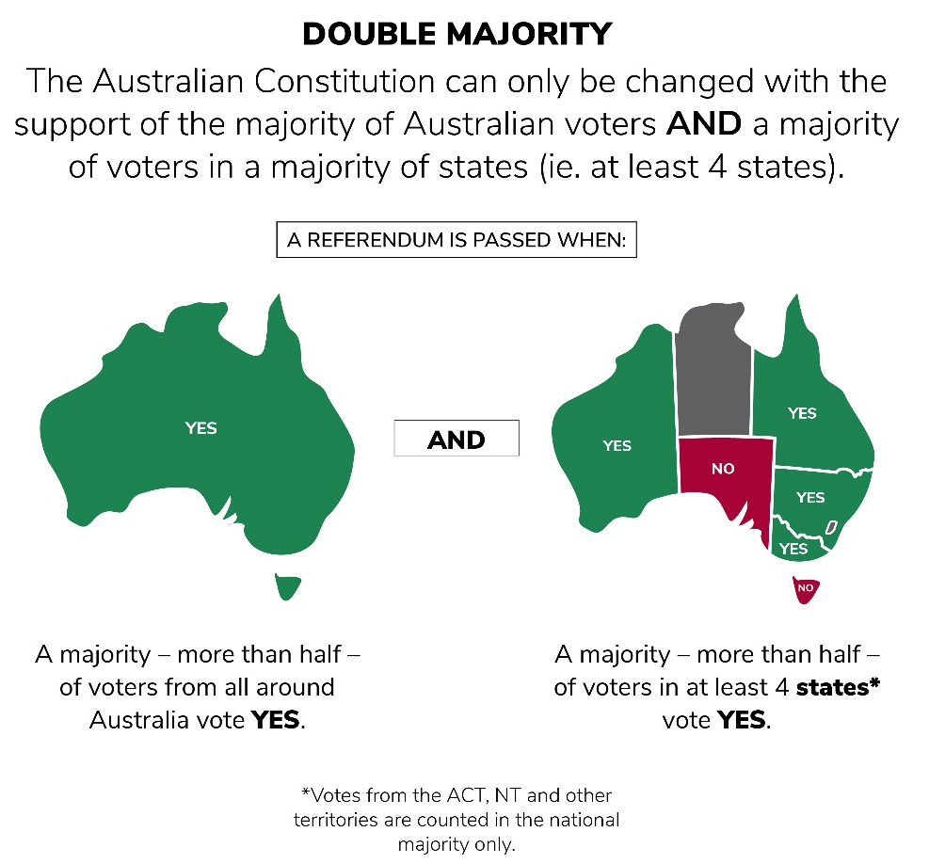
Referendums
A referendum is:
a vote on a proposed change to the Australian Constitution.
passed if it is approved by a double majority.
How does a referendum keep the powerful in check?
Can you think of any recent referendums in Australia?
Images from: Parliamentary Education Office
Notes:
Referendums and plebiscites are covered in the Year 7 Civics & Citizenship HASS curriculum. This should just be a quick recap.
https://peo.gov.au/understand-our-parliament/having-your-say/elections-and-voting/referendums-and-plebiscites
There is a ‘can you make a double majority’ activity you can project on the PEO website (sliders)
The steps that need to be taken before the Australian Constitution can be changed:
1. Bill passed
A bill is introduced into Parliament and PASSED by an absolute majority in both the House of Representatives and the Senate.
2. The factors
Members of parliament who support the proposed change prepare the 'YES' case and members of parliament who don't support it prepare the 'NO' case.
3. AEC
The Australian Electoral Commission produces and sends out a pamphlet explaining both the 'YES' and the 'NO' cases.
4. Referendum
Australians vote 'YES' or 'NO'.
5. Double Majority
A majority of voters nationally and a majority of voters in 4 or more states vote 'YES'
6. Bill signed
The Governor-General signs the bill and the Constitution is changed.

Slide 11
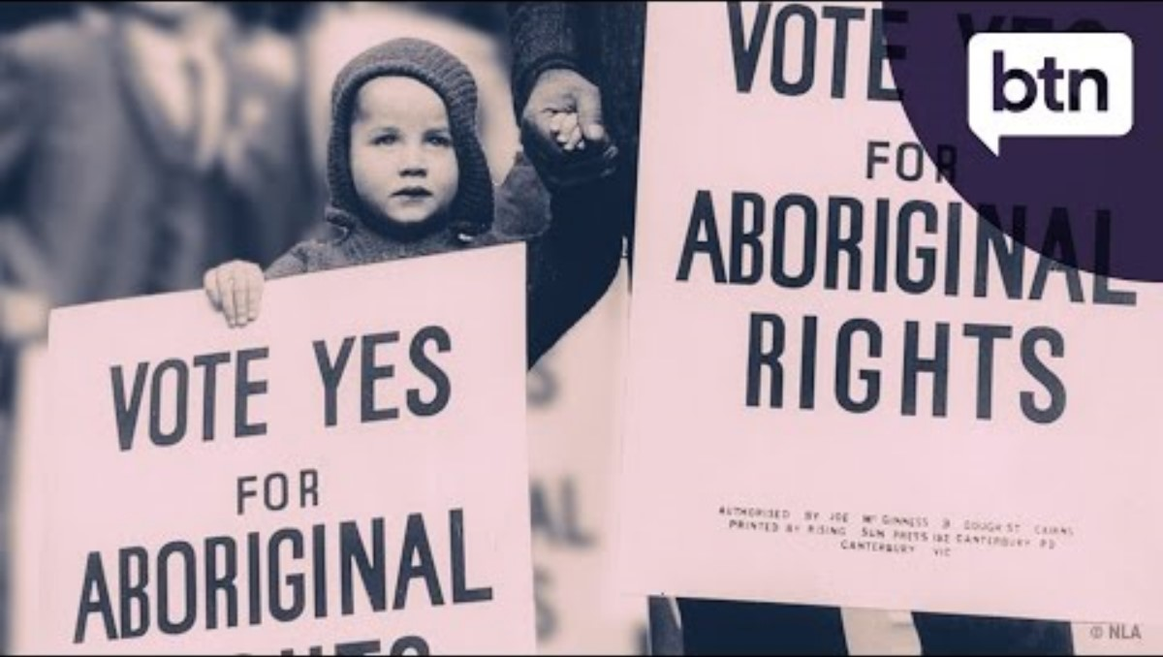
1967 Referendum - Behind the News
Notes:
https://www.youtube.com/watch?v=pz7hrwgczPg
(3:59)
You may need to stop this video a few times to allow time to answer questions.
After watching – ask students if they know who was speaking during the ‘I have a dream speech’
Time, questions and answers (in bold)
0:39 Indigenous Australians faced a lot of discrimination, and weren’t counted as citizens of their own country
0:57 In 1962 all Indigenous people were given the right to enrol to vote in Federal elections.
1:04 In 1965 Indigenous workers stood up against unfair working conditions and stood up for land rights
1:11 In the same year, university students protested racism and poor living conditions around country NSW
2:17 What are the 2 voting options in a referendum? Yes and No
2:25 What was the first step to get a referendum? Petitions
(note, this is the first step mentioned in the video, before it reaches parliament)
2:31 Eventually they collected 100,000 signatures, and after 10 years of campaigning there was a referendum.
2:45 On 27 May 1967, Australians voted; 90% voted yes to changing the Constitution.
3:15 Removing the 2 lines in the Constitution helped paved the way for what changes for Aboriginal people? Answers may include, counted in population data, land rights and traditional ownership
3:45 What issues still exist in the Constitution? Aboriginal people aren’t recognised as the nation’s First people and governments can still make laws that discriminate based on race.

Slide 12
Impact of the 1967 referendum
"The victory of the 1967 referendum was not a change of white attitudes. The real victory was the spirit of hope and optimism which affected blacks all over Australia. We had won something … we were visible, hopeful and vocal."
Oodgeroo Noonuccal (Kath Walker)
Notes:
The ABC’s ‘Right Wrongs’ series has a collection of resources before, during and after the 1967 referendum which you may want to explore and share with students.

Slide 13
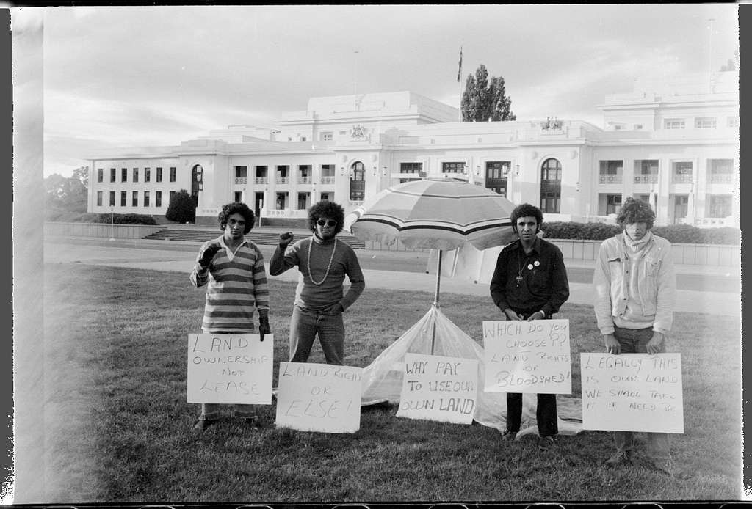
First day of the Aboriginal Tent Embassy (Mitchell Library, State Library of New South Wales and Courtesy SEARCH Foundation)
Notes:
Ask students if they know the history of this photo.
Photo 1: https://oercollective.caul.edu.au/diverse-hist-narratives/chapter/perspectives-of-civil-rights-movements-in-australia-by-hannah-grace/
This Photo by Unknown Author is licensed under CC BY-NC

Slide 14
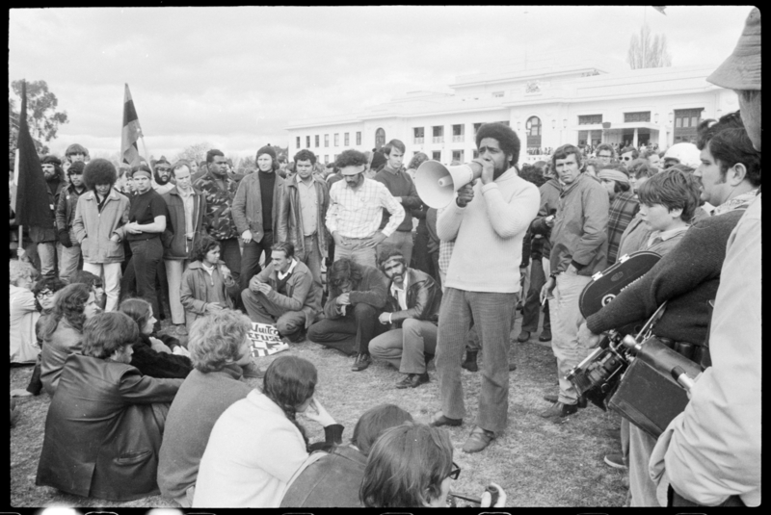
Protests: The Aboriginal Tent Embassy
In 1972 Aboriginal people were the only cultural group not represented with an embassy.
The Aboriginal Tent Embassy began on January 26 1972, to protest until the government granted land rights to Aboriginal people with Billy Craigie, Bert Williams, Michael Anderson and Tony Coorey. (left to right in top photo)
A beach umbrella was set up in front of (Old) Parliament House on Ngunnawal Country (Canberra) with a sign 'Aboriginal Embassy’.
The Government (led by William McMahon) didn’t want to negotiate. Instead, they changed the law to make camping on the lawn of Parliament House illegal (this was reversed by the ACT Supreme Court).
Photo: Bob Maza addresses a protest at the Aboriginal Tent Embassy in front of Parliament House, 30 July 1972 (Mitchell Library, State Library of New South Wales and Courtesy SEARCH Foundation)
Notes:
Content adapted from: https://www.moadoph.gov.au/explore/stories/history/a-short-history-of-the-aboriginal-tent-embassy-an-indelible-reminder-of
Photo 2: Wikicommons
https://commons.wikimedia.org/wiki/File:Bob_Maza_1972.jpg
https://archival.sl.nsw.gov.au/Details/archive/110366679

Slide 15
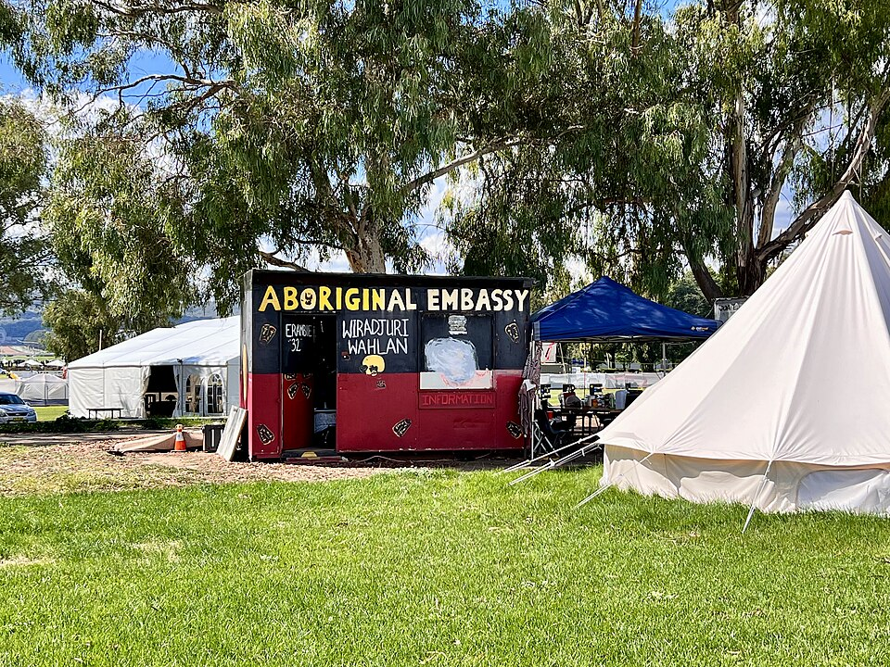
The Aboriginal Tent Embassy
The next Government (led by Gough Whitlam) gave land title deeds to the Gurindji people soon after coming into power, which paved the way for further land rights.
The Aboriginal Tent Embassy is still on the lawn of Old Parliament House today
The Aboriginal Tent Embassy demonstrates the continued fight of Aboriginal and Torres Strait Islander people for the reclamation of our lands and sovereign rights as First Nations peoples.
The Aboriginal Tent Embassy, Canberra, 2022 (50th anniversary).
Source: wiki commons (own work, Kgbo)
Notes:
Content adapted from: https://www.moadoph.gov.au/explore/stories/history/a-short-history-of-the-aboriginal-tent-embassy-an-indelible-reminder-of
https://commons.wikimedia.org/wiki/File:Aboriginal_Tent_Embassy,_Canberra,_2022,_01.jpg

Slide 16
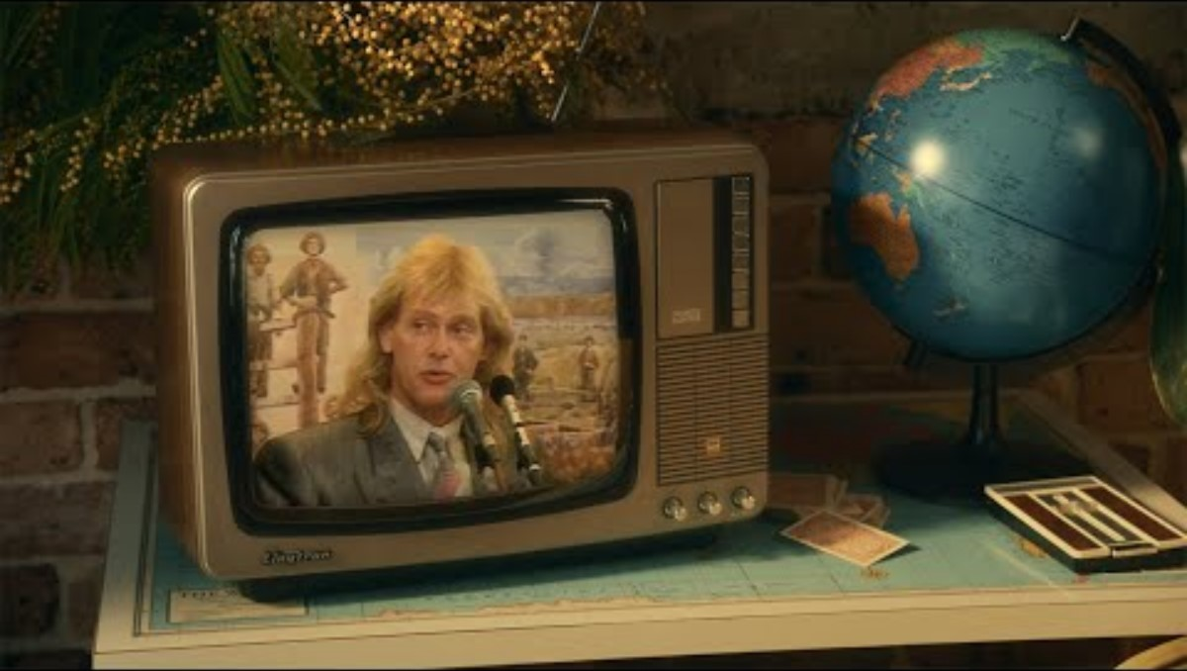
You’re the voice that will make history.
Notes:
https://www.youtube.com/watch?v=RkSu9MYt7Uk
This is a campaign video from the Uluru Statement of the Heart to vote yes, however it provides teachers and students with an overview of significant social and political changes over recent history.
Play video and ask students how many/which events they recognised in the video.
Ask students if they know what the final event ‘vote yes’ was about.

Slide 17
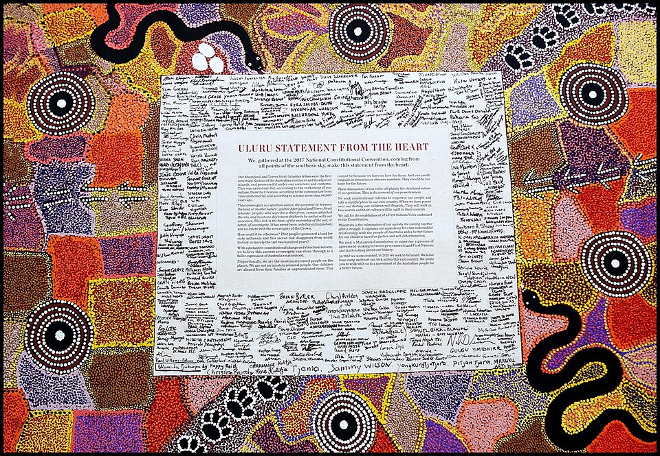
Uluru Statement from the Heart
The Uluru Statement from the Heart was signed in 2017.
It called for reform to help realise Indigenous rights, through:
the establishment of an Indigenous Voice to Parliament
a Makarrata Commission. 'Makarrata' is a Yolŋu word meaning the coming together after a struggle
The final line of the statement says:
“In 1967 we were counted, in 2017 we seek to be heard. We leave base camp and start our trek across this vast country. We invite you to walk with us in a movement of the Australian people for a better future.”
Picture: Uluru Statement from the Heart, May 2017, Aboriginal Convention, Central Australia (Source: Wiki commons, BrownHoneyAnt, own work)
Notes:
Read/show the Uluru Statement from the statement here: https://ulurustatement.org/the-statement/view-the-statement/
Ask students to share their thoughts about the reference to the 1967 referendum and its significance.
Image source: https://commons.wikimedia.org/wiki/File:Uluru_Statement.jpg

Slide 18
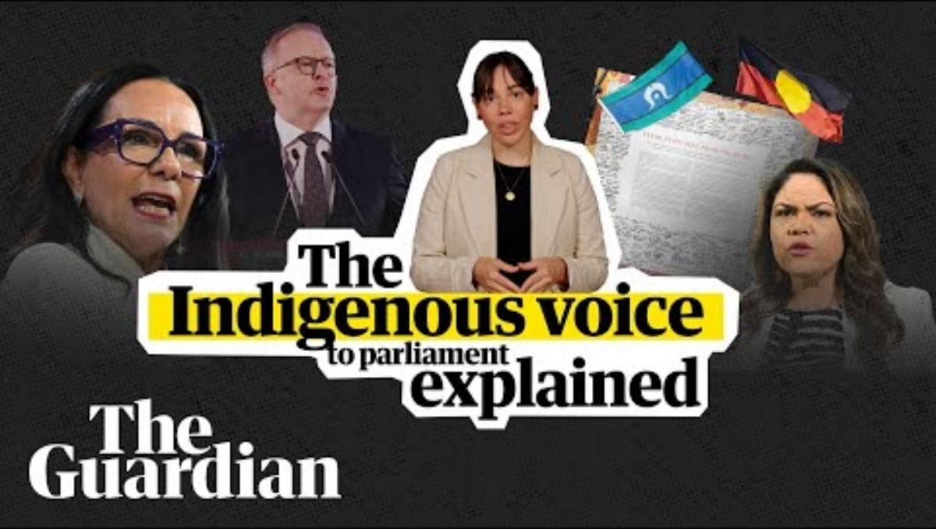
The voice to parliament explained in under two minutes, Guardian Australia
Notes:
This video was created before the Voice to Parliament referendum – students should be told this, but it outlines the background of the referendum, and arguments for both a yes and no vote.
https://www.youtube.com/watch?v=OtAQQg8IwJE
0:20 Who would the Indigenous body advise? The government and parliament (on laws and policies that would affect First Nations people)
Reasons for and against the vote:
For/Yes: it would improve the lives of First Nation peoples
Against/No: it wouldn’t help fix (alleviate) the problems / could divide the nation / some groups prefer a treaty with the government instead.

Slide 19
Key Findings from the 2023 Voice to Parliament Referendum
Referendum outcome:
  only 39.9% of legal votes were in favor of the change
  no majority support in any of the 6 Australian States, but a majority in the Australian Capital Territory.
General support:
  Australians generally support constitutional recognition of First Peoples
  if the referendum was solely about recognition, the "yes" votes would outnumber "no" votes
  around 80% of Australians support reconciliation and believe in the importance of Aboriginal and Torres Strait Islanders having a say in matters that affect them.
Insights:
  "No" voters were more likely to be male, older, speak a language other than English at home, have low levels of education, live outside capital cities, and be from low-income households
  trust in social media, disliking the Prime Minister, and views on land rights/native title influenced "no" votes
  “Yes” voters were more likely support reconciliation, trust the federal government, and believe in special cultural protection for Indigenous people.
Notes:
Fact sheet – additional resource from Monash University:
https://www.monash.edu/__data/assets/pdf_file/0007/3272920/2023-Castan-Centre-Voice-to-Parliament-Factsheet-and-Debunking-Myths-Combined.pdf
Extra information from an ANU report:
https://csrm.cass.anu.edu.au/research/publications/detailed-analysis-2023-voice-parliament-referendum-and-related-social-and
Outcome:
Only 39.9% of legal votes were a “yes”
No majority support in any States, but a majority in the Australian Capital Territory
Australians are less satisfied with democracy, the government, the direction of the country, and their own lives.
"No" voters were more likely to be male, older, speak a language other than English at home, have low levels of education, live outside capital cities, and be from low-income households
Those who supported reconciliation, trusted the federal government, and believed in special cultural protection for Indigenous people were more likely to vote "yes".
Reasons for voting "No":
Trust in social media, disliking the Prime Minister, and views on land rights/native title influenced "no" votes
Many Australians voted "no" because they didn't want division and were skeptical of rights for some Australians that are not held by others
They believed Aboriginal and Torres Strait Islander Australians continue to suffer from past government policies and need extra government assistance, but did not see the Voice model as the right approach.
Support for recognition:
If the referendum was just about recognition, the "yes" votes would outnumber "no" votes
Around 80% of Australians support reconciliation and believe in the importance of Aboriginal and Torres Strait Islanders having a say in matters that affect them

Slide 20
Reflection -
Four key ideas of Australian democracy revisited
Active and engaged citizens
An inclusive and equitable society
Free and franchised elections
The rule of law for both citizens and the government
  How did the 1967 Referendum impact First Nations people?
  What do you think were the main reasons behind the outcome of the 2023 Voice to Parliament Referendum?
Notes:
Active and engaged citizens
People have a voice and can make changes in society.
People can participate by getting involved in their community. This might be by joining a charity, a political party or a community group.
Everyone can get involved in the work of Parliament through contacting members of parliament, the work of committees, protesting and petitioning.
An inclusive and equitable society
People work towards a society where everyone is respected and free, where everyone is valued and supported to reach their full potential.
People have freedom of speech, association, movement and belief.
Our society supports the development and well-being of individuals and their right to make their own choices.
Opposing ideas are tolerated and respected. People listen to different points of view in Parliament and society.
Free and franchised elections
People can stand for elections and choose who makes decisions on their behalf.
Voting is done in secret so people can make their choice without pressure or intimidation.
Elections are run by an independent organisation­—the Australian Electoral Commission.
The rule of law for both citizens and the government
Everyone is equal before the law and must follow the law, including the people who make laws.
Laws should be fair, clearly written and protect people's rights.
After discussing these key ideas – students should work in pairs or small groups on the worksheet with the 4 ideas. They should choose 2 questions for each key idea and discuss their answers with a peer.

Slide 21
Activity 3: Direct democracy now

Slide 22
What is important to you?
From a USA study, 62% of Gen Z say moral and ethical issues are the why they get engaged in politics.
Their top concerns are:
      Climate change and environmental protection
      Racial equity and social justice
      LGBTQ+ rights and gender equality
      Economic inequality and wealth distribution
      Gun violence prevention
      Mental health awareness and support
      Education reform and student debt
      Healthcare accessibility and affordability
      Immigration rights and reform
      Digital privacy and data protection
Are these important to you?
What else would you add?
Notes:
See if students can identify the top concerns
Optional – you could create a Microsoft Form with a ‘ranking’ question – add the above list and/or add/remove additional issues from your class and have students vote/rank them based on importance and share the results to see how they compare.

Slide 23
The power of young people: direct democracy
Young people are withdrawing from formal politics, but are increasing participation in the democratic process in other ways, such as:
attending demonstrations or protests
boycotts
signing petitions.
Notes:
https://www.bbc.com/worklife/article/20220803-gen-z-how-young-people-are-changing-activism
Boycotts: not using a product, purchasing from company and country or state because of a political, social or environmental stance

Slide 24
The power of young people
52% of people of all generations believe teenagers and university-aged students influence how we create change.
70% of Gen Z are involved in a social or political cause
From a 2020 study of 8- to 17-year-olds:
34% said the internet inspired them to take action about a cause
43% said the internet made them feel their voices matter.
Notes:
Sources:
https://www.bbc.com/worklife/article/20220803-gen-z-how-young-people-are-changing-activism
https://www.edelman.com/sites/g/files/aatuss191/files/2022-06/2022 Edelman Trust Barometer Special Report The New Cascade of Influence FINAL.pdf
https://saferinternet.org.uk/safer-internet-day/safer-internet-day-2020/free-to-be-me-research

Slide 25
Bringing it all together
Think about the 4 key ideas of democracy:
From what you have learned about the referendums and the issues that are important to you, do you think Australia is democratic?
How could you get involved in action?
Active and engaged citizens
An inclusive and equitable society
Free and franchised elections
The rule of law for both citizens and the government
Notes:
Link back to the four key ideas of democracy activity to bring all activities together.

Slide 26
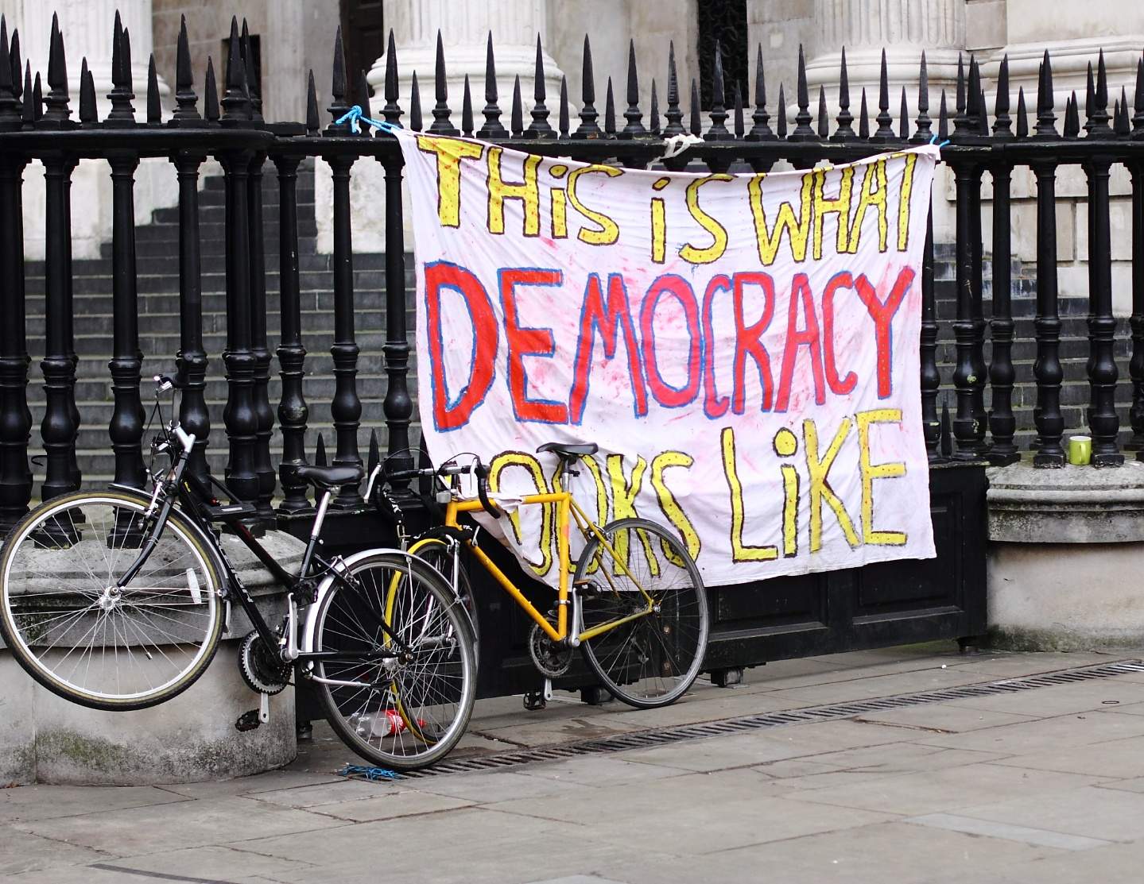
Reflection
  How do young people now use direct democracy to address issues like racism and inclusivity?
  How does this compare to the past?
Photo ‘This is what democracy looks like’, by Yossi Gurvitz
Notes:
Referendums (and other examples covered in the videos may be answers). Ask students to think about other examples they know about or have seen.
This Amnesty International article lists 9 social change movements – they may not all be appropriate for students, but could provide examples for your reference: https://www.amnesty.org.au/9-powerful-social-change-movements-you-need-to-know-about/
https://www.flickr.com/photos/ygurvitz/6331468167

Slide 27
Thank you

