Slide 1
1.5 Australia diaspora and third culture generations
Diversity in Australian Citizenship
9 / 10 HASS
D25/1173920
December 2025
Notes:
This resource can be used with the accompanying lesson and worksheet.

Slide 2
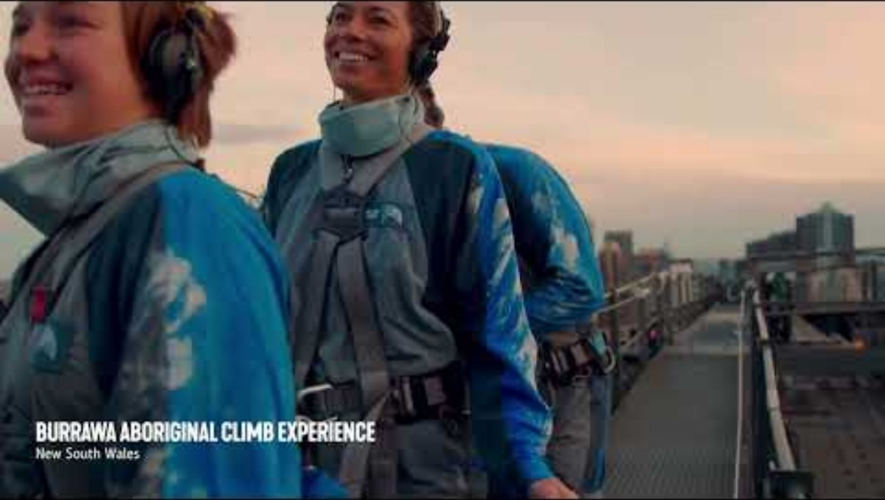
Signature experiences of Australia
Notes:
Before playing:
Discuss how people's perceptions of places are shaped by their experiences, media, and societal influences.
Explain that understanding these perceptions can help us recognise biases and promote inclusivity.
While watching, ask students to think about anywhere they have been, seen before, or they want to visit or learn more about.
Video – Tourism Australia ‘Signature experiences Australia’: https://www.youtube.com/watch?v=sMoTMvxd7uU

Slide 3
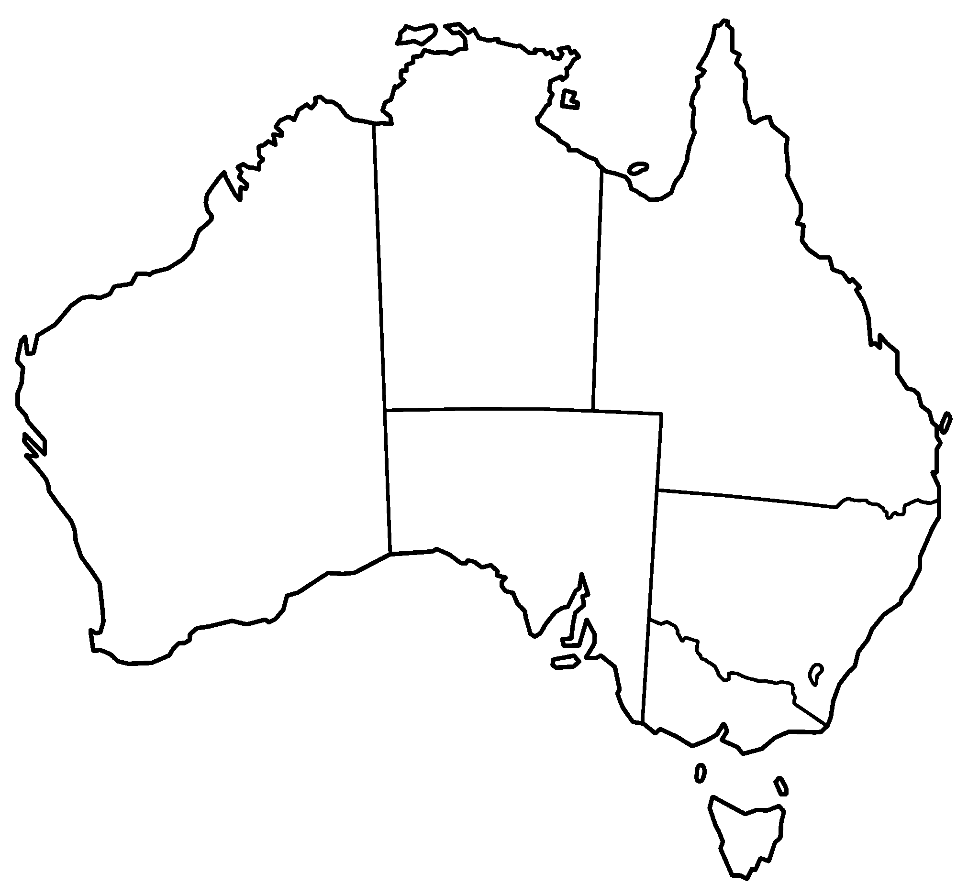
Mapping Personal Connections
Mark places on the map that you feel a connection to. This could be places you’ve lived, visited, have family ties to or have seen on tv or other media
Use different colours for different reasons for connections:
      family
      media
      You can add categories more if needed.
Write a few sentences about why you feel connected to these places.
Blank map of Australia, Golbez
Notes:
Distribute blank maps of Australia (and/or world maps), and coloured pencils/highlighters.
The experiences in the video may have given students some ideas, or reminded them of similar experiences/connections they have across Australia.
For example:
Sydney (Family):
"I feel connected to Sydney because my grandparents live there, and we visit them every summer."
Melbourne (Travel):
"I visited Melbourne to watch the footy and loved the vibrant culture and street art."
Kununurra (Media Influence):
"I've never been to Kununurra, but I've seen pictures and documentaries about the Bungle Bungles about its cultural significance to Indigenous Australians."
https://commons.wikimedia.org/wiki/File:Australia_states_blank.png

Slide 4
Create a mind map
Cultural Identity

Slide 5

Definitions
Culture:
The customs, habits, beliefs, social organisation and ways of life that characterise different groups and communities.
Identity (cultural identity):
A person’s conception and expression of their individuality or association with a group.
Refers to a person's sense of belonging to a culture or to a state or nation, a region or at a global level.
It is a feeling one shares with a group of people, regardless of citizenship status.
Discuss these definitions – can you think of examples? Does this affect what you have in your mind map?

Slide 6
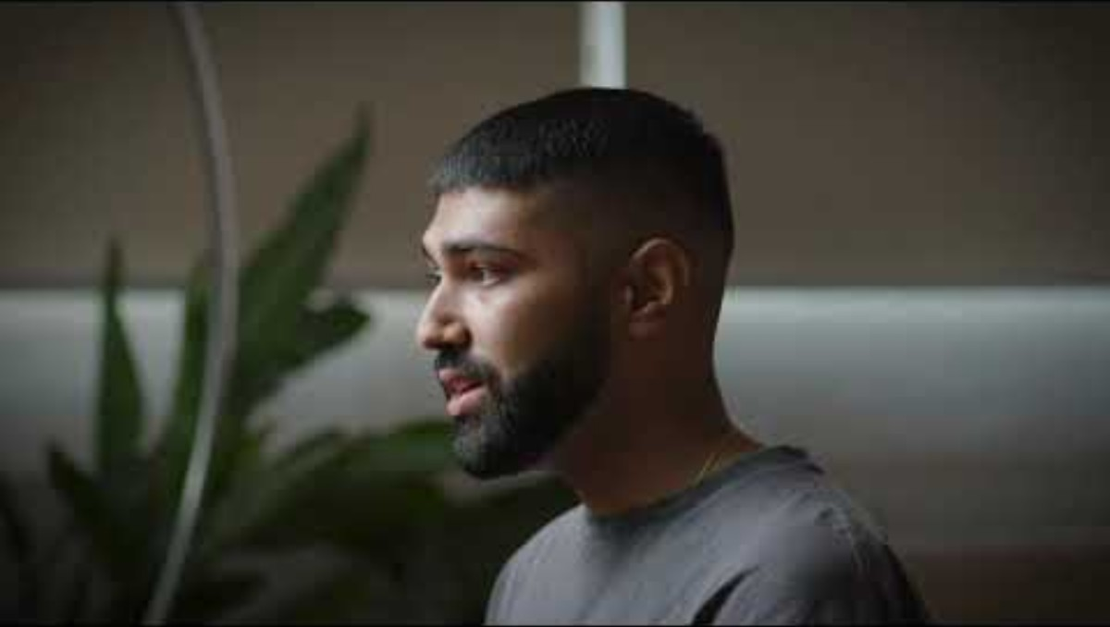
Learning to navigate your cultural identity | ReachOut Australia
Notes:
https://www.youtube.com/watch?v=I7IXI7lfFTI
Learning to navigate your cultural identity | ReachOut Australia

Slide 7
Activity 2: Australia’s changing cultural diversity and experiences

Slide 8
What do these terms mean?
    First generation Australians
    People living in Australia who were born overseas.
    Second generation Australians
    Australian-born people living in Australia, with at least one parent born overseas.
    Third-plus generation Australian
    Australian-born people whose parents were both born in Australia.
    One or more of their grandparents may have been born overseas or they may have many generations of ancestors born in Australia.

Slide 9
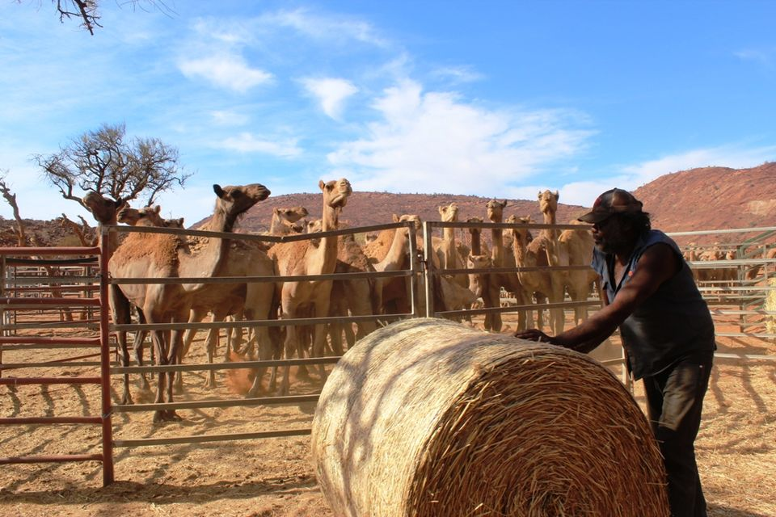
Migration in Australia
Aboriginal and Torres Strait Islanders have lived in Australia for at least 50,000 years
  More than 160,000 convicts were sent to Australia from Europe
  In 1901 the largest migrant groups were from the UK, German-speaking countries and China
  In the second half of the 19th-century:
      South Sea Islanders worked on Queensland sugar plantations
      Afghan cameleers explored the Australian outback
      Japanese divers developed the pearling industry.
An Indigenous stockman at a feral camel muster on the APY Lands of South Australia
Source: Australian Broadcasting Corporation, 2013
Notes:
https://commons.wikimedia.org/wiki/File:Camel_Muster_On_APY_Lands_Australia.jpg

Slide 10

Migration in Australia
  Post-World War II the ‘Populate or Perish’ scheme accepted migrants and displaced people from Europe (and the Ten Pound Poms from Britain)
  This extended to groups of people who had been excluded before – including Italians and Greeks
  The 1970 – 1990s included refugees and migrants from Asia, including East Timor, Vietnam, Cambodia, Laos and southern China
  In June 2024, over 31.5% of Australia’s population was born overseas and in 2021, 48% of Australians had a parent born overseas.
Bronze Opera House, Adrian Gigante
Notes:
Ask students how many of their families were born overseas.
Ask students if they know which countries most migrants are from today in Australia.
https://commons.wikimedia.org/wiki/File:Bronze_Opera_(142322781).jpeg

Slide 11
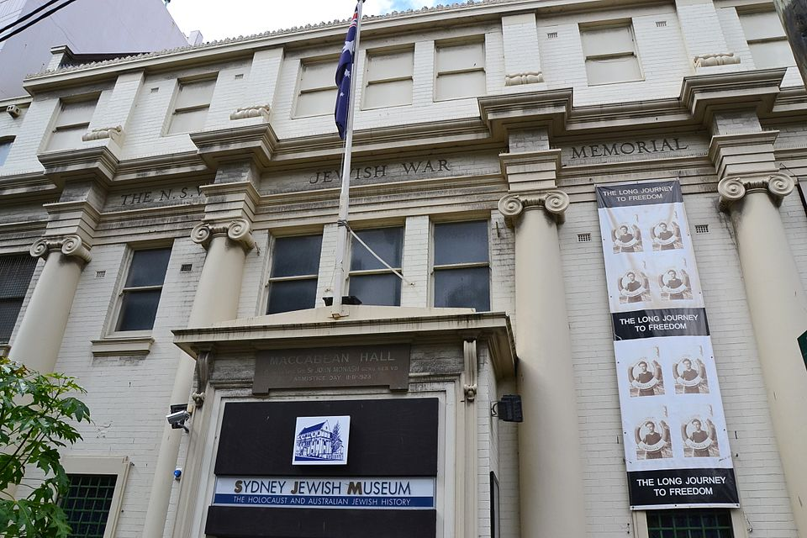
Diversity in Australia: Journeys of Hope – Peter’s story
Identify the "push" and “pull” factors that influenced Peter's family to migrate to Australia.
As someone new to Australia, how did Peter become part of a community? Why was it important?
Citizenship is a significant milestone in the life of someone who has migrated to Australia.
3. To what extent do you agree with this statement?
4. Assess the extent to which Peter's migration experience was mutually beneficial for him and for Australia.
      What did Peter gain? What did Australia gain?
      How can Australia benefit from the lessons and legacy of Peter's experiences?
      Video link
Sydney Jewish Museum, Sardaka, 2011 (own work)
Notes:
https://www.abc.net.au/education/digibooks/journeys-of-hope/104544800
Picture: https://commons.wikimedia.org/wiki/File:1_Sydney_Jewish_Museum.jpg
Video testimony: Migration experience
Peter describes how, having survived the Holocaust, his parents fled the former Czechoslovakia to escape Communist totalitarianism under Joseph Stalin. Wanting to get "as far away from Europe as possible", he and his parents made the journey to Australia by ship.
Peter talks fondly of the voyage, including his memorable first encounters with oranges and bananas and, after docking in Fremantle, a chocolate milkshake.
In Melbourne, Peter was sent to a boarding school because his parents were working multiple jobs, seven days a week. He says the experience turned out well, forcing him to learn English extremely quickly.
Peter discusses the way in which he and his parents were made to feel different because of language and cultural differences. They were discriminated against, he says, but "in a very inoffensive way".
Having survived Nazism and Communism, Peter says Australia's system of democracy is "far better than the alternatives", and he says young Australians need to contribute to its preservation. "It's not up to the other person; it's up to each and every one of us."
Student questions
Identify the "push" factors that influenced Peter's family to migrate to Australia. Identify the "pull" factors that influenced Peter's family to migrate to Australia.
Use the video to discuss the idea of community and its importance to society. As someone new to Australia, how did Peter become part of a community?
Citizenship is a significant milestone in the life of someone who has migrated to Australia.
3. To what extent do you agree with this statement? Use examples from the video to support your response.
4. Assess the extent to which Peter's migration experience was mutually beneficial for him and for Australia. What did Peter gain? What did Australia gain? How can Australia benefit from the lessons and legacy of Peter's experiences?

Slide 12
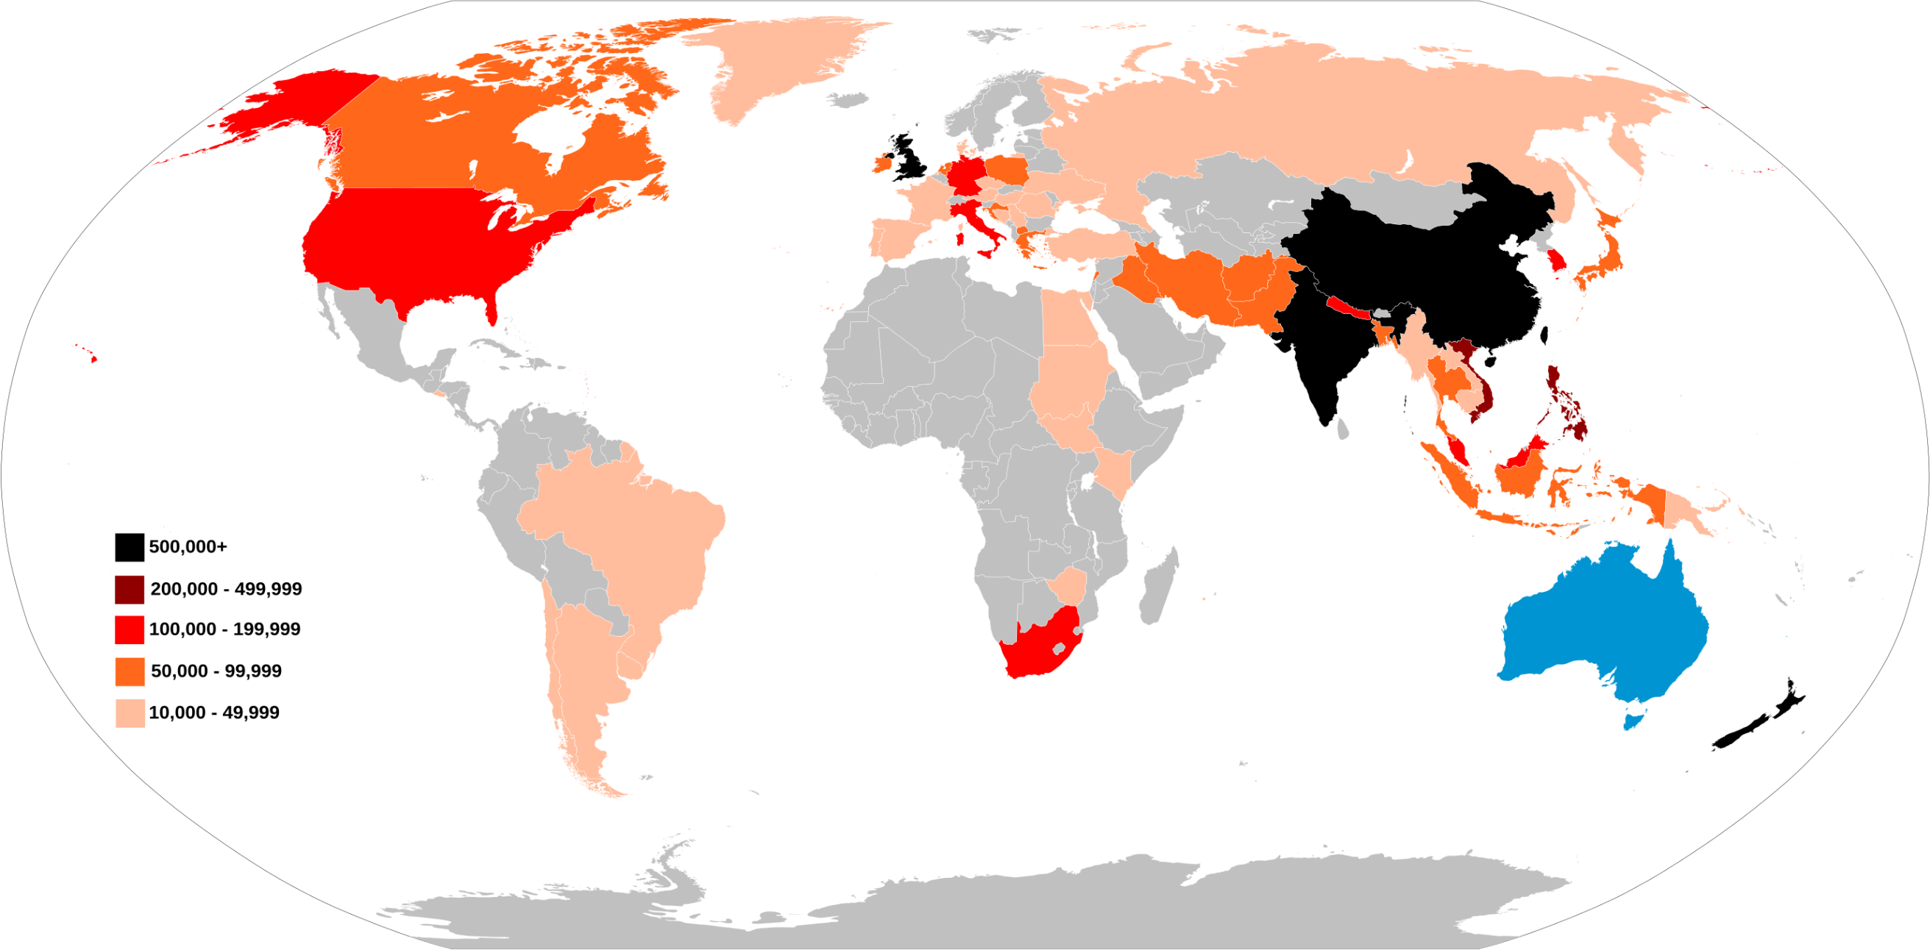
“Describe the distribution of Australian residents by country of birth using evidence from the source”
Australian Residents by Country of Birth 2021 Census
Notes:
Source: https://commons.wikimedia.org/wiki/File:Australian_Residents_by_Country_of_Birth_2021_Census.svg
Answers should name specific countries and use data, i.e.
“The distribution of Australian residents by country of birth is largest in China, India, New Zealand and the United Kingdom (with over 500,000 people from each of these countries). There are many residents who were born in Asia, the United States, South Africa and parts of Europe, such as Italy, which range between 100,000 – 499,999 residents. In South America, Central America and Africa, there are under 49,999 residents (with most countries less than 10,000 or no data), except for South Africa.

Slide 13
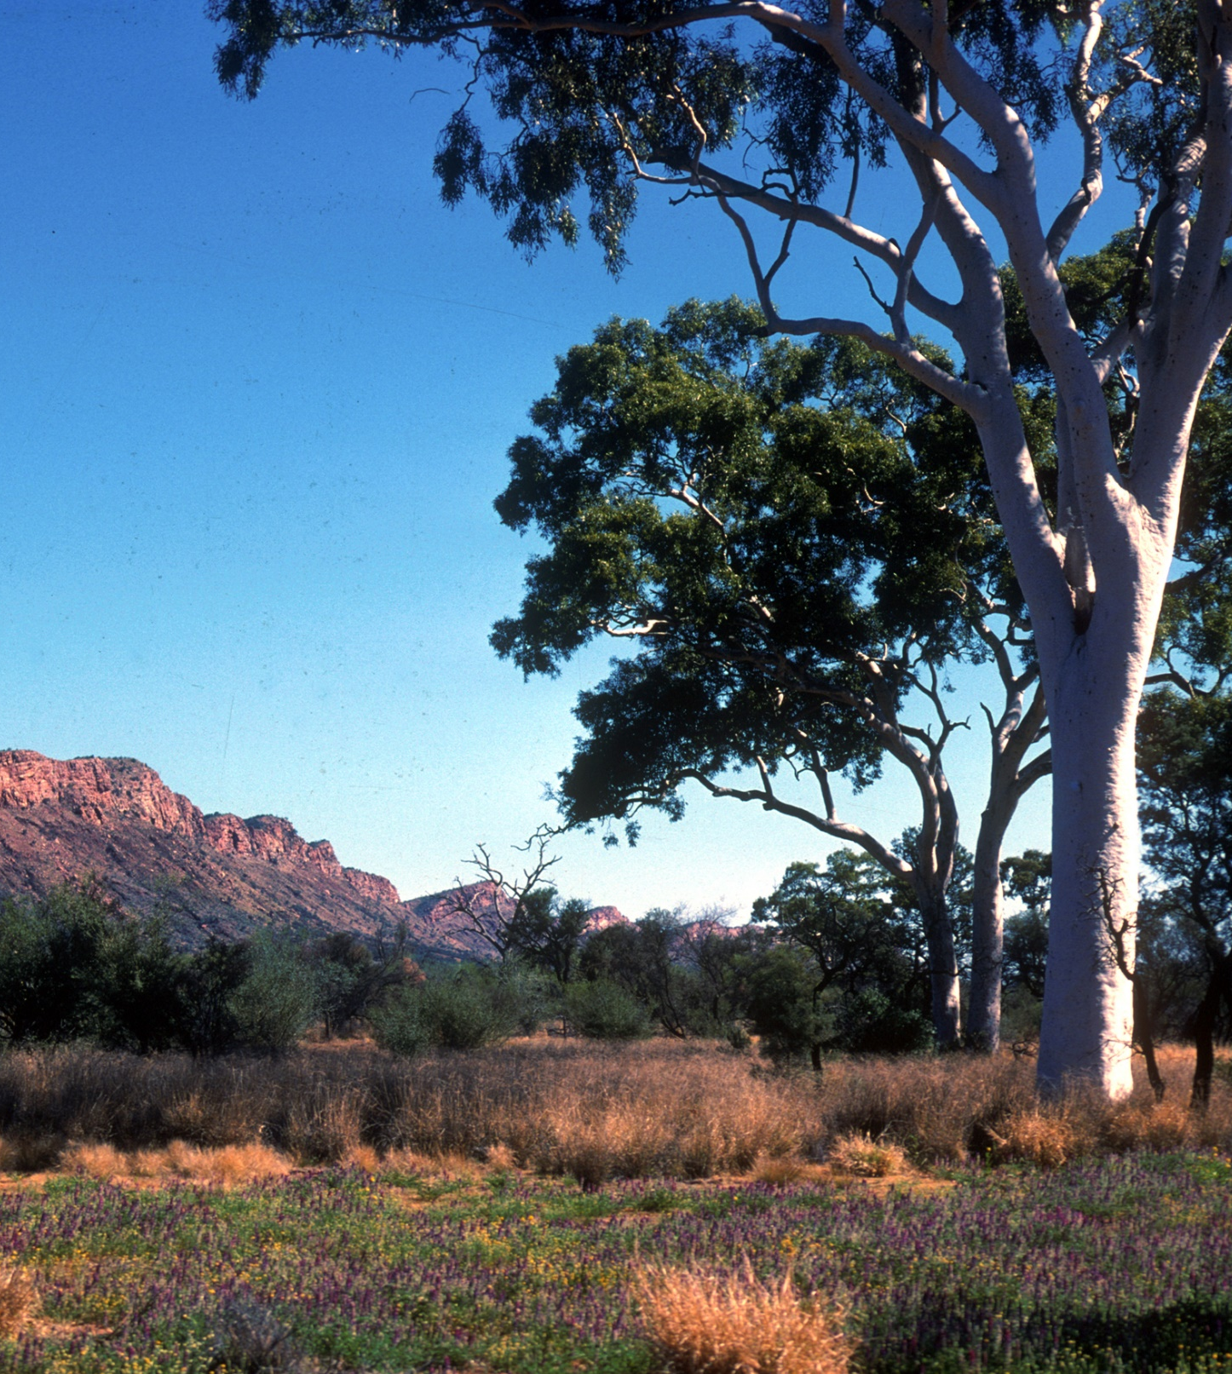
Experiences today
Watch the You can’t ask that segment in the ABC’s Experiences of African Australians
What new information did you learn from watching this video?
How were your preconceived ideas about Africa and African-Australians challenged or reinforced?
What are the benefits of challenging pre-conceptions?
Image: Purnululu National Park, Phil Whitehouse
Notes:
Ask students how many of them are dual citizens and/or for a discussion on what the class thinks about dual citizens
Watch the You can’t ask that segment in the ABC’s Experiences of African Australians (12 min 13 sec)
https://iview.abc.net.au/show/you-can-t-ask-that-in-the-classroom
Image source: https://commons.wikimedia.org/wiki/File:Bungle_Bungles_(2051697677).jpg
Ask students:
What new information did you learn from watching this video?
How were your preconceived ideas about Africa and African-Australians challenged or reinforced?
What are the benefits of challenging pre-conceptions?

Slide 14
Thank you

