Slide 1

Refugees Seeking a Better Life in Australia Post-WWII
2.3 9 /10
D25/1142285

Slide 2
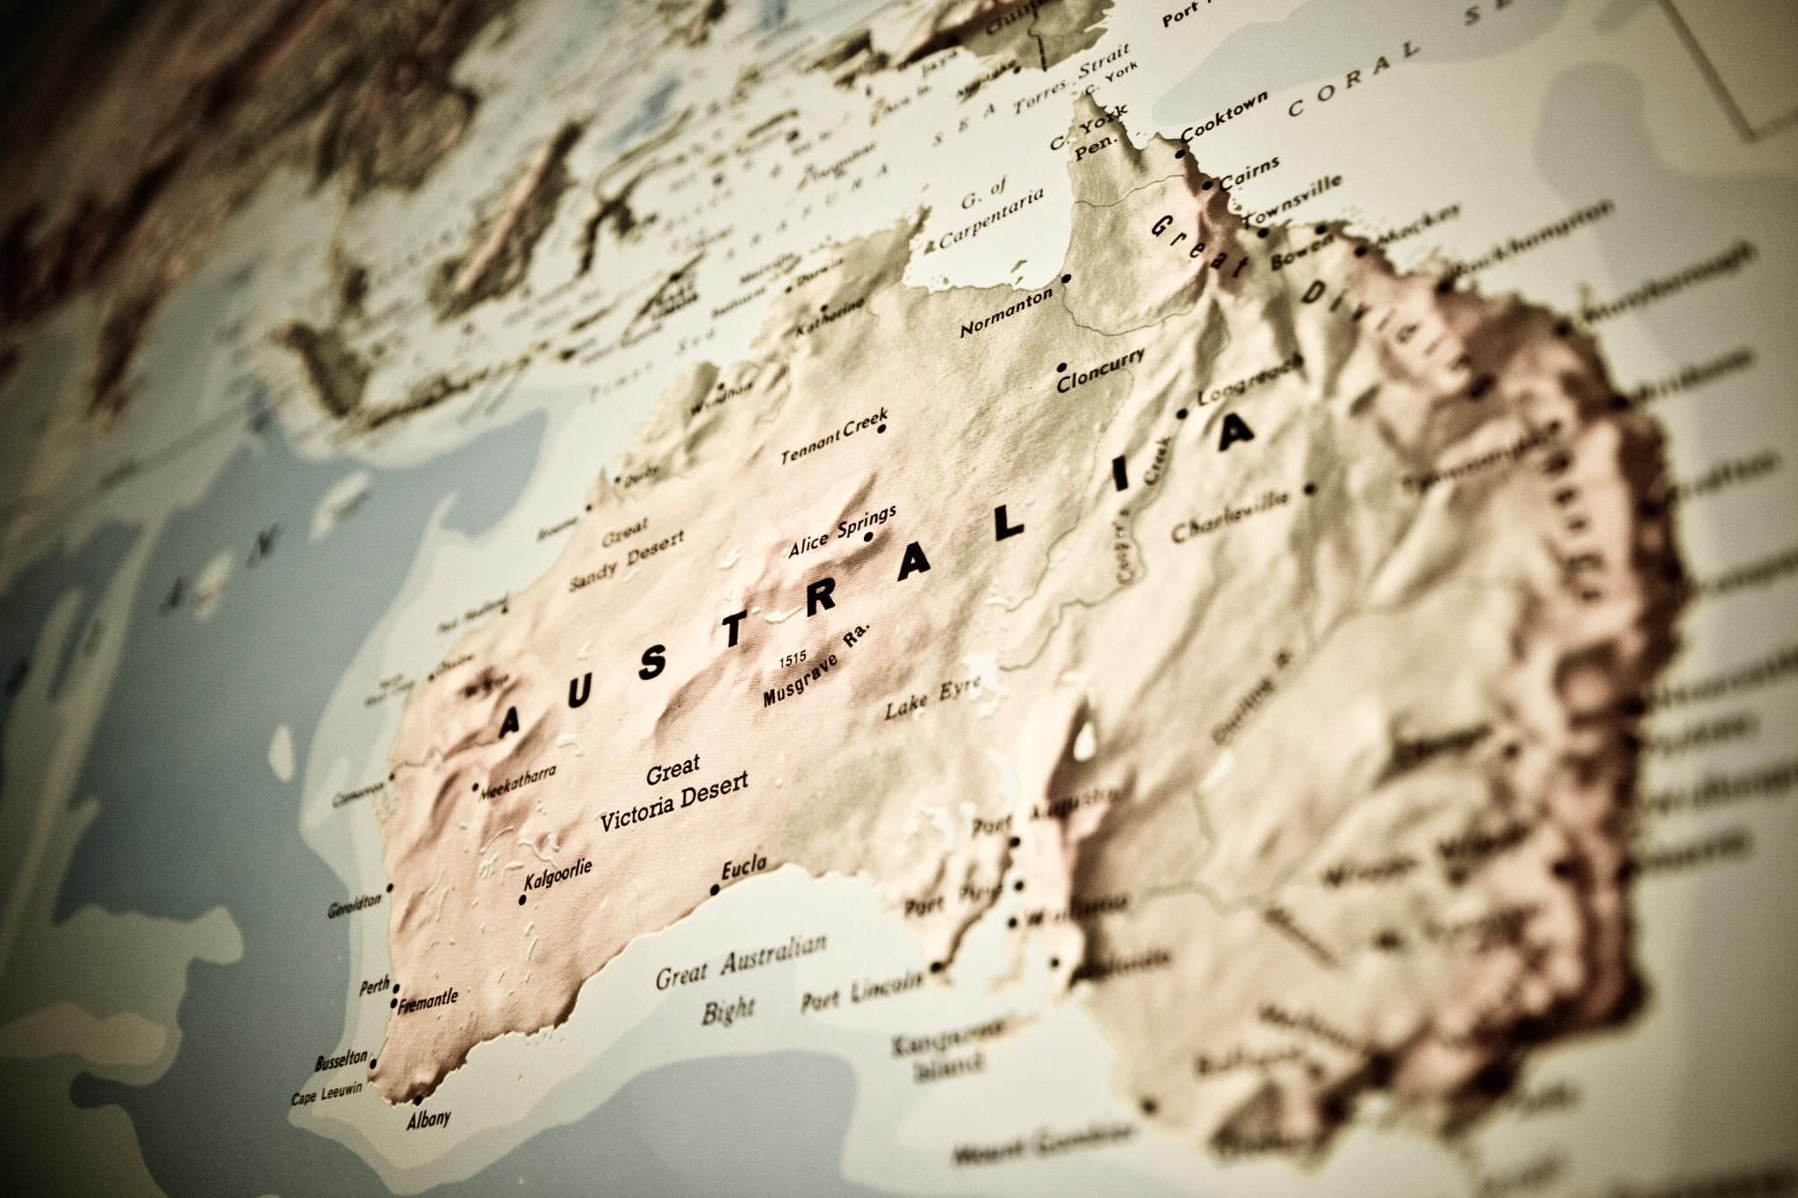
End of World War II
Global Devastation and Displacement
  World War II ended with widespread destruction and millions displaced across Europe and Asia. The aftermath triggered an urgent humanitarian crisis with widespread need for refuge and rebuilding.
Australia's Immigration Initiative
  Australia pursued immigration to address labor shortages and boost national security post-war. This era began major demographic shifts shaping Australia's cultural and economic future.
Notes:
World War II concluded in 1945, leaving behind a devastated global landscape and millions of displaced individuals across Europe and Asia. The aftermath of the war created an urgent humanitarian crisis, with countless people seeking refuge from destroyed homes, fractured economies, and unstable political regimes. Australia, emerging from the war with a relatively intact infrastructure but facing significant labour shortages and population concerns, recognized the opportunity to address both humanitarian needs and national interests. The Australian government began to consider large-scale immigration as a means to bolster its workforce and enhance national security. This period marked the beginning of a transformative era in Australia's demographic and cultural history, setting the stage for the arrival of refugees and migrants who would contribute significantly to the nation's development.

Slide 3
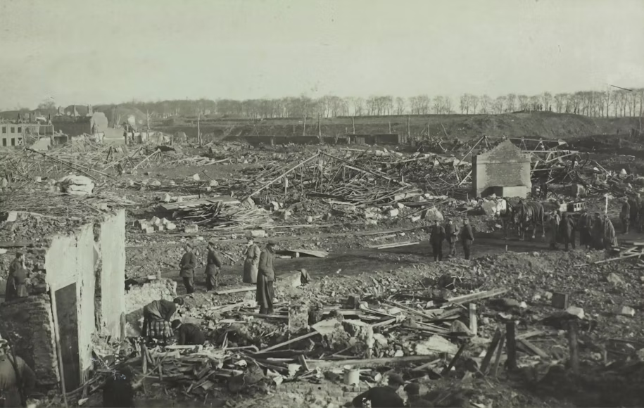
European Refugee Crisis
Widespread Displacement
  World War II caused massive displacement across Europe due to bombings, invasions, and political unrest. Refugees faced homelessness, food shortages, and persecution while fleeing their homelands.
Migration to Australia
  Australia was viewed as a hopeful destination offering safety, jobs, and a fresh start for displaced refugees. The United Nations and other organizations coordinated refugee resettlement, marking global humanitarian cooperation.
Notes:
The devastation of World War II led to widespread displacement, particularly in countries such as Greece, Italy, Poland, and Germany. Entire communities were uprooted due to bombings, invasions, and political upheaval. Refugees faced dire conditions, including homelessness, food shortages, and persecution. The push factors driving migration included the collapse of local economies, the threat of violence, and the loss of family and community structures. For many, Australia represented a distant but hopeful destination—a place where safety, employment, and a fresh start were possible. The scale of displacement was unprecedented, and international organizations, including the United Nations, began coordinating efforts to resettle refugees. Australia's willingness to participate in these efforts signaled a shift toward a more active role in global humanitarian responses.

Slide 4

Policy and Immigration Initiatives
Establishment of Immigration Department
  The 1945 creation of the Department of Immigration marked a strategic shift toward growing Australia's population for national security.
'Populate or Perish' Policy
  This slogan emphasized urgent demographic growth to ensure economic resilience and national security after the war.
Notes:
In 1945, the Australian government established the Department of Immigration, marking a significant policy shift aimed at increasing the national population. The 'Populate or Perish' slogan encapsulated the urgency of this initiative, emphasizing the need for demographic growth to ensure national security and economic resilience. Australia signed agreements with international bodies to accept displaced persons and refugees, particularly from war-torn Europe. These policies prioritized individuals who were fit for work and could contribute to Australia's post-war reconstruction. The government also implemented the Assisted Passage Scheme, which subsidized travel costs for migrants. This proactive approach laid the groundwork for a diverse influx of migrants and demonstrated Australia's commitment to humanitarian principles and national development.

Slide 5
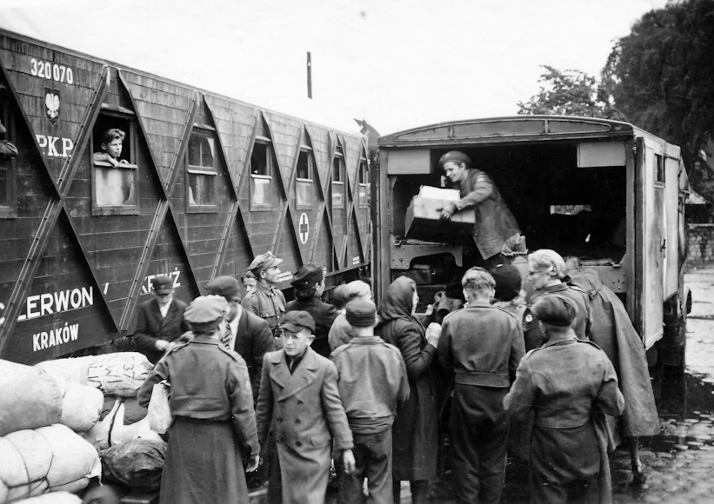
Acceptance of Displaced Persons
  Agreements prioritized displaced Europeans fit for work, aiding Australia's post-war reconstruction efforts and humanitarian goals. Government subsidized travel costs to encourage migration, fostering population diversity and economic development.

Slide 6
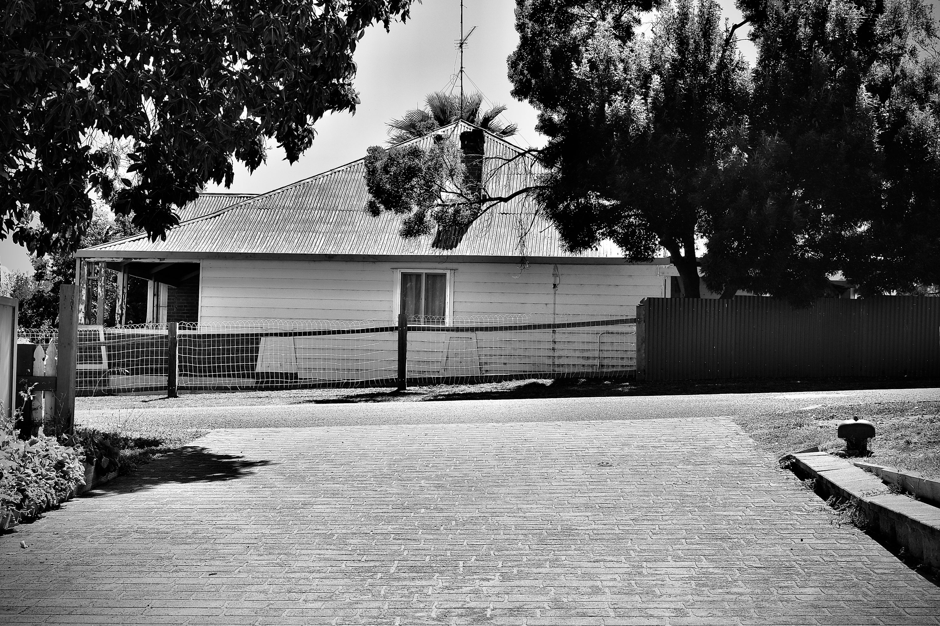
Migrant Hostels and Integration
Temporary Migrant Housing
  Migrant hostels provided temporary accommodation near jobs as refugees settled into Australia. Migrants faced language barriers, unfamiliar customs, and financial hardship during resettlement.
Support and Integration Programs
  Community networks and government programs provided language classes, job placement, and cultural orientation. Many migrants established businesses and contributed to urban communities, reflecting societal inclusivity.

Slide 7

Challenges and Community Building
Cultural Adaptation Challenges
  Migrants faced discrimination and pressure to assimilate while adapting to a new social landscape in post-WWII Australia. Learning English was essential for migrants to gain employment and integrate socially in Australian society.
Community Building Efforts
  Migrants formed tight-knit communities preserving traditions and embracing Australian life through cultural clubs and religious institutions.

Slide 8

Economic and
Social Impact
  Post-WWII migrants contributed to infrastructure, manufacturing, agriculture, and business growth, strengthening Australia's economy.
  Migrants introduced new cultural traditions, cuisines, and social practices, enriching Australia's multicultural identity. Active involvement in civic life, education, and community organizations showcased migrants' commitment to society.

Slide 9
Thank you

