Slide 1
eRideables
Knowing the law and staying safe
Year 7 - 9
D25/0693313
September 2025
Notes:
Learning intentions:
Students will:
review the laws relating to the use of eRideable devices.
Success criteria
Students can:
explain key Western Australian laws related to the use of eRideables
discuss the benefits and risks of eRideable use
apply the Safe Systems Approach to suggest improvements that enhance eRideable safety.

Slide 2
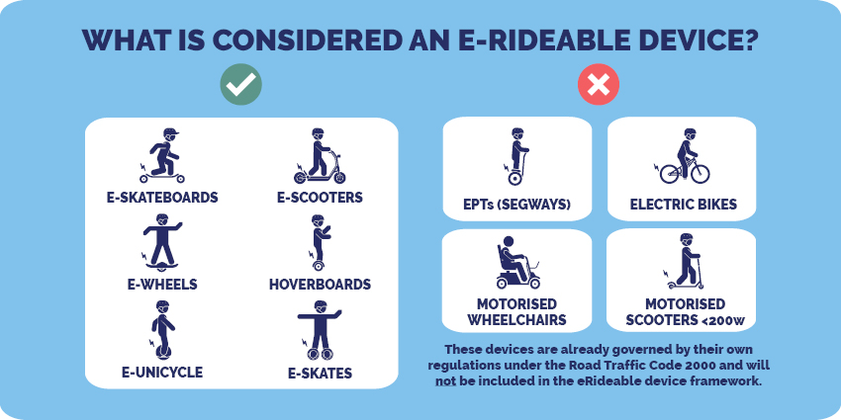
What is an eRideable?
Figure 1 Road Safety Commission
Notes:
Introduction: What do you know about eRideables?
eRideable definitions
An eRideable is an electric rideable device that:
has at least one wheel
is designed to be used by only one person
has a speed limit of 25 km/h on level ground
weighs 25 kg or less
is no more than 125 cm long, 70 cm wide and 135 cm high.
Using eRideables that do not meet these rules on WA roads and paths is prohibited.
Examples of eRideables include:
eScooters
eSkateboards
hoverboards
eSkates
eUnicycles.
Electric bikes (eBikes) are not considered eRideable devices. Under WA law, riders must be at least 16 years of age to operate an eBike if its motor is engaged.
Reference: Road Safety Commission. (2025). eRideables. Government of Western Australia Retrieved at: https://www.wa.gov.au/organisation/road-safety-commission/erideables

Slide 3
Myth or Fact?
Organise the scenarios under Myth or Fact headings
People of any age can ride an eRideable.
An eRideable can be ridden on any road.
In Western Australia, eRideables must be limited to a maximum speed of 25km/h on shared paths
and 10km/h on footpaths.
eRiders must give way to pedestrians.
A child under 16 years of age riding an eRideable can be fined.
eRiders can ride on all paths and footpaths unless marked with ‘no wheeled devices’ or a ‘no bicycle’ sign or marking.
eRiders must have lights
and reflectors when riding
at night.
Riding with a friend on the same eScooter is allowed,
as long as the person in control of the eRideable is over 16 years of age.
eRiders don’t need a helmet if they are just riding on the footpath.
An eRider can use their phone while riding so long
as they are careful.
Notes:
Introduction
To gain an understanding of what students already know about eRideable laws:
Divide the class into small groups.
Provide each group with resource sheet – Scenario cards.
Students work together to organise them under Myth or Fact headings.
Students will leave these on their desk for the lesson – as they go through the lesson, they can confirm their answers and move them to the correct headings.
MYTHS
People of any age can ride an eRideable.
eRiders don’t need a helmet if they are just riding on the footpath.
An eRideable can be ridden on any road.
Riding with a friend on the same eScooter is allowed, as long as the person in control of the eRideable is over 16 years of age.
An eRider can use their phone while riding as long as they are careful.
FACTS
A child under 16 years of age riding an eRideable can be fined.
eRiders must have lights and reflectors when riding at night.
eRiders can ride on all paths and footpaths unless marked with ‘no wheeled devices’ or a ‘no bicycle’ sign or marking.
eRiders must give way to pedestrians.
In Western Australia, eRideables must be limited to a maximum speed of 25 km/h on shared paths and 10km/h on footpaths.

Slide 4
Think – Pair – Share
Why do we have laws/rules?
Notes:
Activity 1: eRideable laws Positive, Negative, Interesting
Think, pair, share:
1. Why do we (in general) have laws.
Answers could include:
To keep people safe
To ensure justice and fairness
To maintain order and stability
To regulate behaviour.

Slide 5
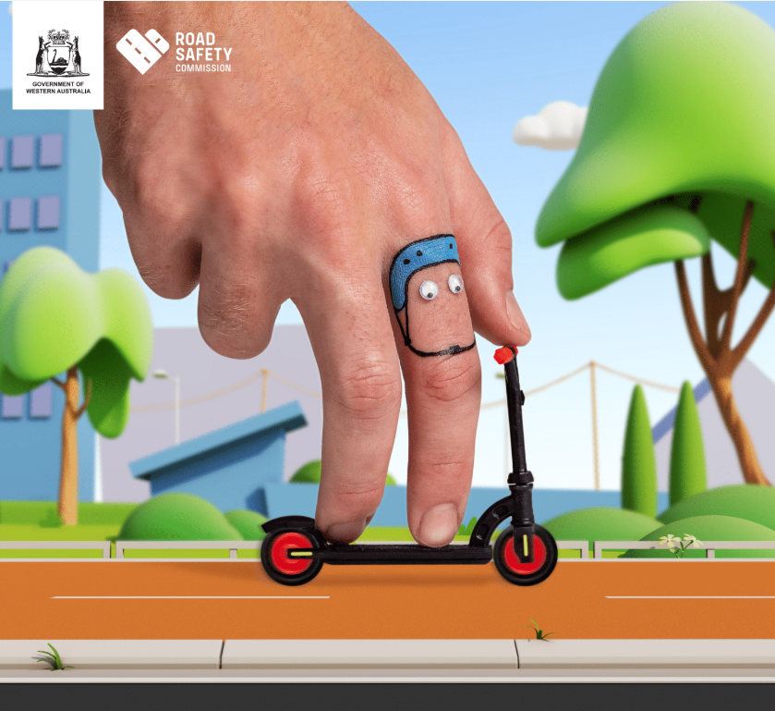
What WA eRideable laws do you know?
Figure 2 Road Safety Commission
Notes:
Activity 1: eRideable laws PNI (Positive, Negative, Interesting)
Ask students: What Western Australian laws are you aware of that people using an eRideable such as an eScooter must abide by?

Slide 6
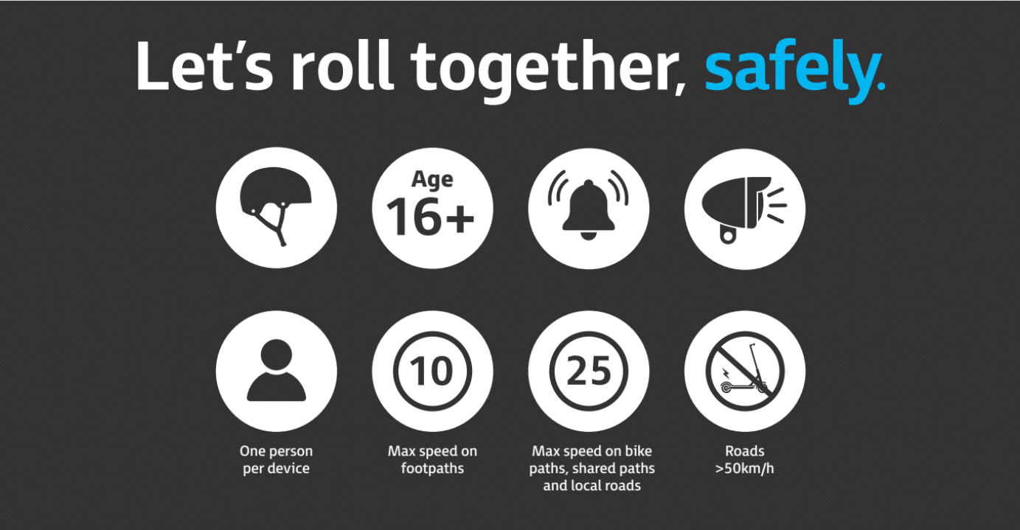
Helmet?
Age?
Allerts?
Visibility features?
Number of people?
Speed - footpath?
Speed – shared path?
Riding on roads?
Figure 3 Road Safety Commission
Notes:
Activity 1: eRideable laws PNI
Go through the 8 questions relating to eRideable laws from the ‘Let’s roll together, safely’ campaign.
Click on each of the circles and discuss the law as a class:
Helmet? Rider must be wearing a helmet
Age? Minimum age to use an eRideable is 16.
Alerts? Use a bell or verbal warning before approaching or overtaking pedestrians or other path users.
Visibility features? Use lights and reflectors when riding at night.
Number of people? There can only ever be on person on an eRideable – no passengers allowed.
Speed – footpath? On footpaths the maximum speed is 10km/hr
Speed – shared path? On shared paths the maximum speed is 25km/hr. It is never legal to go over 25km/hr on an eRideable. Question: How can you identify a shared path versus a footpath? Shared paths are clearly signed, they are generally wider, have a dividing line and red or reddish-brown colour
Riding on roads? No travel is allowed on roads with:
a dividing line
a speed limit exceeding 50km/h
more than one marked lane
Other laws:
You must not touch or use a mobile phone when on an eRideable.
eRiders are subject to the same drink and drug driving laws as motor vehicle drivers.
Optional video – eRideable laws: Watch video: eRideables - Get Streetwise, Road Safety Commission. Available at: https://streetwise.rsc.wa.gov.au/rules/erideables/
Ask students: What school rules must students follow relating to eRideables?

Slide 7
eRideable laws
Positive | Negative | Interesting
Notes:
Activity 1: eRideable laws PNI
Split the class into pairs or small groups
Provide each group with a copy of the resource sheet – PNI chart.
Students unpack the current eRideable laws by brainstorming the positive, negative and interesting implications, recording their ideas in the PNI chart. Students can visit the Road Safety Commission website to learn more about the eRideable laws.
Once completed, each group chooses one point from each section of the PNI to share with the class.

Slide 8
How aware is the local community is about eRideable laws?
1
10
Not aware
Very aware
Notes:
Activity 2: Community awareness
Awareness ranking
Ask the class: Do you think everyone in the community is aware of WA’s eRideable laws?
In pairs or small groups, students determine a rating from 1 – 10 that best describes how aware they think their local community is about eRideable laws.
Groups share their rating with the class justifying why they chose that rating.
Discuss the following questions:
How might this awareness rating differ across different age groups or types of communities?
What could be done to increase awareness of the laws and safety recommendations?

Slide 9
Campaign analysis
  In groups analyse your eRideable campaign and summarise:
  the message of the campaign/initiative
  the target audience
  the strategies used to deliver the message
  recommendations to improve appeal and impact for young people.
Notes:
Form small groups and allocate each a campaign asset or community awareness resource to analyse. The Road Safety Commission have a range of campaign assets including social media tiles and banners, flyers, posters and videos to choose from - https://www.wa.gov.au/government/document-collections/erideable-resources.
After reviewing the campaign, groups discuss the strategies that were used to deliver the road safety message and summarise:
the message of the campaign/initiative
the target audience
the strategies used to deliver the message
recommendations to improve appeal and impact for young people.
Once completed, groups share their thoughts and findings with the class.

Slide 10
Myth
Fact
People of any age can ride an eRideable.
A child under 16 years of age riding an eRideable can be fined.
Riding with a friend on the same eScooter is allowed, as long as the person in control of the eRideable is over 16 years of age.
eRiders can ride on all paths
and footpaths unless marked
with ‘no wheeled devices’ or
a ‘no bicycle’ sign or marking.
An eRider can use their phone while riding so long as they are careful.
In Western Australia, eRideables must be limited to a maximum speed of 25 km/h on shared paths and 10km/h on footpaths.
eRiders don’t need a helmet
if they are just riding on the footpath.
eRiders must have lights and reflectors when riding at night.
An eRideable can be ridden
on any road.
eRiders must give way to pedestrians.
Notes:
Review and assess What do you know about eRideables reflection
Display the myths and facts from the introduction activity.
Ask the students to review their responses from the beginning of the lesson and move any cards that need correcting to the right column.
MYTHS
People of any age can ride an eRideable. – Must be over 16
eRiders don’t need a helmet if they are just riding on the footpath. – eRiders must always wear a helmet
An eRideable can be ridden on any road. – No travel is allowed on roads with a dividing line, a speed limit exceeding 50km/h, more than one marked lane
Riding with a friend on the same eScooter is allowed, as long as the person in control of the eRideable is over 16 years of age. – There can only ever be on person on an eRideable – no passengers allowed.
An eRider can use their phone while riding as long as they are careful. – Because WA classifies eRideables as vehicles, other rules that apply to all vehicle drivers and riders (such as drink driving rules, mobile phone use) also apply to eRideable users.
FACTS
A child under 16 years of age riding an eRideable can be fined. – For more information on penalties: https://streetwise.rsc.wa.gov.au/rules/erideables/
eRiders must have lights and reflectors when riding at night. – eRiders must have lights and reflectors when riding at night
eRiders can ride on all paths and footpaths unless marked with ‘no wheeled devices’ or a ‘no bicycle’ sign or marking.
eRiders must give way to pedestrians.
In Western Australia, eRideables must be limited to a maximum speed of 25 km/h on shared paths and 10km/h on footpaths.

Slide 11
Stay safe!

Slide 12
References
Figure 1: Road Safety Commission, eRideable resources, What is considered an eRideable device. Retrieved from: https://www.wa.gov.au/media/27290
Figure 2: Road Safety Commission, eRideable resources, Let’s roll together, safely. Retrieved from: https://www.wa.gov.au/media/50596
Figure 3: Road Safety Commission, eRideable resources, Let’s roll together, safely. Retrieved from: https://www.wa.gov.au/media/50596

