Slide 1
eRideables
Safe and respectful eRideable use
Year 10 - 12
D25/0693310
September 2025
Notes:
Learning intentions:
Students will:
review the laws relating to the use of eRideable devices.
Learning intentions:
Students can:
explain key Western Australian laws related to the use of eRideables
discuss the benefits and risks of eRideable use
apply the Safe Systems Approach to suggest improvements that enhance eRideable safety.

Slide 2
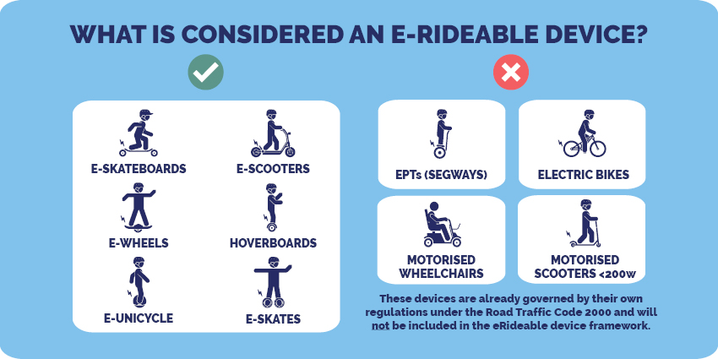
What is an eRideable?
Figure 1, Road Safety Commission
Notes:
Introduction What do you know continuum
eRideable definitions
An eRideable is an electric rideable device that:
has at least one wheel
is designed to be used by only one person
has a speed limit of 25 km/h on level ground
weighs 25 kg or less
is no more than 125 cm long, 70 cm wide and 135 cm high.
Using eRideables that don’t meet these rules on WA roads and paths is prohibited.
Examples of eRideables include:
eScooters
eSkateboards
hoverboards
eSkates
eUnicycles.
Electric bikes (eBikes) are not considered eRideable devices. Under WA law, riders must be at least 16 years of age to operate an eBike if its motor is engaged.
Reference: Road Safety Commission. (2025). eRideables. Government of Western Australia Retrieved at: eRideables

Slide 3
eRideable laws
True
Unsure
False
Notes:
Introduction What do you know continuum
Read out the range of laws and myths listed below and ask students stand on the continuum from true, false and unsure.
Laws and myths:
Anyone can ride an eRideable in WA, regardless of your age. – False, you must be over 16.
In Western Australia, eRideables must be limited to a maximum speed of 25 km/h on shared paths and 10km/h on footpaths. – True
Wearing a helmet is mandatory when riding an eRideable in WA. – True
It is legal to use an eRideable on all roads as long as you keep left. – False, you cannot ride on roads with a dividing line or roads where the speed limit is more than 50km/h
You do not need lights or reflectors when riding an E-Rideable at night in WA. – False, eRiders must have lights and reflectors when riding at night

Slide 4
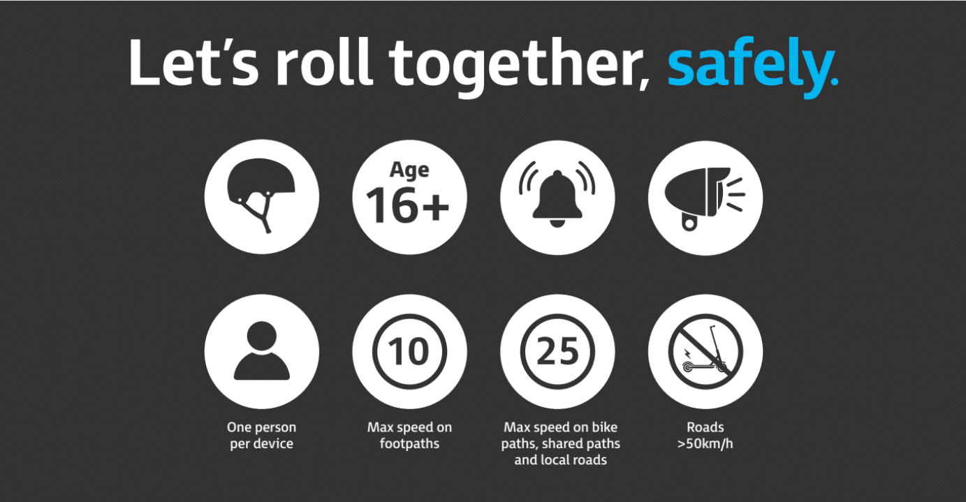
Helmet?
Age?
Allerts?
Visibility features?
Number of people?
Speed - footpath?
Speed – shared path?
Riding on roads?
Figure 2 Road Safety Commission
Notes:
Activity 1: eRideable laws PNI
Go through the 8 questions relating to eRideable laws from the ‘Let’s roll together, safely’ campaign.
Click on each of the circles and discuss the law as a class:
Helmet? Rider must be wearing a helmet.
Age? Minimum age to use an eRideable is 16.
Alerts? Use a bell or verbal warning before approaching or overtaking pedestrians or other path users.
Visibility features? Use lights and reflectors when riding at night.
Number of people? There can only ever be on person on an eRideable – no passengers allowed.
Speed – footpath? On footpaths the maximum speed is 10km/hr.
Speed – shared path? On shared paths the maximum speed is 25km/hr. It is never legal to go over 25km/hr on an eRideable.
Question: How can you identify a shared path versus a footpath?
Shared paths are clearly signed, they are generally wider, have a dividing line and red or reddish-brown colour.
Riding on roads? No travel is allowed on roads with:
a dividing line
a speed limit exceeding 50km/h
more than one marked lane.
Other laws:
You must not touch or use a mobile phone when on an eRideable.
eRiders are subject to the same drink and drug driving laws as motor vehicle drivers.
Optional video – eRideable laws: Watch video: eRideables - Get Streetwise, Road Safety Commission. Available at: https://streetwise.rsc.wa.gov.au/rules/erideables/
Ask students: What school rules must students follow relating to eRideables?

Slide 5
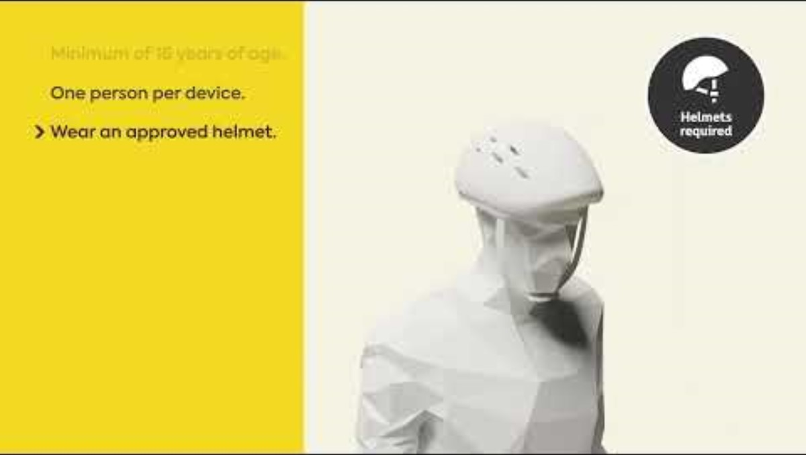
eRideable laws
Notes:
Optional video – eRideable laws
To further students understanding of eRideable laws:
Watch video: eRideables - Get Streetwise, Road Safety Commission. Available at: https://streetwise.rsc.wa.gov.au/rules/erideables/
Look at the penalties related to eRideables https://streetwise.rsc.wa.gov.au/rules/erideables/

Slide 6
eRideable laws
When used responsibly and in accordance with Western Australia's road laws, eRideables offer are several benefits however there are also risks that it is important to for eRiders to consider.
eRideables
Benefits | Costs/risks
When considering costs/risk, think broadly not just the eRiders themselves.
Notes:
Activity 1 Benefits vs costs
Divide the class into pairs or small groups.
Allocate each group resource sheet – Benefits and Costs.
When considering costs/risk, encourage students to think broadly not just the eRiders.
Ask groups to share 1 benefit and 1 cost/risk with the class.
Teacher consolidates ideas on the board.
Benefits - answers could include:
More environmentally friendly than cars
Supports active travel
May reduce the number of cars on the road
More affordable than cars
Improve accessibility.
Costs/risk answers could include:
Risk of injury or death: Between 1 January 2017 and 30 June 2024 there were 4 deaths and 287 injuries related to eRideables, with an average length of stay in hospital of 3 days. Males accounted for 80% of all injuries. eRideable related injuries were most common among those aged 30- 39 years (23%), followed by those aged 10-19 years (22%) (WA State Trauma Unit, 2025).
Safety risks for other road users such as pedestrians.
Non-compliance with rules and use of noncompliant devices: eRiders can be fined up to $500 for not following eRideable laws. Nearly half of injured riders in one study were intoxicated at the time of the crash and there was a high proportion of head injuries due to non-helmet use (Road Safety Commission, 2025).
Fire risk – there have been cases of the lithium battery in eRideables exploding/catching on fire (Department of Transport, 2025).

Slide 7
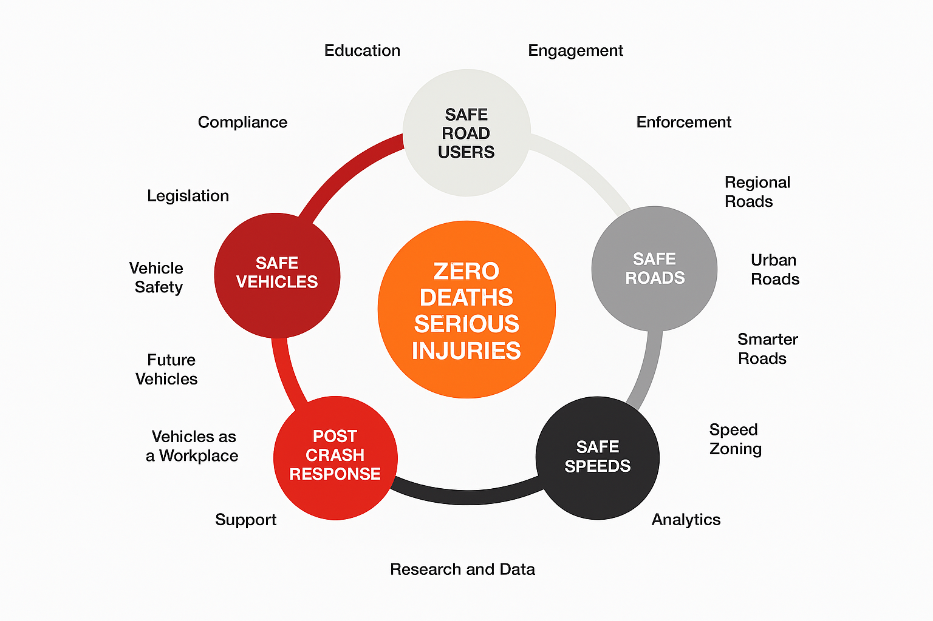
WA’s Driving Change Strategy
Figure 3, Road Safety Commission
Notes:
Activity 2 Safe System Approach
WA’s Driving Change Road Safety Strategy is informed by the internationally recognised Safe System Approach.
These priorities underline a holistic view of the road system and the interactions between each priority area. It recognises that people will always make mistakes and may have road crashes, but those crashes should not result in death or serious injury. This strategy can be applied to increasing the safety of eRiders and all other road users.
The strategy is split into 5 priority areas:
Safe Road Users: Encourage safe, responsible driving and behaviour by people who use our roads and create conditions that prioritise their ability to reach their destination unharmed.
Safe Roads: Design roadway environments to reduce human mistakes and account for mistakes, to encourage safer behaviours, and to facilitate safe travel by the most vulnerable users.
Safe Vehicles: improve vehicle systems and features that help to prevent crashes and minimise the impact of crashes on both occupants and non-occupants.
Safe Speeds: Promote safer speeds in all roadway environments, appropriate speed-limits, targeted education, community education and enforcement.
Post-Crash Response: improve the survivability of crashes through faster access to emergency medical care.
Reference: Government of Western Australia (2020) Driving Change, Road Safety Strategy for Western Australia 2020 – 2030 – available at - https://www.wa.gov.au/system/files/2021-07/Driving-Change-Road-Safety-Strategy-2020_2.pdf

Slide 8
WA’s Driving change strategy
For this activity we will focus on the first 4 priority areas of the Safe Systems Approach and consider how the priority area can be applied to increase the safety of eRiders.
Safe roads
Safe road users
Safe speeds
Safe vehicles
Consider infrastructure such as paths and roads
Consider eRider behaviours
Consider the speeds allowed in different environments
Consider the design of eRideables – what could improve safety of riders?
Notes:
Activity 2 Safe System Approach
Split the class into groups, allocate each group one of the first 4 priority areas from WA’s Driving Change Road Safety Strategy.
Using resource sheet – Safe System Approach, groups answer the following questions:
What are the objectives of the priority area?
How does it relate to eRideable use?
What is one improvement that could be made in my town, suburb, city or state to help keep eRiders safe?
Groups present their improvement to the class.

Slide 9
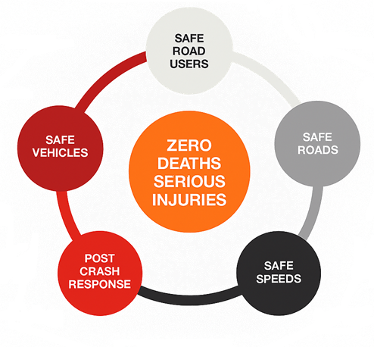
Which priority area could students at an individual level have the most impact on?
Safe and considerate eRiders:
Follow all WA laws
Dismount in high traffic areas
Use lights and reflectors at night
Give way to pedestrians
Keep left unless overtaking
Use a bell or verbal warning when approaching pedestrians
Keep 2 hands on the device
Ride single file
Ride to the conditions.
Notes:
Reflect and assess How can I make a difference?
Ask the class: Which priority area could all people at an individual level have the most impact on? Expected answer - Safe road users (Click for animation).
As a class discuss what all eRiders can do to be a safe and considerate riders? (Click for example responses)

Slide 10
Safe riding

Slide 11
References
Figure 1: Road Safety Commission, eRideable resources, What is considered an eRideable device. Retrieved from: https://www.wa.gov.au/media/27290
Figure 2: Road Safety Commission, eRideable resources, Let’s roll together, safely. Retrieved from: https://www.wa.gov.au/media/50596
Figure 3: Government of Western Australia (2020) Driving Change, Road Safety Strategy for Western Australia 2020 – 2030. Retrieved from: https://www.wa.gov.au/system/files/2021-07/Driving-Change-Road-Safety-Strategy-2020_2.pdf
Australian Medical Association WA. (2025). Submission to the Inquiry into eRideables Retrieved at https://www.amawa.com.au/news/ama-wa-has-its-say-on-erideables/
Department of Transport. (2025). Electric Rideable Device Storing and Charging: A Guide for Government Tenancies. Government of Western Australia. Retrieved from: https://www.transport.wa.gov.au/getmedia/671044e1-e382-47ae-8058-7a7394094547/TI_P_ElectricRideableDeviceStoringandCharging.pdf
Government of Western Australia (2020) Driving Change, Road Safety Strategy for Western Australia 2020 – 2030. Retrieved from: https://www.wa.gov.au/system/files/2021-07/Driving-Change-Road-Safety-Strategy-2020_2.pdf
Road Safety Commission. (2025). Review of the eRideable Road Rules. Retrieved from: https://www.wa.gov.au/system/files/2025-05/rsc433_erideable_report_may_2025.pdf
WA State Trauma Unit. (2025). Royal Perth Hospital Trauma Registry. Perth. [cited 4 July 2025)

