Slide 1
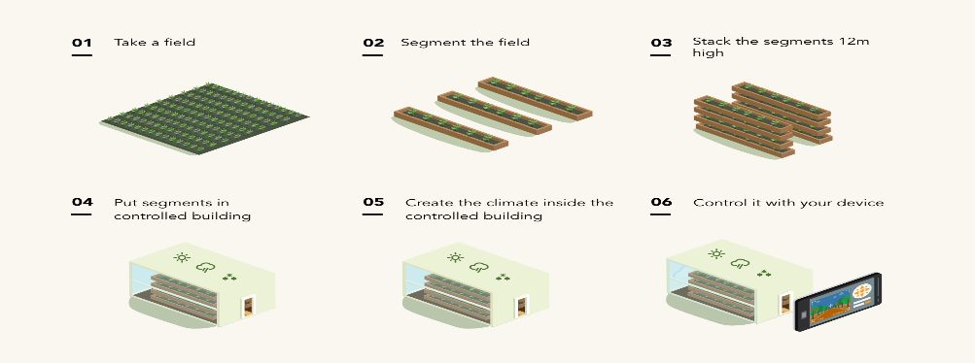
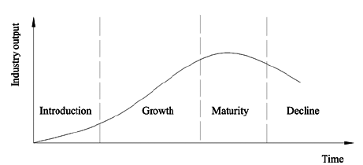
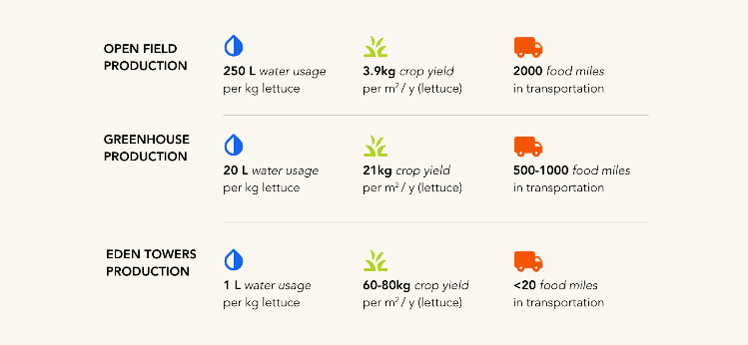
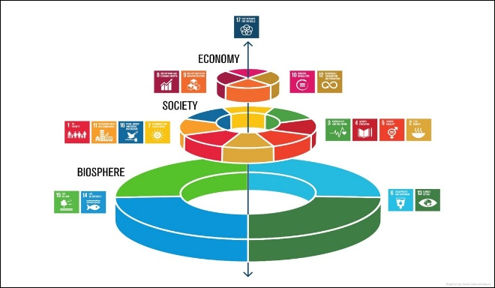
BUSINESS CASE STUDY
Industry life cycle model
Image 1.2
Technology
- Internet of things - Artificial intelligence - Robots - renewable energy sources -
Climate control
Movement of growing trays
Administering, scheduling and monitoring nutrients
Less water required
Image 1.1
Image 1.3
Inputs | Electricity, robots, software, computers, water, labour, coconut fibre, mineral nutrients, seeds, stainless steel trays, LED lights
Processes | seeding germinating growing harvesting packaging
Outputs | Leafy greens Micro herbs
Global links
Intelligent Growth Solutions Scotland
World class research and development
ESG and UNSDG frameworks
Media links | Web links
Farm Weekly Asia Fruit Green Biz (Intelligent growth Solutions) | Eden Towers Birchal Eden Towers - Future of Farming
The future
New products – strawberries, chillies, edible flowers
New locations – East coast, Asia – Singapore, Jakarta
New customers – restaurants, national supermarket chains
Reduced energy consumption
Increased production
Peel Food Zone
Benefits
Air locked = no pests, no weeds, no toxins
No chemicals used
Less water required (1L/kg of produce) 98% less than traditional methods
Increased productivity: 15x more efficient
Reduced carbon footprint, zero food miles
Biosecurity controls
Improved taste and nutrition
Local, fresh, healthy
Image 1.4
The State of Food Security And Nutrition in the World 2020
Image 1.6
Image 1.5

Slide 2
Acknowledgements
References
Tracey, Millie (9 June 2021) ‘Vertical thinking when it comes to growing’ Farm Weekly available at <https://www.farmweekly.com.au/story/7287708/vertical-thinking-when-it-comes-to-growing/> accessed 27 July 2021
Komorek, Chris (2 June 2021) ‘Eden Towers target expansion’ Asia Fruit available at <http://www.fruitnet.com/asiafruit/article/185403/eden-towers-targets-expansion> accessed 27 June 2021
Klein, Jesse (20 July 2021) ‘Meet one vertical farm venture helping the industry grow past greens’ Greenbiz available at <https://www.greenbiz.com/article/meet-one-vertical-farm-venture-helping-industry-grow-past-greens> accessed 10 August 2021
Eden Towers (n.d) ‘Our Farms’ available at <https://www.edentowers.life/pages/our-farms> accessed 10 August 2021
Birchal (n.d) ‘Amazing Fresh Now – Vertical Farming sustainable produce’ available at <https://www.birchal.com/company/edentowers> accessed 10 August 2021
Christian Proskscha (1 June 2021) ‘Eden Towers – Future of Farming’ available at <https://www.youtube.com/watch?app=desktop&v=R8pK_hkSPCQ&feature=youtu.be> accessed 10 August 2021
Images
Image 1.1 Supplied courtesy of Christian Proskscha, founder of Eden Towers
Image 1.2 Supplied courtesy of Christian Proskscha, founder of Eden Towers
Image 1.3 Tonči Mikack (2018) ‘Industry cycle model’ All rights reserved, available at: <https://www.researchgate.net/figure/Industry-life-cycle-model_fig1_258518402> accessed 10 August 2021
Image 1.4 Supplied courtesy of Christian Proskscha, founder of Eden Towers
Image 1.5 Supplied courtesy of Christian Proskscha, founder of Eden Towers
Image 1.6 ‘Biosphere – Society – Economy’ by Azote Images for Stockholm Resilience Centre, Stockholm University. Accessed at <https://www.stockholmresilience.org/research/research-news/2016-06-14-how-food-connects-all-the-sdgs.html>​ accessed 10 August 2021

