Slide 1
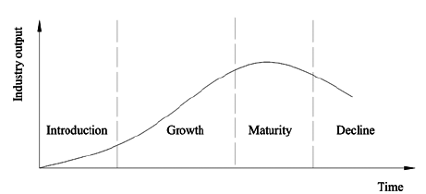
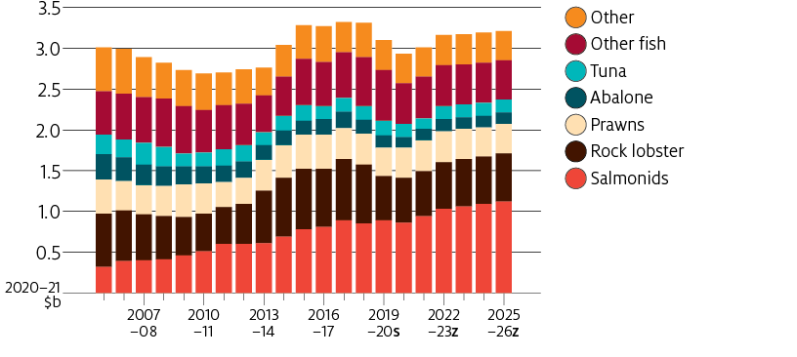
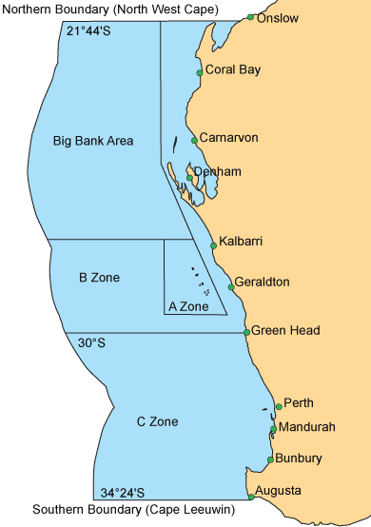
HISTORY
Pre 1950: Individual fishermen, small group of factories, lobster were canned and exported (USA biggest market)
1949-1951: Suggestion and implementation of a northern cooperative.
1951: First ‘Brolos’ brand was processed, product shifted from canned to tails.
1952: Geraldton Fishermen’s Co-operative (GFC) was one of ten processors in WA. GFC starts providing a variety of services to members. Continued to develop products for US market.
1954-1955: GFC investigate Asian markets
1960s: GFC continued to research, diversify and adapt the industry
1979: (March) HRH the Prince of Wales officially opened GFC’s new premises
1984: Live export research begins
1990s: Markets in Taiwan and Beijing established
2000s: Western Rock Lobster fishery certified by the Marine Stewardship Council (MSC); new product lines developed; market share increases from 19% to 60%; demand in Western Europe grows and live sales to China increases
2015: GFC China launched
2017: $23m Welshpool live lobster facility commissioned.
BUSINESS CASE STUDY
Geraldton Fishermen’s Co-operative
BROLOS
Industry life cycle model
Australian fisheries and aquaculture production values
Image 2.1
Global links
Export markets
International recognition of MSC
Research and development
Image 2.2
Commercial rock lobster fishing zones
Inputs -> | Processes | -> Outputs
Boats Pots Fuel Equipment Trailers Storage Bait Servicing and mainten-ance of boats | Receival points Processing facilities Transport networks | Whole cooked Whole raw Raw tails Live lobsters
Future
Impact of COVID-19 and trade sanctions from China = new markets required.
Back of boat sales
Analysis of data
Adjustment of quotas
Tourism related activities
Image 2.3
Other Lobster exporters: Bluwave, Fremantle Lobster, Indian Ocean Rock Lobster, KB Food Co. Lobster Alive.
https://www.westernrocklobster.org/

Slide 2
Acknowledgements
References
Brolos (n.d) ‘Geraldton Fisherman’s Co-operative’ available at: <https://brolos.com.au/> accessed 27 July 2021
Western Rock Lobster (n.d) ‘World Leading Sustainable Fishery’ available at: <https://www.westernrocklobster.org/> accessed 27 July 2021
Images
2.1 Tonči Mikack (2018) ‘Industry cycle model’ All rights reserved, available at: <https://www.researchgate.net/figure/Industry-life-cycle-model_fig1_258518402> accessed 10 August 2021
2.2. Department of Agriculture, Water and the Environment (n.d) 'March 2021 Fish Aqua' available at: <https://www.agriculture.gov.au/sites/default/files/images/mar-2021_fish-aqua_1-01.png > accessed 10 August 2021
2.3 Western Rock Lobster (n.d) ‘Map of the fishery’ © Western Rock Lobster Council 2021, available at: <https://www.westernrocklobster.org/the-western-rock-lobster/map-of-the-fishery/>accessed 10 August 2021

