Slide 1
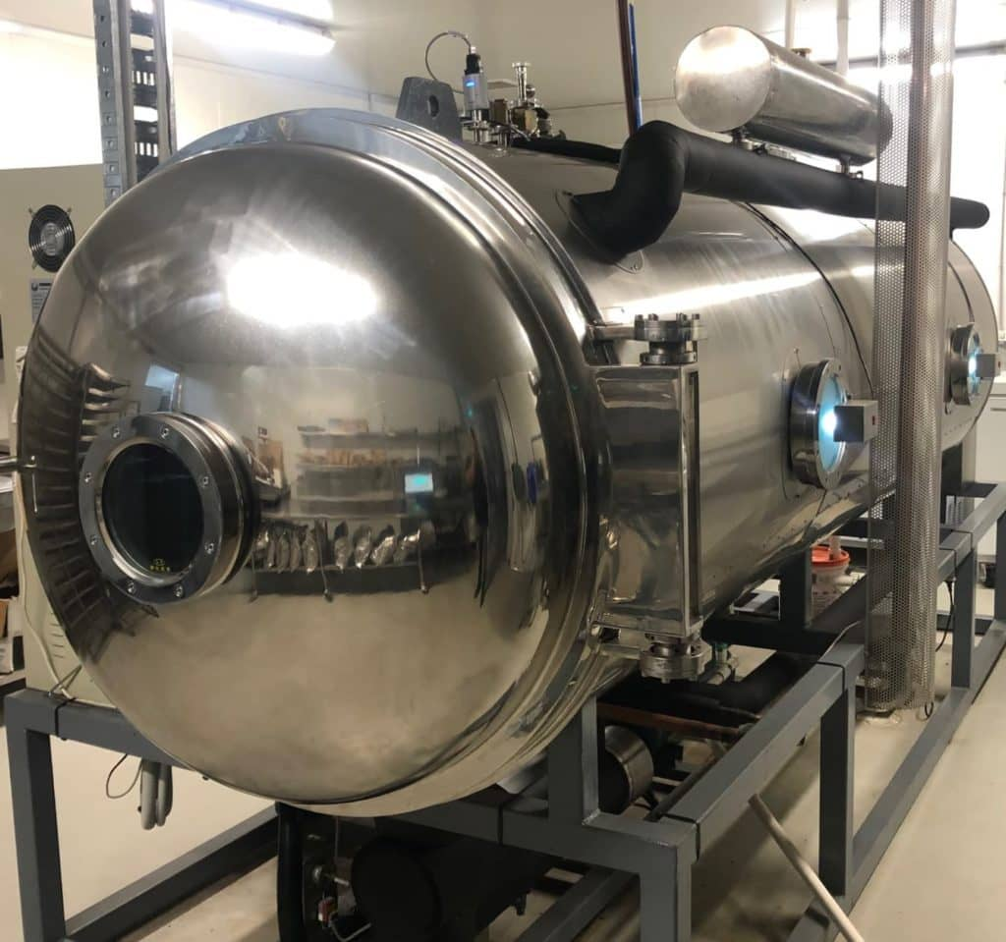
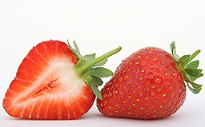
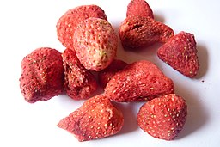
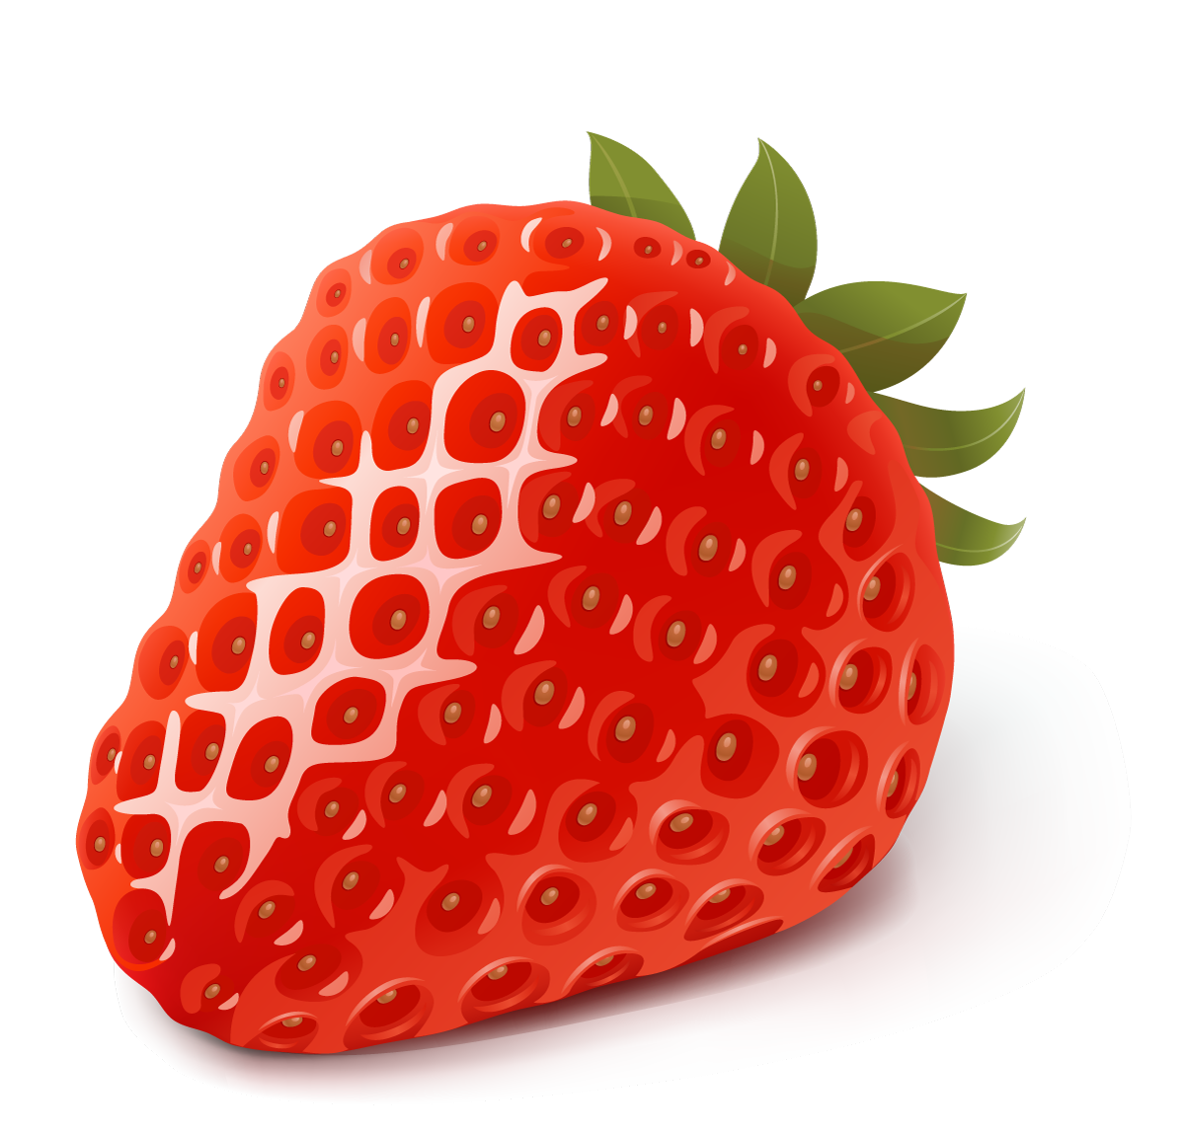
History
Pre 1991: Neil Handasyde worked on family farm
1991: Neil purchased a strawberry farm in King River area.
2018: Lyn and Neil purchased current farm on Chester pass Road
BUSINESS CASE STUDY
Handasydes Strawberries
Background information
Neil is a fourth-generation farmer with a passion for producing high quality, delicious fresh produce. While strawberries are their bread and butter, Neil and his wife Lyn also produce raspberries, passionfruit, and eggs. In an effort to reduce wastage, decrease food mileage and provide great value, they produce a range of gelato, sorbet, sauces, syrups, jams and preserves. Having also invested in freeze drying technology, they have created a range of freeze dried strawberries that maintain their intensity of flavour and colour long term.
https://www.agric.wa.gov.au/capability-guides
Handasydes Strawberries increase productivity by producing
Homemade jams, syrups and sauces
Farm fresh eggs
Fresh honey
Freeze dried fruits
Gelato and sorbet
And offering …
Coffee
Meals and snacks
Space to relax
A playground for kids
Berry farming
Inputs | Sunshine, soil, water, strawberry plants (runners), plastic sheets, paint scraper (for planting), irrigation system, plastic tunnels, cooling facilities
Processes | Soil preparation, planting, pruning and cutting, raking leaves, weed control, harvesting, grading, packing, transporting to market
Outputs | Fresh strawberries, Youngberries, loganberries
The future of strawberry production
Breeding of new varieties
Growing in substrate under controlled environments.
Totally impermeable film to improve retention of fumigants
Automated technologies aid with harvest
Extending the shelf life of strawberries
Investigating new markets
Blockchain data and mobile apps
Strawberry innovation
Technology
To increase productivity and reduce waste, Handasydes Strawberries freeze dry B grade strawberries to create alternative products.
Image 3.1
Image 3.2
Image 3.3

Slide 2
Acknowledgements
References
Department of Primary Industries and Regional Development (19 August 2021) ‘Food and Beverage Capability Guides’ available at: <https://www.agric.wa.gov.au/capability-guides> accessed 31 August 2021
Strawberry Innovation (n.d) ‘New technology in strawberry production’ available at: <https://www.horticulture.com.au/globalassets/hort-innovation/resource-assets/bs15002-new-technology-in-strawberry-production.pdf#page=1&zoom=auto,-274,848> [PDF 539 kB] accessed 31 August
Images
Image 3.1 Shutterbug (n.d) Pixabay License For free commercial use ‘Strawberries’ available at: <https://pixabay.com/fi/photos/marja-ruokaa-tuoreena-hedelmi%c3%a4-1239306/> accessed 31 August 2021
Image 3.2 Savant-fou (26 April 2021) CC-BY-SA-3.0, CC-BY-SA-2.5, CC-BY-SA-2.0, CC-BY-SA-1.0 ‘Astronaut Strawberries’ available at: <
https://commons.wikimedia.org/wiki/File:Astronaut_Strawberries_6.jpg> accessed 31 August 2021
Image 3.3 Handasydes (n.d) ©Handysides 2021 ‘Freeze Drying’ available at: <https://handasydestrawberries.com.au/freeze-drying/> ©Handysides 2021 accessed 31 August 2021

