Slide 1
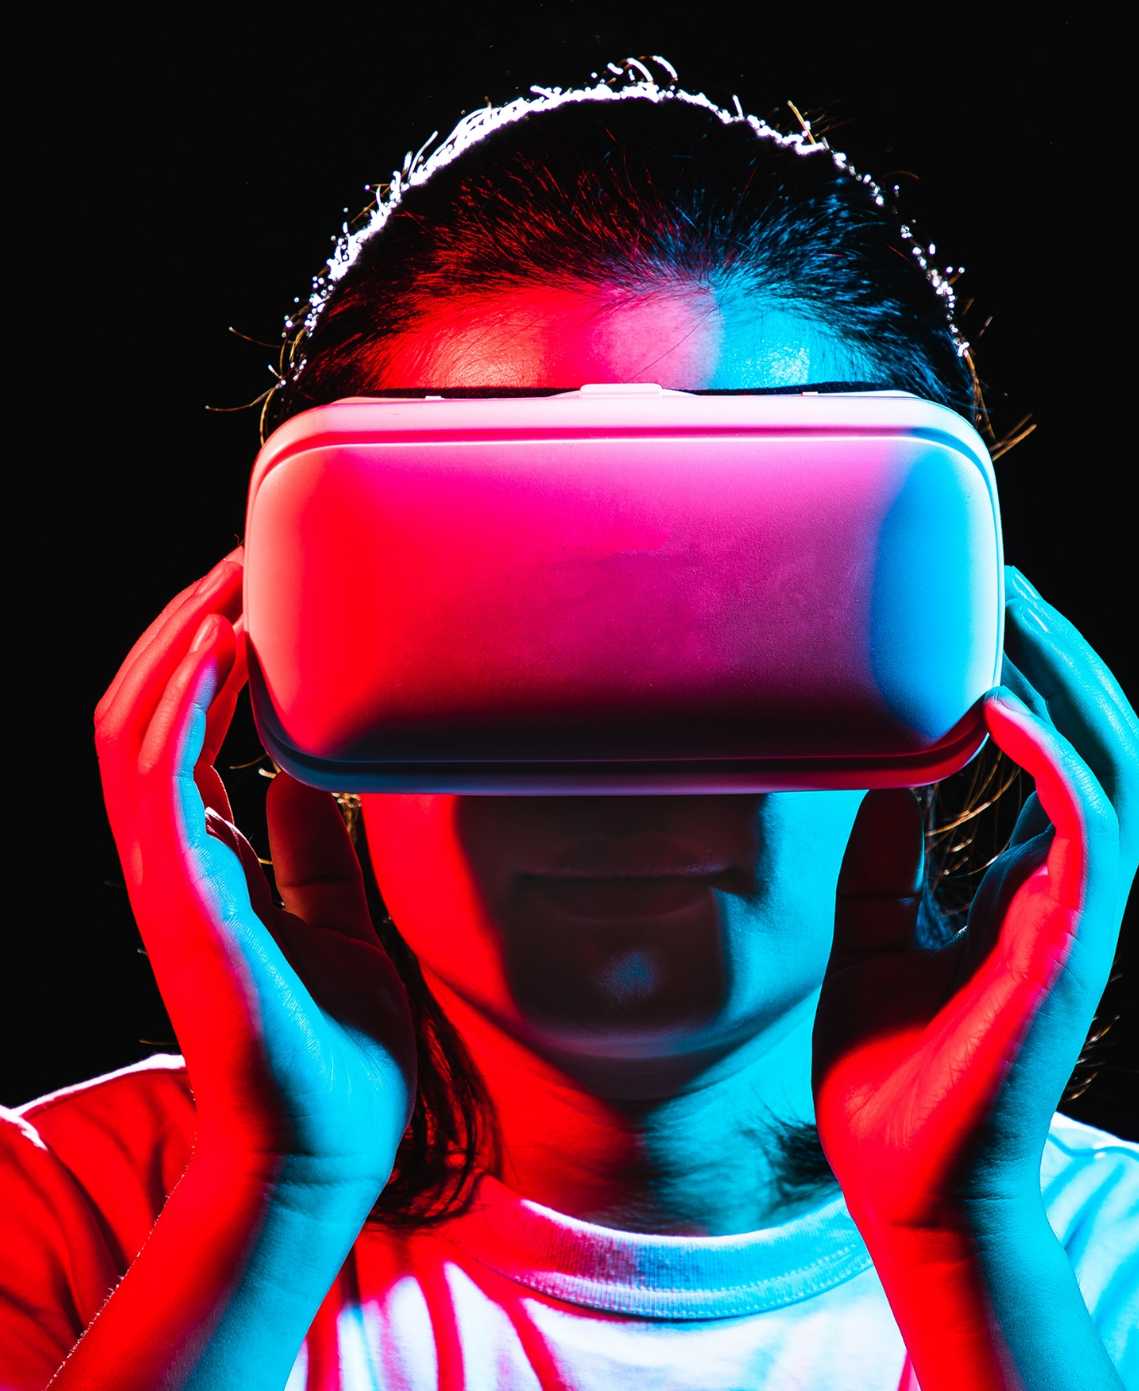

WA Virtual Education (WAVE) Project
Instructions for students
Alcohol and other Drug Education
Road Safety and Drug Education branch
TRIM Number
DD Month YYYY

Slide 2
What to expect during the lesson…
This is a seated experience.
You can look around in every direction, but the entire experience is forward facing.
If you feel sick or dizzy, take the goggles off and raise your hand.
Make sure the area around you is clear of any obstructions. Take care of the equipment - they are fragile and expensive.

Slide 3
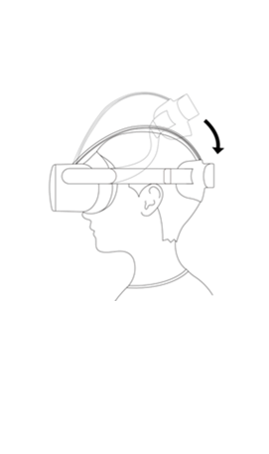
VR Instructions: wait for all instructions before starting
Step 1: Putting the headset on
Place the goggles on your eyes first (whatever way you face the goggles when setting up is the direction the experience will face)
If you have glasses, the goggles will fit over the top
Adjust the straps around your head so it sits snugly, without feeling tight or uncomfortable

Slide 4
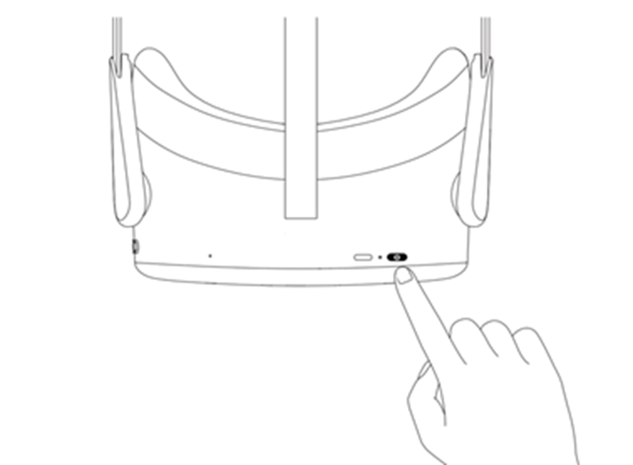
Set-up instructions: With the VR goggles on your head
Step 2: Turn on the VR headset
Turn on VR headset by holding down the power button.
Once on, you will see a ‘Pico’ logo.
This may be blurry, wait for the next screen then adjust the position of the headset on your head through tightening/ loosening.

Slide 5
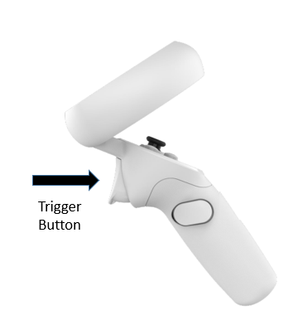
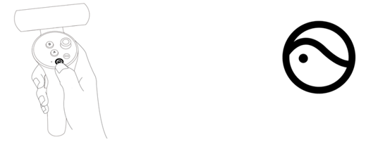
Set-up instructions: With the VR goggles on your head
Step 3: Turn on the controllers
Power on the controllers by pressing the HOME button for 1 second until the status indicator flashes blue and you feel a vibration.
Once on, you will see a laser coming from the hands.
The trigger button is the only button needed for the experience.
HOME button
Trigger button
Hold it for 1 second until it flashes blue.

Slide 6
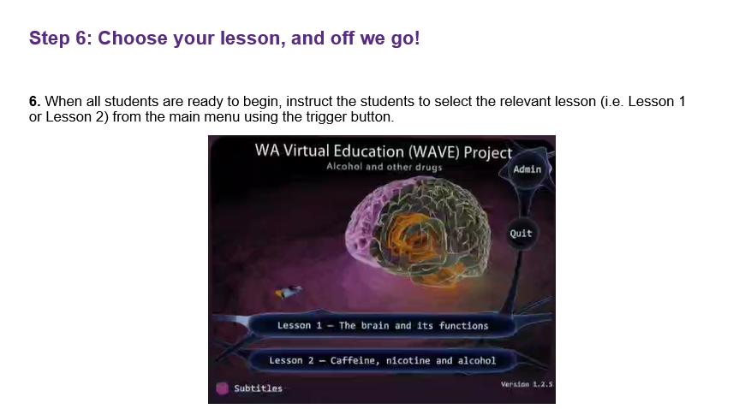
Set-up instructions: With the VR goggles on your head
Step 4: Choose your lesson
On the flash screen, click the lesson your teacher instructs you to choose.

Slide 7
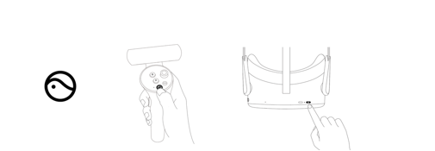
At the end of the lesson
(After completing the in-VR survey and submitting your responses)
Turn off the equipment by pressing and holding each of the controllers HOME button for 5 seconds - it will vibrate and the light will turn red.
Place them back in your case.

