Slide 1
Defence Industry
Skills, pathways and careers
D24/0472719
July 2024
Notes:
Use this PowerPoint in conjunction with the defence industry pathways worksheet, found on Education Resources.
Use this worksheet/activity with Years 10-12

Slide 2
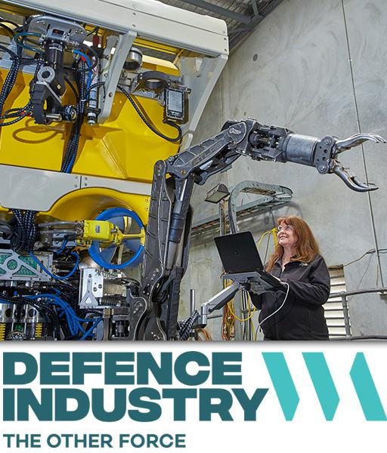
What is Defence Industry?
“The private-sector businesses that employ people who develop and produce the products, services, and technology the Australian Defence Force require.”
Notes:
Ask students if they know the definition of ‘defence industry’ (then write down the definition in the worksheet)
When people hear the term "Defence Industry", they often think it refers to the Defence Forces (the navy, the army, or the air force).
However, it is important to the recognise that the Defence Industry is not the Australian Defence Force.
The Defence Industry is defined as the private-sector businesses that employ people who develop and produce the products, services, and technology the Australian Defence Force require.
As the Western Australian Defence sector grows, it will generate new jobs that require thousands of highly qualified and skilled work.

Slide 3
What types of jobs are related to defence industry?
Key trades areas include:
structural steel & welding
metal fitter & machinists
industrial riggers & scaffolders
electricians.
Additional occupations include those associated with engineering, vehicles, equipment, AI, robotics and IT.
Notes:
Ask students what types of jobs they think are related to defence industry, knowing and thinking about the definition.
Transfer the additional occupations to their worksheet (next page) – the next slide covers the trade name / job description table.

Slide 4
Match the key trade areas to what they do
automotive electricians; construction riggers; electricians; electricians (special class); metal fitters and machinists; scaffolders; structural steel and welding trades workers
Trade area | Job description
 | cut, shape, join and repair metal components of iron and steel structures, boilers, pressure vessels and pipes, ships and other vessels.
 | fit and assemble fabricated metal parts into products, set up machining tools, production machines and textile machines, and operate machining tools and machines to shape metal stock and castings.
 | erect and dismantle scaffolding to provide work platforms on building and industrial sites, and for temporary structures such as staging and seating.
 | assemble and install rigging gear, such as cables, ropes, pulleys and winches, to lift, lower, move and position equipment, structural steel, and other heavy objects.
 | design, assemble, install, test, commission, diagnose, maintain and repair electrical networks, systems, circuits, equipment, components, appliances and facilities for industrial, commercial and domestic purposes, and service and repair lifts, escalators and related equipment.
 | install, maintain and repair electrical wiring and electronic components in motor vehicles.
 | service and repair intricate and complex electrical and electronic circuitry.
Structural steel and welding
Metal fitters and machinists
Scaffolders
Construction riggers
Electricians
Automotive electricians
Electricians (special class)
Notes:
Each click will reveal the matching trade area.

Slide 5
Notes:
Ask students what they noticed while watching.

Slide 6
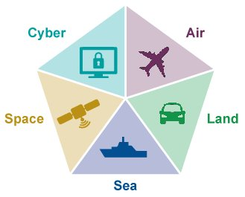
The 5 domains of the defence industry
WA is home to around 200 businesses involved in developing, maintaining, supporting and implementing cutting edge technology, infrastructure and assets across the five defence domains.
Each domain offers a range of jobs across trade, paraprofessional and professional roles
Skills, knowledge and experiences can be transferrable across domains, expanding career options and opportunities.
https://theotherforce.wa.gov.au/was-defence-industry
Notes:
Paraprofessional: a person trained to assist a professional, but not licensed or fully trained to practice in the profession

Slide 7
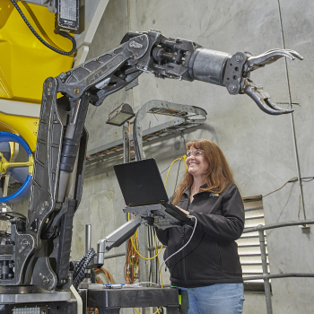
Defence industry VET courses
TAFE WA offer a number of Defence Industry related courses. Some examples of qualifications include:
Certificate II in Engineering (Heavy Fabrication Pre-Apprenticeship) OR (Mechanical Fitter and Machinist Pre-Apprenticeship)
Certificate III in Electrotechnology Electrician
Certificate III in Engineering – Fabrication Trade (Boilermaking/Welding) OR (Sheetmetal)
Certificate III in Engineering – Mechanical Trade (Machinist)
Certificate III in Engineering – Technical
Certificate IV in Electronics and Communications
Certificate IV in Entrepreneurship and New Business
Certificate IV in Cyber Security
Diploma of Business
Diploma of Civil and Structural Engineering
Diploma of Project Management
Notes:
There are many Federally funded opportunities available – these three listed are just some of the options for defence industry.
On completion, graduates may seek to follow pathways to entry-level employment in one of these defence support industries, or to pursue further education and training opportunities in areas such as engineering and logistics.

Slide 8
Your task – the Other Force website
https://theotherforce.wa.gov.au/
Go to ‘Careers and Training’ and then click on ‘Occupations’.
Select 2 jobs that appeal to you and complete the tables in your worksheet.
Optional:
‘VET steps to uni’
A defence qualification from TAFE could be eligible for credit towards a university degree, reducing the time and cost. Explore the different courses and transferrable degrees on the Other Force.
Defence projects
Spend time reading about defence projects in Western Australia. This information can be found under the 5 domains on the WA’s Defence Industry page on the Other Force website.

Slide 9
Defence Industry Career Advice
A dedicated defence industry team is available at the Rockingham Jobs and Skills Centre to provide free advice about jobs, careers, and training pathways into the defence industry.
T: 08 9599 8655
E: defence.careers@smtafe.wa.edu.au
Building G — SM TAFE Rockingham Simpson Avenue Rockingham
Notes:
This team can visit your school and talk to students.
If you are interested, you can show students the support programs:
Defence Industry Pathways, Internships, Scholarships | The Other Force
Focusing on the Defence Industry Pathways Program
Defence Industry Pathways Program | South Metropolitan TAFE (southmetrotafe.wa.edu.au)
This website also has videos and case studies from graduated trainees/host employers that you could show.

Slide 10
Thank you

