Slide 1
Session 1
Vaping facts vs misconceptions
D23/1525322 September 2024
Notes:
Required resources:
A3 sheet of paper - 1 per group
This session will cover facts about e-cigarettes and vaping and involve discussion of any misconceptions you may have.

Slide 2
By the end of the session you will…
describe common misconceptions regarding vaping.

Slide 3
In groups, you have 1 minute to write down as many facts as you can about vaping.
Do you know what you are vaping?
Notes:
Activity instructions: Do you know what you are vaping?
In small groups, students write down facts that they already know about vaping.
Give groups 1 minute to write down as many facts as they can.
Groups share their facts with the class.
Write responses on the board.
Review students’ answers using the factsheets from the toolkit and slides 4-6.

Slide 4
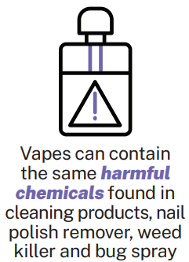
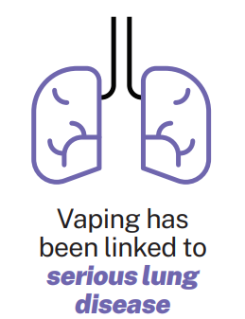
Vaping is harmless compared to cigarettes
Vaping is NOT safe
Notes:
Activity: Agree or disagree statements
Examples of teaching strategies for this activity (slides 4-6):
Thumbs up, thumbs down
Heads (agree) or tails (disagree)
Values continuum: one wall = agree, other wall = disagree
Do you agree or disagree with the following statement? ‘Vaping is harmless compared to cigarettes.’
(Click next) The idea that vaping is harmless in comparison to cigarettes is a common misconception. (Click next)
Vaping is not safe. Harms from vaping can include:
E-liquids when heated and inhaled may contain many harmful chemicals that are not listed on the pack - which can cause adverse health effects such as vomiting, shortness of breath and lung damage.
Vapes may expose young people to chemicals and toxins at levels that have the potential to cause adverse health effects.
Vapes can leave a young person at increased risk of depression and anxiety.
Vaping has also been linked to serious lung disease.
Vapes can expose young people to:
harmful chemicals.
toxins such as formaldehyde and heavy metals.
ultrafine particles that can be inhaled deep into the lungs.
flavouring chemicals such as diacetyl (a chemical linked to a serious lung disease).
Vapes have even been known to explode causing serious burns.
Recent media reports indicate that vaping has caused increased hospitalisations in young people, with patients experiencing:
seizures
loss of consciousness
Importantly, many of the long-term harms of vaping are still unknown. It is also important to know that a lot of these harms occur whether smoking nicotine-free or nicotine vapes.

Slide 5
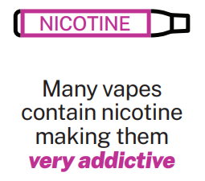
Most vapes don’t contain nicotine
Nicotine is highly addictive
A recent Australian study analysed 10 vapes from Australian suppliers that claimed to be nicotine-free. A total of 60% of the vapes were found to actually contain nicotine [3].
Notes:
Activity: Agree or disagree statements
Do you agree or disagree with the following statement?
(Click next) Most vapes don’t contain nicotine.
(Click next) This is a common misconception.
A recent Australian study analysed 10 vapes from Australian suppliers that claimed to be nicotine-free. A total of 60% of the vapes were found to actually contain nicotine [3]. There is no way to know what you are really vaping as the labels are often misleading.
Nicotine is highly addictive. Nicotine dependence (addiction) will be covered in further detail during session 5. Most people don’t start vaping intending to become addicted. Often people don’t realise they are addicted until they start to feel withdrawal symptoms such as:
irritability
headaches
emotional distress (sad and upset)
difficulty sleeping
anxiety
trouble concentrating.

Slide 6
Everyone is vaping
Most young people DO NOT vape
Vaping may seem popular, but research shows that more than 7 out of 10 (70.1%) young people HAVE NEVER vaped.
Notes:
Activity: Agree or disagree statements
Do you agree or disagree with the following statement? (Click next) ‘Everyone is vaping’.
(Click next) This is another misconception. Often people may perceive that to be the case, research has shown that it isn’t true. (Click next)
Recent data reported 29.9% of school students aged between 14 and 17 have ever vaped, meaning 70.1%
HAVE NEVER vaped. Only 3% had vaped daily in the month prior to the survey [8].

Slide 7
Discussion
Do you think knowing these facts could influence a young person’s decision to vape?
Why or why not?
How do you feel knowing that most people your age don’t vape?
Notes:
Activity: Discussion
In pairs or small groups discuss the following questions. Allow time in small groups then conduct a class discussion.
How do you think knowing these facts would influence young people’s decisions to vape?
How do you feel knowing that most people your age don’t vape?
Studies show that young people, in comparison to adults, are heavily influenced by their peers to take risks and make risky decisions [9]. Knowing that most young people don’t vape helps to reduce the impact that your peers can have on your decision making.

Slide 8
Accessing credible information
Discussion questions:
Where do you think young people get their information regarding vaping?
How do misconceptions around vaping occur? Where do you commonly hear misinformation?
How could this be prevented?
Why is it important to identify credible resources? What are some examples of where you can access credible resources?
Notes:
Activity: Discussion
In pairs or small groups discuss the following questions. Allow time in small groups then conduct a class discussion.
Where do you think young people get their information regarding vaping? (Click next)
How do misconceptions around vaping occur? Where do you commonly hear misinformation?
How could this be prevented? (Click next)
Why is it important to identify credible resources? What are some examples of where to access credible resources? (Click next)
Possible answers may include
Government websites: Healthy WA
WA Health
Cancer Council
Road Safety Drug Education Vaping factsheets
Government resources are supported by research. The information has been provided by experts and the information has been thoroughly reviewed.

Slide 9
Reflection
Refer to your facts about vaping sheet from the beginning of the lesson
Correct any misconceptions you may have had.
Add any facts that you have learned today.
Notes:
Activity instructions: Reflection
Groups refer back to the facts that they wrote down at the beginning of the session.
Students review their ‘facts’ and correct any misconceptions.

Slide 10
Thank you

Slide 11
Session 2
Analysing marketing tactics
Notes:
Required resources:
Video link: Kids and the Tobacco Predator https://www.youtube.com/watch?v=9wp5Qv54_MM
This session will cover why young people might choose to vape or not vape and how social media, advertising and may influence this decision.

Slide 12
By the end of the session you will…
know the marketing tactics vaping companies use to influence consumers.

Slide 13
Kids and the Tobacco Predator
Discussion questions:
What are your thoughts about the video?
Why do you think young people choose to vape?
What can influence a young person’s decision to vape?
How does social media, media, advertising and marketing influence young people’s decisions about vaping?
Notes:
Watch video: Kids and the Tobacco Predator
Discussion questions: In pairs or small groups discuss the following questions. Allow time in small groups then conduct a class discussion.
What are your thoughts about the video?
Why do you think young people choose to vape?
What can influence a young person’s decision to vape?
Possible answers may include [7]:
Curiosity: exposure to advertisement and promotion has been linked to increased curiosity.
Unaware of the harms.
To fit in: young people are more likely to vape if they have friends who vape; perceptions that vaping is cool, fun and help young people ‘fit in’ is linked to increased use. This is why it is important to remember the statistics from last lesson that most young people don’t vape.
Influence of social media.
Flavours and packaging: studies have found that e-cigarette flavours may make vaping more appealing to young people.
The perception that it will assist in coping with feelings of stress or anxiety: nicotine dependence can lead to feelings of anxiety worsening.
4. How does social media, media, advertising and marketing influence young people’s decisions about vaping?

Slide 14
Impact of media and marketing on young people vaping
1. What marketing tactics do vape companies use to reach their target audience?
Social media highlights features such as bright colours, small discrete design and flavours that appeal to young people [5].
2. What are the common messages regarding vaping portrayed on social media?
Studies have found that 97.7% of videos involving vaping represented vaping as being positive [4].
3. Who is the target audience for vaping-related content on social media?
A recent study found that 40% of vaping-related TikTok videos refer to flavours. Young people say that flavours are the main motivator to vape [5].
4. Why do vape companies choose to target young people?
Notes:
Activity instructions: There are 4 questions to this slide. Ask students each question. Allow time for discussion in small groups, then conduct a class discussion. After receiving class responses, click next for research on each topic.
(Click next) What marketing tactics do vape companies use to reach their target audience?
(Click next) Some of the tactics seen on social media to promote e-cigarettes include highlighting features such as colours, flavour variations as well as price promotions, discount vouchers and even celebrity endorsements [5].
2. (Click next) What are the common messages regarding vaping portrayed on social media?
(Click next) A study by Curtin University on the way e-cigarettes are portrayed on TikTok, found that of 1599 e-cigarette related videos analysed, 97.7% portrayed e-cigarettes positively. Only 5 posts portrayed e-cigarettes negatively. The posts with the 5 highest engagement rates all portrayed e-cigarettes positively [4].
3. (Click next) Who is the target audience for vaping related content on social media?
(Click next) 47% of TikTok users are in the 10-29 age group. A study amongst 14-17 year olds found that flavours and taste were the most important characteristic of e-cigarettes to adolescents. The Curtin study found that 40% of videos on TikTok showed e-liquid flavours [5]. Other videos included humour and vaping tricks.
4. (Click next) Why do vape companies choose to target young people?
Go to slide 14 after receiving responses from students for answer.

Slide 15
Tobacco companies are continuously looking for new customers.
Many vapes have 50mg nicotine which is equivalent to roughly 50 cigarettes.
For children and young people, vaping nicotine can have long-lasting, damaging effects on brain development and there is risk of nicotine addiction which could result in becoming a lifelong smoker.
As of 2023, the global e-cigarette market is estimated to be worth AUD $38.2 billion [4].
Notes:
The main aim of vape companies is to make money. As of 2023, the global e-cigarette market was estimated to be worth USD 24.6 billion [4]. They advertise and market their product at a target audience that, in the long run, will result in the largest cash flow. Vapes are a new way to get young people addicted to nicotine, which is often difficult to quit.
A recent Australian study conducted in March 2023 found the following results [8]:
The highest prevalence of vaping was those aged between 18 and 24.
The 2nd highest prevalence was those aged between 25 and 34.
The 3rd highest were those aged between 14 and 17.
The earlier in life a person becomes addicted to nicotine, the more money vape companies can make over the person’s life span.
Most young people do not vape. Of those who choose to vape, almost three-quarters (71.9%) of young users reported using e-cigarettes “out of curiosity” [4]. Vape companies use tactics which aim to intrigue people. Even if those people just bought 1 vape to try it, that helps to increase revenue.

Slide 16
Reflection
Discussion questions:
How does it make you feel that your age group is a target audience for vape companies?
Do you think it is ethical? Why or why not?
How can young people avoid being influenced by social media and make better-informed decisions?
Notes:
Activity: Discussion
In pairs or small groups, discuss the following questions. Allow discussion time in small groups then conduct a class discussion.
How does it make you feel that your age group is a target audience for vape companies?
Do you think this is ethical? Why or why not?
How can young people avoid being influenced by social media and make better-informed decisions?
Possible discussion points include:
Educate yourself: knowing the harmful effects and the reasons why young people choose to vape can assist you in making informed decisions. Make sure you are using credible sources of information.
Avoid platforms that glamorise the use of vaping. Unfollow accounts or pages that promote vaping and contain misleading advertising. Instead follow people or pages that provide accurate information that supports your values and goals.
Think critically: question the credibility of the information and the motive behind the content that you see online. Always fact check the information using credible sources of information.
Develop clear attitudes and opinions about vaping: when you have a clear opinion about vaping it can make it easier to resist the influence of social media.

Slide 17
Thank you

Slide 18
Session 3
Harmful effects of vaping
TRIM Number DD Month YYYY
Notes:
Required resources:
Video link: Gen Vape | What do young people think of vaping? – YouTube https://www.youtube.com/watch?v=_4OsHGsa874&t=56s
Activity sheet 3.1: Harms of vaping brainstorm – 1 per group

Slide 19
By the end of the session you will…
define and explain the categories of harms of vaping using the 4L model.

Slide 20
What are the harms of vaping?
Gen Vape | What do young people think of vaping? - YouTube
Harms from vaping
In your groups, write down the potential harms of vaping. You will have 30 seconds.
When the timer goes off pass your sheet to another group.
Repeat the same process, adding ideas to those of the previous group.
Notes:
Watch video: Gen Vape | What do young people think of vaping? – YouTube
Activity instructions: students form small groups and ensure each student has a pen. Provide groups with activity sheet 3.1 - Vaping Brainstorm.
The students will consider the question, ‘What are the harmful effects of vaping’.
Use examples from the video as starting points.
For 30 seconds, everyone in the group will write down their responses on the group sheet.
After 30 seconds the groups will swap sheets.
Groups will then have time to add ideas to those of the previous group.
Repeat 2-3 times.

Slide 21
The 4 Ls model
The effects of vaping can be classified into 4 categories:
Lung physical health psychological health social and emotional health/wellbeing | Lover Important relationships e.g. family friends partners
Lifestyle accommodation work education finances recreation/hobbies | Legal Legal impacts e.g. Fines/criminal record
Notes:
The effects of vaping or any AOD use can be placed into 4 categories.
‘Lung’ refers to physical health or your connection to the body. This can include physical health, psychological health and emotional health. This is often the area that most people think about because it is often visible. All of the examples from the video came from this category.
‘Lover’ refers to important relationships like families and friends.
‘Lifestyle’ refers to changes or worries in relation to factors such as school, study or work, housing and hobbies.
‘Legal’ refers to the legal impacts of using or selling vapes, which could lead to a criminal record including being fined or arrested [10]. It is illegal to sell, supply or possess an e-cigarette or any liquid that contains nicotine in Australia without a doctor’s prescription. Further information on the sale of vapes in WA is available on the Department of Health’s website.

Slide 22
4 Corners
Which harm do you think would have the greatest impact on a you, and is therefore the biggest reason for you to choose not to vape?
Front of the class
1 | 2
3 | 4
Increased risk of damage to your heart and lungs.
Lying to parents or family/carer about vaping.
Falling behind at school due to suspensions.
Experiencing short term effects: nausea, vomiting, mouth and airway irritation.
Notes:
Activity instructions:
Number the four corners of the space 1 to 4.
Using the 4 Corners slides, read all options out, then ask students to move to the corner that indicates which harm they think would have the greatest influence on them to not vape.
If working within a large group, you may choose to get students to vote for a corner instead of moving.
Encourage students to make their own choice and try not to be influenced by other people.
After each round, conduct a group discussion:
Why did you pick this corner?
Which of the 4 Ls categories does this harm fit under?

Slide 23
4 Corners
Which harm do you think would have the greatest impact on you, and is therefore the biggest reason for you to choose not to vape?
Coughing and difficulties breathing.
Putting loved ones health at risk due to second hand vape exposing others to harmful substances.
Not having enough money to do things with friends due to spending your money on vapes.
Realising that your symptoms of anxiety are worsening.
Front of the class
1 | 2
3 | 4
Notes:
Activity instructions:
Number the four corners of the space 1 to 4.
Using the 4 Corners slides, read all options out, then ask students to move to the corner that indicates which harm they think would have the greatest influence on them to not vape.
If working within a large group, you may choose to get students to vote for a corner instead of moving.
Encourage students to make their own choice and try not to be influenced by other people.
After each round, conduct a group discussion:
Why did you pick this corner?
Which of the 4 Ls categories does this harm fit under?

Slide 24
4 Corners
Which harm do you think would have the greatest impact on you, and is therefore the biggest reason for you to choose not to vape?
Becoming dependent (addicted) to vaping
Changes in mood due- experiencing withdrawal symptoms causing you to lash out at loved ones
Struggling to focus in school due to the effects that nicotine can have on your ability to pay attention and learn
Losing the trust of loved ones because of your vaping.
Front of the class
1 | 2
3 | 4
Notes:
Activity instructions:
Number the four corners of the space 1 to 4.
Using the 4 Corners slides, read all options out, then ask students to move to the corner that indicates which harm they think would have the greatest influence on them to not vape.
If working within a large group, you may choose to get students to vote for a corner instead of moving.
Encourage students to make their own choice and try not to be influenced by other people.
After each round, conduct a group discussion:
Why did you pick this corner?
Which of the 4 Ls categories does this harm fit under?

Slide 25
4 L model examples
Lung Dependence. Serious lung disease. Can make symptoms of depression and anxiety worse. Can increase the risk of depression and anxiety. Increased chance of damage to the heart and lungs. Short term effects: nausea, vomiting, mouth and airway irritation. Coughing and difficulties breathing. | Lover Second hand vape can expose others to harmful substances. Addiction may lead to stealing from loved ones. Changes in mood due to the impact of vaping on the brain can cause people to lash out at loved ones. Lying to loved ones about vaping can negatively impact relationships.
Lifestyle Nicotine can affect your ability to pay attention and learn, impacting your education. Suspensions from school can lead to falling behind in school work. Money spent on vapes. Vaping impacts lung health which can impact your ability to be involved in sports/ hobbies. | Legal Fines/criminal record.
Notes:
Activity instructions:
As a class, go through the 4 Ls model examples. Give the students an opportunity to add to their original brainstorm.

Slide 26
Reflection
Discussion questions:
Was the harm that you picked each round from a different category of the 4 Ls, or was it often from the same category?
If there was, why do you think that happened? If there wasn’t, why do you think that happened?
Notes:
Activity: Discussion
In pairs or small groups, discuss the following questions. Allow discussion time in small groups then conduct a class discussion.
Was the harm that you picked each round from a different category of the 4 Ls, or was it often from the same category?
If there was, why do you think that happened? If there wasn’t, why do you think that happened?

Slide 27
Thank you

Slide 28
Session 4
Refusal skills
TRIM Number DD Month YYYY
Notes:
Required resources:
Activity sheet 4.1: Refusal skills scenarios – 1 per student or group
This session will cover how to improve your ability to say no in challenging situations.

Slide 29
By the end of the session you will…
demonstrate refusal skills using assertive communication.

Slide 30
What is the most common reason people vape?
A friend used them
A study of Australians aged between15 and 30 years found that of people who vape or have vaped in the last month, 61% reported they did so because “a friend used them” [6].
Discussion questions:
Does this statistic surprise you? Why?
In any situation, why do you think it can be challenging to go against the group or a friend?
Notes:
Activity: Discussion
Allow time to discuss the question below in small groups then conduct a class discussion.
What do you think is the most common reason why young people vape?
(Click next) A study of Australians aged 15-30 found that of people who vape or have vaped in the last month, 61% reported they did so because “a friend used them” [3].
(Click next) Does this statistic surprise you? Why?
(Click next) In any situation, is it hard to go against the group or a friend? Why?
This lesson will go into how you can use refusal skills when put in a challenging situation.

Slide 31
Refusal skills
Refusal skills are skills that allow people to say no to peer pressure in order to avoid situations involving risk.
Provide a reason for refusal: Think back to last session on the effects of vaping. What was your biggest reasons not to vape?
Be assertive: Use ‘I’ statements. Be respectful but firm. Body language and eye contact is also important.
Suggest other options: Try to persuade your friends to do something that is safer and healthier.
Take action: If nothing seems to be working, leave. That is a clear statement that you won’t change your mind.
Notes:
Some people are able to say no when faced with peer pressure. This may not come naturally for everyone. Some people may find it hard to advocate for themselves. This is where refusal skills can help.
There are 4 key steps that will help you say no to peer pressure in order to avoid situations involving risk [2].
Provide a reason: think back to last session where you wrote down all of the possible harms of vaping. They are your reasons to say no.
Be assertive: being assertive means getting your point across in a respectful manner. It is important to not be aggressive or passive.
Suggest other options: it helps if you can provide another option for an alternate activity. This can also show that you are concerned about your friend’s as well.
Take action: Your friends or peers may still want to vape and insist that you do too. You need to remove yourself from the situation. This will make a clear statement that you will not change your mind.

Slide 32
Assertive communication
Which of the following do you think is the most assertive way to say no?
‘I can’t’
or
‘I don’t’
‘I can’t’ statements suggest that someone or something else is in control of your decisions - that you are being restricted.
‘I don’t’ statements show that you have a choice and you are in control of your decisions.
Notes:
Ask students: Which phrase do you think is more assertive? ‘I don’t’ or ‘I can’t’. How do the 2 phrases differ?’
(Click next) ‘I don’t’ statements show that you have a choice, and you are in control of your decisions, whereas ‘I can’t’ statements suggest that someone or something else is in control of your decisions, and that you are being restricted.

Slide 33
Refusal skill example
Reason (everyone's is different)
Assertive
No thanks, I don’t want to vape. It makes me feel nauseous. I’d rather get something to eat. Let’s go to the canteen.
Take action: If nothing else works, leave
Options
Activity:
Go through the scenarios in the activity sheet.
Write down refusal responses to each of the scenarios.
Make each answer different. Having multiple responses prepared is important.
Notes:
This is an example of what effective refusal skills look like. This is a response to a friend asking if you want to go to the bathroom to vape with them.
A possible response could be ‘No thanks, I don’t want to vape. It makes me feel nauseous. I’d rather get something to eat. Let’s go to the canteen.’ If this statement doesn’t work and they continue to pressure you, remove yourself from the situation.
Just like any other skill, refusal skills need to be practised. The more you use them, the more confident you will get. Having a few responses ready to go will help make it easier.
Activity instructions: students complete activity sheet 4.1. Students can complete this individually, or alternatively, allocate a scenario to each group. Students work together to formulate a refusal response then share with class.
Read the scenarios.
Write down a refusal response for each.
Ensure all responses are different using different reasons and options for each.
Once completed, allow students time to share with their partners or the group.

Slide 34
Reflection
Discussion questions:
Do you think having knowledge and facts about vaping strengthens your refusal skills? How?
How could group dynamics and peer support influence your confidence in using refusal skills?
Notes:
Activity: Discussion
Allow time to discuss the following questions in small groups then conduct a class discussion.
Do you think having knowledge and facts about vaping strengthens your refusal skills? How?
How could group dynamics and peer support influence your confidence in using refusal skills?

Slide 35
Thank you

Slide 36
Session 5
Help seeking
TRIM Number DD Month YYYY
Notes:
Required resources:
Video link: Vaping – Respect Your Brain - YouTube (52 seconds): www.youtoube.com/watch?v=mAej2dkX6ow
‘Where can I access help’ help sheet – 1 per student

Slide 37
By the end of the session you will…
identify and translate health consequences of nicotine dependence (addiction) and services that can help.

Slide 38
Vaping – Respect Your Brain - YouTube (52 seconds)
Discussion question:
What could be some of the signs that someone may have become dependent (addicted) to vaping and may need help?
Notes:
Watch video: Vaping – Respect Your Brain - YouTube (52 seconds)
Activity: Discussion
Allow time to discuss the question below in small groups then conduct a class discussion.
What could be some of the signs that someone may have become addicted to vaping and may need help?
Possible responses may include [11]:
feeling irritable
feeling anxious
experiencing intense cravings to vape
decreased ability to concentrate when you can't vape
trouble sleeping.

Slide 39
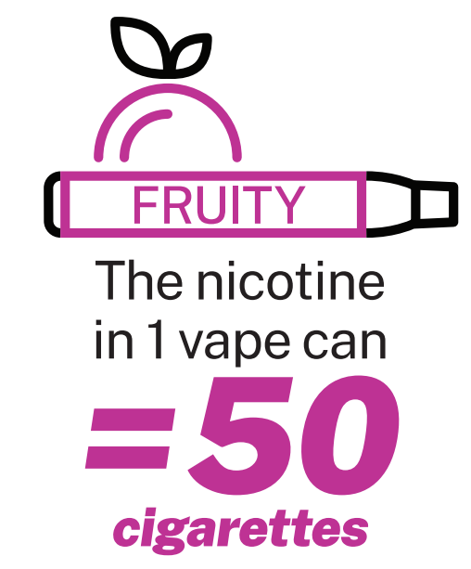
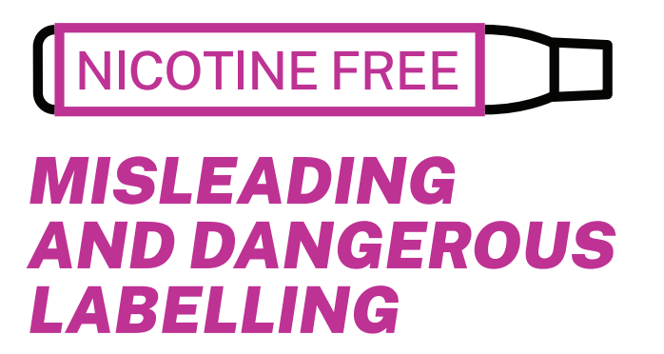
Nicotine is a highly addictive substance
How dependence to nicotine occurs
People who smoke develop nicotine receptors in the brain
When nicotine receptors receive nicotine, dopamine is released
When the nicotine fades away, the receptors are left wanting more which is what causes cravings
If these cravings aren’t met, uncomfortable withdrawal symptoms are experienced. [13]
Notes:
As discussed in lesson one, nicotine is highly addictive. Young people are more susceptible to becoming dependent to substances such as nicotine than adults [5]:
Nicotine can harm the developing adolescent brain. The brain keeps developing until about age 25.
Using nicotine in adolescence can harm the parts of the brain that control attention, learning, mood, and impulse control.
Each time a new memory is created, or a new skill is learned, stronger connections – or synapses – are built between brain cells.
Young people’s brains build synapses faster than adult brains. Nicotine changes the way these synapses are formed.
Using nicotine in adolescence may also increase risk for future addiction to other drugs.

Slide 40
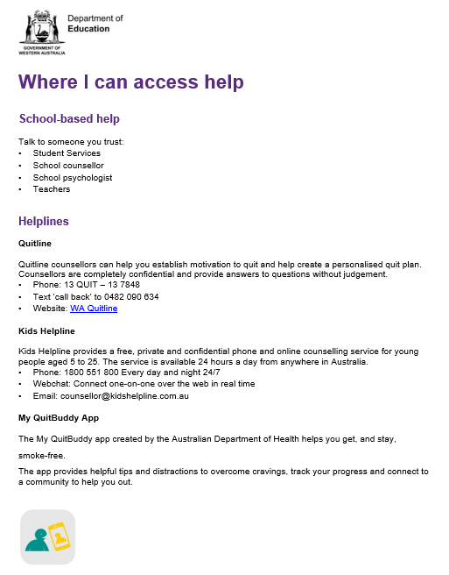
Quitting can be hard, but help is available
Who could you go to if you needed help regarding vaping?
Student Services
School counsellor
School psychologist
Teacher
Parents/carers and family
Doctor
Helplines
WA Quitline: 13 78 48
Kids Helpline: 1800 55 1800
Notes:
Activity: Discussion
Allow time to discuss in small groups then conduct a class discussion.
Who could you go to if you needed help regarding vaping? This could be help quitting, questions regarding vaping, guidance or help in refusing vapes or how you could help a friend or loved one quitting from vapes.
Possible responses may include: (Click next)
Talk to someone you trust:
Student Services
school counsellor
school psychologist
teacher
parents/ carers and family
Doctor
Helplines
WA Quitline: 13 78 48
Kids Helpline: 1800 55 1800
Direct students to the ‘Where I can access help’ help sheet.

Slide 41
What can I do to help my friend or loved one?
Ask them what you can do to help.
Spend time with them doing activities that help take their mind off it.
Try to not put them in situations where other people may be vaping.
If they are struggling, help remind them why they wanted to quit.
Quitting can be hard. Celebrate the small wins with them.
Notes:
Activity: Discussion
Allow time to discuss the question below in small groups then conduct a class discussion.
Knowing how to help someone you care about can be hard. What do you think you could do if someone you cared about needed help quitting?
Possible responses may include: (Click next)
Ask them what you can do to help. Avoid giving advice unless you are asked for advice. Just acknowledge that you understand that it is hard and that you are there to help.
Spend time with them. Do activities that will help take their mind off vaping.
Help them to avoid situations where other people may be vaping.
Remind them of the reasons why they are wanting to quit.
For a lot of people, quitting takes multiple tries, so celebrate the small wins.

Slide 42
Reflection
As a senior school student, you are a role model in the school community.
Discussion questions:
What could you do to advocate for young people in your school and community not to vape?
What could you do to help people in your school to feel safe?
Notes:
Reflect back on the last 5 sessions. We have talked about the facts about vaping and corrected any misconceptions. We discussed what influence social media, advertisement and marketing has on choosing to vape or not to vape. We identified the harms of vaping and how to use refusal skills in challenging situations. Finally, today we discussed nicotine dependence (addiction) and how to access help and support when needed.
Reflect on your role in the school community. As you are senior students, younger students look to you as role models. This can influence their behaviour in positive or negative ways. You could be the person that someone comes to when they need help.
Activity: Discussion
Allow time to discuss the questions below in small groups then conduct a class discussion.
What could you do to advocate for young people in your school and community not to vape?
What could you do to help people in your school to feel safe?

Slide 43
Thank you

Slide 44
References
1. Alcohol and Drug Foundation. (2023) Talking About Drugs- Vaping, accessed on 13 July 2023. https://adf.org.au/drug-facts/vaping-e-cigarettes/
2. California Courts (2023) Develop Your Refusal Skills, accessed on 13 July 2023.
https://www2.courtinfo.ca.gov/stopteendui/teens/stop/yourself/develop-refusal-skills.cfm
3. Chivers, E, Janka, M, Franklin, P, Mullins, B, Larcombe, A. Nicotine and other potentially harmful compounds in “nicotine-free” e-cigarette liquids in Australia. Medical Journal of Australia. 2019.
4. Jancey, J, Leaver, T, Wolf, K, Freeman, B, Chai, K, Bialour S, Bromberg, M, Adams P, Mcleod, M, Carey, N, McCausland K. Promotion of E-Cigarettes on TikTok and Regulatory Considerations. Environmental Research and Public Health. 2023.
5. Know the Risks. (2023) E-Cigarettes and Young People, accessed on 5 July 2023. https://e-cigarettes.surgeongeneral.gov/default.html
6. Pettigrew, S, Miller, M, Santos, J, Raj, T, Brown, K, Jones, A. E-cigarette attitudes and use in a sample of Australians aged 15-30 years. Australian and New Zealand Journal of Public Health, April 2023.
7. Watts, C.; Egger, S.; Dessaix, A.; Brooks, A.; Jenkinson, E.; Grogan, P.; Freeman, B. Vaping product access and use among 14-17-year-olds in New South Wales: A cross-sectional study. Aust. N. Z. J. Public Health, December 2022.
8. Cancer Council Victoria. (2023) ASSAD 2022/2023: Australian secondary school students’ use of tobacco and e-cigarettes https://www.health.gov.au/resources/collections/australian-secondary-school-students-alcohol-and-drug-survey
9. Gardner, M., & Steinberg, L. Peer Influence on Risk Taking, Risk Preference, and Risky Decision Making in Adolescence and Adulthood: An Experimental Study. Developmental Psychology. 2005
10. Roizen, R., & Weisner, C. (1979). Fragmentation in Alcoholism Treatment Services: An Exploritory Analysis. Berkeley, CA, United States: Alcohol Research Group, University of California.
11. Department of Health, Healthy WA. (2023) E-cigarettes and Vaping, accessed on 6 July 2023. https://www.healthywa.wa.gov.au/vaping
12. Department of Health, New South Wales (2023) Get the facts – Vaping Toolkit, Vaping Evidence Summary Vaping evidence summary (education.wa.edu.au)
13. Quit Victoria (2021) Nicotine addiction explained, accessed on 14 July 2023. https://www.quit.org.au/articles/nicotine-addiction-explained/

Slide 45
References
Videos:
UNDO (2014) ‘Kids and the Tobacco Predator’ Kids and the Tobacco Predator - Tobacco Free CA (1:13min)
Cancer Council NSW (2023) ‘Gen Vape | What do young people think of vaping?’ Gen Vape | What do young people think of vaping? - YouTube (59 seconds)
NSW Health (2023) ‘Vaping- Respect Your Brain’ Vaping – Respect Your Brain - YouTube(52 seconds)
Factsheet Images:
Department of Health, New South Wales (2023) Get the facts – Vaping Toolkit https://www.health.nsw.gov.au/tobacco/factsheets/vaping-factsheet-young.pdf

