Slide 1


ABOUT FETAL ALCOHOL SPECTRUM DISORDER

Slide 2
Acknowledgement of country
“I respectfully acknowledge the past and present traditional custodians of this land on which we are meeting, the <traditional name(s)> people. It is a privilege to be standing on <traditional name> country. I also acknowledge the contributions of Aboriginal Australians and non-Aboriginal Australians to the education of all children and people in this country in which we all live and share together – Australia.”

Slide 3
Session 1 - Understanding FASD
Session outcomes
During this session, participants will learn about:
Fetal Alcohol Spectrum Disorder (FASD)
the impact of FASD on the way the brain functions
a range of strategies suitable for all students with diverse learning needs.
Trigger warning: Please be aware that some information in this workshop may be distressing for some participants. If this workshop raises any concerns, please feel free to leave or to take some time away and return when you are ready. Department of Education staff are entitled to six sessions of counselling per year through PeopleSense. Phone to make an appointment on 9388 9000 or 1300 307 912 or reception@peoplesense.com.au

Slide 4

Principal Performance Improvement Tool
Leading the moral purpose
Building productive relationships
Creating enabling conditions
Promoting improved teaching
Driving data-informed practice
Leading strategic change

Slide 5
Australian Professional Standards for Teachers
Domains of teaching | Standards
Professional Knowledge | 1. Know students and how they learn
 | 2. Know the content and how to teach it
Professional Practice | 3. Plan for and implement effective teaching and learning
 | 4. Create and maintain supportive and safe learning environments
 | 5. Assess, provide feedback and report on student learning
Professional Engagement | 6. Engage in professional learning
 | 7. Engage professionally with colleagues, parents/carers and the community

Slide 6
Activity: What is FASD?
In small groups:
discuss what you already know about FASD
prepare to share your ideas.

Slide 7

What is Fetal Alcohol Spectrum Disorder (FASD)?
Fetal Alcohol Spectrum Disorder (FASD) is a diagnostic term for the range of physical, cognitive, behavioural and neurodevelopmental abnormalities which can result from maternal drinking during pregnancy.
National Fetal Alcohol Spectrum Disorder Strategic Action Plan 2018-2028, Commonwealth of Australia 2018, p.8
FASD is a lifelong condition.
‘The evidence demonstrates that FASD is present in Australia, in all places in which alcohol is consumed.’ (Liotta, M. 2018).

Slide 8
Diagnosing FASD
In Australia, FASD is under recognised and often goes undiagnosed or may be misdiagnosed. This may be due to:
the stigma and blame associated with being required to admit to drinking while pregnant
family access to appropriate heath care professionals
the emotional and cognitive behaviours observed in students with FASD that appear similar to the behaviours in students with other disorders.

Slide 9
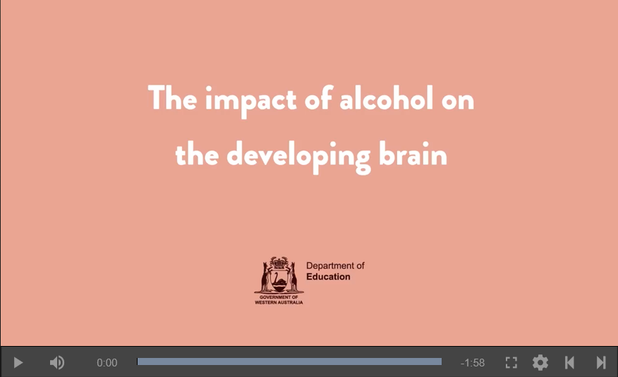
The impact of alcohol on the developing brain

Slide 10
FASD and the 10 neurodevelopmental domains
Brain structure/neurology
Motor skills
Cognition
Language
Academic achievement
Memory
Attention
Executive function – impulse control and hyperactivity
Affect regulation – emotional regulation and sensory processing
Adaptive behaviour – daily living skills, social skills and social communication.

Slide 11
National Fetal Alcohol Spectrum Disorder Strategic Action Plan 2018-2028
The three key aims of the Plan are to:
reduce prevalence of FASD
reduce the associated impact of FASD
improve the quality of life for people living with FASD.
In Western Australia, FASD is a shared priority across Government agencies that work together to achieve the most efficient and effective outcomes, taking into account the National FASD Plan Priorities Areas.

Slide 12
A strength based approach
Knowing your students’ strengths and areas requiring improvement is essential in providing quality education.
‘Australia has the highest known prevalence rate of FASD in a juvenile detention environment in the world. A recent study on the prevalence of FASD within the juvenile justice system found that 36% of 10-18 year olds in Banksia Hill Detention Centre (WA) were diagnosed with FASD.’
Fetal alcohol spectrum disorder and youth justice: a prevalence study among young people sentenced to detention in Western Australia. (Bower, C. et al, 2018).

Slide 13
Activity: The impact of FASD
Write a list of the tasks you have completed today.
In small groups, discuss the skills you used to complete these tasks.

Slide 14
The impact of FASD on learning
The challenges faced by students with FASD are a result of injury to the brain. Effective educators take care not to misinterpret these challenges, as the student being wilful, egocentric or lacking in empathy.
Educators focus on supporting students to develop the knowledge, skills and understandings required for:
learning
communication
personal and social capability including self-regulation.

Slide 15
The impact of FASD on learning
Educators observe that students with FASD are bright and communicative but may repeatedly make the same mistakes.
While a student with FASD may not have the cognitive ability to understand why something is inappropriate, they can learn what is appropriate through regular repetition of the desired behaviour.
Modelling, practice and repetition of the appropriate behaviour continues until the student consistently demonstrates the newly learnt behaviours.

Slide 16

Prenatal alcohol exposure and the developing brain

Slide 17
How do effective educators support students with FASD?
Effective educators value the individuality of their students and know a
one-size-fits-all approach is not suitable. Effective educators incorporate the insights and strategies that parents and students identify as working well at home and at school.
Maximising the learning experiences for students with FASD requires us to provide opportunities for students to use their:
strong visual memory
high energy levels
verbal fluency
unique creative skills.

Slide 18
Activity: Minimising the impact of FASD
In small groups, discuss what would enable students to use their:
strong visual memory
high energy levels
verbal fluency
unique creative skills.
Consider how to incorporate these opportunities into lessons.

Slide 19
Session 2: Accessing the curriculum
Session outcomes
During this session, participants will learn about:
the challenges faced by students with FASD in accessing the curriculum
effective approaches that support students to access the curriculum
a range of strategies suitable for all students with diverse learning needs.

Slide 20
Accessing the curriculum: Student Diversity
‘All students from Kindergarten to their final year of secondary schooling in Western Australia have a right to an education that is equitable and embraces diversity.
This right is enshrined in the United Nations Conventions on the Rights of the Child
… education must be inclusive of students’ individual strengths and needs. Differences in terms of characteristics such as ethnicity, language (linguistic background), culture, gender, socioeconomic status, disability, sexual orientation or geographic location should not be allowed to detract from a student’s access to the high-quality education that is their right ...’
Guiding principles of the Western Australian Curriculum – Student Diversity
School Curriculum and Standards Authority

Slide 21
Accessing the curriculum: Academic achievement
Students with FASD face barriers to academic success due to their impairments.
Some aspects of the developmental age of students with FASD are unlikely to match their chronological age. Educators use flexible, thoughtful approaches when providing students with access to a high-quality education.
Effective educators personalise the learning for their students by selecting strategies that support individuals to develop knowledge, skills and understandings they need.

Slide 22

Accessing the curriculum: Adjustments
Effective educators:
provide explicit teaching
break tasks into smaller components
pitch the learning at a level appropriate for the students’ developmental stage
provide repetition of instructions and rules, both verbally and through visual support materials
incorporate co-operative learning strategies and opportunities for peer mentoring
use concrete materials and practical hands-on experiences.

Slide 23
Accessing the curriculum: Cognition
Students with FASD require explicit teaching to counteract cognitive impairments that may impact:
processing speed
abstract thinking
language skills and comprehension.
Effective educators provide scaffolds that connect new information to students’ current knowledge and skills to support cognition and the storing of new information into long term memory.

Slide 24
Accessing the curriculum: Language
Language is comprised of receptive and expressive language.
Students require explicit teaching of vocabulary, syntax, semantics and pragmatics as the curriculum requirements increase in complexity.
Students are provided with multiple opportunities to develop their expressive communication skills through modelling, practising in real life situations and role playing across different contexts

Slide 25


Accessing the curriculum: Language acquisition -Standard Australian English
Western Australia has a diverse cohort of English as an additional Language or Dialect (EAL/D) learners.
Students with FASD who are also EAL/D learners will require targeted support to develop competency in Standard Australian English (SAE).

Slide 26
Accessing the curriculum: Memory
Memory relates to the brain’s ability to store, correctly sequence events, manipulate and retrieve information as well as make associations and generalise.
FASD impacts on how well students can process information, strategies and new knowledge.
Memory comprises a number of components:
Short-term memory
Long-term memory
Working memory

Slide 27
Accessing the curriculum: Memory
Effective educators:
provide daily repetition of instructions and rules
use ‘think alouds’ to model how information is processed and organised
use ‘think alouds’ so students learn the steps in problem solving processes
provide scaffolding, concrete materials and visual prompts.
All of these strategies support students with FASD to develop the skills required to comprehend abstractions, generalisations and to ‘fill in the blanks’ when processing instructions.

Slide 28
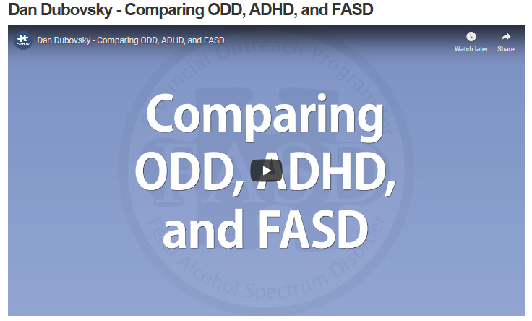
Accessing the curriculum: Comparing ODD, ADHD and FASD

Slide 29
Accessing the curriculum: Attention
Effective educators gain the attention of students with FASD by:
linking the students’ strengths, interests and prior knowledge to lessons
minimising classroom stimuli to reduce distraction and help students to focus their attention
providing scaffolds that divide tasks into smaller components, communicated in clear, literal and simple ways so that students can systematically work through lessons.

Slide 30
Accessing the curriculum: Motor skills
Students with FASD may have gross and/or fine motor skill impairments
that affect:
manual dexterity, precision (fine motor skills)
balance, strength, co-ordination, ball skills and agility (gross motor skills)
handwriting which requires the combination of motor skills, perception and cognitive processing (grapho-motor skills)
hand-eye coordination required for drawing, writing and sports (visuo-motor integration)
sensory processing of information from the muscles and joint (proprioception).

Slide 31
Accessing the curriculum: Motor skills
Effective educators:
incorporate hand strengthening activities such as tug-of-war; using hole punches, spray bottles, modelling clay and squeezing squishy balls
provide adjustments such as increasing time allocated to written tasks
decreasing time spent copying from the board and replacing this activity with a hardcopy for students to highlight relevant information
use of technology, where appropriate, to help minimise fatigue and increase keyboard and word processing skills
use of predictive text apps.

Slide 32
Accessing the curriculum: Posture and body awareness
‘Poor central or postural stability of the core body or trunk muscles can affect students’ balance and functioning in the classroom …
They may bump into peers and furniture, trip over their own feet when crossing the room and play in an apparent rough or aggressive manner, often hurting peers or breaking toys.
This is not intentional or defiant behavior, rather a result of impaired motor skills and poor body awareness caused by neurological impairment.’
What educators need to know about FASD, Working Together to Educate Children in Manitoba with Fetal Alcohol Spectrum Disorder, 2009

Slide 33
Accessing the curriculum: Posture and body awareness
Effective educators:
closely supervise students to ensure personal safety and the safety of others in the classroom or playgroup
ensure students are given regular, short breaks away from their desks
include physical activity such as obstacle courses, ball games and running races
use weight bearing activities such as wall push-up or wheel barrow races to build upper body strength.
These activities will also support students to remain calm.

Slide 34
Accessing the curriculum on the same basis as their peers
Educators are required to implement legislation and Department of Education policies in their classrooms.
Disability Discrimination Act 1992 (DDA) provides a definition of what constitutes a disability as ‘a disorder or malfunction that results in a person learning differently from a person without the disorder or malfunction.’
A student does not require a diagnosis to be protected under the DDA.

Slide 35
Accessing the curriculum on the same basis as their peers
Disability Standards for Education 2005 (the Standards) clarify the obligations of education and training providers, and seek to ensure that students with disability can access and participate in education on the same basis as their peers.
Teaching, learning and assessment adjustments are provided for students who are working below expected achievement in order to support them to access the curriculum.

Slide 36

Accessing the curriculum: NCCD levels of adjustments
The Nationally Consistent Collection of Data on School Students with Disability (NCCD) occurs annually.
The data identifies the number of school students with disability, the category of disability and the level of reasonable educational adjustment.
Visit NCCD site to view illustrations of practice

Slide 37
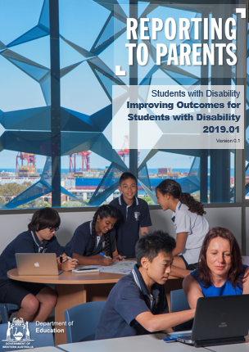
Accessing the curriculum: RTP for students with special educational needs
Reporting to Parents (RTP) allows for a student-centric view of reporting, which means that achievement data is available to schools even when students transfer between, or are enrolled at, multiple schools.
RTP has now been updated to include additional features for reporting progress of students with special educational needs.

Slide 38
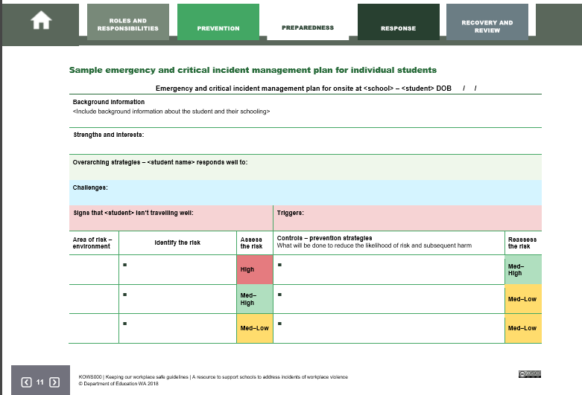
Accessing the curriculum: Keeping our workplace safe
Students with FASD may appear to be defiant or oppositional and may be prone to aggressive behaviour.
Understanding the needs of our students helps to prevent or manage the risk of incidents occurring.
Extract from Keeping our Workplace Safe guidelines

Slide 39
Activity: Accessing the curriculum
In small groups, consider what you now know about FASD
and determine:
the changes to teaching and learning that will enable students to better access the curriculum
a variety of assessment approaches that provide quality evidence about what students know and still need to learn.

Slide 40
Session 3: Supportive learning environments
Session outcomes
During this session, participants will learn about:
the importance of supportive learning environments
effective approaches to provide supportive learning environments
a range of strategies suitable for all students with diverse learning needs.

Slide 41
Supportive learning environments
‘Effective teachers have high expectations of students in terms of both their standard of learning and their behaviour. They treat their students with respect and expect the same in return. They know that a safe and orderly environment is necessary for their students to progress well and so their discipline is firm but fair. Good schools provide a friendly, welcoming and cared for environment with clear expectations of the standards expected.’
Classroom First Department of Education

Slide 42
Supportive learning environments: Quality relationships
Quality relationships are built on:
students’ likes, interests, strengths and world views that motivate participation in learning
regular two-way communication that is clear and based on evidence of student achievement
feedback for students about what is working well and areas for improvement
a collaborative approach to preparing differentiation that meets students’ needs
trust and mutual respect between all contributors.

Slide 43

Supportive learning environments: Quality relationships
Educators act with compassion and understanding because they know that student behaviours are symptomatic of the injury to the brain.
Students with FASD have a brain injury that:
impacts their ability to cope with everyday tasks
means they can’t rather than won’t
requires support and redirection rather than punitive responses

Slide 44
Structured and predictable learning environments
Students with FASD do best in structured and predictable environments as unpredictable environments cause confusion and may increase stress and anxiety.
Effective educators prepare students by explaining:
the purpose of the routine
If and why the routine had to change and/or giving notice of changes
through demonstration, modelling and rehearsal.

Slide 45
Supportive learning environments: Primary and secondary behaviours
Primary behavioural characteristics caused by brain impairments may include:
impulsivity
memory challenges
slower processing
difficulty with abstract thinking and predicting skills.
Secondary behavioural characteristics may include:
fatigue
the appearance of a lack of motivation
depression and frustration that may lead to aggression.

Slide 46
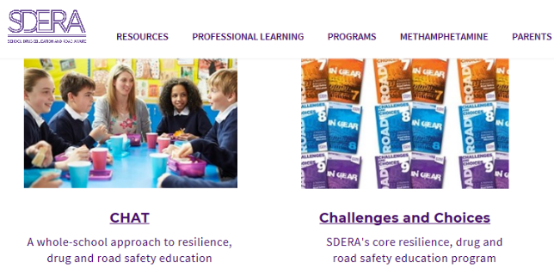
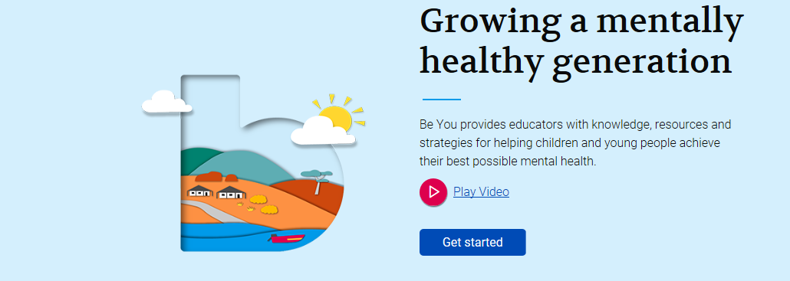
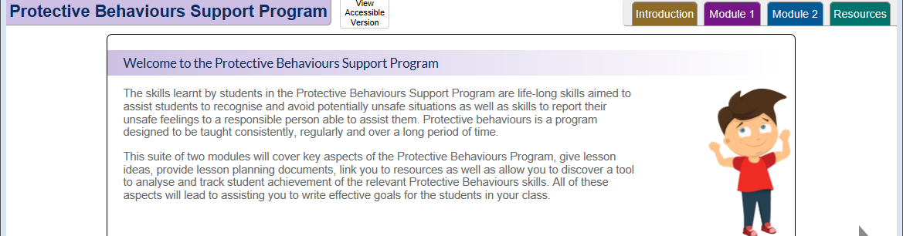
Supportive learning environments: Environmental factors
Effective educators make sure students develop a sense of belonging and tend to their students’ physical and emotional comfort.
Classroom resources are available:
Positive behaviour support
Protective behaviours
Student Wellbeing Hub
Be You programs for mental health
School Drug Education and Road Awareness (SDERA).

Slide 47
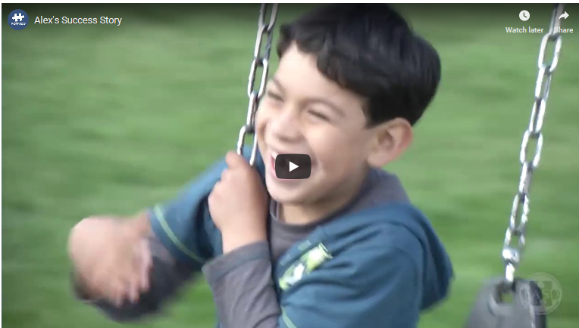
Supportive learning environments: Alex’s success story

Slide 48

Activity: Supportive learning environments
In small groups, think about your classrooms and discuss how you will increase the effectiveness of the learning environment you provide. Consider:
what you will keep
what you will remove
what you will improve.

Slide 49
Session 4: Personal and social capability
Session outcomes
During this session, participants will learn about:
the importance of personal and social capability
effective approaches to teach personal and social capability
a range of strategies suitable for all students with diverse learning needs.

Slide 50
Personal and social capability
Personal and social capability supports students in becoming creative and confident individuals with 'a sense of self-worth, self-awareness and personal identity that enables them to manage their emotional, mental, spiritual and physical wellbeing', with a sense of hope and 'optimism about their lives and the future'.
On a social level, it helps students to 'form and maintain healthy relationships' and prepares them 'for their potential life roles as family, community and workforce members'.
The Melbourne Declaration on the Educational Goals for Young Australians (2008)
Ministerial Council on Education, Employment, Training and Youth Affairs

Slide 51
Personal and social capability: Adaptive behaviours
Adaptive behaviours enable people to interact successfully and meet the demands of everyday living.
Effective educators explicitly teach students with FASD adaptive behaviours such as:
self-regulation, including naming, recognising and understanding emotions
social judgement, including interpreting social cues and conventions
effective communication
daily living skills.

Slide 52
Personal and social capability: Self regulation
We teach self-regulation on a daily basis so that students with FASD develop insight into their own emotions and learn the self-control required to respond in balanced ways.
Self-regulation enables students to:
work at an optimal level
sit still, listen and take turns
behave in socially acceptable ways in a variety of environments
control impulses express emotions in appropriate ways using correct language.

Slide 53
Activity: Personal and social capability - Self-regulation
In small groups:
discuss how you achieve the required level of alertness throughout
the day
prepare to share your ideas.

Slide 54
Personal and social capability: Self-regulation
There are three neurological domains required for self-regulation:
Sensory processing is the function that supports students to make sense of information, organise and apply it in a purposeful way.
Executive functioning coordinates the processes required to shift attention, set goals, plan steps and make decisions, hold and remember information and control thoughts and impulses.
Emotional regulation assists the functions involved in responding in proportionate ways to problems, understanding others’ perspectives and developing self-motivation.

Slide 55
Personal and social capability: Self-regulation – Sensory processing
‘Students may appear disorganised, confused, emotionally upset, scared, shut down or become out of control. Frequently caregivers and teachers interpret this behaviour as hyperactive, defiant, resistant, avoidant or aggressive’
What Educators Need to Know about FASD, Working Together to Educate Children in Manitoba
with Fetal Alcohol Spectrum Disorder (2018) Healthy Child Manitoba

Slide 56
Personal and social capability: Self-regulation – Executive function
‘Executive functioning is a set of higher-order cognitive processes that all have to do with managing oneself and one’s resources in order to achieve a goal.’
What Educators Need to Know about FASD, Working Together to Educate Children in Manitoba
with Fetal Alcohol Spectrum Disorder (2018) Healthy Child Manitoba

Slide 57

Personal and social capability: Self-regulation – Executive function
Effective educators model personal and social capability using:
the language of emotions including body language and facial gestures
that express their feelings in appropriate ways
‘think alouds’ to demonstrate how to regulate thoughts, emotions and behaviours
conversation skills such as describing expected behaviours and/or social rules
organisation skills such as colour coding
for subject matter and/or learning areas.

Slide 58
Personal and social capability: Self-regulation – Emotional regulation
Emotional regulation involves responding in a proportionate way to problems, understanding the perspectives of others and developing self-motivation.
Scaffolding the thinking required for appropriate social behaviour develops the skills required for:
linking cause and effect
understanding point of view
decision making
conflict resolution.

Slide 59
Personal and social capability: Self-regulation – Emotional regulation
Effective educators provide:
daily opportunities for students to learn and practise rules, routines and social skills including protective behaviours
visual support materials that enable students to process information and self-regulate.
‘think time’ in order for students to respond thoughtfully rather than impulsively
transition support, sensory breaks and modified tasks.

Slide 60
Personal and social capability: Social judgement
Due to their impairments students with FASD are likely to:
lack social judgement
misinterpret social cues and language
misread face, gestures and body language
have underdeveloped inferencing skills
focus on the wrong information and ignore relevant details
be incapable of considered decisions based on sensible conclusions.

Slide 61
Personal and social capability: Social judgement
Students with FASD highly value friendships, want to please and immediately trust others.
Students may:
use the right social cues but only process parts of information
say anything they think will please the other person
not comprehend questions and answers in social situations
give several responses until stumbling on the one that is expected
be easily led by peers or strangers into situations which can have serious consequences.

Slide 62
Personal and social capability: Communication
Effective educators ensure students learn the:
vocabulary of emotional terms and skills for reading faces and body language
conversational rules that apply to social situations such as taking turns and following and applying social rules
group norms that support all students to know the work requirements and expectations for the classroom.
This is particularly important for students with FASD who are also
EAL/D learners.

Slide 63
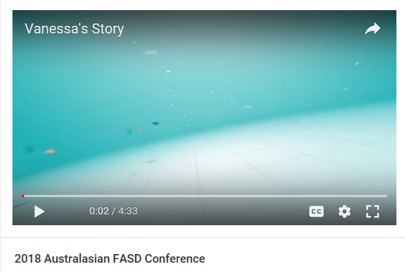
Living with FASD: Vanessa’s story

Slide 64
Personal and social capability: Daily living skills
Daily living skills are the life skills used to cope with everyday tasks and to live independently in a safe and socially responsible way.
They require the application of:
conceptual skills such as language, reading, mathematics, reasoning
and memory
social skills such as social judgement, empathy and interpersonal skills required for friendships
practical self-management skills such as hygiene, work requirements, financial management, recreation, commitment and organisation.

Slide 65
Personal and social capability: Daily living skills
Effective teachers provide opportunities for students to develop their social skills and build independence through:
explicit teaching, modelling and role playing the skills required for organisation
timelines, visual schedules and daily overviews
the use colour as a way of organising materials
cooperative learning, small group work and peer mentoring.
Social skills are modelled and practised throughout the day and across
learning areas.

Slide 66
Activity: Personal and social capability
In small groups, discuss:
the strategies you could immediately use in your daily classroom practice
how these strategies will help provide better supports for students to develop their personal and social capability.

Slide 67
Module outcomes
This professional learning has developed your understandings about:
Fetal Alcohol Spectrum Disorder (FASD)
the impact of FASD on the way the brain functions
effective approaches to:
  support students to access to the curriculum
  provide supportive learning environments
  teach personal and social capability.
a range of strategies that support all student with diverse learning needs

Slide 68
Call to action: Planning for improvement
Apply what you have learnt to your classroom. Join with a trusted colleague and in:
one week, share the strategies you plan to implement
five weeks, discuss what is working well
10 weeks, discuss what you have kept, removed or changed in order to meet the diverse learning needs of your students.

Slide 69

More support
For complex cases, support is available through Statewide Services Centre:
• Schools of Special Educational Needs.
  – SSEN: Behaviour and Engagement
  – SSEN: Disability
  – SSEN: Sensory
  – SSEN: Medical and Mental Health
• Disability Support Services
• School Psychology Service
Department of Education
Statewide Services Centre Reception 9402 6101

