Slide 1


Defence industry
Skills, pathways and careers
D24/0472719
February 2026
Image © Government of Western Australia (2024). Source: The Other Force
Notes:
Use this PowerPoint in conjunction with the Defence Industry: Skills, pathways and careers lesson plan and student worksheet, found on the Department’s Education Resources website.

Slide 2


What is defence industry?
Image © Commonwealth of Australia. Source: ADF Careers
Image © Government of Western Australia (2024). Source: The Other Force
The Australian Defence Force
(made up of the Army, Navy and Air Force)
Defence industry
Notes:
Display the question “What is defence industry?” and ask students what they think is meant by ‘defence industry’. Expect to hear responses that describe the Australian Defence Force such as the Army, Navy and Air Force.
Click to display the 2 images, one depicting two members of the Air Force in uniform (Australian Defence Force) and one depicting defence industry. Invite students to respond further to the 2 images before clicking to display the image captions which differentiate between the Australian Defence Force and defence industry.

Slide 3
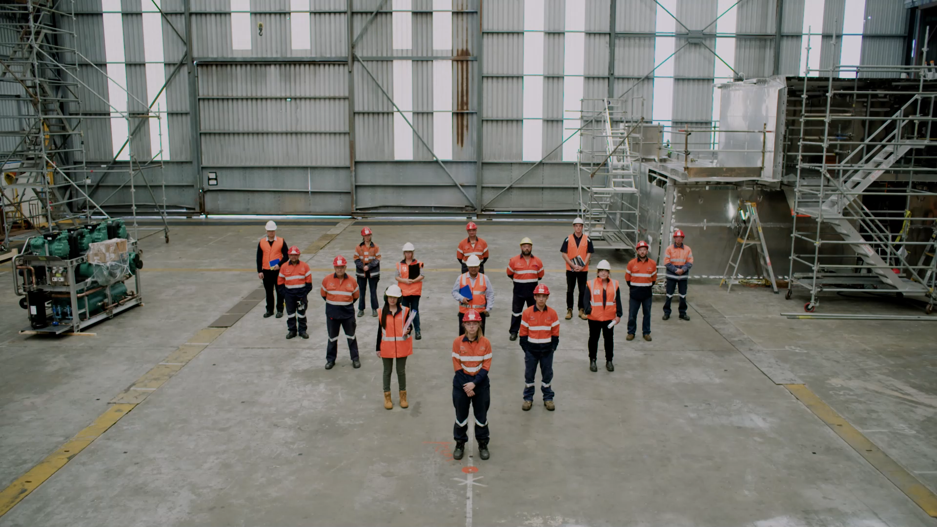
Notes:
Play this short clip and lead a discussion on how the video compared to student answers about what defence industry is.
Video © Government of Western Australia (2024). Source: The Other Force

Slide 4
What is defence industry?
Defence industry is not the Australian Defence Force.
Defence industry is made up of private-sector businesses that design, develop, produce and maintain the products, services, and technologies required by the Australian Defence Force.
Image © Government of Western Australia (2024). Source: The Other Force
Notes:
Explain the definition of defence industry - ‘The private-sector businesses that design, develop, produce and maintain the products, services, and technologies required by the Australian Defence Force’. It refers to the network of organisations, companies, and workers that design, build, and maintain the equipment, technologies, and services that support Australia’s defence capabilities.
Instruct students to write this definition on their worksheet.
Discuss why people might confuse defence industry and the Australian Defence Force.
Inform students that working in the defence industry does not mean joining the Australian Defence Force.

Slide 5

Why defence industry?
Western Australia's defence industry needs skilled workers to meet future industry requirements and prepare for major projects happening now and in the future.
Image © Government of Western Australia (2024). Source: The Other Force
Notes:
Ask students what they already know about defence industry and/or if they know of any defence industry projects, which may require skilled workers now and into the future.
Explain that, as the Western Australian Defence sector grows, it will generate new jobs that require thousands of highly qualified and skilled workers. WA’s defence industry is set to support 10,000 highly-skilled jobs over the next two decades. (Delivering a Skilled Workforce | DTWD Defence Industry)
Explain, for example, that AUKUS will have a big impact on the shipbuilding sector and that a world-class shipbuilding precinct will be built in Henderson. It will need skilled workers for blue/grey-collar jobs such as structural steel fabrication, welding and metal fitting, alongside white-collar professions such as such as project management and cyber security.

Slide 6
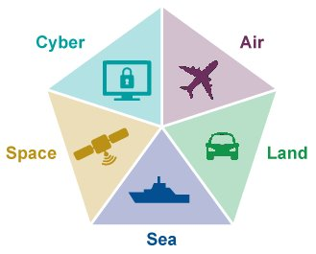
The 5 domains of the defence industry
Notes:
Information from the WA Defence Industry Domains | The Other Force webpage refers to these 5 domains as: Information and Cyber, Air, Space, Land and Maritime.
Western Australia is home to around 200 businesses involved in developing, maintaining, supporting and implementing cutting edge technology, infrastructure and assets across the five defence domains.
Ask students which of the 5 domains they think AUKUS-generated jobs predominantly fall under.
Each defence industry domain offers a range of jobs across trade (blue collar), paraprofessional (grey collar - trained to assist a professional but not licensed or fully trained to practice in the profession) and professional (white collar) roles.
Skills, knowledge and experience can be transferrable across domains, expanding career options and opportunities.

Slide 7

Skills needed in defence industry
Some in-demand skills in the defence industry include:
Engineering
Design
Manufacturing
Program management
Logistics
Support services
Image © Government of Western Australia (2024). Source: The Other Force
Notes:
Ask students to think about what skills are needed in defence industry (thinking about what they saw in the video clip and from the 5 domains). Following discussion, click to display a list of skills. Emphasise that each skill is used across a range of roles in the defence industry, with jobs available at different levels.
Note: The defence industry website contains more in-depth information about each in-demand skill, its sub-disciplines and associated skills.

Slide 8
In-demand occupations within WA’s defence industry
Automation/Robotics/Mechatronics engineers
Business development manager
Cybersecurity specialist
Drafter
Electrical engineer
Program manager
Software engineer
Occupation | Description
Electrical engineer
design, develop and oversee the manufacturing, installation, operation and maintenance of electrical machines and systems
Drafter
work closely with engineers to create precise drawings, technical plans and maps
Program manager
oversee and coordinate multiple special Defence projects and support services
Automation/Robotics/ Mechatronics engineers
design, develop, manufacture and test robotics systems and smart machines
Cybersecurity specialist
design, develop and test cybersecurity software applications and systems
Software engineer
develop specifications and oversee the design, construction and testing of advanced software systems
Business development manager
identify, plan and coordinate research and development activities to enhance the business’ goods and services
Notes:
Instruct students to look at the in-demand occupations within WA’s defence industry on the slide and match them to the descriptions provided in the table. Review the correct answers as a class.

Slide 9
Pathways to defence industry
Given the range of in-demand roles within defence industry, there are many pathways to a successful career.
School | VET | Apprenticeships and Traineeships | University
People with Science, Technology, Engineering and Mathematics (STEM) skills and training are highly sought-after.
Studying STEM subjects in school is important for undertaking a career in defence industry.
STEM subjects include:
Physics
Engineering
ICT
Metal fabrication
TAFE WA offer defence industry related courses, including:
Certificate II and III in Engineering (with different specialisations)
Certificate III in Electrotechnology Electrician
Certificate IV in Cyber Security
Diploma of Business
Diploma of Project Management
School-based traineeships - Certificate III in Defence Industry Pathways
The Defence Industry Pathways Program (DIPP) offers a fully funded, 12-month paid traineeship.
The program includes mentoring and on the job training with some of WA's leading defence industry employers, as well as on-campus training at TAFE for a nationally recognised qualification (Certificate III in Defence Industry Pathways)
All four of WA’s universities have programs in areas such as engineering that relate directly to defence, including:
Bachelor of Science (Cyber Security)
Bachelor of Engineering Technology
Bachelor of Advanced Computing Science
Bachelor of Information Technology in Artificial Intelligence and Autonomous Systems
Notes:
Highlight the different pathways available to careers within defence industry.

Slide 10
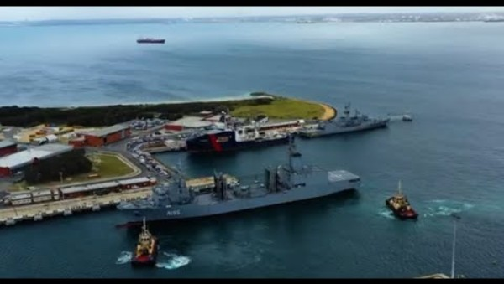
Opportunities within defence industry at South Metropolitan TAFE
Notes:
When you open this PowerPoint file, a security warning will appear. Click Enable Content to allow the video to play.

Slide 11
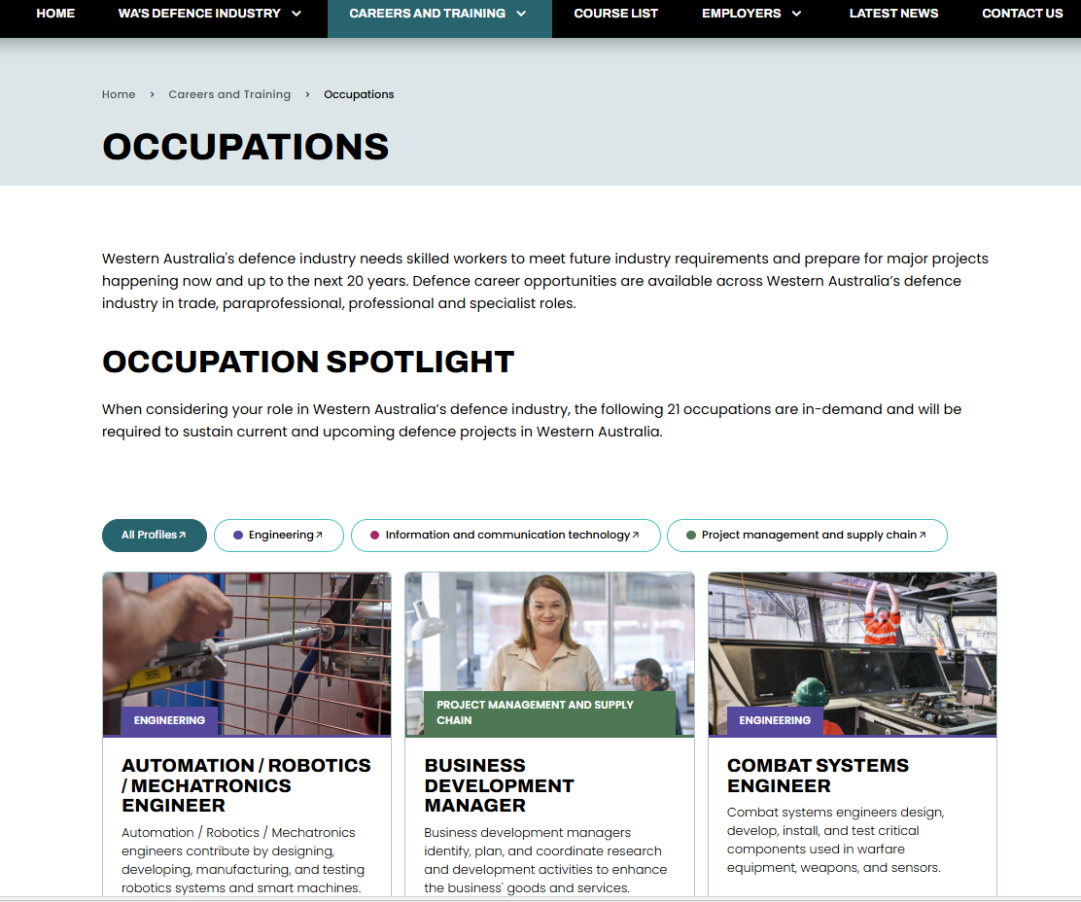
Activity 3 - Defence industry occupation spotlight
Notes:
Direct students to occupation spotlight page on The Other Force website to complete Activity 3. Display this slide for reference.
Instruct students to explore the in-demand occupations within WA’s defence industry, choose a job that interests them and complete the table on their worksheet using the information provided on the website.

Slide 12

Defence Industry Career Advice
A dedicated defence industry team is available at the Rockingham Jobs and Skills Centre to provide free advice about jobs, careers, and training pathways into the defence industry.
T: 08 9599 8655
E: defence.careers@smtafe.wa.edu.au
Building G — SM TAFE Rockingham Simpson Avenue Rockingham
Notes:
This team can also visit your school and talk to students.

