Slide 1
Agriculture and Technology

Slide 2
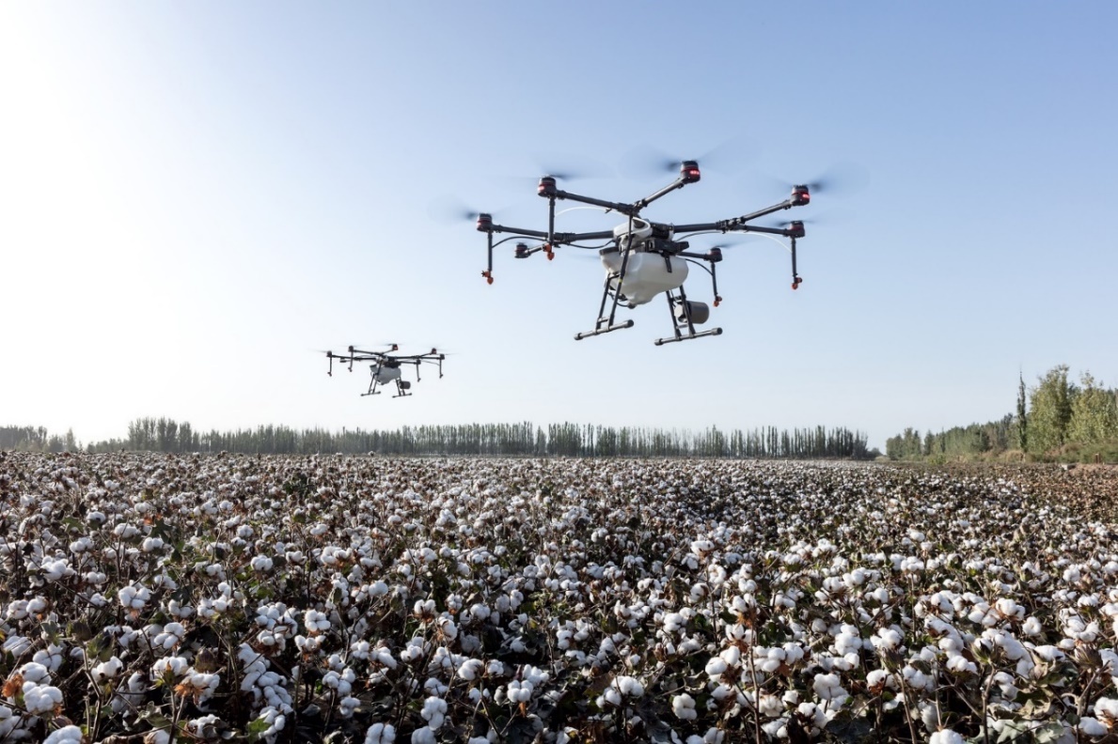
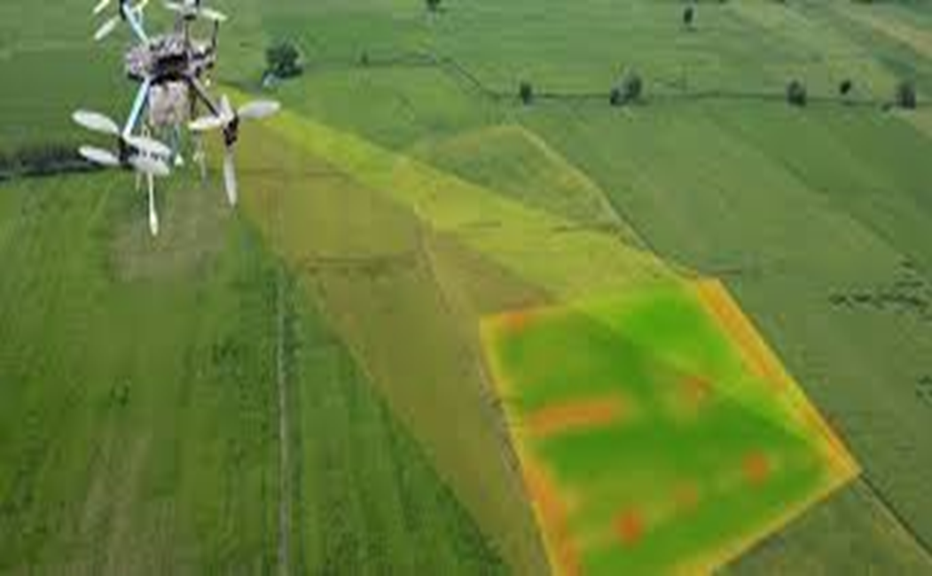
Drones
Adapted from military use
Used in agriculture to assist in variable rate applications, decreasing fertiliser, chemical and water use by:
Using sensors to inspect fields for moisture deficiencies
Using sensors to calculate vegetation index / heat signatures
Using cameras to monitor livestock
Capturing images, including near-infrared, to show detailed crop development and reveal crop health and spot bacterial or fungal infection
Using sensors and automated distance-measuring equipment to scan the ground and target spray the correct amount of chemicals
Notes:
Image- drones monitoring a cotton crop Image by Agriculture Drone Dji - Free photo on Pixabay
More info- 18-048.pdf (agrifutures.com.au)

Slide 3
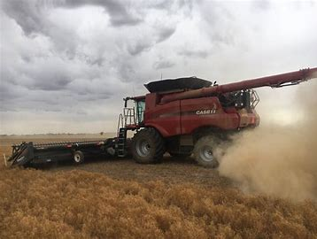
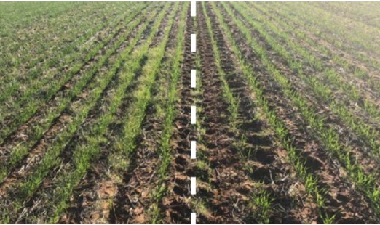
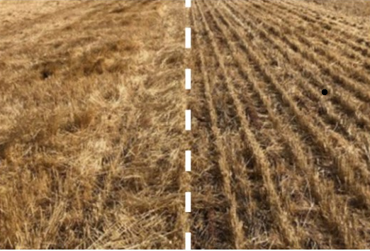
Harrington Seed Destructor
Created by WA farmer Ray Harrington in 2012
Latest version in 2018. Can be fitted to a variety of combine harvester brands
Weeds are usually sprayed with herbicide
Weed populations that have developed herbicide resistance pose an increasing threat to WA's agricultural production.
With the Seed Destructor, 99% of weed seeds are destroyed at harvest
Prevents seeds from entering the seed bank and using up soil moisture
Helps combat the problem of herbicide resistant weeds
Reduces chemical use
without with destructor without with destructor

Slide 4
The Internet of Things
The Internet of Things is a network of objects that are connected wirelessly using sensors.
Connected objects can include humans, animals, plants and infrastructure.
Potential Benefit to Agriculture:-
Precision Agriculture
Livestock monitoring
Improve supply chains

Slide 5
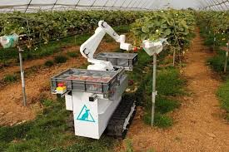
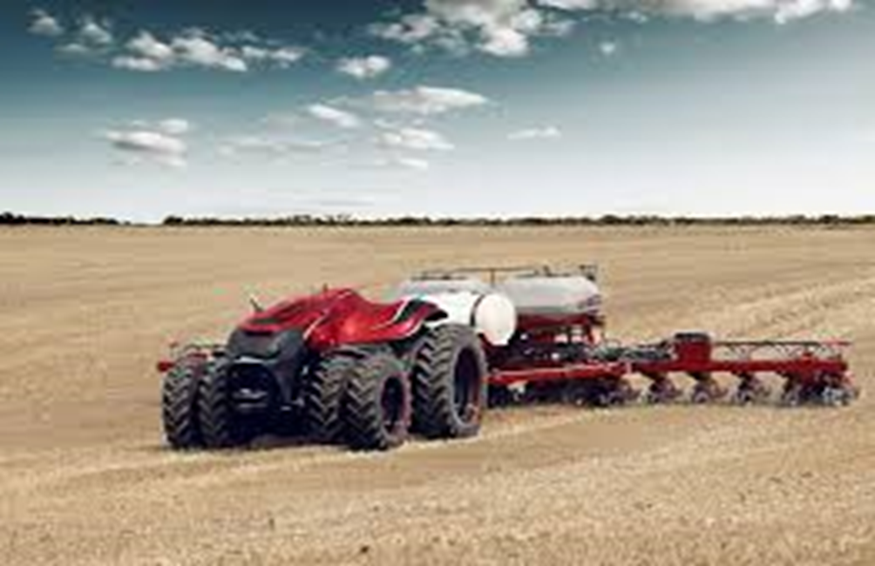
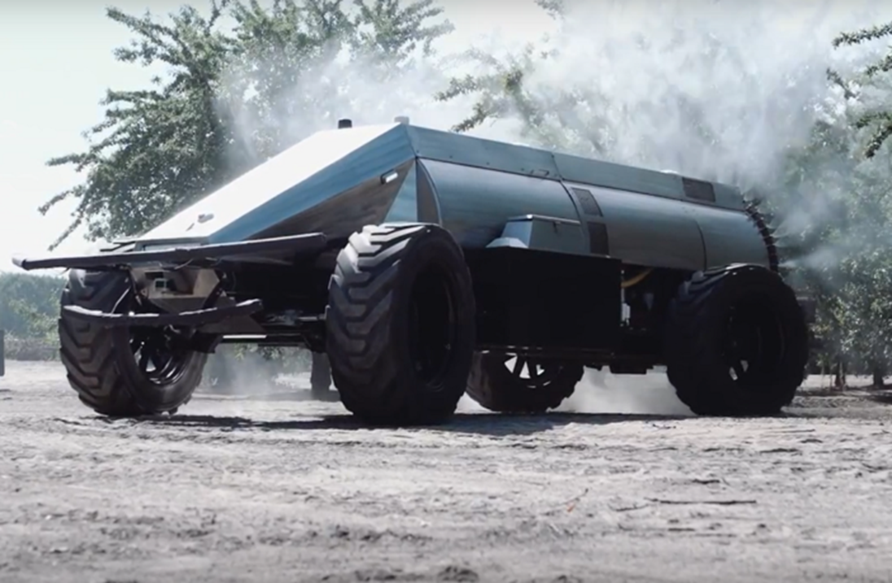
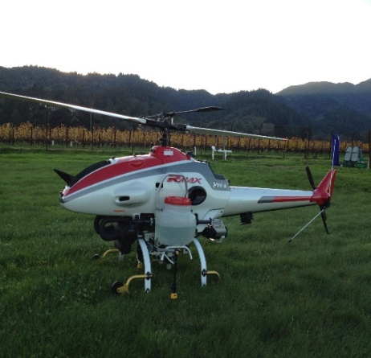
Robots and autonomous vehicles
Potential benefits:
Targeted management means reducing chemical use
Combine autonomous tractors and sensors along with management software to help lift crop yields by 70% by 2050
Ability to collect data, include information on yield, chemical use, soil data, livestock stress, and crop condition
Collecting and processing field data, robots have the capability to help reduce operating costs associated with insecticides, herbicides and fertilisers by 40%
Safer and cheaper production e.g. robotic weeding vs hand weeding in horticulture
Finding labour in remote locations is stressful for farmers, and they often have to fill the gap themselves.
Notes:
Photos- top two- robotic strawberry picker (imagine the sensitivity needed to pick without crushing!). Uses sensors to determine ripeness
Bottom four- prototypes of autonomous vehicles. Tractor (towing plough), sprayer, targeted weed sprayer (similar to drone tech)

Slide 6
Nanomaterials
Potential uses in Agriculture
Sensors: Use in soil analysis and bio-chemical sensing and control (e.g. electrochemically active carbon nanotubes, nanofibers and fullerenes).
Fertilisers: The nanofertilisers coated in nanoscale polymers are being shown to increase product stability and can control nutrient release from the granules.
Pesticides: nanoparticles, nanotubes and nanocomposites could be used for the detection, degradations and removal of pesticides.
Animal Husbandry: Nanomaterials have shown potential for use in targeted animal health products and as additives to stock feeds
Water Treatment: Pollution removal
Currently, the main uses for nanomaterials are in medicine, environmental science, and food processing (e.g. additives and food contact materials)
Potentially, they can be used to improve seed germinations and growth, plant protections, pathogen detection and pesticide / herbicide residue detection
Benefits would be in increasing yields while minimising input costs and providing environmental benefits.
Notes:
Information from 18-048.pdf (agrifutures.com.au)

Slide 7
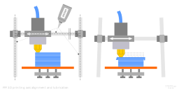
3D PRINTING
3D printing is the process of constructing a three dimensional object using a variety of materials.
Potential benefits to agriculture:
Reduces the cost and time to produce equipment
Improves supply chains
Assists researchers when developing new products
Notes:
paulo@kiefe.com, CC BY-SA 4.0 <https://creativecommons.org/licenses/by-sa/4.0>, via Wikimedia Commons
https://upload.wikimedia.org/wikipedia/commons/0/00/3D_printing_calibration_axis_alignment_movement_and_lubrication.svg

Slide 8
Acknowledgements
Original PowerPoint designed by
Stacey Carter BSc (Biomed) Grad Dip (Education) Course Coordination and Learning Design - Associate Degree in Agribusiness
Faculty of Science and Engineering Curtin University Room | 303.285 Tel | (08) 9266 4568
Email | stacey.carter@curtin.edu.au
Web | www.curtin.edu.au

