Slide 1
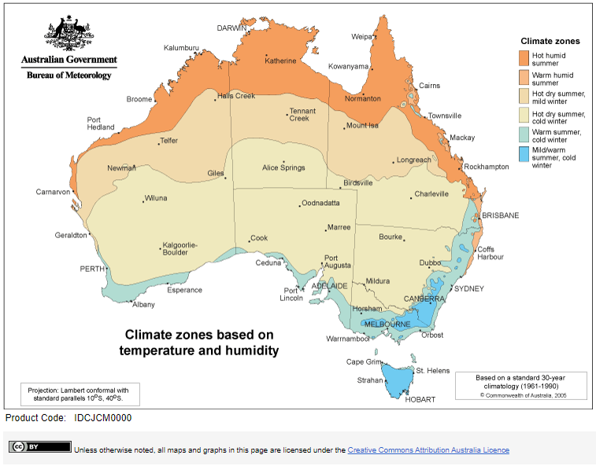
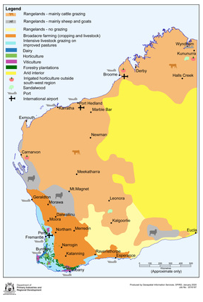
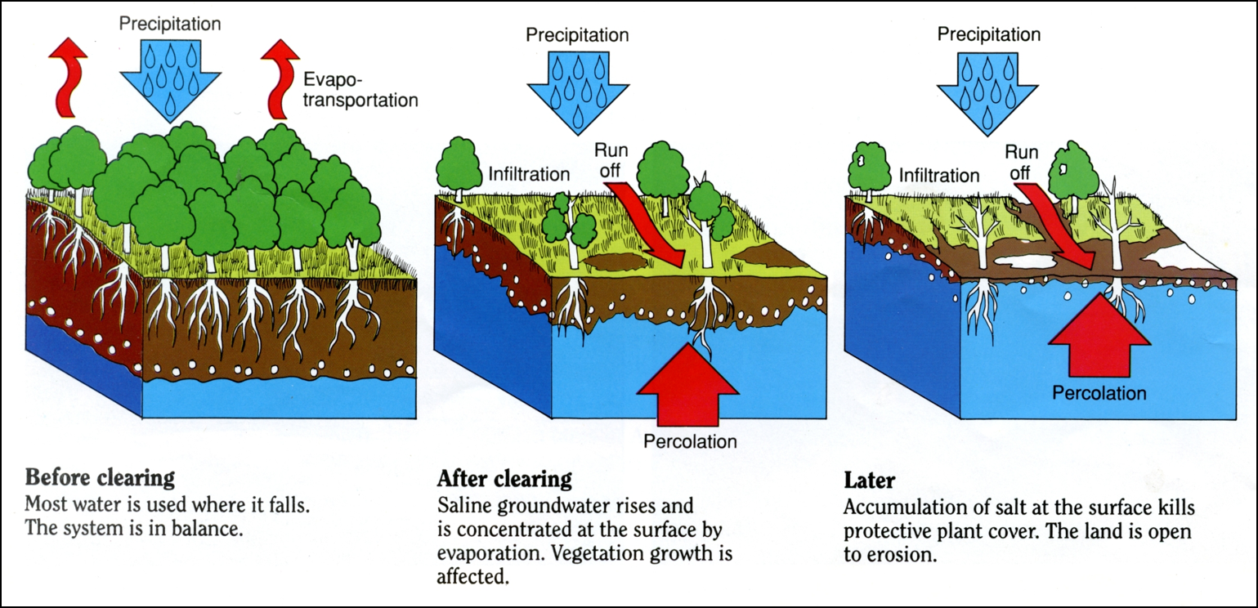
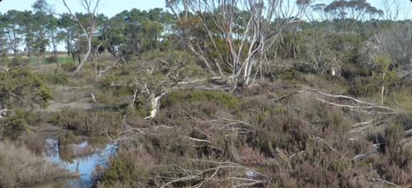
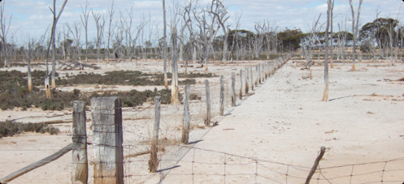
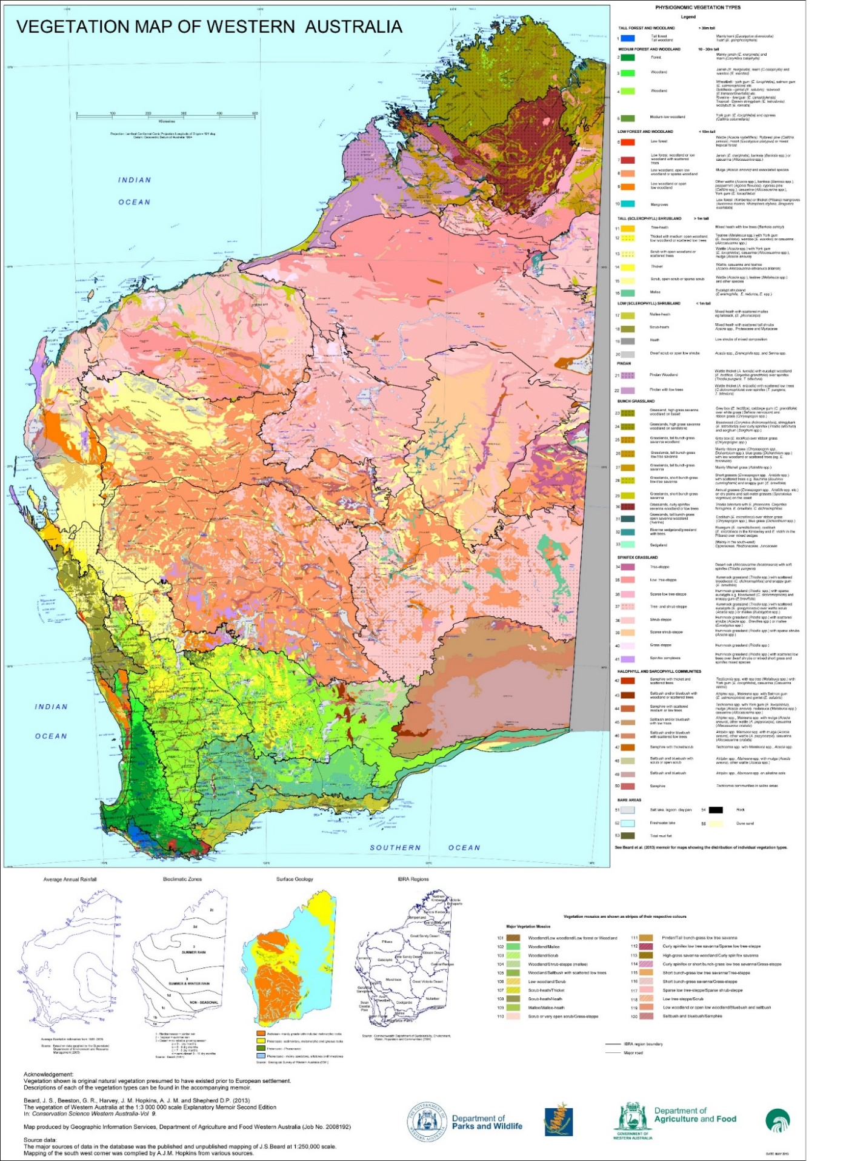
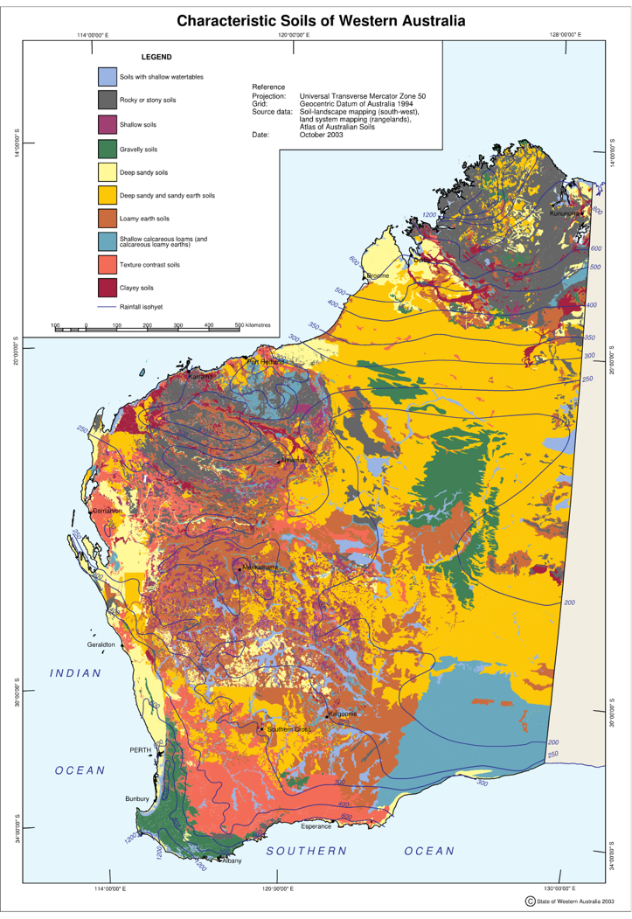
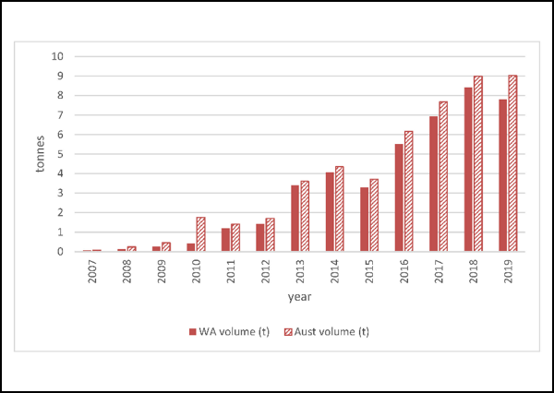
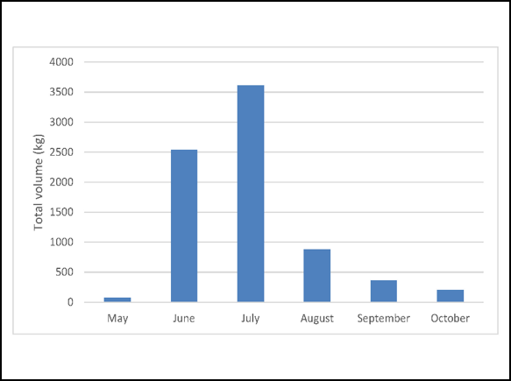
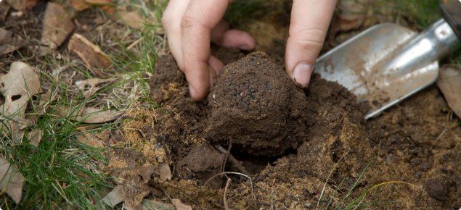
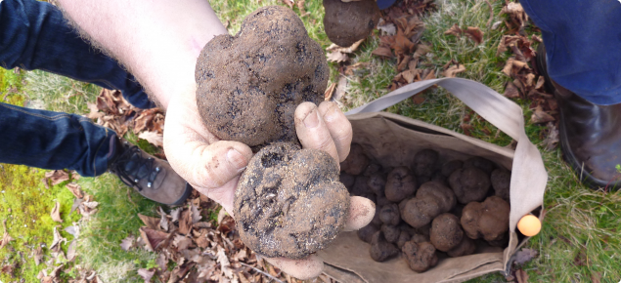
SPOTLIGHT ON WESTERN AUSTRALIA – BIOMES
Figure 1.1
CLIMATE ZONES
LAND USE MAP
Figure 1.3
Figure 1.5
SALINITY
Image 1.1
Image 1.2
PRE-EUROPEAN VEGETATION OF WESTERN AUSTRALIA
TRUFFLE CASE STUDY
Figure 1.2
WESTERN AUSTRALIAN SOILS
Figure 1.4
The truffle has been developed around the black truffle produced by Tuber melanosporum.
The first commercial plantings of T. melanosporum in Western Australia occurred in 1997.
The first black truffle harvested in 2003, with production steadily increasing since.
The majority of WA produced black truffles are exported.
Figure 1.6
Annual volume truffle exports from Australia and WA
Total monthly volume of truffles exported from WA
Figure 1.7
Image 1.3
Image 1.4

Slide 2
Acknowledgements
Figures
1.1 ‘Climate Zones’ by Australian Bureau of Meteorology. Licensed Creative Commons Attribution Australia Licence available at <http://www.bom.gov.au/jsp/ncc/climate_averages/climate-classifications/index.jsp>
1.2 Pre-European Vegetation of Western Australia’ by Department of Parks and Wildlife available at <https://www.dpaw.wa.gov.au/images/documents/about/science/cswa/articles/PreEuropeanVegMap_Jun_14.pdf>
1.3 ‘Land Use Map’ by Department of Primary Industries and Regional Development available at <https://researchlibrary.agric.wa.gov.au/gis_maps/10/>
1.4 ‘Western Australian Soils’ by Department of Primary Industries and Regional Development available at <https://researchlibrary.agric.wa.gov.au/gis_maps/15/>
1.5 ‘Salinity’ by Western Australian Government’s State Natural Resource Management Program available at http://www.moorecatchment.org.au/wp-content/uploads/2020/03/Moore-nrm-shire-guide-March-2020-Web.pdf
1.6 ‘Annual volume truffle exports from Australia and WA’ by the Department of Primary Industries and Regional Development available at <https://www.agric.wa.gov.au/agricultural-exports/truffle-industry-western-australia>
1.7 ‘Total monthly volume of truffles exported from WA’ by the Department of Primary Industries and Regional Development available at <https://www.agric.wa.gov.au/agricultural-exports/truffle-industry-western-australia>
Images
1.1 Department of Primary Industries and Regional Development available at https://www.agric.wa.gov.au/soil-salinity/dryland-salinity-western-australia-0
1.2 Department of Primary Industries and Regional Development available at <https://www.agric.wa.gov.au/soil-salinity/dryland-salinity-western-australia-0>
1.3 Department of Primary Industries and Regional Development available at <https://www.agric.wa.gov.au/agricultural-exports/truffle-industry-western-australia>
1.4 Department of Primary Industries and Regional Development available at <https://www.agric.wa.gov.au/new-horticulture-crops/cultivation-black-truffles-western-australia>

