Slide 1
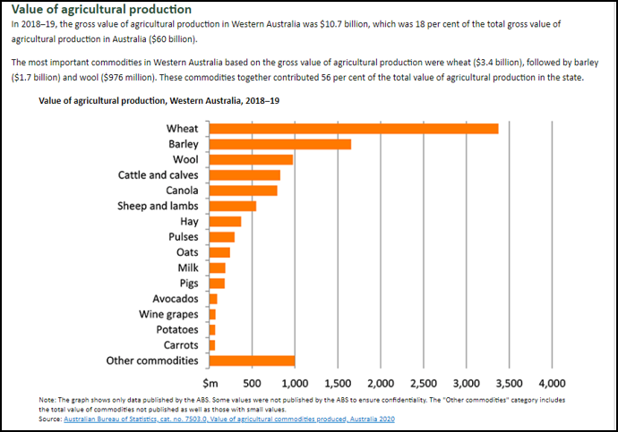
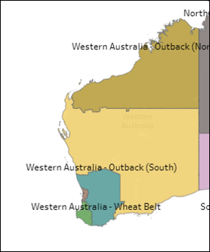
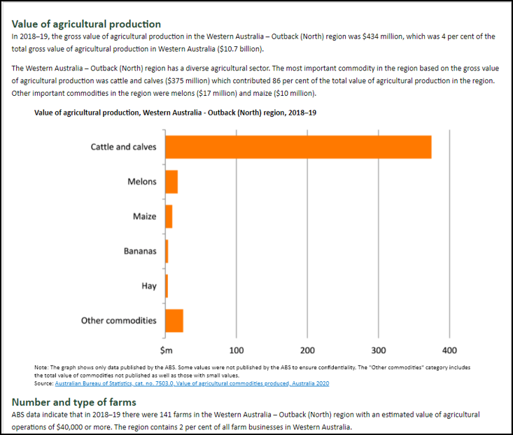
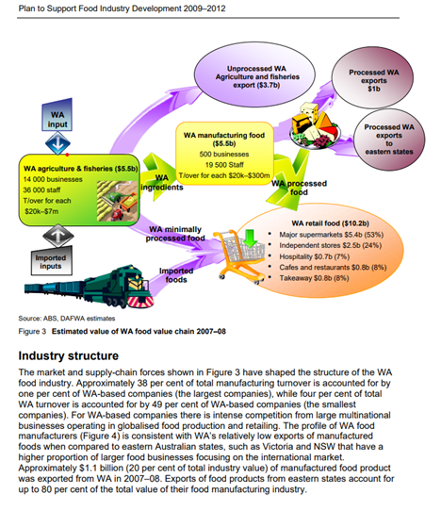
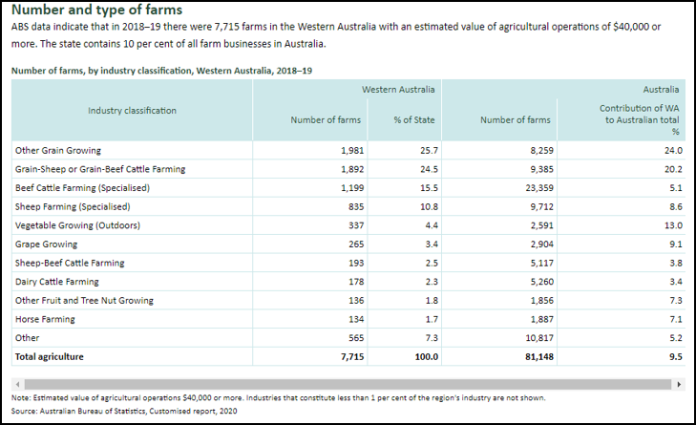
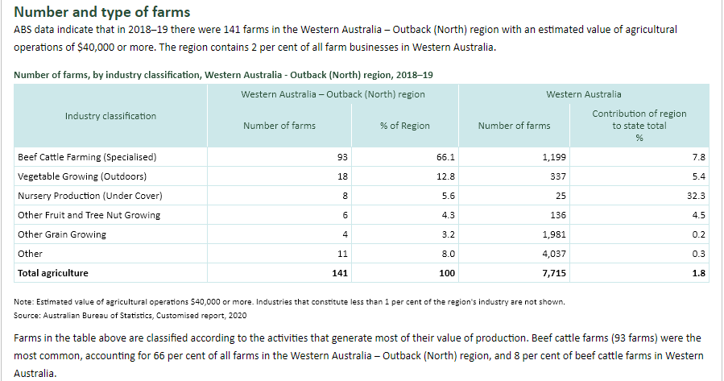
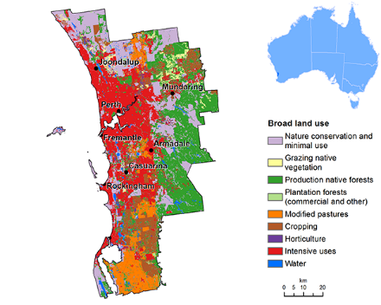
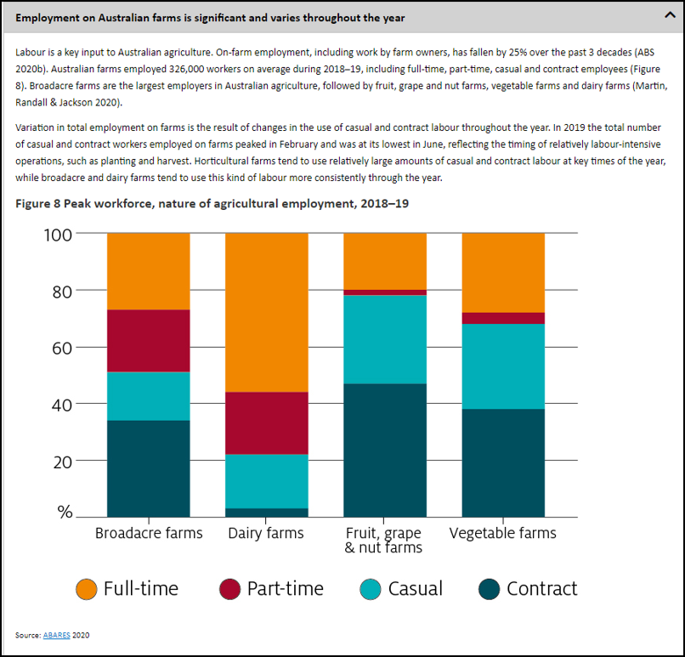
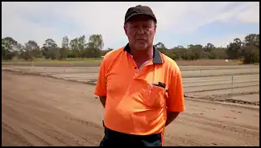
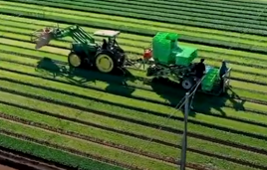
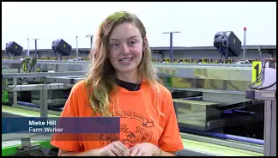
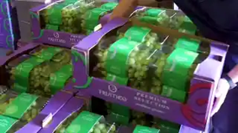
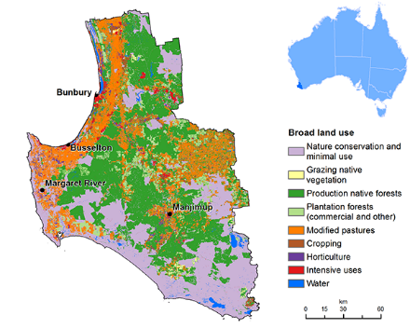
Spotlight on WA – The production of food and fibre
Figure 2.1
Figure 2.2
Figure 2.3
WESTERN AUSTRALIA
WESTERN AUSTRALIA - OUTBACK (NORTH)
SUPPLY CHAIN FOR FOOD INDUSTRY
About my region
Figure 2.4
Figure 2.5
WORKING IN AGRICULTURE
A day on….
FORESTRY
A lettuce farm
Western Australia's timber industry is sustainably managed and produces high-quality products for domestic and export markets.
Forestry sector employs 6000+ people and injects $1.4 billion into the state’s economy.
Four main timber industries in WA:
Hardwood plantation industry
Sandalwood industry
Softwood (pine) plantations industry
Native timber industry
Hardwood are used for high quality writing and printing paper and woodchips; softwood timbers are used for housing and construction; native timbers are used for furniture design, flooring and joinery and sandalwood is exported all over the world for a range of products.
A melon farm
A table grape vineyard
#Workandwander
Women in Farming
Visible Farmer
Before 1994 women could not legally be called farmers.
Women are under-represented in all areas of agriculture.
Women make up 41% of the workforce in agriculture.
About My Region: Greater Perth and Bunbury
FIFWA Infographic
PRIMED9TL001 | HASS | Food now and in the future | Infographic2 - Spotlight on WA The production of food and fibre | © Department of Education WA 2021

Slide 2
Acknowledgements
References
Australian Government, Department of Agriculture, Water and the Environment (3 August 2021) ‘About my region’ Australian Bureau of Agricultural and Resource Economics and Sciences available at <https://www.agriculture.gov.au/abares/research-topics/aboutmyregion#western-australia> accessed on 22 June 2021
Department of Primary Industries and Regional Development (n.d) #workandwander Youtube < https://www.youtube.com/hashtag/workandwander> accessed on 15 June 2021
Kaufmann Production Pty Ltd (2021) Visible Farmer: Season 1 – Western Australia online <https://www.visiblefarmer.com/Watch/> accessed on 15 June 2021
Forest Industries Federation (WA) Inc. (n.d) ‘FIFWA Infographic’ available at < https://www.forestindustries.com.au/infographic.html> accessed on 22 June 2021
Figure
2.1 ‘Western Australia’ by the Australian Government Department of Agriculture, Water and the Environment. Licenced Creative Commons Attribution (CC-BY) available at <https://www.agriculture.gov.au/abares/research-topics/aboutmyregion#western-australia>
2.3 ‘Supply Chain for Food Industry’ by the Department of Agriculture and Food Plan to Support Food Industry Development, accessed at <https://www.parliament.wa.gov.au/parliament/commit.nsf/(Evidence+Lookup+by+Com+ID)/B2E90A0DADA3793B4825794F0029AEC3/$file/ef.aar10.111116.001.aqton.Attachment+9C+Ag&Food.pdf>
2.4 ‘Working in Agriculture Employment Graph’ by Australian Government Department of Agriculture, Water and the Environment. Licenced Creative Commons Attribution (CC-BY) available at <https://www.agriculture.gov.au/abares/products/insights/snapshot-of-australian-agriculture-2021#employment-on-australian-farms-is-significant-and-varies-throughout-the-year>
2.4 ‘Working in Agriculture Man’ by the Department of Primary Industries and Regional Development, accessed at <https://www.youtube.com/watch?v=GddBstDVXJE>
2.4 ‘Working in Agriculture Woman’ by the Department of Primary Industries and Regional Development, accessed at <https://www.youtube.com/watch?v=2tjjyvIPnX4>
2.4 ‘Working in Agriculture Lettuce’ by the Department of Primary Industries and Regional Development, accessed at <https://www.youtube.com/watch?v=GddBstDVXJE>
2.4 ‘Working in Agriculture Vineyard’ by the Department of Primary Industries and Regional Development, accessed at <https://www.youtube.com/watch?v=RdODcRwkE_Q>
2.5 ‘Forestry Greater Perth’ by the Department of Agriculture, Water and the Environment, accessed at <https://www.agriculture.gov.au/abares/research-topics/aboutmyregion/wa-perth#regional-overview>
2.5 ‘Forestry Greater Bunbury’ by the Department of Agriculture, Water and the Environment, accessed at <https://www.agriculture.gov.au/abares/research-topics/aboutmyregion/wa-bunbury#regional-overview>
PRIMED9TL001 | HASS | Food now and in the future | Infographic2 - Spotlight on WA The production of food and fibre | © Department of Education WA 2021

