Slide 1
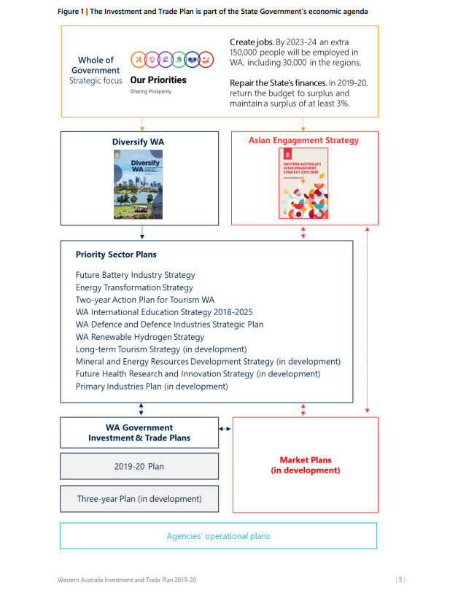
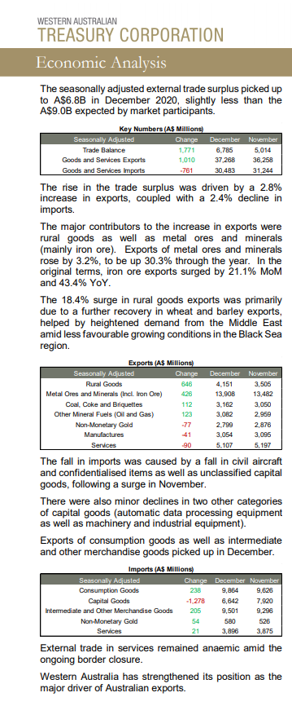
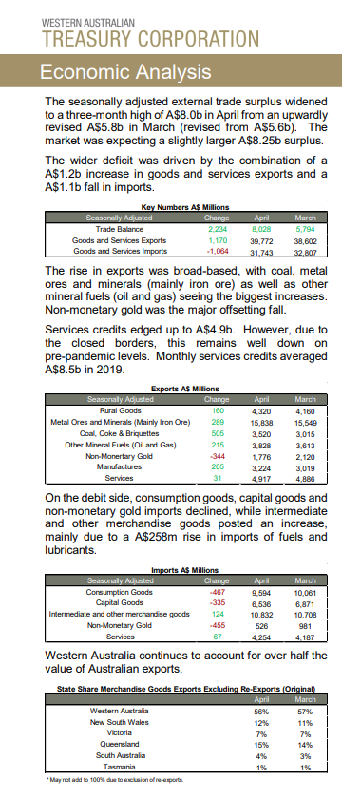
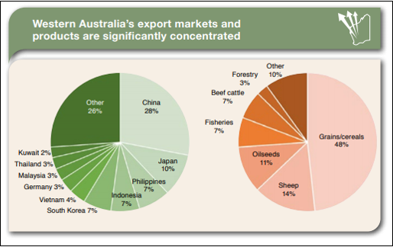
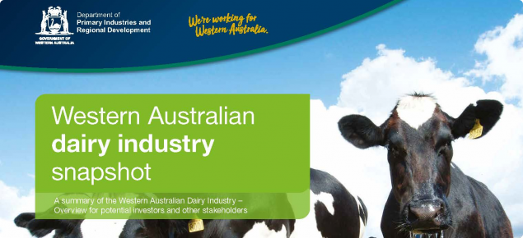
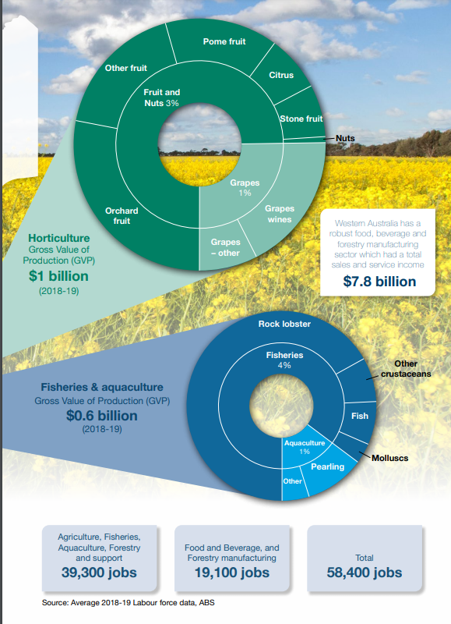
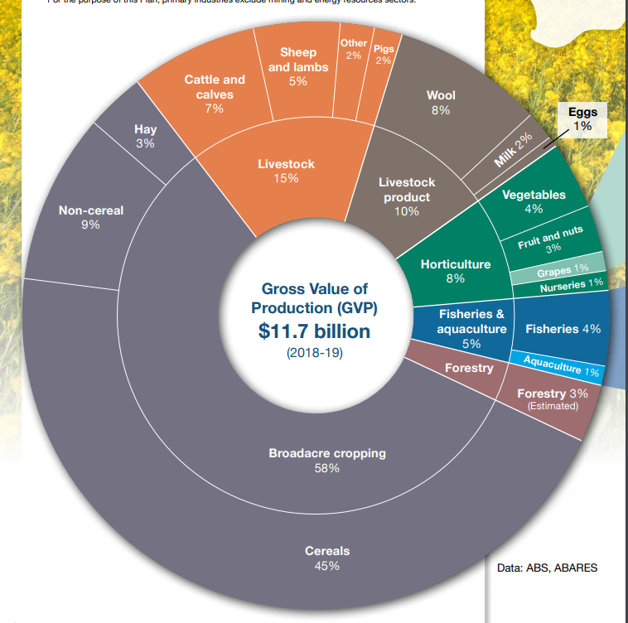
Image 3.1
SPOTLIGHT ON WESTERN AUSTRALIA - TRADE
Examples from Treasury Corporation
Western Australian Corporation Trade Balance
The Primary Industry Plan (DPIRD 2020) provides the following information:
Industry at a glance
• Primary industries¹ have played an important part in the history and development of Western Australia (WA). They are integral to the fabric of our cities and regions, and a critical part of our economy.
• WA has a diversity of established industries spanning broadacre grains, pastoral, seafood and horticultural industries.
• Production is dominated by broadacre and mixed farming systems, including grains, meat and livestock, and sheep and wool.
• Numerous emerging industries—including avocados, wine, aquaculture, and food and beverage manufacturing—add to the increasing diversity of the sector.
1 For the purpose of this Plan, primary industries exclude mining and energy resources sectors.
Figure 3.1: Western Australia’s export markets and products
Western Australia’s Top 10 trading partners
Western Australia's economy and international trade (www.wa.gov.au)
Figure 3.3: State Government contribution to WA economic agenda
Top 10 Western Australian markets for total trade in goods (exports and imports) by value in 2020.
Rank in 2020 | Market | Value A$ billion | Share of WA total (%)
1 | China (Mainland) | 109.7 | 50.0
2 | Japan | 20.4 | 9.3
3 | United Kingdom | 13.3 | 6.0
4 | United States | 11.3 | 5.2
5 | South Korea | 10.7 | 4.9
6 | Singapore | 9.0 | 4.1
7 | Hong Kong | 5.0 | 2.3
8 | Thailand | 4.0 | 1.8
9 | Malaysia | 3.5 | 1.6
10 | Taiwan | 3.3 | 1.5
Western Australian Industry Snapshots (DPIRD 2020) provides the following information:
The snapshots are designed to drive investment interest from a range of sources – supply chain; innovation, new product development and marketing; expansion; research, development and innovation; and public sector capacity building, education and support.
The snapshots include information on current growth trends, comparative advantages, production capacity, export details, market demand, supply chain returns, investment themes and value propositions for investment.
Western Australian Industry Snapshots
Image 3.2
Image 3.3
Top 10 Western Australian markets for export of goods by value in 2020.
Rank in 2020 | Market | Value A$ billion | Share of WA total (%)
1 | China (Mainland) | 103.6 | 55.6
2 | Japan | 18.0 | 9.7
3 | United Kingdom | 12.1 | 6.5
4 | South Korea | 10.1 | 5.4
5 | Singapore | 7.9 | 4.2
6 | United States | 6.7 | 3.6
7 | Hong Kong | 4.4 | 2.4
8 | Taiwan | 3.0 | 1.6
9 | Malaysia | 2.2 | 1.2
10 | Germany | 2.1 | 1.1
Figure 3.2: Gross Value of production of WA exports
Top 10 Western Australian markets for imports of goods by value in 2020.
Rank in 2020 | Market | Value A$ billion | Share of WA total (%)
1 | China (Mainland) | 6.1 | 18.5
2 | United States | 4.6 | 13.9
3 | Thailand | 2.7 | 8.2
4 | Japan | 2.4 | 7.3
5 | Malaysia | 1.4 | 4.1
6 | United Kingdom | 1.2 | 3.5
7 | Singapore | 1.1 | 3.3
8 | Indonesia | 1.1 | 3.2
9 | Germany | 1.0 | 2.9
10 | United Arab Emirates | 0.9 | 2.8
Images 3.4
Images 3.5

Slide 2
Acknowledgements
Reference
Western Australian Treasury Corporation (2021) ‘Trade Balance’ available at <https://www.watc.wa.gov.au/economic-services/economic-analysis/economic-indicators/trade-balance/> 21 June 2021
Western Australian Government (n.d) ‘Western Australia’s economy and international trade’ available at <https://www.wa.gov.au/government/publications/western-australias-economy-and-international-trade> accessed on 22 June 2021
Department of Primary Industries and Regional Development (6 August 2020) ‘Western Australian Industry Snapshots’ available at <https://www.agric.wa.gov.au/Waindustrysnapshots>
Figures
3.1 ‘Western Australia’s export markets and products’ by the Department of Primary Industries and Regional Development available at <https://www.wa.gov.au/system/files/2020-12/Primary-Industries-Plan-2020-24.pdf>
3.2 Figure 3.2: Gross Value of production of WA exports by the Department of Primary Industries and Regional Development available at <https://www.wa.gov.au/system/files/2020-12/Primary-Industries-Plan-2020-24.pdf>
3.3 ‘State Government contribution to WA economic agenda’ by the Government of Western Australia available at <https://www.wa.gov.au/sites/default/files/2021-01/202021%20Investment%20and%20Trade%20Plan.pdf>
Images
3.1 ‘Western Australian Flag’ by Clker-Free-Vector-Images/29565. Licenced https://pixabay.com/service/license/ Free for commercial use. No attribution required. Available at https://pixabay.com/vectors/western-australia-flag-state-28587/> (If these links above do not work, try copying the link into the address bar of your browser.)
3.2 ‘Western Australian Industry Snapshots – Dairy Industry’ by the Department of Primary Industries and Regional Development. Available at <https://www.agric.wa.gov.au/Waindustrysnapshots>
3.3 ‘Western Australian Industry Snapshots – Aquaculture Industry’ by the Department of Primary Industries and Regional Development. Available at <https://www.agric.wa.gov.au/Waindustrysnapshots>
3.4 ‘Western Australian Industry Snapshots –Horticulture Industry’ by the Department of Primary Industries and Regional Development. Available at <https://www.agric.wa.gov.au/Waindustrysnapshots>
3.5 ‘Western Australian Industry Snapshots-Processed Foods Industry’ by the Department of Primary Industries and Regional Development. Available at <https://www.agric.wa.gov.au/Waindustrysnapshots>

