Slide 1
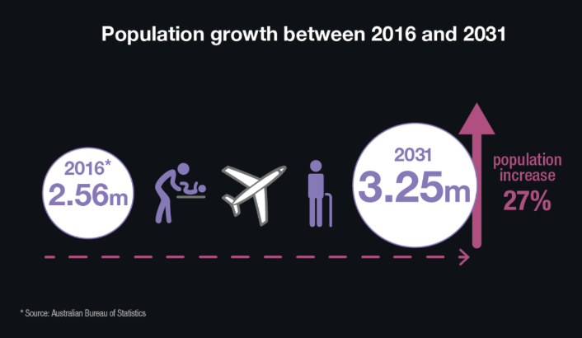
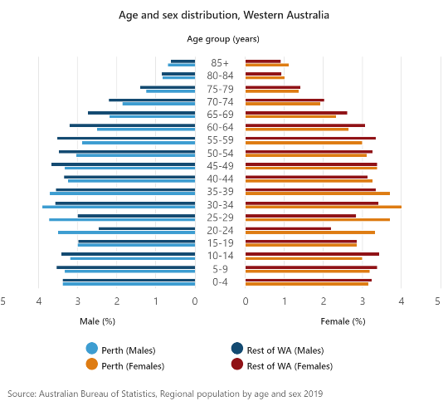
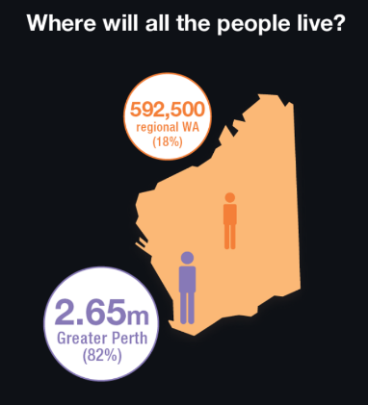
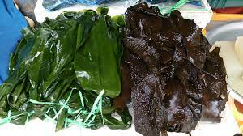
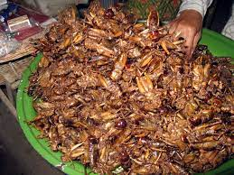
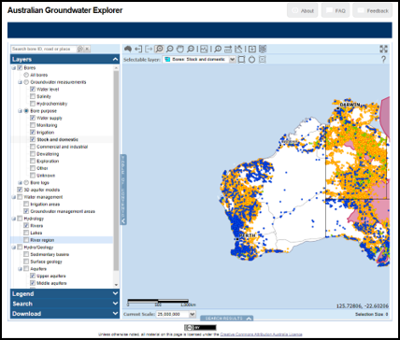
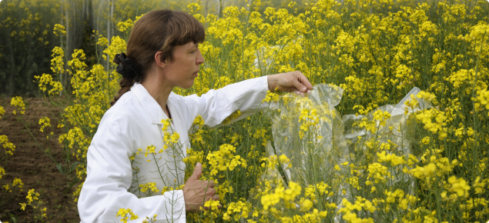
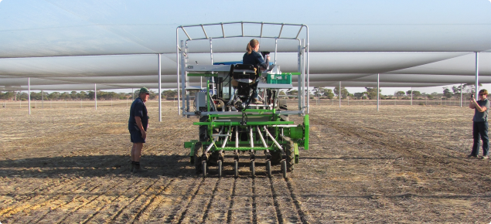
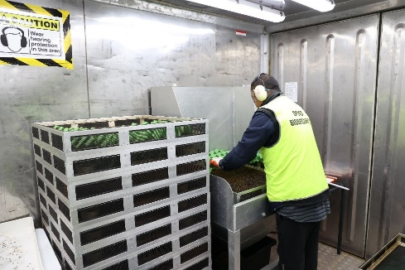
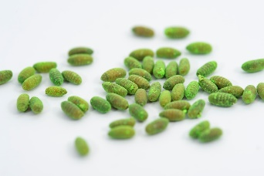
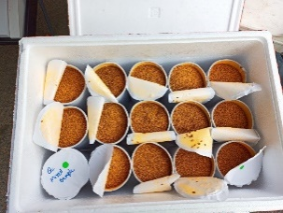
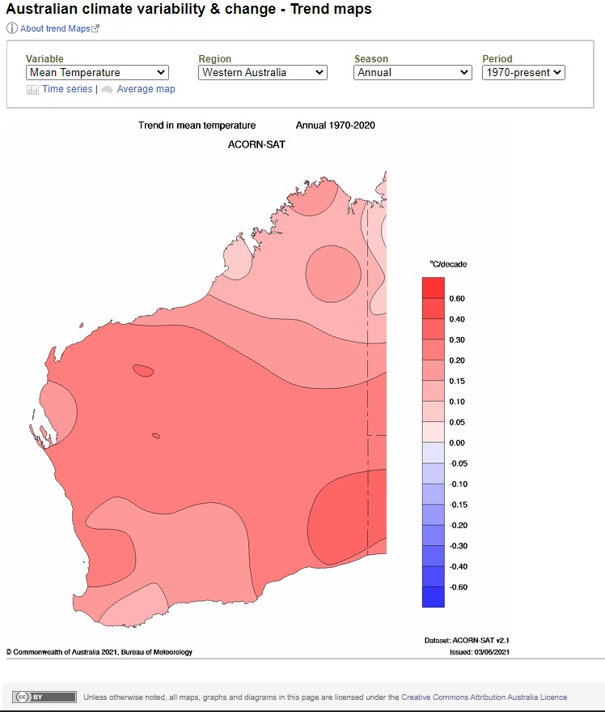
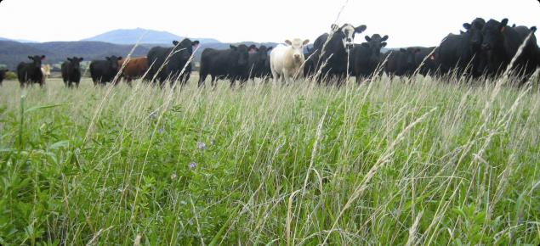
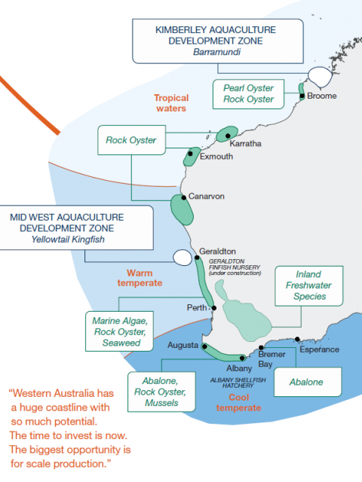
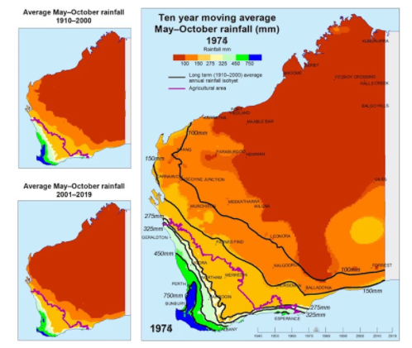
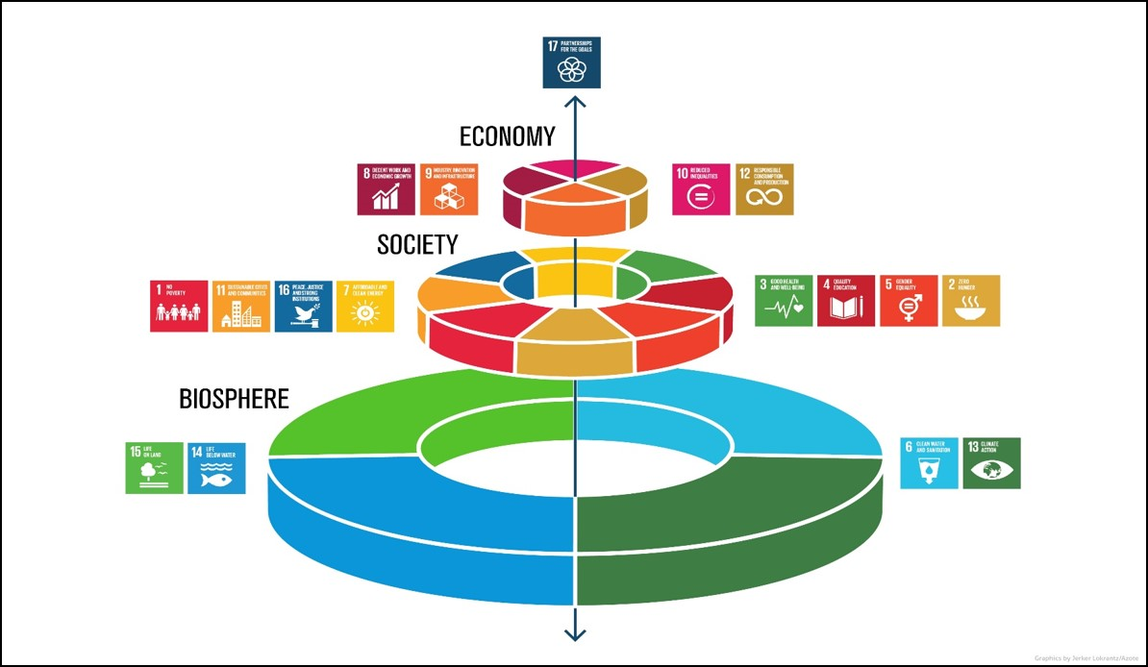
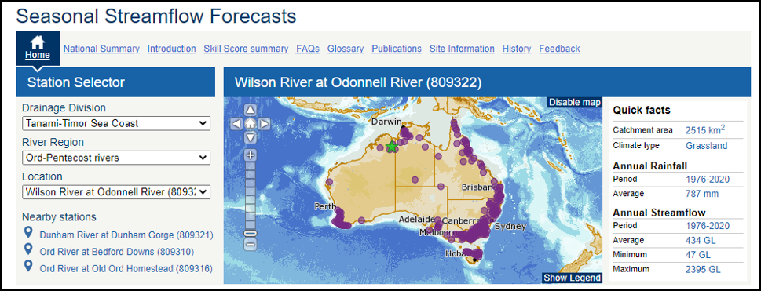
Figure 4.1
POPULATION GROWTH
Population growth, urbanisation and aging
FUTURE FOOD SECURITY
Figure 4.6
FUTURE FOOD OPTIONS
As the global population increases and traditional protein sources from meat become increasingly constrained, the need to diversify our food supply with alternative and more sustainable sources of proteins must play a role in filling this gap. Alternatives include:
insects
algae
lab grown meat
Figure 4.3
WESTERN AUSTRALIA (WA) FOOD SECURITY PLAN
Food Security Plan for Western Australia
WA population expected to double by 2050
Australia contributes to the diets of nearly 400 million people
Producers, suppliers, consumers, researchers and governments must work together
Story Maps: WA Tomorrow
Figure 4.2
WATER AVAILABILITY
Figure 4.7
RESEARCH AND GM CROPS
Genetic modifications are playing an increasingly important role
in crop science with greater areas being planted to genetically
modified (GM) crops in over 25 countries worldwide,
including Australia.
All agricultural systems rely on water.
The BOM provides data on supplies, usage and trends.
Figure 4.4
CASE STUDY - PESTS AND DISEASES
QUEENSLAND FRUIT FLY IN WESTERN AUSTRALIA
Biosecurity means protecting the economy, environment, and the community from the negative impacts of pests, disease, weeds, and contaminants.
Figure 4.8
AQUACULTURE
Figure 4.5
REGENERATIVE AGRICULTURE AND PASTORALISM IN WA
The principle of regenerative agriculture and regenerative pastoralism is to enhance natural ecosystem services, resulting in sustainable production, an improved natural resource base, healthy nutrient cycling, increased biodiversity and resilience to change.
Aquaculture, the world’s fastest-growing food production sector, is set to overtake capture fisheries as the major source of seafood. The share of farmed species in global fishery production was 46% in 2018, which is projected to exceed that of wild species for the first time in 2020 and to grow to 54% in 2030. Total world fish production (capture plus aquaculture) is expected to continue to expand to reach 201 million tonnes in 2030, with the major growth in production originating from aquaculture, which is projected to reach 109 million tonnes in 2030.
The State of Food Security And Nutrition in the World 2020
Figure 4.9
PRIMED9TL001 | HASS | Food now and in the future | Infographic4 – Future Food Security | © Department of Education WA 2021

Slide 2
Acknowledgements
Reference
Government of Western Australia (n.d) ‘Story Map WA population’ Department of Planning, Lands and Heritage available at
<https://storymaps.arcgis.com/stories/87e2fc367b4f4252a4b4ffa3a65fbb54> accessed on 9 August 2021
Curtin University and NRM (2019) ‘Food Security Plan for Western Australia: Situation report to guide the strategic development of a food security plan for Western Australia 2019’ available at <https://www.perthnrm.com/nrmwp/wp-content/uploads/2020/06/WA-Food-Security-Plan-Situation-Report-LR-web-spreads.pdf> [PDF 2,002 Kb] accessed on 9 August 2021
Food and Agriculture Organization of the United Nation (13 June 2020) ‘The State of Food Security and Nutrition in the World 2020’ YouTube available at <https://www.youtube.com/watch?app=desktop&v=64KLuGzGxEQ&feature=youtu.be> accessed on 15 June 2021
Figures
4.1 ‘Population Growth’ by the Department of Planning, Lands and Heritage accessed at <https://storymaps.arcgis.com/stories/87e2fc367b4f4252a4b4ffa3a65fbb54>
4.2 ‘Water Availability- Australian Groundwater Explorer’ by the Bureau of Meteorology. Licenced CC BY 4.0 Accessed at <http://www.bom.gov.au/water/groundwater/explorer/map.shtml>
4.2 ‘Water Availability- Australian climate variability and change – trend maps’ ’ by the Bureau of Meteorology. Licenced CC BY 4.0. Accessed at <http://www.bom.gov.au/climate/change/#tabs=Tracker&tracker=trend-maps>
4.2 ‘Water Availability – Ten year moving average May-October rainfall (mm) 1974’ by the Department of Primary Industries and Regional Development. Accessed at <https://www.youtube.com/watch?v=ZQFOjzVlgAc&t=55s>
4.2 ‘Water Availability – Seasonal Streamflow Forecasts’ by the Bureau of Meteorology. Accessed at http://www.bom.gov.au/water/ssf/
4.5 ‘Regenerative Agriculture and Pastoralism in WA’ by the Department of Primary Industries and Regional Development. Accessed at <https://www.agric.wa.gov.au/land-use/regenerative-agriculture-and-pastoralism-western-australia>
4.6 Future Food Options – Sea Weed’ by Project Manhattan. Licenced Creative Commons Attribution-Share Alike 3.0 Unported. Accessed at <https://commons.wikimedia.org/wiki/File:Sea_weed.jpg>
4.6 ‘Future Food Options- Crickets’ by Thomas Schoch. Licenced CC-BY-SA. Accessed at <https://pl.m.wikipedia.org/wiki/Plik:Fried_crickets_in_Cambodia.jpg>
4.7 ‘Research and GM Crops- Flowers’ by the Department of Primary Industries and Regional Development. Accessed at <https://www.agric.wa.gov.au/genetic-modification/information-genetically-modified-organisms>
4.7 ‘Research and GM Crops- Machine’ by the Department of Primary Industries and Regional Development. Accessed at <https://www.agric.wa.gov.au/genetic-modification/grains-research-facilities-new-genes-new-environments?nopaging=1>
4.8 ‘Aquaculture’ by the Department of Primary Industries and Regional Development. Accessed at <https://www.agric.wa.gov.au/climate-change/climate-trends-western-Australia>
4.9 ‘Biosphere – Society – Economy’ by Azote Images for Stockholm Resilience Centre, Stockholm University. Accessed at < <https://www.stockholmresilience.org/research/research-news/2016-06-14-how-food-connects-all-the-sdgs.html>
PRIMED9TL001 | HASS | Food now and in the future | Infographic4 – Future Food Security | © Department of Education WA 2021

