Slide 1

Keys4Life
Lesson 1
Learn to Drive
Notes:
Note: these powerpoint slides are intended to supplement the content available in the Keys4Life Teacher Resource, Edition 8 (2026)
Preparation and planning:
Activity 1.1
Provide students with:
Behind the wheel journal or Keys4Life student workbook (hard copy or digital version)
Drive Safe book (hard copy or available on DTMI website)
Provide parents and carers with:
Family information sheet – Keys4Life program (page 23)
Family information sheet – Before you start (page 24)
Activity 1.2
Activity sheet – Licensing steps (page 27) – photocopy to A3 size and cut out cards (one per group)
Activity sheet – Graduated Licensing System (pages 27–29, also available as a pack to order)
Drive Safe handbook – one copy per group for reference
Family information sheet – The WA Graduated Licensing System (GLS) (page 30) – one per student, or email
Behind the wheel – Task 1 Keeping an eye on things (page 2)

Slide 2
Learning Intentions
Explain the six steps in the WA Graduated Licensing System
Articulate the requirements for sitting the theory test at school as a conclusion to the Keys4Life Program
Explain the requirements for supervising drivers
Notes:
Note: these powerpoint slides are intended to supplement the content available in the Keys4Life Teacher Resource, Edition 8 (2026)

Slide 3
Exploring the Keys4life Program
What is the Keys4Life program
Keys4Life certificates
L Plates
Topics
Number of Lessons
Assessments
Incentives
Obligations
Notes:
Activity 1.1: Exploring the Keys4Life program
What is Keys4Life?
Pre-driver education for young people
Pre-learning to the Learner’s Permit
Opportunity to sit the Learner’s Permit Theory Test at school and get a Keys4Life Certificate (but this is not an actual Learner’s Permit!)
Emphasise the following points.
Student obligations and eligibility criteria to sit the Learner’s Permit Theory Test (test) at school (i.e. lesson attendance, journal tasks and 15 years as the minimum age for the test).
The benefits and incentives associated with the Keys4Life certificate when applying for a Learner’s Permit (i.e. provides an exemption from sitting the theory test at the Driver and Vehicle Services (DVS) centre or regional agent, saves money, and is recognised as a Category C form of identity).
The importance of organising five forms of identity for the Learner’s Permit application process (i.e. a Keys4Life certificate and four other forms of identity – refer transport.wa.gov.au/licensing/).
Being able to identify and ask a parent or trusted adult to assist in the learn to drive process and completion of the log book, in order to gain a provisional (P plate) licence.

Slide 4
Advantages and disadvantages of having a driver’s licence
Advantages
Disadvantages
Notes:
Briefly brainstorm (page 168) the advantages and disadvantages of having a driver’s licence, or have students complete a T‑chart (page 171) in small groups. Record student ideas on the board.
Some examples –
Advantages: Freedom from parents, buy my own car
Disadvantages: Cost to run a car, need access to a supervisor, responsibility of being a driver

Slide 5

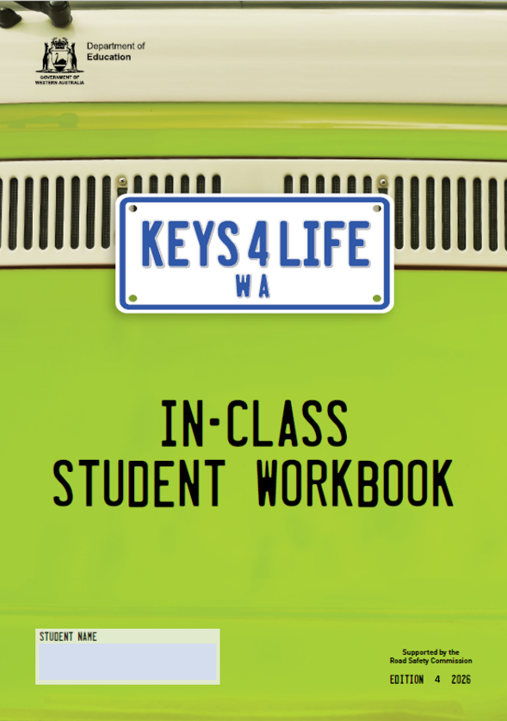
Student journal/workbook
Must complete one of these books to be able to sit the test.
Behind the Wheel Journal
Read page 1
Keys4Life Student Workbook
Notes:
Distribute Behind the Wheel journals or Keys4Life student workbooks – one per student, or instruct students to download these as writable PDFs. Explain that the aim of both the journal and workbook is to:
prepare students and parent/carers for the learn to drive process; and
provide a pre‑requisite for sitting the Learner’s Permit Theory Test at school.

Slide 6
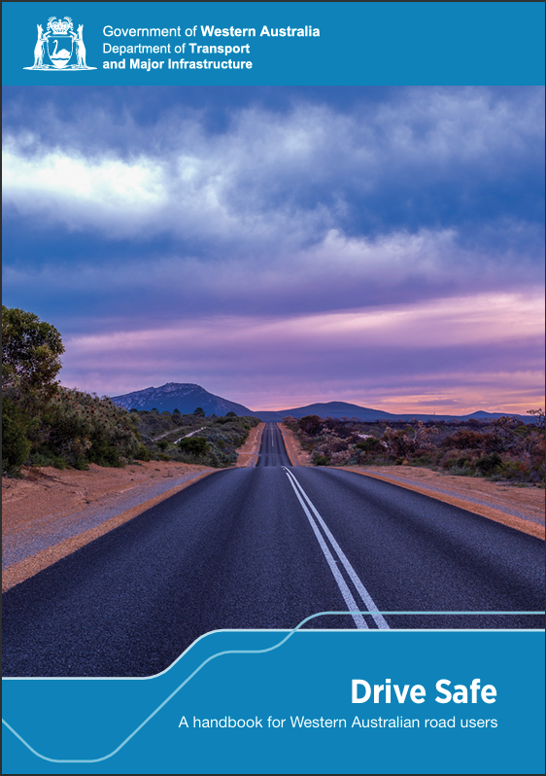
Drive Safe: A handbook for Western Australian road users
Guide to safe driving and an interpretation of the laws that govern driving in WA.
Complete a think, pair, share:
1. How you feel about getting your driver’s licence.
2. What type of driver you want to be.
Notes:
Distribute the Department of Transport and Major Infrastructure’s Drive Safe or show students where they can access this online (Department of Transport website): A handbook for Western Australian road users to each student. Explain to students that this resource will be used throughout the Keys4Life program and is a guide to safe driving and an interpretation of the laws that govern driving in Western Australia.

Slide 7
The WA Graduated Licensing System
STEP 1 Learners permit (L plates) | STEP 2 Learning to drive (Log book) | STEP 3 Hazard perception test | STEP 4 Gain experience (Log book) | STEP 5 Practical Driving Assessment | STEP 6 Provisional Licence (P plates)
Graduated Licensing System activity
1. Place the steps of the licensing system in order horizontally across your desk.
2. Place the condition cards under each of the steps. There are double ups of cards as they apply to multiple steps.
Notes:
**Note for teachers: Changes to WA’s GLS were announced in April 2026, not yet passed as law. Implementation dates are yet to be announced, but Keys4Life teachers will be notified and updated resources published in line with the changes. Keep an eye on the Keys4Life portal for updates and refer to DTMI website for current GLS information**
Activity 1.2: THE WA GRADUATED LICENSING SYSTEM (GLS)
Explain that the WA licensing system starts with learning the road rules and then proceeds to supervised driving and then independent driving.
Highlight to students that by participating in the Keys4Life program at school they may be offered the opportunity to sit the Learner’s Permit Theory Test which, if passed, will be the start of their entry into the licensing system.
Ask students to move into groups of 4–5 students. Hand out to each group a set of prepared Licensing steps cards (page 27) and Graduated Licensing System cards (page 28–29).
Explain to students that in WA there are six steps to the licensing system. Work through each of the steps explaining what they are e.g. Step 3 – Hazard perception test is a computer‑based test featuring a series of video clips of traffic situations. The test is used to measure the ability of the learner driver to assess road hazards and make safe driving decisions.
Explain to students that each step has a number of prerequisites (e.g. age, passing a test) and/or conditions attached (e.g. drive with L plates displayed, 0.00% blood alcohol concentration [BAC]).
Introduce the activity to students explaining that they are to place the steps in the licensing system in order in a horizontal line using the cards provided and then try to place the prerequisites or conditions under each of the steps. Allow time for students to discuss and complete the activity referring to their Drive Safe handbook as required.
At the end of the working time, hand to each student a copy of the Family information sheet The WA Graduated Licensing System (page 30). Ask students to use the information sheet to move any incorrect prerequisites or conditions into the correct step.

Slide 8
The prerequisites and conditions for each step in the licensing system
Did you find any of the prerequisites or conditions surprising? Why?
Why do you think there are prerequisites and conditions for each step in the licensing system?
Why do you think WA introduced the Graduated Licensing System?
How do you feel about entering the licensing system now knowing the steps, pre-requisites and conditions?
Notes:
Class discussion:
Did you find any of the prerequisites or conditions surprising? Why?
Why do you think there are prerequisites and conditions for each step in the licensing system?
Why do you think WA introduced the Graduated Licensing System? (It has been designed to make sure learner drivers get a wide range of supervised driving experiences over a longer period of time in different conditions before driving solo).
Optional: Upcoming changes to GLS (Refer to DTMI for up to date information. )
Discuss that in April 2026 the WA Government announced upcoming changes to the GLS (as at May 2026 is no confirmed implementation date, but likely to be introduced in the coming year or two).
Emphasise to students that details are only finalised once legislation is passed.
Focus on why graduated licensing changes are proposed (safety, experience, risk reduction), rather than exact rule details.
Reinforce that being informed and adaptable is part of being a responsible road user.
Encourage students and families to use official sources (e.g. Department of Transport and Major Infrastructure) for updates when changes are confirmed.

