Slide 1
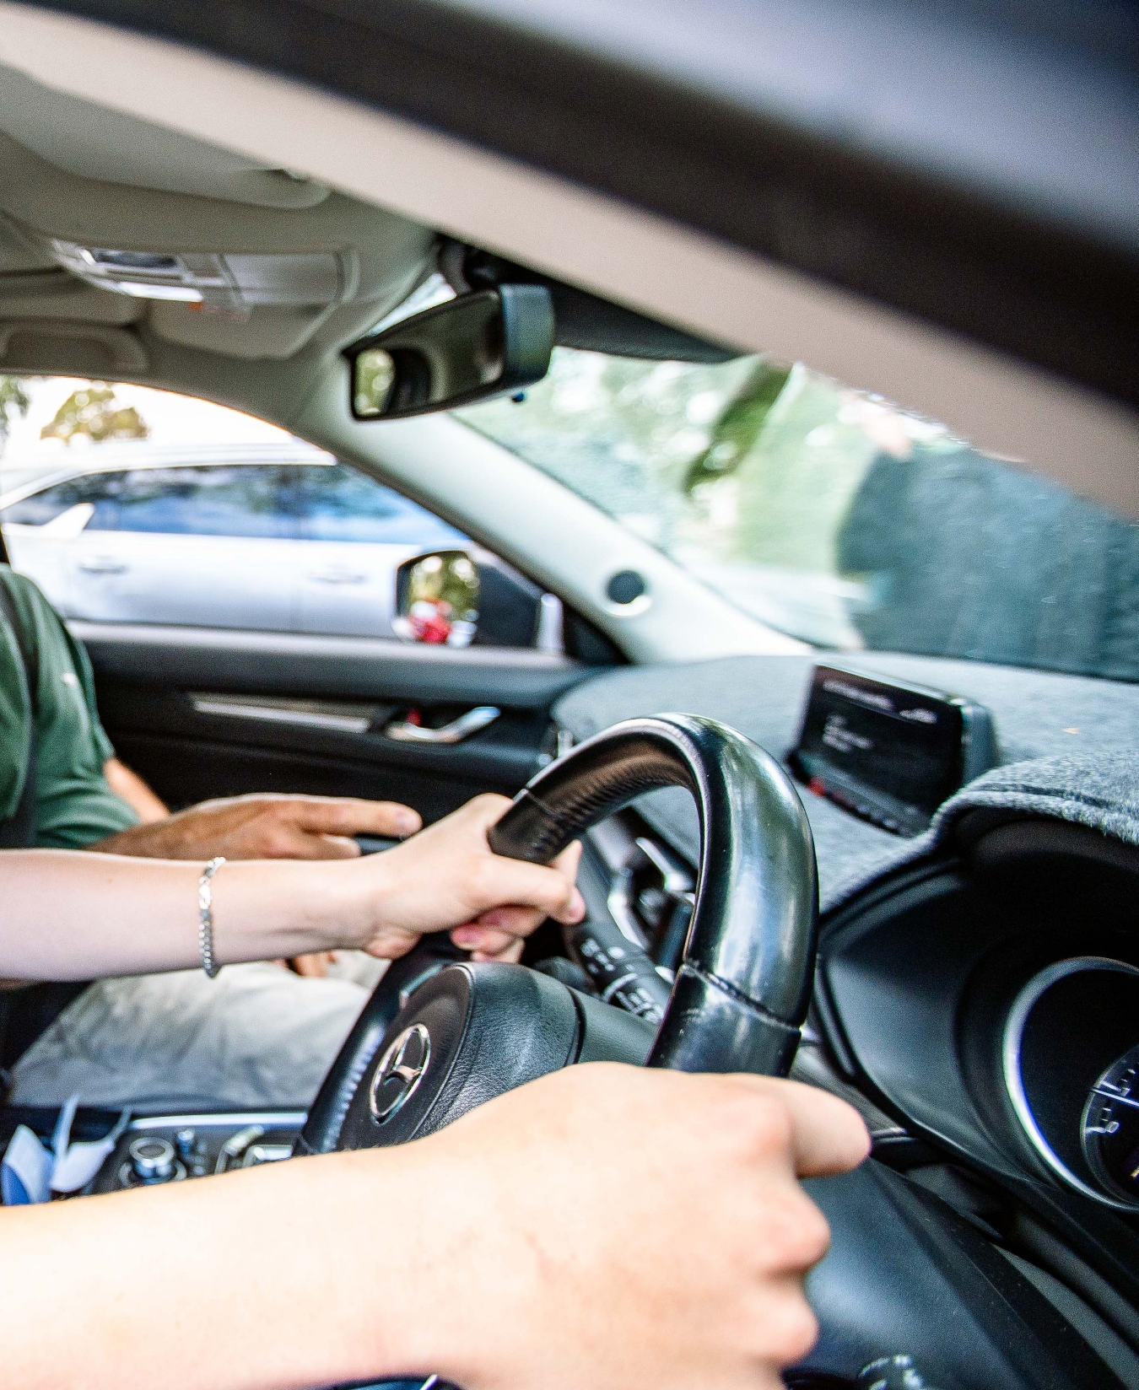
Keys4Life
Lesson 10
On the road
Notes:
Planning and Preparation
Activity 10.1 – Before other help arrives (page 162)
Activity sheet – Before other help arrives (page 164) – photocopy one per student
St John Ambulance – First Aid Facts – DRSABCD Action Plan, Bleeding, CPR Adult, CPR Infants, Recovery Position, Shock (Available at https://stjohn.org.au/first-aid facts) – one per students as required
Activity 10.2 – Test prep (page 165)
Keys4Life Attendance record (page 14)
Student answer sheet (page 16) – one per student sitting the test
Family information sheet – How to use the Keys4Life certificate (page 166)

Slide 2
Learning Intentions
Explain how to remain safe and help others at the scene of a road crash.
Notes:
DRIVERS INVOLVED IN A ROAD CRASH
If a driver is involved in a crash there are several things they must do.
Stop immediately and turn on their hazards lights.
Check it’s safe to exit their car then carefully approach other vehicles that are involved to see if anyone else at the scene is injured. Call emergency services if help is needed.
Send someone for help if required.
In a minor incident where cars involved can be moved, take them out of the traffic flow. If cars can’t be moved, leave them with the hazard lights on and stay off the road somewhere safe.
Collect as many details as possible from the other parties involved and take down the details for any witnesses in case they need to be contacted during the claims process.
WHAT DETAILS NEED TO BE COLLECTED?
By law, drivers involved in a crash must stop and supply their name and address (unless they have a disability). If they refuse, call the police. When involved in a crash it is recommended that you collect the following information.
The full name, address and contact details (phone numbers and email addresses) of all parties involved in the crash.
The other vehicles’ registration numbers, the make and model of vehicles involved and the other parties’ vehicle insurers.
Record the time, date, and location of the crash and everything that can be remembered about what happened. Note the street names and position of any vehicles involved. Diagrams can help.
If possible, take photos of the scene using a mobile phone.
DO I NEED TO REPORT THE CRASH TO POLICE?
Not every crash needs to be reported to the police.
According to the WA Police, a traffic crash must be reported when the incident (on a road or any place commonly used by the public) fits the following criteria.
Resulted in bodily harm to a person.
Caused more than $3000 worth of damage to all property involved.
The owner of the damaged property isn’t present. When someone has been injured, you must also report the crash to the Insurance Commission of Western Australia.

Slide 3
Before other help arrives
What should you do at the scene of a road crash?
Notes:
Ask students to brainstorm (page 168) what they should do at the scene of a road crash (eg check for injuries, call emergency services or give a witness report to police, if required).
Discuss the ideas generated by students and as a class sequence these according to priority.
Check the ideas against the information provided on Before other help arrives (page 164).
Stress the importance of students always checking for their own safety before assisting victims (eg not touching a car or person when electrical wires are nearby, or when fuel is escaping from an overturned vehicle with the motor still running).

Slide 4
DRSABCD
Danger
Response
Send for help
Airway
Breathing
CPR
Defibrillate
Notes:
Activity 10.1
Using the St John Ambulance Fact Sheet – DRSABCD Action Plan available at DRSABCD action plan – St John Australia explain the process.

Slide 5
Discussion questions
Why do bystanders sometimes choose to not get involved in providing first aid?
What factors may affect a potential helper’s decision whether or not to assist with first aid?
Do you have a responsibility to offer road crash victims’ assistance? Why?
Notes:
Discuss the following questions and ask students to share any concerns they may have about offering first aid assistance at a road crash.
Why do bystanders sometimes choose to not get involved in providing first aid? (Lack of first aid knowledge or concern about legal implications).
What factors may affect a potential helper’s decision whether or not to assist with first aid? (Shock, previous experiences with a road crash, victims are aggressive, location of the crash).
Do you have a responsibility to offer road crash victims’ assistance? Why? (If you are the driver of a vehicle involved in a crash, you must stop the vehicle and offer assistance to victims. Failure to do so can result in loss of licence or a custodial sentence).
Set up a values continuum (page 171) by placing the three labelled cards (agree, unsure and disagree) in a line.
Read one of the following statements and ask students to move to the position on the continuum that best represents how they feel about the statement. Ask students to discuss their opinion with others standing nearby and formulate a group response to justify the stance they have taken. Have students consider the opposing points of view.
It should be compulsory for all learner drivers to complete a first aid course.
Everyone has a responsibility to offer help at a road crash scene.
You need to know more than the DRSABCD procedure to help a road crash victim.

Slide 6
Discussion questions
What should you do to ensure your own safety at a road crash scene and to provide help for those involved in the crash?
What is one thing you can do to help an injured crash victim?
How can you protect yourself when providing help to a crash victim?
Do you feel you know enough about first aid to be able to offer road crash victims assistance? If not, how can you find out more?
What are some typical reactions from people involved in a crash?
Where might you seek help to deal with road trauma?
Notes:
Ask the following questions discussing the responses.
What should you do to ensure your own safety at a road crash scene and to provide help for those involved in the crash? (Make sure area is safe such as there are no electrical wires nearby or fuel escaping from an overturned vehicle with the motor still running before administering first aid to victims; call the emergency number for assistance; continue with the DRSABCD procedure).
What is one thing you can do to help an injured crash victim? (Tilt their head to allow a clear air passage).
How can you protect yourself when providing help to a crash victim? (Use plastic gloves, stay clear of the road and oncoming traffic).
Do you feel you know enough about first aid to be able to offer road crash victims assistance? If not, how can you find out more? (St John Ambulance or handbook produced by Department of Transport).
What are some typical reactions from people involved in a crash?
Where might you seek help to deal with road trauma? (Road Trauma Support WA 1300 004 814)

Slide 7
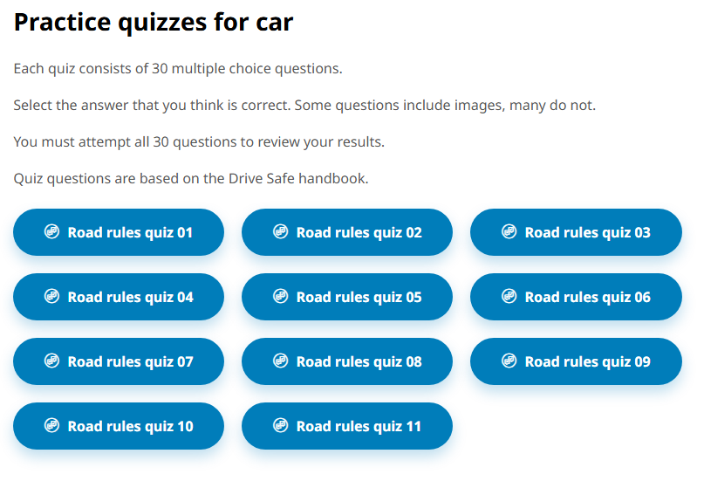
Test prep
https://www.transport.wa.gov.au/licensing/drivers-licence/get-a-licence/learner-driver-resources/road-rules-theory-test-quiz
Notes:
Provide students with instructions about the school-based Learner’s Permit Theory Test including:
the test date and process
encourage all students to prepare by doing the online practice tests
a final reminder about completing their Behind the wheel journal to meet the eligibility criteria to sit the test.
Ensure students understand the following about the Learner’s Permit application process.
The Keys4Life certificate should be presented when applying for a Learner’s Permit as it provides significant savings and benefits that are approved by the Department of Transport.
It is recognised as a Category C form of identity (ie one of the five forms of identity)
It is recognised as proof that the applicant has already passed the theory test (eg the student will not be required to sit the Computerised Theory Test and will receive a reduction in the application fee).
Five forms of identity are required and the Keys4Life certificate is one of these. Remind students to find and organise their forms of identity.
Students with a medical condition or taking a prescribed medication will need to declare this at the time of the application, and are therefore advised to visit their doctor before applying for a Learner’s Permit so they can be assessed in relation to safely drive a vehicle under these conditions.

Slide 8
At home tasks
Encourage students to complete
Quiz 9 – Emergencies and crashes (page 28) in Behind the wheel (if not yet completed).
Quiz 10 – The law and you (page 29) in Behind the wheel (if not yet completed).
Notes:
Remind students that they must complete all 10 tasks in the Behind the wheel journal to be considered eligible to sit the test at the end of the Keys4Life program.
Encourage students to access the Department of Transport and Major Infrastructure’s road rules theory test quizzes to begin building and consolidating their knowledge of road rules.
Distribute (or email) a copy of the Family information sheet – How to use the Keys4Life certificate (page 166).

