Slide 1
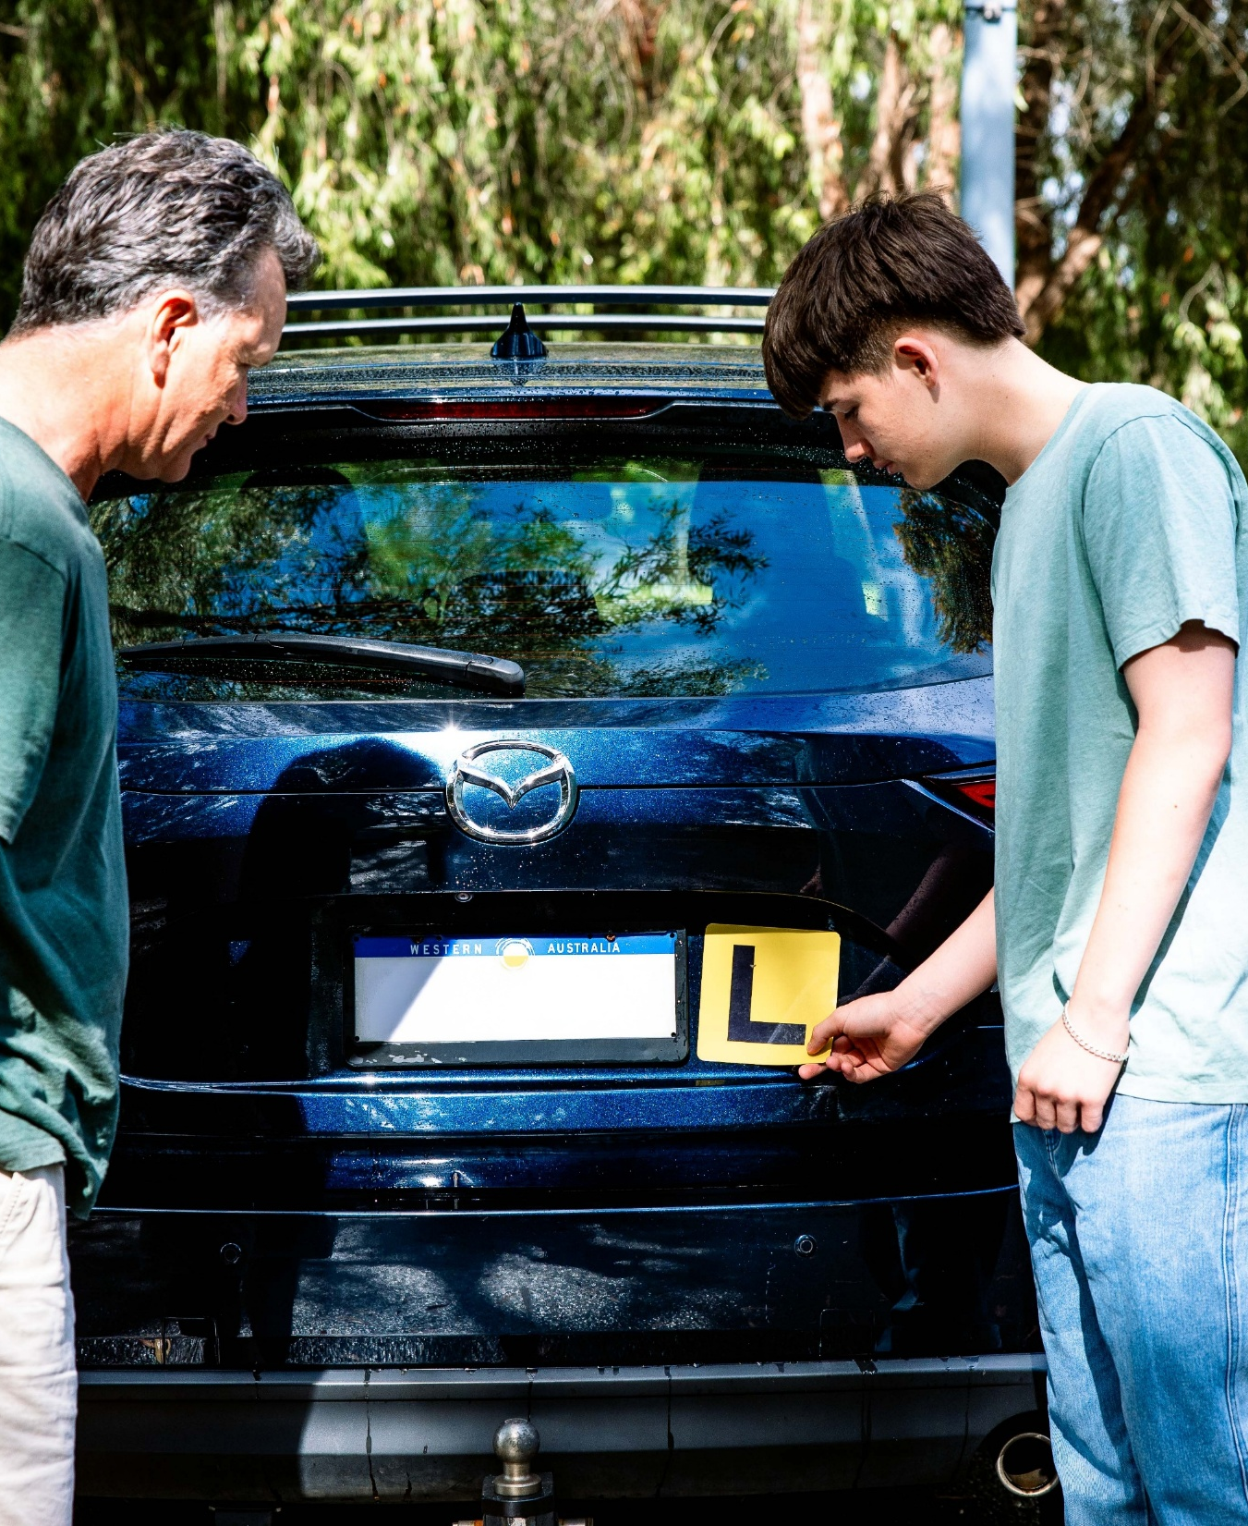
Keys4Life
Lesson 2
Responsibilities, Behaviours and Consequences
Notes:
Planning and preparation:
Activity 2.1
Activity sheet – Road user responsibilities (page 36) – A4 sheet of paper per student
Drive Safe handbook – one copy per student or internet access to transport.wa.gov.au
Option activity – one A4 sheet of blank paper per student
Activity 2.2
A3 paper – one sheet per group
Activity sheet ‑ Grouping consequences (page 40) – A3 photocopy per group
Activity sheet – Consequences (pages 41‑42) – photocopy and cut out one set of cards per group (also available as a pack to order)
Behind the wheel – Task 3 – Spot the error (page 4)
Behind the wheel – Quiz 1 – Speed (page 21)
Behind the wheel – Quiz 2 – Alcohol and other drugs (page 22)
Activity 2.3
Drive Safe handbook – one per student or at transport.wa.gov.au/licensing/
Activity sheet – Drive safe bingo (page 48) – one per student
Internet access for the Department of Transport and Major Infrastructure’s road rules theory test quizzes transport.wa.gov. au/licensing/road-rules-theory-test-quiz.asp
Behind the wheel – Quiz 4 – Intersections and turning (page 24); Quiz 6 – Traffic signals and road markings (page 26) OR use Quizzes 1–5 in the Keys4Life student workbook.

Slide 2
Learning Intentions
Outline driver responsibilities and the potential consequences of not being a safe driver.
Understand consequences of road crashes.
Apply road rules to different driving situations.

Slide 3
Road user responsibilities and behaviours
Right
Privilege
Responsibilities
Having a just claim or title to something (e.g. voting at the age of 18, access to medical care or challenging a speeding ticket)
A special right enjoyed by a person that is given or earned (e.g. travelling overseas or a driver’s licence)
A particular load of care placed on someone who is responsible (e.g. a teacher has a duty of care for their students or a driver is responsible for ensuring that all passengers are restrained in their vehicle).
Discussion:
Is having a licence and being able to drive a right or privilege?
Notes:
Activity 2.1
This slide includes animations – click through to reveal definitions of a right, privilege and a responsibility.
RESPONSIBILITIES AND BEHAVIOURS
Write the terms ‘rights’, ‘privileges’ and ‘responsibilities’ on the board. Discuss with students what these terms might mean. Reach a common understanding as a group.
Right – having a just claim or title to something (e.g. voting at the age of 18, access to medical care or challenging a speeding ticket)
Privilege – a special right enjoyed by a person that is given or earned (e.g. travelling overseas or a driver’s licence)
Responsibility – a particular load of care placed on someone who is responsible (e.g. a teacher has a duty of care for their students or a driver is responsible for ensuring that all passengers are restrained in their vehicle).
Discuss with students if ‘having a licence and being able to drive’ would be a right or privilege. Ask students to explain and justify their responses.

Slide 4
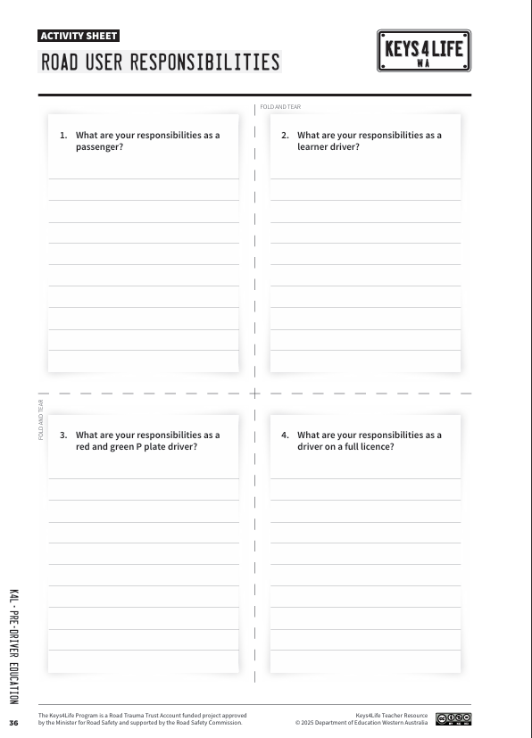
Road user responsibilities
In groups of 4 complete a rip and review:
Cut the paper along the dotted lines.
Each person completes one of the questions.
Notes:
Place students in groups of four and give each group a copy of the activity sheet Road user responsibilities (page 36).
Explain that students are to complete a rip and review (page 170) using the questions on the sheet.
1. What are your responsibilities as a passenger? (e.g. always wear a seatbelt, do not distract the driver, notice the road rules and traffic signals, remain calm and quiet with other passengers).
2. What are your responsibilities as a learner driver? (e.g. always wear a seatbelt, observe the road rules, never drive impaired, drive to the conditions and to the speed limit, remain calm).
3. What are your responsibilities as a red and green P plate driver? (e.g. always wear a seatbelt, observe the road rules, never drive impaired, drive to the conditions and to the posted speed limit, be a respectful, calm, patient driver).
4. What are your responsibilities as a driver on a full licence? (e.g. be available as a supervising driver for a learner driver, always wear a seatbelt, observe the road rules, never drive impaired, drive to the conditions and speed limit, be a respectful, calm, patient driver).

Slide 5
Class discussion
The community believes that all road users have a responsibility for their own safety and the safety of others. Do you think that all young people believe this too? Why/why not?
Some drivers try to intimidate other drivers. The media refers to this as ‘road rage’. Why do some drivers act in this way?
What are the characteristics of a tolerant driver compared to an aggressive driver? What do their actions look and feel like?
If you were a learner driver and another driver acted aggressively towards you while driving, how would you feel?
What would you do to make sure the incident didn’t put you and other road users at risk?
What actions could you take to avoid aggressive drivers?
What actions could you take to become a tolerant and calm driver?
How can you control your own anger when faced with an annoying situation?
Is aggressive or abusive behaviour acceptable in any situation? Why?
Notes:
PROCESS
Continue the discussion about road user responsibilities and behaviours by asking the following questions.
REFLECT
Ask students to consider the type of driver they want to be and come up with three adjectives to describe this e.g. calm, respectful, safe, responsible etc.

Slide 6
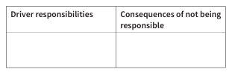
Responsibilities and consequences
T chart
Draw and label a T chart on a sheet of A3 paper with the headings:
Driver responsibilities
Consequences of not being responsible
2. Write a list of driver responsibilities in the corresponding column of the T chart.
3. Discuss the possible consequences of not being responsible as a driver and write these in the corresponding column.
4. Be prepared to share with the class.
Notes:
Activity 2.2
REVISE
Groups draw and label a T chart (page 171) on a sheet of A3 paper with the headings shown below.
Ask students to write a list of driver responsibilities in the corresponding column of the T chart. Some examples have been provided.
Students then discuss the possible consequences of not being responsible as a driver and write these in the corresponding column. Some examples have been provided.
Driver responsibilities - example responses:
Learn and practise safe driving habits (e.g. travel at posted speed limit, wear a restraint)
Legally obtain a driver’s licence (e.g. pass all required tests and requirements)
Obey the law (e.g. follow road rules and signs, do not drink and drive)
Avoid conflicts (e.g. show courtesy and ‘forgive’ other road users’ errors)
Protect passengers and other road users (e.g. make sure all vehicle occupants are wearing a seatbelt)
Consequences of not being responsible - example responses:
Loss of licence
Demerit points and fines
Injuring self and others
Criminal record
Jail sentence
Not able to travel to some countries because of a criminal record
Relying on others for transport
Costs of re‑sitting tests
Living with guilt

Slide 7
Extension activity
Scenario
A newly licensed driver has been involved in a crash. The crash was their fault as they had been speeding and overtaking another vehicle when it wasn’t safe to do so.
Impacts and consequences
Move into groups of 4‑5.
Deal out the consequences cards and set out a continuum by placing the ‘greatest impact’ card at one side of the desk and the ‘least impact’ card at the other.
Take turns to place and justify the positioning of the consequence cards they have been dealt along the continuum. Once all of the cards have been placed, discuss the placements and decide as a group if any of the cards should be moved along the continuum in either direction.
Place the consequences into groups i.e. social, emotional, physical, legal or financial.

Slide 8
Class discussion
Which consequences (i.e. physical, emotional, legal, social or financial) had the most cards?
Why might opinions about consequences differ from person to person?
Which consequences of road crashes do most young people think about? Why?
Which of the possible consequences of a road crash would make you reconsider acting irresponsibly on the roads? Why?
Has identifying the range of consequences challenged your thoughts about getting a driver’s licence? Why?
Do you think some of the legal consequences are a deterrent for irresponsible drivers? Why or why not?
What changes would you need to make in your life if you no longer had the use of a vehicle?
How would repaying thousands of dollars worth of expenses, not covered by insurance, impact on your life?.
Would knowing the legal and financial consequences of a crash change the way a young driver might use the roads? Why?
The community wants young people to consider the consequences of poor driving decisions. How could this be achieved?

Slide 9
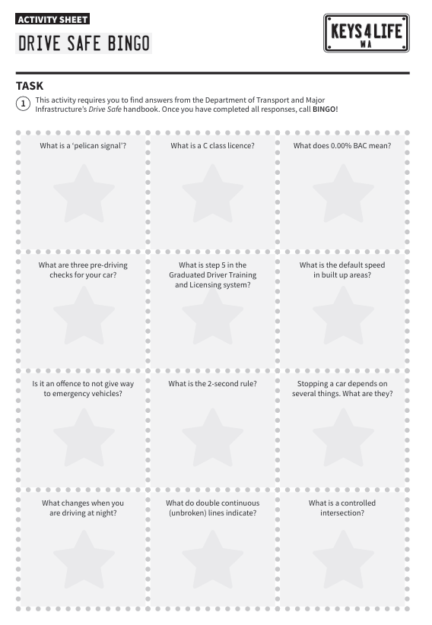
Learning the road rules
Drive Safe Bingo
Discuss the following questions:
What are some ways that might help you learn the road rules for the Learner’s Permit Theory Test?
What rules do you see commonly being ignored or broken on the road?
How would those drivers try to justify breaking the rules?
What could be the outcomes of breaking the road rules?
Notes:
Activity 2.3 are optional activities that you can do if you have time. These will support students in learning the road rules.
PLANNING AND PREPARATION
Drive Safe handbook – one per student or at transport.wa.gov.au/licensing/
Activity sheet – Drive safe bingo (page 48) – one per student
Internet access for the Department of Transport and Major Infrastructure’s road rules theory test quizzes transport.wa.gov. au/licensing/road-rules-theory-test-quiz.asp
Behind the wheel – Quiz 4 – Intersections and turning (page 24); Quiz 6 – Traffic signals and road markings (page 26) OR use Quizzes 1–5 in the Keys4Life student workbook.
PROCEDURE
DRIVE SAFE BINGO
Explain that the Learner’s Permit Theory Test is based on information and road rules described in the Drive Safe handbook. The rules and regulations are those effective at the time of printing. It is not a legal document as not all traffic regulations are included.
Briefly explore the handbook as a class pointing out to students the different sections of the book.
Introduce Drive safe bingo which will provide an opportunity for students to explore the handbook. On BINGO, check answers asking students to fill in any missing answers.
ANSWER
What is a ‘pelican signal’?
A pelican crossing works like a set of traffic lights however it has an extra phase – a flashing yellow light. This flashing light means – PROCEED WITH CAUTION. If there are pedestrians crossing you MUST give way to them.
What is a C class licence?
A C class licence is a licence to drive a car. What does 0.00% BAC mean? 0.00 per cent BAC means you must not drink any alcoholic drinks at all if you intend to drive.
What are three pre-driving checks for your car?
Before driving your car check your tyres, brakes, steering, lights, horn, windscreen and windscreen wipers, mirror and seat position.
What is step 5 in the Graduated Licensing System?
Step 5 in the Graduated Licensing System is sitting the practical driving assessment.
What is the default speed in built up areas?
50km/h.
Is it an offence to not give way to emergency vehicles?
Yes.
What is the 2-second rule?
While driving along the road look at an object by the side of the road, such as a tree or pole, that will soon be passed by the vehicle ahead. As soon as that vehicle passes the object, say to yourself, ‘one thousand and one, one thousand and two’. You should take the full two seconds it takes to say this to reach the object. If you get there before you have said it, you are too close. Slow down until you are at least two seconds behind the vehicle ahead.
Stopping a car depends on two things. What are they?
How quickly the car can be stopped depends on the stopping distance (reaction distance + braking distance).
What changes when you are driving at night?
The distance that you can see ahead and to the side is severely reduced after dark. This means that it will take you longer to respond to hazards after dark so you must use extra caution to allow for the reduced visibility.
What do double continuous (unbroken) lines indicate?
Double continuous (unbroken) lines are used as dividing lines (centre lines) on roads. You must not cross these lines to overtake but you can cross them to turn right at an intersection, ‘U’ turn or enter or leave a road if it is safe to do so.
What is a controlled intersection?
A controlled intersection is an intersection that has: traffic control signals, a ‘STOP’ or ‘GIVE WAY’ sign, a roundabout or a police officer or other authorised person directing traffic.

Slide 10
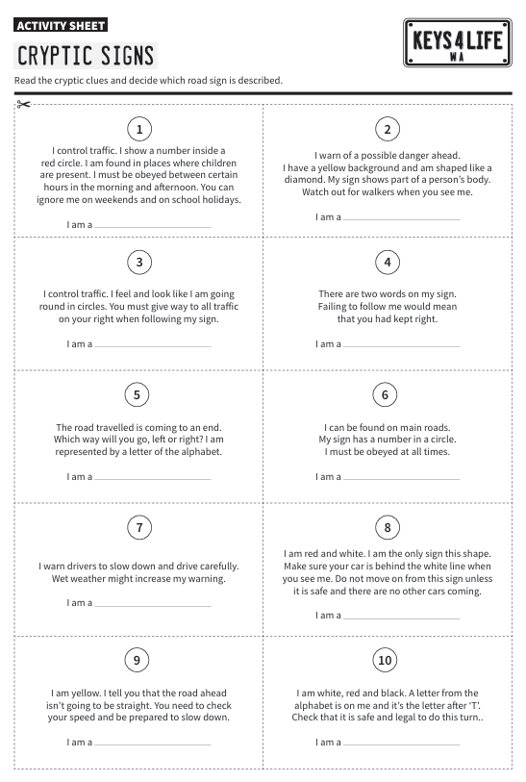
Cryptic signs
Form pairs.
Identify the sign described using the clues.
Notes:
CRYPTIC SIGNS
Activity sheet – Cryptic signs (page 50) – photocopy one per pair
Drive Safe handbook – one per pair
PROCEDURE
Ask students to form pairs.
Distribute copies of Cryptic signs (page 50).
Ask students to identify the sign described using the clues.
Get students to check the signs using the Drive Safe handbook.
Answers 1. School zone. 3. Roundabout. 5. T‑junction. 2. Pedestrian crossing. 4. Keep left. 6. Speed limit. 7. Slippery when wet. 8. Stop sign. 9. Winding road. 10. U turn.

Slide 11
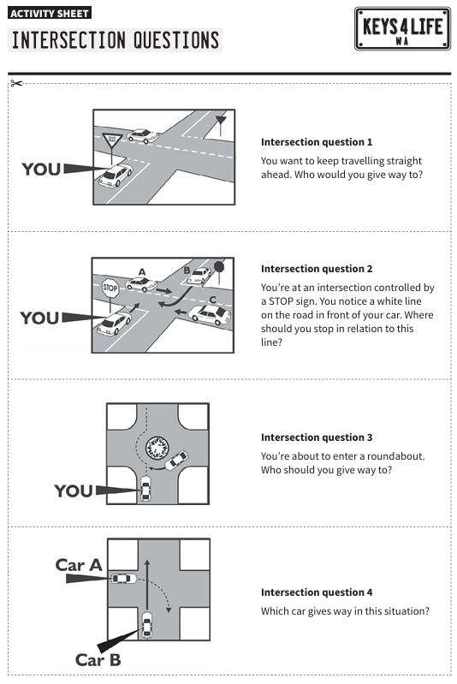
Intersections and turning situations
Divide the class into two groups.
Group 1 = question card
Group 2 = answer card.
Find your matching question or answer card.
Notes:
INTERSECTIONS AND TURNING SITUATIONS
Activity sheet – Intersection questions (pages 51‑52) – one set per group
Activity sheet – Intersection answers (pages 53‑54) – one set per group
Activity sheet – Turning questions (page 55) – one set per group
Activity sheet – Turning answers (page 56) – one set per group
Activity sheet – Road map (page 49) – photocopy to A3 size or draw up a road scene on a large sheet of paper that includes intersections. Alternatively order the A3 or A0 traffic mat available through the Keys4Life ordering system.
PROCEDURE
Divide the class into two groups. Students in Group 1 are each given a question card from the sheet. Students in Group 2 are each given an answer card. Students need to find their matching question or answer card.
Discuss each situation as a group. Ask students to demonstrate each situation using toy cars on a drawn road scene or use the A0 or A3 traffic mat available to order.

Slide 12
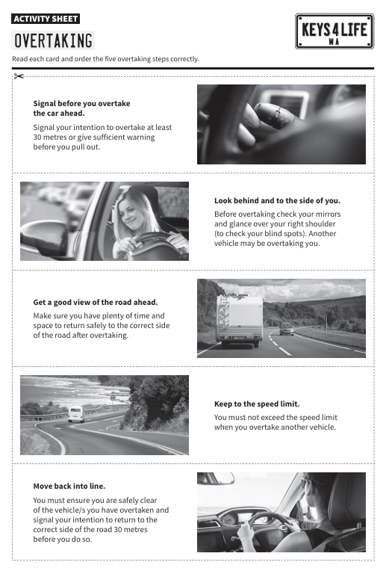
Overtaking
Get into groups with a set of overtaking cards.
Explain the five key steps when overtaking another car.
Cut out the cards and place them in step order.
Use the Drive Safe handbook for suggestions.
Notes:
OVERTAKING
Activity sheet – Overtaking (page 57) – one set of cards per group
Drive Safe handbook – one per group
PROCEDURE
Place students into groups with a set of overtaking cards.
Explain the five key steps when overtaking another car.
Ask each group to cut out the cards and place the steps in order. Alternatively, students can number the cards.
The Drive Safe handbook can support students in their decisions.
Discuss the steps as a group.
Answers 1. Get a good view of the road ahead. 2. Look behind and to the side of you. 3. Signal before you overtake. 4. Keep to the speed limit while overtaking. 5. Move back into line.

Slide 13
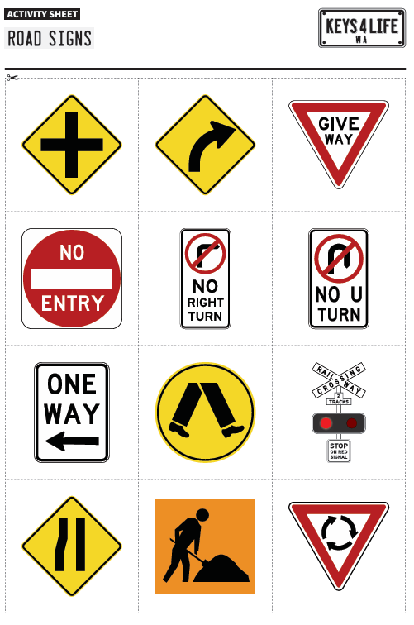
Road sign concentration
Place all road signs and road sign explanation cards face down on the desk.
Start the game by turning over two cards – one sign card and one explanation card. If the sign card and the explanation card match, they can keep the cards. The student then has another turn.
If the cards do not match, they are placed face down on the desk ready for the next student’s turn.
Winner is the player with the most pairs.
Notes:
ROAD SIGN CONCENTRATION
Activity sheet – Road signs (pages 58‑59) – two sets of cards per group
Activity sheet – Road sign explanations (pages 60‑61) – one set per group
PROCEDURE
In small groups place all road signs and road sign explanation cards face down on the desk. Make sure they are placed with signs on one side of the desk and explanations on the other.
A student starts the game by turning over two cards – one sign card and one explanation card. If the sign card and the explanation card match, they can keep the cards. The student then has another turn.
If the cards do not match, they are placed face down on the desk ready for the next student’s turn.
The game continues with each student having a turn until all the cards have been matched.
The winner is the player with the most pairs.

Slide 14
Student cars
Get into pairs.
Act as drivers and passengers in recreated traffic situations. The drivers will need to demonstrate safer driving behaviours such as adjusting speed, watching out for other traffic and indicating (refer to the Drive Safe handbook for instructions on hand signals) as well as comply with the road rules.
Passengers need to move with the driver observing their driving to give feedback at the end of the manoeuvre.
Recreate a range of different traffic situations on a large area such as the school oval by marking out lanes and intersections using the markers. Some examples are provided.
  Merging – mark out two lanes of traffic that merge into one. Drivers must move within the lanes, indicating and merging correctly.
  Intersections – mark out a T intersection, four‑way intersection or roundabout. Have drivers move through the intersections giving way and indicating appropriately.
  Overtaking – mark out two lanes of traffic. Identify some drivers to travel more slowly than others. Drivers move along the two lanes in opposite directions, overtaking the slower vehicles by identifying a safe time and indicating
Notes:
STUDENT CARS
Set of markers such as witches hats, ice cream containers, chairs
Drive Safe handbook – one per pair
PROCEDURE
Place students in pairs.
Explain that students are to act as drivers and passengers in recreated traffic situations. The drivers will need to demonstrate safer driving behaviours such as adjusting speed, watching out for other traffic and indicating (refer to the Drive Safe handbook for instructions on hand signals) as well as comply with the road rules.
Passengers need to move with the driver observing their driving to give feedback at the end of the manoeuvre.
Recreate a range of different traffic situations on a large area such as the school oval by marking out lanes and intersections using the markers. Some examples are provided.
Merging – mark out two lanes of traffic that merge into one. Drivers must move within the lanes, indicating and merging correctly.
Intersections – mark out a T intersection, four‑way intersection or roundabout. Have drivers move through the intersections giving way and indicating appropriately.
Overtaking – mark out two lanes of traffic. Identify some drivers to travel more slowly than others. Drivers move along the two lanes in opposite directions, overtaking the slower vehicles by identifying a safe time and indicating.
REFLECT
At the end of the lesson ask students if they feel confident with the rules of the road and the strategies they can adopt to continue to learn and apply these in the road traffic environment. Discuss student responses.

