Slide 1
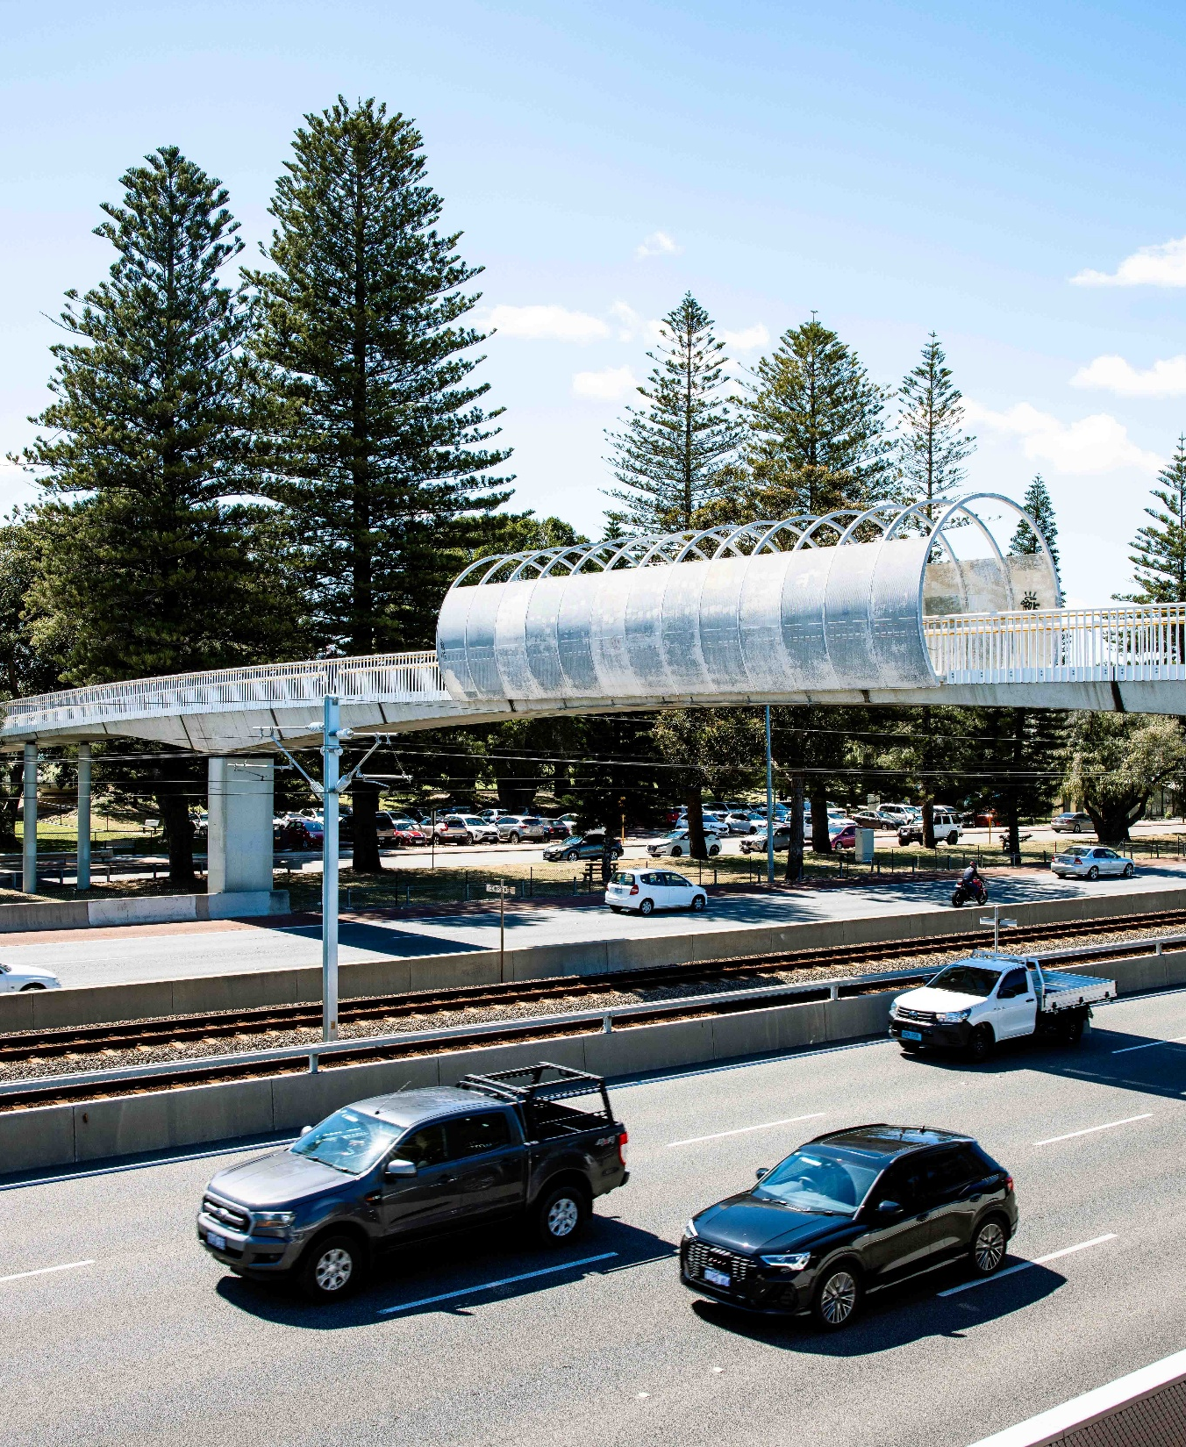
Keys4Life
Lesson 3
Road safety statistics
Notes:
Planning and Preparation
Activity 3.1
Activity sheet – Who’s at risk? (A) for different types of road users (page 68) – photocopy one per student
Activity sheet – Who’s at risk? (B) for different types of road users (page 69) – photocopy one per student
Internet access or copies of the most recent Road Safety Commission Preliminary summary of fatalities on Western Australian roads available from rsc.wa.gov.au/ Statistics/Annual‑Statistics focusing on the pages on road user type, gender and age
Behind the wheel – Quiz 7 – Seatbelts (page 26)
Activity 3.2
No prep needed

Slide 2
Learning Intentions
Rank road user groups involved in road crashes in WA from most at risk to least at risk.
Identify individual circles of support.

Slide 3
Crash stats
Predict which road user group was most represented in WA fatal crashes and injuries.
Drivers
Passengers
Motorcyclists
Who’s most at risk?
Pedestrians
Cyclists
Notes:
CRASH STATS
Introduce the lesson’s activities by reading the preliminary summary of fatalities from the latest year available. Road Safety Commission Annual statistics rsc.wa.gov.au/Statistics/Annual‑Statistics
Give each student a copy of Who’s at risk? (A) (page 68) or Who’s at risk? (B) (page 69).
Explain that students are to predict which road user group was most represented in WA fatal crashes and injuries. Each road user group card should be cut out and ranked on the list, with 1 being the highest crash involvement to 10 being the least.
Students then share their rankings and give reasons for their placement of each road user group.
Answers for activity sheet Who’s At Risk? (A) 1. Male drivers 2. Female drivers 3. Male motorcyclist 4. Male passenger 5. Female passenger 6. Male pedestrian 7. Male cyclist 8. Female pedestrians 9. Female motorcyclists 10. Female cyclists
Answers for activity sheet Who’s At Risk? (B) 1. Drivers 2. Passengers 3. Motorcyclists 4. Pedestrians 5. Cyclists
Note: The answers for Activity sheet Who’s at risk is based off data from the Western Australian Road Fatalities and Serious Injuries 2024 report.

Slide 4
Crash stats – Who’s at risk (b)
Crash stats – Who’s at risk (a)
1. Male drivers
2. Female drivers
3. Male motorcyclists
4. Male passenger
5. Female passenger
6. Male pedestrian
7. Male cyclists
8. Female pedestrian
9. Female motorcyclist
10. Female cyclist
1. Drivers
2. Passengers
3. Motorcyclists
4. Pedestrians
5. Cyclists
Notes:
This slide has animations, click to reveal answers.
Answers for activity sheet Who’s At Risk? (A) 1. Male drivers 2. Female drivers 3. Male motorcyclist 4. Male passenger 5. Female passenger 6. Male pedestrian 7. Male cyclist 8. Female pedestrians 9. Female motorcyclists 10. Female cyclists
Who’s At Risk? (B) 1. Drivers 2. Passengers 3. Motorcyclists 4. Pedestrians 5. Cyclists
Note 1: The answers for Activity sheet Who’s at risk is based off data from the Western Australian Road Fatalities and Serious Injuries 2024 report. Data does change so it is recommended that teachers check the order of user groups using current statistics available from the Road Safety Commission.
Note 2: Most at risk is taken from raw data. It does not consider the ratios of different road user types. Discuss the importance of being cautious when interpretating data i.e. are there more male motorcyclists than female motorcyclists?

Slide 5
Discussion
Why do you think more males than females are involved in road crashes?
What factors do you think contribute to crashes involving young people?
What can a young driver do to reduce the likelihood of being involved in a crash?
Notes:
Why do you think more males than females are involved in road crashes? (Take more risks. More often the driver. Don’t wear a seatbelt. Speed can be a factor).
What factors do you think contribute to crashes involving young people? (Alcohol, drugs, fatigue, speed, distractions, not wearing a seatbelt, overcrowding vehicles, drivers who are inexperienced and overconfident).
What can a young driver do to reduce the likelihood of being involved in a crash? (Get as many hours of supervised driving practice as possible. Don’t drive after consuming alcohol or using other drugs. Have a ‘get home safely’ plan. Always wear a seatbelt. Drive to the conditions. If tired, don’t drive).

Slide 6
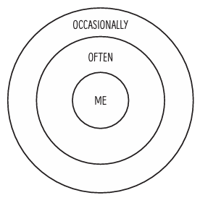
Circle of support
Notes:
Activity 3.2
Draw three concentric circles on the board. Label the centre circle ‘me’, the second circle ‘often’ and the third ‘occasionally’.
Suggest to students that everyone has a ‘circle of support’ that includes people they talk to when faced with a problem or are feeling upset, and that the person they choose to talk to may depend on the problem or situation.
Use the example of ‘being worried about failing an important exam’ or ‘having an argument with a friend’ to show how the circles can be used to identify those who may offer support or advice depending on the problem or situation. Ask students to give some examples and write these in the circles.
Ask students to draw and label their own ‘circle of support’ on a piece of paper then write the names of people who they always ask for advice or to listen to their problems, in the circle labelled ‘often’. Students repeat this for the ‘occasionally’ circle.
In pairs, students should share and discuss why they have used these people to offer advice or support (e.g. a friend may be a good listener or a teacher who is always willing to help students who are struggling at school).
Suggest to students that how a person reacts to road trauma, either directly or indirectly, and who they seek help from, may be different to those people identified in the previous activity.

Slide 7
Circle of support
Road trauma can have a large ripple effect, it not only impact those in the vehicle.
Think about who you could talk to if you were affected by road trauma.
Using a different colour, write down the people and support services that could help you.
Tick the names of any people you identified earlier.

Slide 8
Circle of support follow up
Discuss the following questions:
What changes did you notice to your circle of support when considering a road crash situation? Why?
Why is it important to talk to others about your feelings?
How could you help a friend or family member deal with their reaction to a crash?
If someone is sharing a problem with you, what can you do to show them that you are interested and sincere? (Paraphrasing, eye contact, nodding head to confirm understanding or show empathy).
Notes:
Advise students of who they can go to for support within the school. There is also free support available through Road Trauma Support WA. 08 6166 7688
Freecall: 1300 004 814
rtswa.org.au

