Slide 1
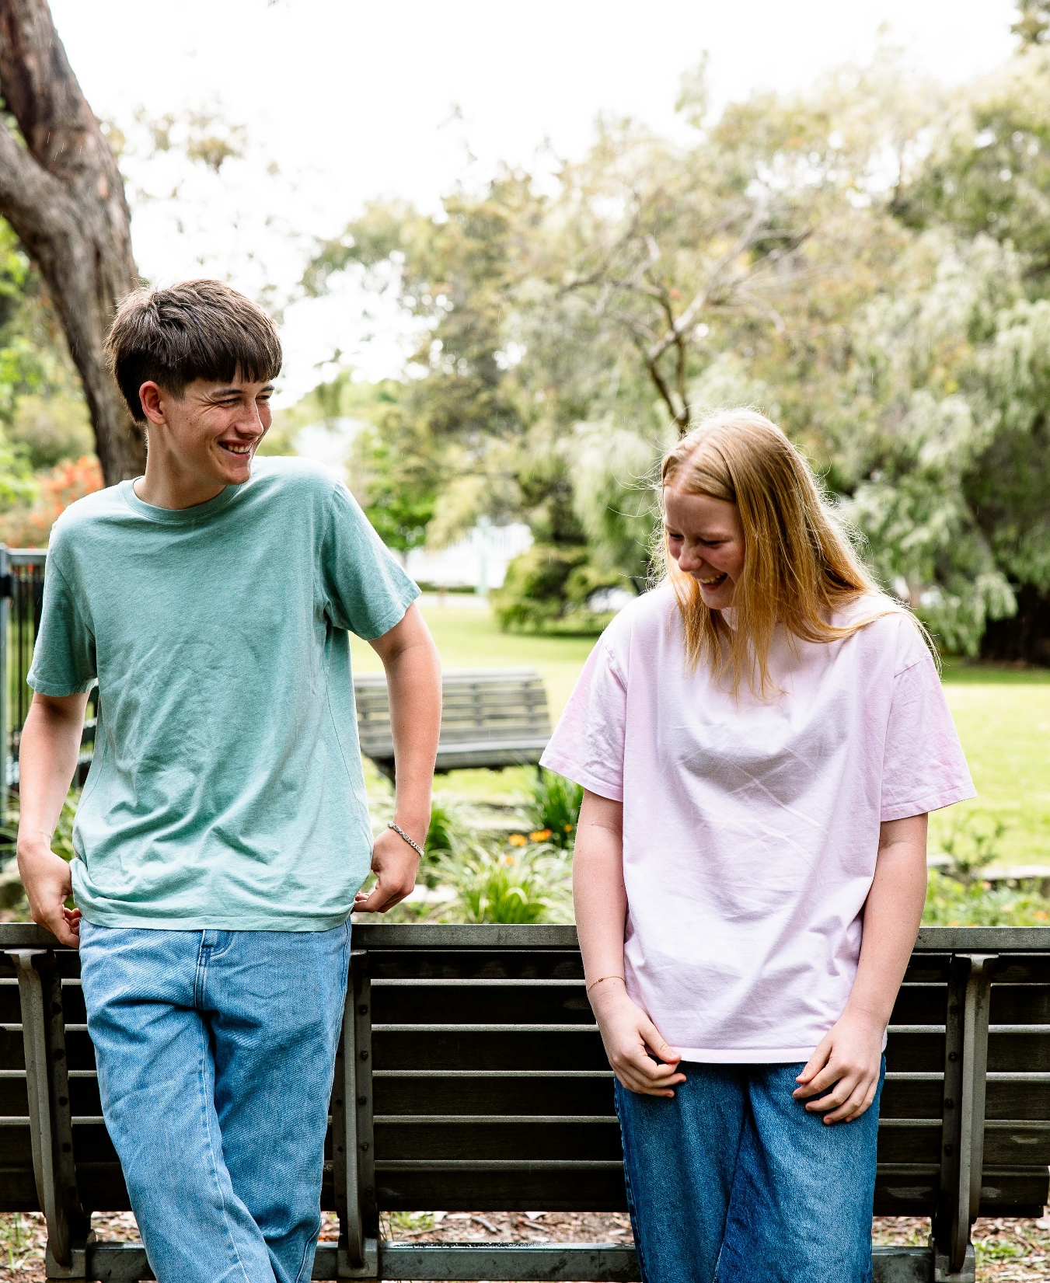
Keys4Life
Lesson 4
Make a decision
Notes:
Planning and Preparation
Activity 4.1
Activity sheet – Make a decision (page 78) – one per student
Strategy sheet – Choose a corner (page 173) – one set
Activity 4.2
Large pieces of butcher paper or large sticky notes and textas
Activity sheet Staying safe (page 81) – one per student
Family information sheet – Sharing the road (page 82) – one copy per student (or email to parents/carers)
Behind the wheel – Task 5 – Tolerance and courtesy (page 6)
Behind the wheel – Quiz 3 – Sharing the road safely (page 23)
Behind the wheel – Quiz 8 – Driving in different conditions (page 28)

Slide 2
Learning Intentions
Understand that attitudes impact decisions and decisions made, have consequences.
Recognise the importance of being a safe, tolerant and courteous road user.

Slide 3
Make a decision
Everyone has a different opinion about road safety issues.
For each statement, move to the corner of the room that relates you agree with most.
Front of the class
1 | 2
3 | 4
Notes:
Activity 4.1
Choose a corner
Give each student a copy of Make a decision
Nominate which situation students should read (i.e. A, B, C or D)
Which response best represents your opinion and move to the corresponding corner of the room.
Discuss responses as a class.
Repeat this procedure for the other situations (e.g. A, B, C or D).

Slide 4
A. There would be fewer crashes if…
Speed limits were lowered
Young drivers were not allowed to drive high-powered cars
Speeding and drink driving offenders visited an emergency or rehabilitation centre
The BAC limit was 0.00 for all drivers
Front of the class
1 | 2
3 | 4

Slide 5
B. Some young people don’t wear seatbelts because…
They think it’s not cool
The fine for not wearing one isn’t high enough
They don’t understand how it reduces car crash injuries
They often travel in cars that are overcrowded
Front of the class
1 | 2
3 | 4

Slide 6
C. If my friend offered me a lift home and I thought they had been drinking alcohol or using other drugs, I would…
Say I have already organised a lift home
Take their car keys off them
Take the lift and keep checking their driving before saying anything
Ask my friend not to drive and arrange a lift for both of us
Front of the class
1 | 2
3 | 4

Slide 7
D. If I could talk to road safety experts, I would tell them to…
Make it harder to get a driver’s licence
Build better roads with more safety features
Make it compulsory for schools to have road safety education programs
Run advertising campaigns designed by young people for young drivers
Front of the class
1 | 2
3 | 4

Slide 8
Class discussion
Why should we listen to other people’s views about road safety?
What influences the way you feel about road safety?
How do you feel when your peers don’t share the same opinion or attitude as yourself?
What are some ways you can help to keep yourself and your mates safe in a risky situation?
If a mate tried to help you and you refused their help, how would they feel?
What are some of the positive consequences of making safer choices as a driver or passenger?
Notes:
Ask students the following questions, discussing their responses.
Why should we listen to other people’s views about road safety?
What influences the way you feel about road safety?
How do you feel when your peers don’t share the same opinion or attitude as yourself?
What are some ways you can help to keep yourself and your mates safe in a risky situation?
If a mate tried to help you and you refused their help, how would they feel?
What are some of the positive consequences of making safer choices as a driver or passenger?

Slide 9
Sharing the road
Graffiti Walk
In small groups, discuss the importance of being a safe, tolerant and courteous driver.
Your group will be allocated a road user group (e.g. passenger, cyclists, motorbike rider, truck and heavy vehicle driver, car driver, bus driver, scooter and moped riders etc)
At the top of your sheet write:
What can you do to be a safe, tolerant and courteous (add your road user group)?
In your groups, write down your ideas.
Move on to the next graffiti sheet, tick the responses that you agree with and add any new ideas.
Notes:
Activity 4.2
PLANNING AND PREPARATION
Large pieces of butcher paper or large sticky notes and textas
Activity sheet Staying safe (page 81) – one per student
Family information sheet – Sharing the road (page 82) – one copy per student (or email to parents/carers)
Behind the wheel – Task 5 – Tolerance and courtesy (page 6)
Behind the wheel – Quiz 3 – Sharing the road safely (page 23)
Behind the wheel – Quiz 8 – Driving in different conditions (page 28)
PROCEDURE
GRAFFITI WALK
Introduce a graffiti walk (page 169).
Place students in small groups (3‑4) to discuss the importance of being a safe, tolerant and courteous driver.
Allocate a road user group (e.g. passenger, cyclists, motorbike rider, truck and heavy vehicle driver, car driver, bus driver, scooter and moped riders etc) to each small group.
Ask each group to write at the top of their sheet What can you do to be a safe, tolerant and courteous __________________. Students need to add their road user group to the end of the sentence.
Working in their small groups ask students to write down all of their ideas.
Click to reveal the next instructions
At the end of the working time, ask students to move on to the next graffiti sheet, tick the responses that they agree with and add any new ideas.
Once all groups have visited each graffiti sheet, ask one student from each group to read out their user group and the strategies that this group can use to be safe, tolerant and courteous on our roads. Discuss responses.

Slide 10
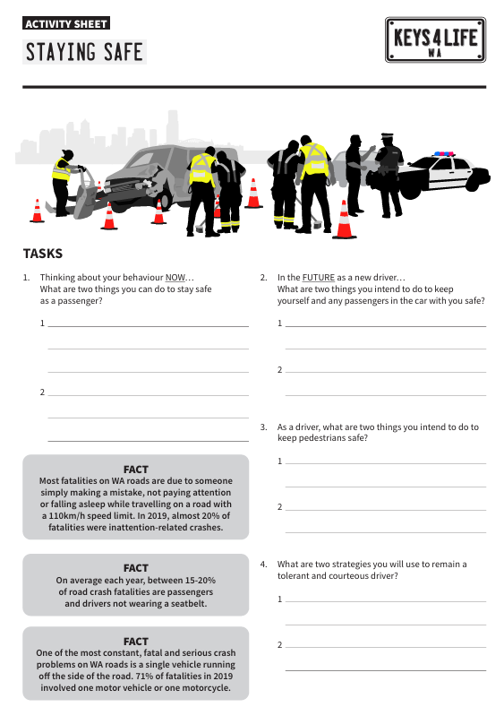
Staying safe
Complete the staying safe worksheet individually.
Notes:
Hand out to each student the activity sheet Staying safe (page 81). Ask them to complete this individually.

Slide 11
Extension activity
Code of Conduct
Work in small groups to develop a Code of Conduct for one road user type:
Drivers
Public transport users
Truck and heavy vehicle driver
Motorcycle and moped riders
Bicycle and scooter riders
Pedestrians
In your Code of Conduct consider:
Appropriate conduct and behaviour.
Understanding of and compliance with road rules.
Rights and responsibilities.
Supporting and helping other road users.
Tolerance and courtesy.
Managing and avoiding risks.
Laws and penalties.
Notes:
CODE OF CONDUCT
Students work in small groups to develop a Code of Conduct for one road user type (e.g. drivers, public transport users, truck and heavy vehicle drivers, motorcycle and moped riders, bicycle and scooter riders, or pedestrians).
Explain that different types of road travel should be considered when developing the code to reflect an attitude of shared responsibility.
Allocate one road user type to each group.
Write the following points on the board and explain that groups are to include these in their Code of Conduct along with strategies to support each point:
Appropriate conduct and behaviour.
Understanding of and compliance with road rules.
Rights and responsibilities.
Supporting and helping other road users.
Tolerance and courtesy.
Managing and avoiding risks.
Laws and penalties.
Have groups share their Code of Conduct with the class.

Slide 12
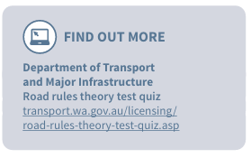
Class discussion
Discuss the merits of shared understanding and the benefits of all road users working towards a safer road network using the following questions:
Why is it important to be clear about your rights and responsibilities as a road user?
Is it fair to expect all road users to have a positive attitude to road safety and saving lives? Why?
Would having all drivers and riders sign a Code of Conduct before being issued with a licence, develop positive attitudes to safer road use? Why?

