Slide 1
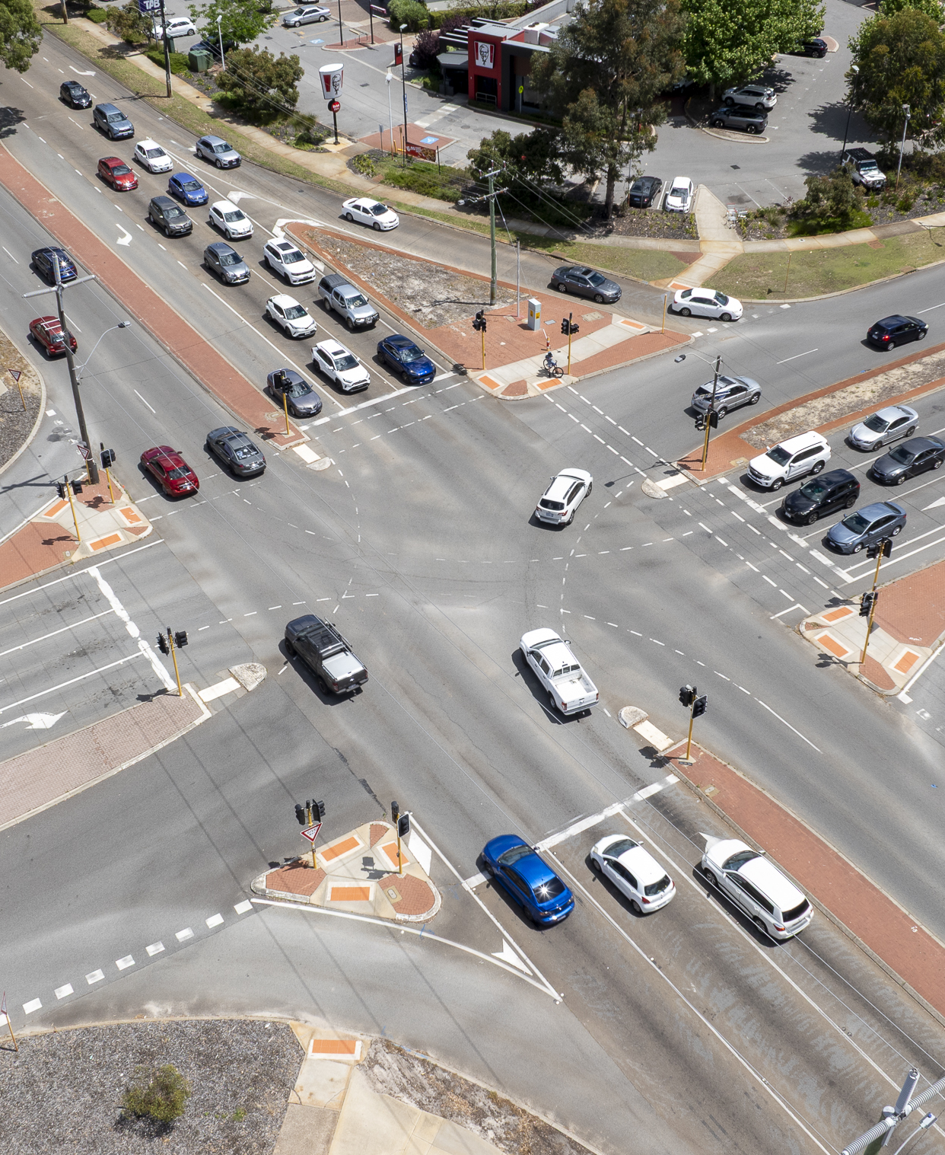
Keys4Life
Lesson 5
Why crashes happen
Notes:
Planning and Preparation
Activity 5.1
No resources required
Activity 5.2
Activity sheets or pre-prepared Driving Triangle activity packs available to order
Driver cards (page 91)
Environment cards (page 92)
Vehicle cards (page 93)
Wild cards (page 94)

Slide 2
Learning Intentions
Understand the driving triangle and the factors that can contribute to a crash.
Explore scenarios to determine driving risks and strategies to mitigate these.

Slide 3
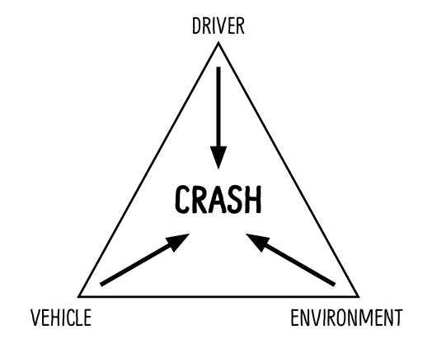
Driving triangle
Road crashes are often the result of the interaction of the driver, the vehicle and environment.
Notes:
Activity 5.1 – Driving triangle
As a stimulus for this activity show a current road safety advertisement from the Road Safety Commission. Choose an advertisement that will resonate with the cohort and establish a platform to start discussing why road crashes happen.
Explain that road crashes are the result of the interaction of the driver, the vehicle and environment (both inside and outside the vehicle). Explain that a driver’s characteristics and actions contribute to over 90% of crashes. Very few crashes are the result of the vehicle’s condition or environment.
Conduct a brainstorm (page 168) or use three sheets of paper around the room to conduct a graffiti walk (page 169). Use either strategy to collect a list of factors and behaviours that relate to each heading (examples on next slide).

Slide 4
Driving triangle
Driver | Vehicle | Environment
Inexperienced Overconfident Risk taker Angry Under the influence of drugs and/or alcohol Tired Not wearing a seatbelt Distracted: Phone Passengers | Foggy windscreen Faulty brakes High powered Headlights not working No seatbelts Small car 4WD Motorbike No rear or side mirrors | Wet weather Road works Nighttime Peak hour traffic Aggressive passenger Faulty traffic signals Corrugated road Wildlife on the road Unsealed road Sunset
Notes:
Share and discuss responses
Select several driver characteristics or behaviours and ask students to identify decisions that would change the outcome in a traffic situation. For example:
a tired driver – swap drivers every two hours or don’t get behind the wheel of a vehicle
a driver who has consumed alcohol – call a family member or friend for a lift.
Discuss the following questions:
What decisions can drivers make to reduce their crash risk?
Knowing that driver behaviours are most commonly the cause of crashes, how will this information influence your driving in the future?
What could a new driver do to reduce their crash risk?

Slide 5
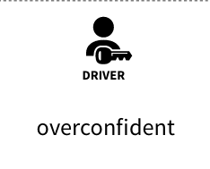

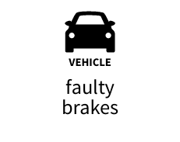
Driving risks
Consider this scenario:
What are the associated risks of this scenario?
What strategies could reduce the level of risk to the driver, passengers and other road users.
Notes:
Complete an example as a class.
Divide the class into groups of three.
Give each group a driver, environment and vehicle card.
Ask students to discuss the scenario created by their three cards to determine the:
associated risks
strategies that could reduce the level of risk to the driver, passengers and other road users.
Ask students holding the driver card to move onto the next group. This will form a new scenario for discussion.
Repeat this procedure several times to allow students to discuss a range of scenarios.

Slide 6
Human continuum
Considering your groups scenario, stand at a point along the continuum that represents the level of risk.
Low risk
High risk
Notes:
Keep students in groups.
Set up a values continuum (page 171) by placing a ‘high risk’ sign at one end of the room and a ‘low risk’ sign at the other.
Ask groups to stand at a point along the continuum that represents the level of risk for the final scenario they discussed.
Invite groups to share their scenario and provide reasons for their position on the continuum.
After sharing, allow groups to move on the continuum if they feel their scenario is of higher or lower risk behaviour then previously decided.
Give each group a ‘wild’ card.
Explain the card describes a type and amount of alcohol or other drug. Groups should decide if the wild card changes the level of risk for the driver and what strategies could be applied. Groups may also decide to change their position along the risk continuum.

Slide 7
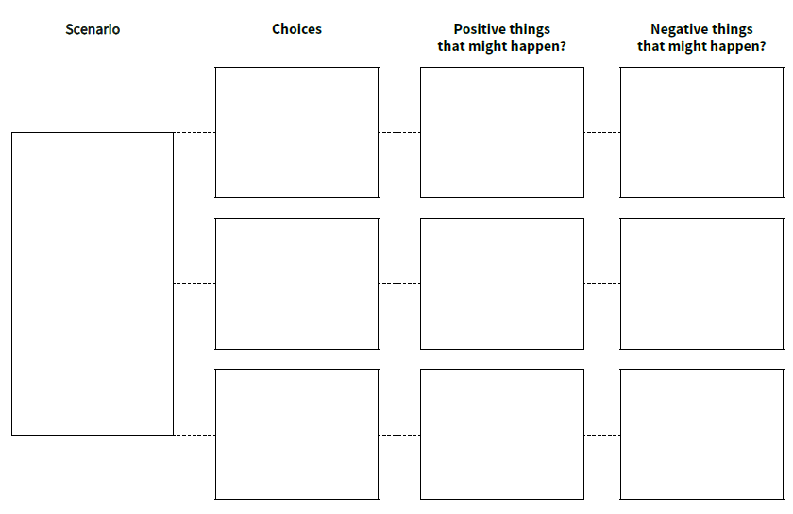
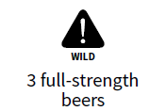
Decision making model
Using the scenario created by you four final cards, as a group, work through the decision-making model.
Risk of crash is high!
Crash could cause injury to death or serious injury to self and other road users.
Legal consequences: e.g. fined, vehicle impounded, loss of licence, jail
Continue driving
Won’t crash –
No one is at risk of being killed or seriously injured.
No legal consequences
Can’t drive self to location:
Could be late
Pay for taxi/rideshare
Stop driving
Keep driving but slowly
Risk of crash is still high!
Brakes might be more effective at slower speeds.
Crash could cause injury to death or serious injury to self and other road users.
Legal consequences: e.g. fined, vehicle impounded, loss of licence, jail
Notes:
In their small groups, using the scenario created by the four final cards, groups work through the decision making model (page 174).
Ensure students select a safe outcome for their scenario.
If students are unfamiliar with how to complete the decision-making process, explain the steps (eg generate options, consequences for each option, and select the safest option) and why it is important to use this process in challenging social and traffic situations in terms of their own and others’ safety.
Click through animations to provide students with an example if needed.
Listen to one or two group responses (ie the options, consequences and the choice that was made).

Slide 8
Class discussion
In the scenarios you discussed, which factor – driver, vehicle or environment – made the largest difference to the possible harm in each situation? Why?
What else might affect a driver’s ability to make a safe decision?
Did the wild card increase the level of risk in all driving situations? Why?
What are some ways drivers can stay safer?
Notes:
Groups discuss the following questions then feedback to class.
In the scenarios you discussed, which factor – driver, vehicle or environment – made the largest difference to the possible harm in each situation? Why?
Did the wild card increase the level of risk in all driving situations? Why? (The driver’s reaction times and ability to make safe decisions would be affected).
What else might affect a driver’s ability to make a safe decision? (Some examples – emotions, temperament, wanting to get somewhere in a hurry, use of alcohol or other drugs, friends, or the situation such as an emergency).
What are some ways drivers can stay safer? (Some include – plan ahead, don’t drive tired, intoxicated or under the influence of drugs, maintain the vehicle, limit passengers, and make sure everyone wears a seatbelt).

Slide 9
Personal reflections
How confident are you to make decisions that affect your safety in traffic?
Do you have responses that you know would be effective when faced with negative influences from friends or peers? What are they?
Can you assertively communicate concern about your safety in different traffic situations such as driving with someone who has been drinking alcohol or taken drugs?
Notes:
Students reflect on the questions; they can record their responses or share with a peer.

