Slide 1
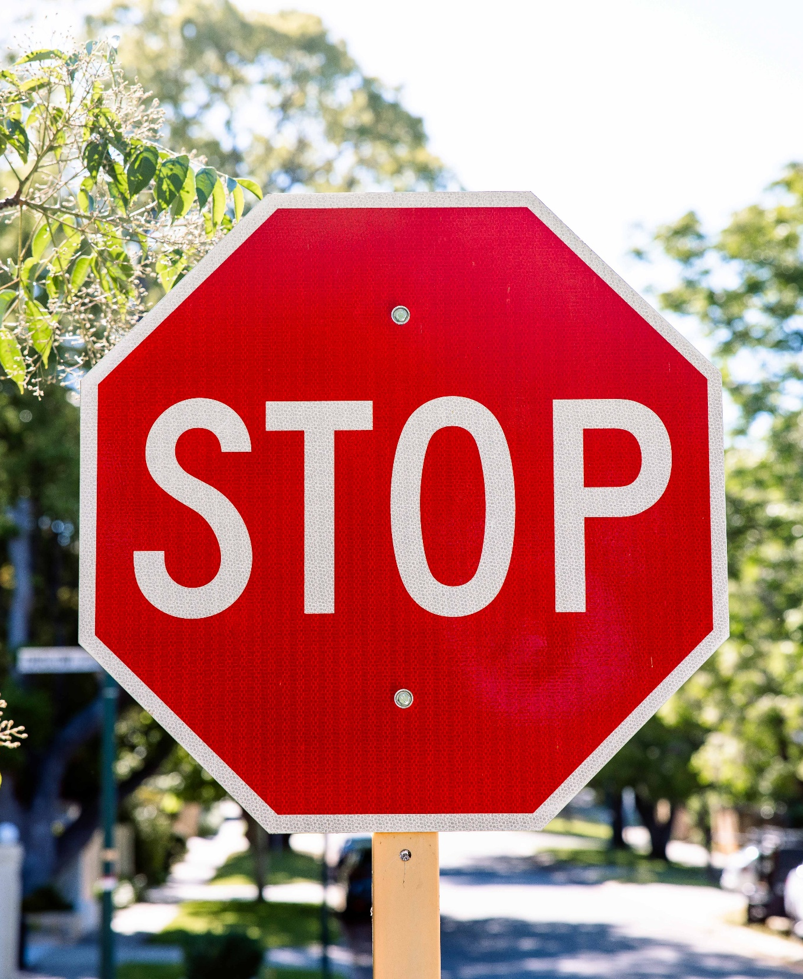
Keys4Life
Lesson 6
Reducing risks
Notes:
Planning and Preparation
Activity 6.1 – Zero alcohol
Activity sheet – To drive or not to drive (page 103)
Activity 6.2 – Signs of fatigue
Activity sheet – Y chart Fatigue, the silent killer (page 106),
Activity 6.3 – Driver distractions

Slide 2
Learning Intentions
Explain the BAC legal requirements for a learner, provisional and full licence driver.
Outline what causes fatigue, how it increases the risk of a road crash and strategies to reduce fatigue for a safer driving experience.
Explore the range of distractions that can impact drivers and strategies to mitigate them.

Slide 3
The Fatal 5
The ‘Fatal 5’ are the leading, preventable human behaviours that cause fatal road crashes.
Speed
Fatigue
Inattention
Alcohol and drugs
Non-use of seatbelts
Notes:
Evidence, research and statistics clearly demonstrate that there are five major risks associated with road crashes for all drivers.
Ask students to discuss what they think these 5 behaviours might be. (Click through animations to reveal answers).

Slide 4
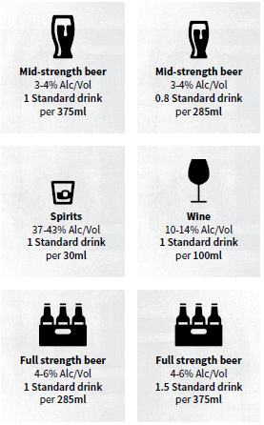
What is a standard drink?
No alcohol is the safest option for children and young people under 18 years of age.
What is a standard drink?
Any alcoholic drink that contains 10 grams of pure alcohol is called a STANDARD DRINK.
Different types of alcoholic drinks contain different amounts of pure alcohol.
Notes:
No alcohol is the safest option for children and young people under 18 years of age.
Different types of alcoholic drinks contain different amounts of alcohol content. By law, the strength of the drink and the number of standard drinks in the container must be written on the bottle or can.
A standard drink contains 10 grams of pure alcohol and it is used to help calculate the amount of alcohol in the blood stream or the Blood Alcohol Concentration (BAC).

Slide 5
Zero alcohol
What is the legal Blood Alcohol Concentration (BAC) for Learners and P-Plate drivers?
There are many factors that can affect a person's BAC. What are some of these factors?
Complete worksheet -
To drive or not to drive
Be prepared to share.
Notes:
BAC is measured by a breathalyser or by analysing a blood sample. There are many factors that can affect BAC.
By law, learner and provisional drivers are required to drive with a zero BAC (0.00 BAC).
Activity 6.1
Students read resource sheets; What is a standard drink and Factors that affect a person’s BAC.
Students' complete worksheet; To drive or not to drive.
Conduct a head talk (page 169) to hear students’ responses.

Slide 6
Fatigue
The 'body clock' in the brain, known as the circadian rhythm, is a 24-hour internal clock in our brain that regulates cycles of alertness and sleepiness by responding to light changes in our environment.
This ‘body clock’ programs people to feel very sleepy between 2am and 5am and 2pm and 5pm.
During these times there is an increase of fatigues related crashes.
How does fatigue affect drivers?
Notes:
Show students a campaign on fatigue from the Road Safety Commission.
Explain that a person’s ‘circadian’ or ‘body clock’ in the brain affects energy levels programming people to feel very sleepy between 2am and 5am and 2pm and 5pm.
At these times people experience their worst physical and mental performance of the day and because of this, there is an increase of fatigue related crashes at these times.
The obvious signs such as yawning and closing eyes are in fact the last signs of tiredness.
How does fatigue affect drivers? (slowing reaction times, reducing concentration, and hindering judgment)

Slide 7
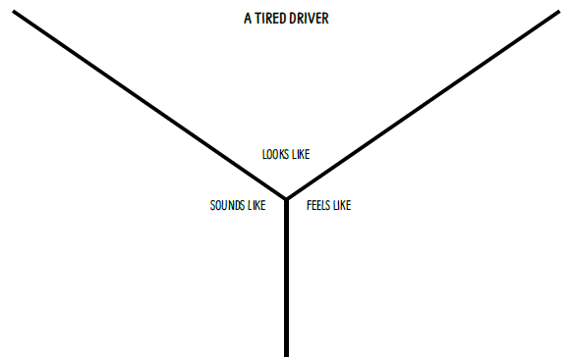
What does fatigue look like, sound like, feel like?
In groups complete the fatigue Y-Chart.
Notes:
In groups, have students complete the Ychart on Fatigue, the silent killer (page 106), by writing the signs of fatigue for each section e.g. looks like, feels like and sounds like.
The following examples can be used to prompt students’ thinking and added to those generated during the activity.
Looks like: Yawning, rubbing eyes, eyes closed, slumped in seat, resting head on hand, head back on head rest, nodding head, blinking, car drifting between lanes, car drifting off the road, going faster, slowing unintentionally, braking late.
Feels like: Daydreaming, wandering thoughts, forgetting driving the last few kilometres, missing road sign or
exit, sleepy, relaxed, restless, heavy body and/or head, eyes closing for a moment or going out of focus.
Sounds like: Yawning, clunk from hitting kerb or audible edging strips, not talking, have I passed the turn off yet?, What speed is it along here? I’m okay. I can go a bit further I’ll stop in another 10 minutes.

Slide 8
Strategies to reduce fatigue-related crashes
Get plenty of sleep the night before starting out.
Share the driving time.
Stop at a rest area during the trip
Avoid alcohol or medications that cause drowsiness
Have a drink stop combined with a ‘stretch your legs’
Plan the trip into manageable distances and swap drivers every two hours
Drive hydrated (dehydration can cause headaches, tiredness and light-headedness which can contribute to fatigue and affect driving)
Avoid driving at night at normal sleep times.
Notes:
Students discuss strategies that can reduce the number of crashes caused by fatigues. Click through animation to reveal examples.
The onset and effects of tiredness are different for everyone.
Fatigue has no predictable level of impairment to driving ability, however, 17 hours of continuous wakefulness is known to impair driving performance to the same degree as a BAC of 0.05% (Williamson & Freyer et al., 2000).
It is possible for drivers to be tired even when driving on short trips as it is not always the driving that makes the driver tired.
It is often what happens before the drive that contributes to the driver becoming fatigued (eg studying late into the night, restless sleep, long hours at work or feeling unwell).
Some drivers believe they are immune to the effects of fatigue or have ‘quick fix’ remedies to combat fatigue, such as playing loud music, coffee or an energy drink, or fresh air. These are not effective.

Slide 9
Driver distractions
Distractions can be categorised into 4 types:
Auditory: paying attention to sounds/noises.
Cognitive: something that takes mental effort.
Manual: something that may take your hand/s of the wheel.
Visual: something that takes your eyes off the road.
In groups, list down as many distractions as they can think of for all four categories.
Notes:
Activity 6.3
Show students a campaign from the Road Safety Commission on distractions.
Explain to students that distractions can be categorised into 4 different categories.
Auditory: paying attention to sounds/noises
Cognitive: something that takes mental effort
Manual: something that may take your hand/s of the wheel
Visual: something that takes your eyes off the road
Provide an example of each category.
In groups, students list down as many distractions as they can think of for all four categories.

Slide 10
Driver distractions – Examples
Auditory | Cognitive | Manual | Visual
Loud noises Passengers Listening to music or podcasts Hands-free phone calls Phone notifications | Hands-free phone calls Passengers Navigation | Using mobile phone Changing the stereo Adjusting temperature controls Eating and drinking | Sun glare Road-side advertising Looking at maps Looking at phone Warning signs Animals near roadside Other road users

Slide 11
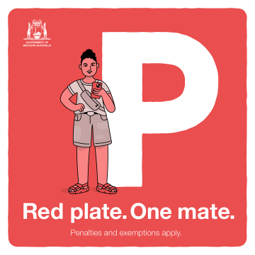
Passenger distractions
Red Plate. One Mate.
The legislation applies to all red P-platers
The red P-plate passenger limit permits only one passenger in a car, or on a motorbike, at all times.
Complete activity sheet:
Driving with friends.
Notes:
Red Plate. One Mate: Explain that these laws were brought in to remove passenger distractions for inexperienced drivers.
The legislation applies to all red P-platers
The red P-plate passenger limit permits only one passenger in a car, or on a motorbike, at all times
A $200 fine and two demerit points will apply which is the same penalty as not complying with the existing midnight to 5am curfew for red P-plate drivers.
Exemptions:
the additional passengers include a driver who has held a full C-class licence for at least four years; or
other passengers are immediate family members; or
if additional passengers are in the vehicle as a necessary requirement of the driver's employment (paid or unpaid). You are required to have a letter from your employer to present to WA Police when requested.

Slide 12
Driver decision scenarios
Notes:
Using the scenarios on page 111, students create a role-play demonstrating the decision the driver should make to reduce the risk.

Slide 13
Personal reflection
• I know that driver distractions include …
• As a passenger I can reduce driver distractions by …
• As a driver I can reduce distraction by …
• As a driver, I feel … to tell my friends how they should behave to make the journey safer.
Notes:
Individually or in small groups, students reflect on the following questions:

