Slide 1
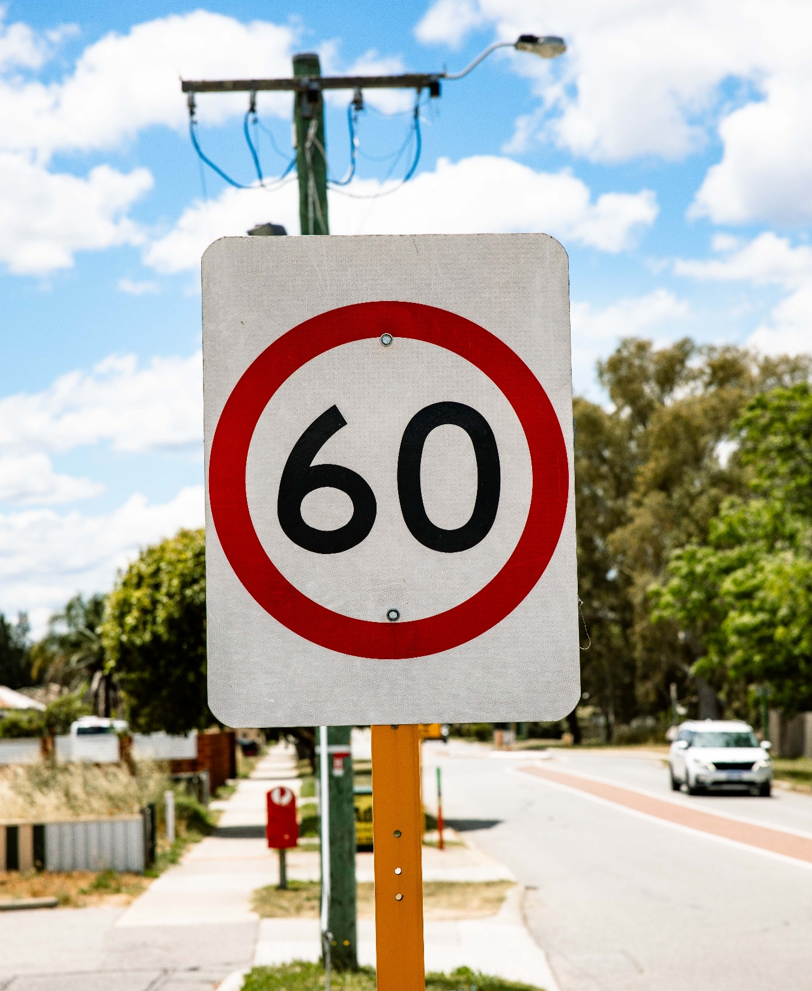
Keys4Life
Lesson 7
More ways to reduce risks
Notes:
Planning and Preparation
Activity 7.1 – Speed and stopping distances
Activity sheet – How fast can you stop? (page 119)
Activity sheet – Speed signs (pages 121-123)
Trundle Wheel (or 100m tape measures)
Witches hats or markers (e.g. ice cream container, duster or ruler)
Area approximately 100 metres long
Activity 7.2 – Driving is a complex task
Activity sheet – Y chart Fatigue, the silent killer (page 106),

Slide 2
Learning Intentions
Explain the impact speed can have on safe driving.
Predict stopping distances and what factors affect them.
Demonstrate how distractions impact driving.

Slide 3
Speed
Speed limits are enforced on all roads in WA including those that don’t have visible speed limit signs.
Reducing speed limits is the single most effective and immediate way to reduce WA’s road crashes.
Speed is a major contributor to road crashes in WA.
Driving above the posted speed limit is illegal and will incur a fine and demerit points.
For every 5km/h increase in travelling speed in a 60km/h zone, the risk of being injured in a crash doubles.

Slide 4
Important information for students:
The human body is vulnerable and collision forces in a crash can result in serious injury and/or death
Serious injury and trauma can occur at an impact speed over 40 km/h
The higher the speed in a crash, the greater the force on impact and severity of injuries to the human body
Speeding is not just about driving faster than the speed limit, but also about driving too fast for the weather, time of day (visibility), traffic and road conditions.

Slide 5
Safe Travel Speeds
Road Type | Safe Speed
Roads with possible conflicts between car and unprotected road users | 30km/h
School zones | 40km/h
Intersections with possible side conflicts between cars | 50km/h
Roads with possible head-on conflicts between cars | 70km/h
Roads with no possible head-on or side conflicts between road users | >100km/h

Slide 6
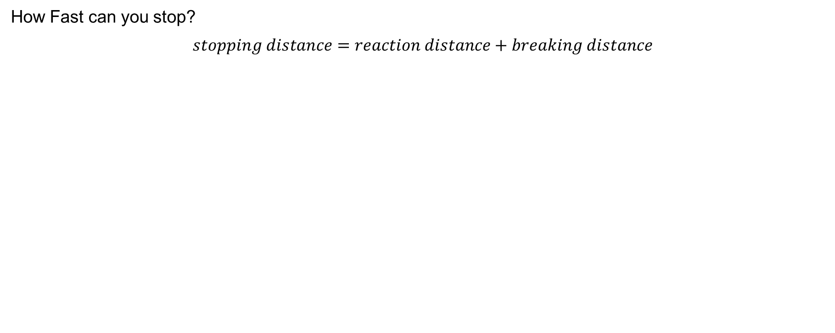
Speed and Stopping Distances
How Fast can you stop?
$$stopping distance=reaction distance+breaking distance$$
Complete worksheet estimates -
How fast can you stop?
Be prepared to share your estimates.
Notes:
The time or distance it takes a vehicle to stop is the combination of both the driver’s reaction time and braking distance of the vehicle (eg stopping distance = reaction distance + braking distance). For example, if the driver has been drinking alcohol their reaction time will be slower which will contribute to a greater stopping distance. Other factors will impact a driver’s ability to slow down, react, and stop a vehicle such as alcohol and other drugs, distractions, tyre tread, condition of the vehicle and brakes, wet and slippery roads, fatigue, weight of vehicle, etc.
Activity 7.1
Students are to read How fast can you stop?
Guess the reaction, braking and stopping distances for each speed and record these on the activity sheet.

Slide 7
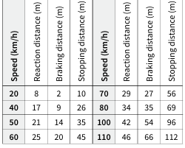
How fast can you stop?
At least 100m long
Actual distances
Front of car
Notes:
Activity 7.1 – outside (At this stage no measuring devices are to be used)
Take the markers, trundle wheels and speed signs outside to an area that is at least 100 metres long.
Groups should also take their activity sheet and a pen.
Indicate a line on the ground to represent the front of a car.
Explain that the driver of the car, who is experienced, alert and not under the influence of alcohol or other drugs, has just seen a small child run out onto the road about 45 metres ahead. The driver’s car is in excellent condition and the weather is fine.
Give each small group a speed sign. Explain that the signs are to be placed where each group thinks that the car (travelling at the speed indicated on the speed sign) would stop once the driver has reacted to seeing the child and applied the brakes (eg the stopping distance written on their activity sheet).
Allow enough time for each group to place their sign.
When all signs have been placed, use the trundle wheel to measure the distances marked by groups (eg from the starting line to where the group has placed their speed sign). If the distances are more or less than the distance indicated on students’ sheets, discuss this discrepancy by asking the following questions:
Were you surprised by the stopping distances of different speeds? Why?
Why is it important to scan for hazards and judge distances when driving?
What builds a person’s skill at judging stopping distances accurately?
Provide groups with correct stopping distances for each speed as listed in the table in the next slide.
Students to complete worksheet: How fast can you stop?
Students are to remeasure the stopping distances and place the speed signs at the correct point.

Slide 8
Reflection questions
What did you notice about your estimations and the correct stopping distances?
What might affect stopping distances?
If you were going to share this information about stopping distances with a learner driver, what tips would you give them?
What areas other than around schools would benefit from having a 40km/h speed limit? Why?
Complete worksheet -
How fast can you stop?
Be prepared to share your answers.
Notes:
Return to class.
Ask students’ the following questions:
What did you notice about your estimations and the correct stopping distances?
What might affect stopping distances? (Factors such as wet weather, different road surfaces, the size of the vehicle, the load being carried and driver reaction time are a few examples).
If you were going to share this information about stopping distances with a learner driver, what tips would you give them? (Travel at the posted speed limit; leave at least a two second gap between your vehicle and the vehicle travelling in front; drive for the conditions; don’t drive impaired by alcohol, other drugs or fatigue; ensure your card is roadworthy eg safe tyres and brakes).
What areas other than around schools would benefit from having a 40 km/h speed limit? Why?

Slide 9
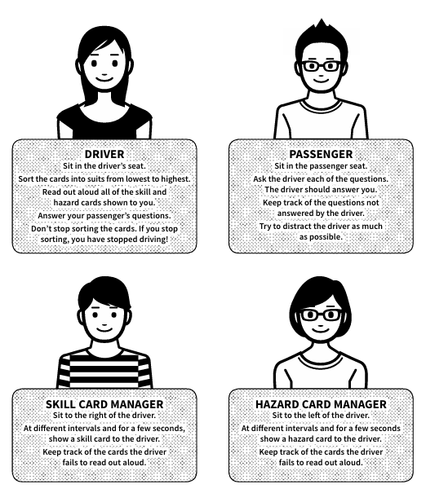
Driving is a complex task
Discuss the following questions:
What did you notice about your ability to concentrate and complete each activity accurately while being distracted?
Why do young drivers underestimate the number of things that must be managed to be a safer driver?
What could assist young drivers to be able to manage the number of tasks involved in driving?
Would the driver’s workload increase as the vehicle’s speed increases?
As a passenger, why is it important that you understand the complexity of driving?
Notes:
Activity 7.2
Place two chairs behind a desk and a chair either side of the desk. Give each student a copy of Driving is a complex task (pages 126 and 127).
Select a group of four students and allocate the roles of driver, passenger, skill card manager and hazard card manager as described on the sheet.
Demonstrate the activity using the group of students explaining that the purpose of the activity is to draw attention to:
How distractions affect driving
The importance of developing hazard perception by practising extensively as a learner driver.
Place other students in groups of four.
Give each group their equipment including:
A set of hazard and skill cards
A deck of playing cards
A copy of the passenger questions.
Allow enough time so that all students experience being the driver. If time allows, let each student repeat the task so it becomes clear that practice can improve performance.
Students’ complete worksheet: Driving is a complex task
Discuss the following questions:
What did you notice about your ability to concentrate and complete each activity accurately while being distracted? (Explain that different areas of the brain control different actions. Even though activities may be regularly carried out, when two are combined it becomes more difficult as the complexity is increased).
Why do young drivers underestimate the number of things that must be managed to be a safer driver? (Lack of experience and overconfidence).
What could assist young drivers to be able to manage the number of tasks involved in driving? (Extensive hours of driving practice before driving solo).
Would the driver’s workload increase as the vehicle’s speed increases?
As a passenger, why is it important that you understand the complexity of driving? (A passenger needs to understand their responsibilities and aim not to distract a driver. A driver’s attention should always be on driving the car safely. Distractions can cause road crashes).

Slide 10
At home tasks
Complete Behind the Wheel:
Task 9 – Get ready to stop (page 10)
Task 4 – Keeping a safe distance (page 5)
Task 8 – Check your speed (page 9) in Behind the wheel.
Task 10 – Be aware of distractions in Behind the wheel (page 11)
Encourage students to complete Quiz 1 – Speed (page 21) in Behind the wheel (if not yet completed).
Notes:
Remind students that they must complete all 10 tasks in the Behind the wheel journal to be considered eligible to sit the test at the end of the Keys4Life program.
Encourage students to access the Department of Transport and Major Infrastructure’s road rules theory test quizzes to begin building and consolidating their knowledge of road rules.

