Slide 1
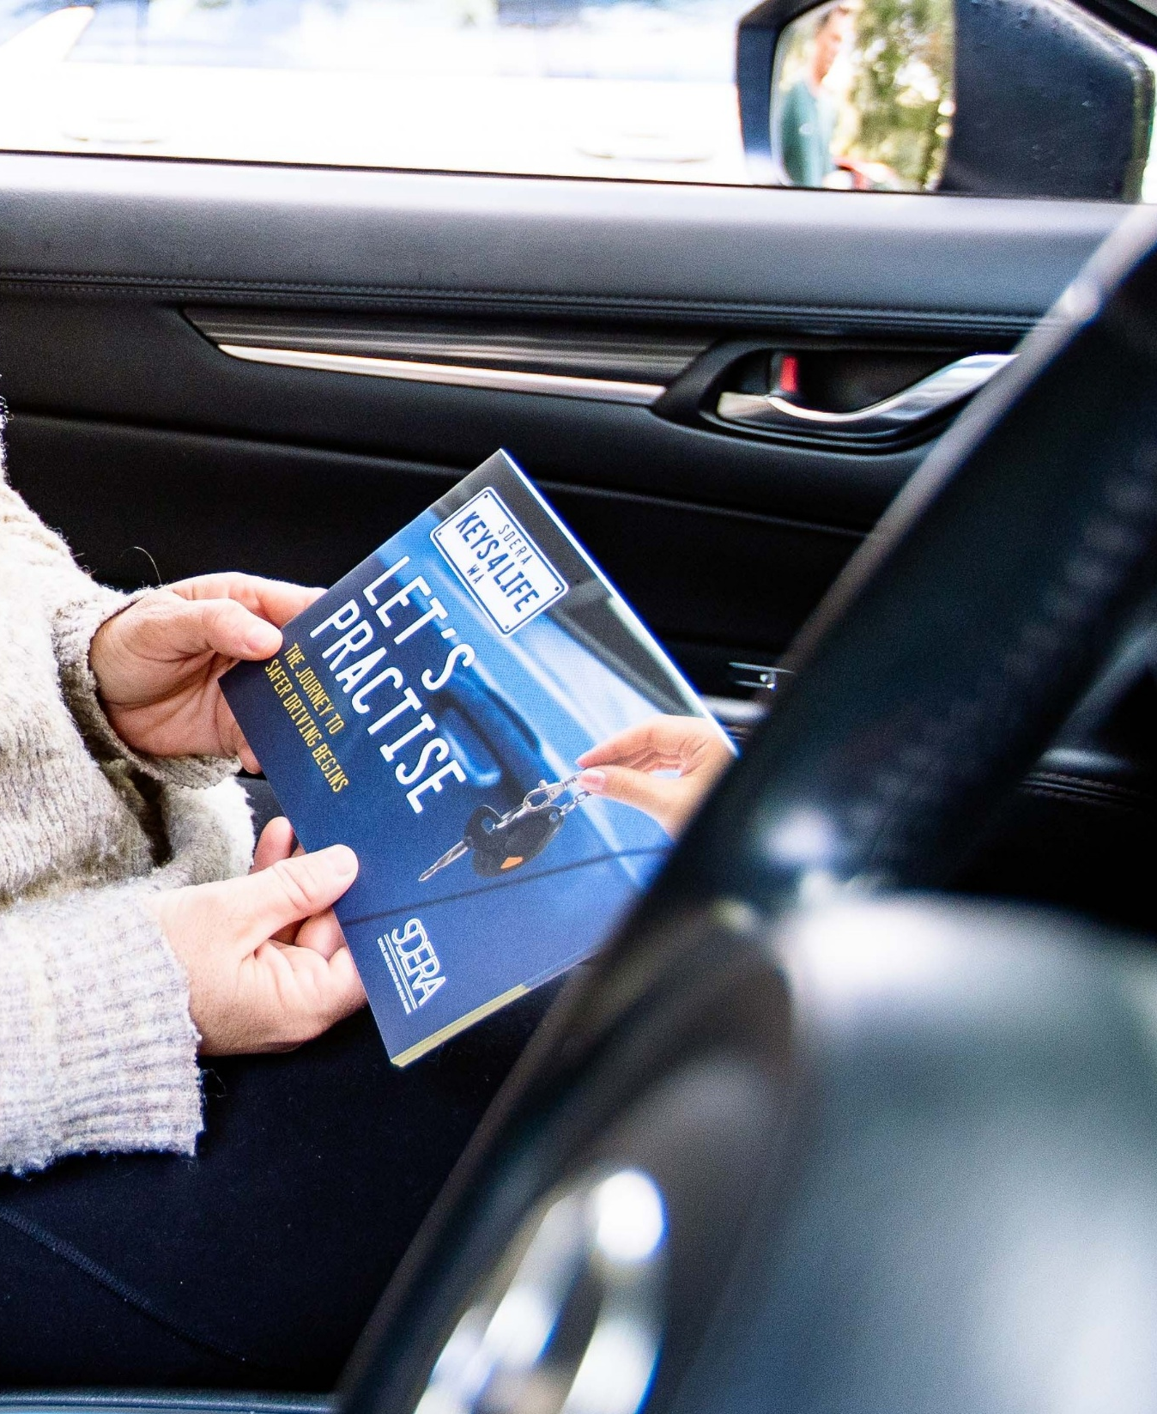
Keys4Life
Lesson 8
Driving practice
Notes:
Planning and Preparation
Activity 8.1 – Why practice?
Markers – enough for one per group and 4 large sheets of paper
Activity sheet – Supervisor qualities (page 137) – one copy per student
Family information sheet – Young drivers (page 138) – photocopy one per student or email to parents
Activity 8.2 – Straight talking
Activity sheet – Communication styles (page 141) – photocopy one per student
Activity sheet – What are you saying? (page 142) – photocopy one per student

Slide 2
Learning Intentions
List and explain preferred driver supervisor characteristics.
Define assertive communication and its applicability during the learn to drive process.

Slide 3
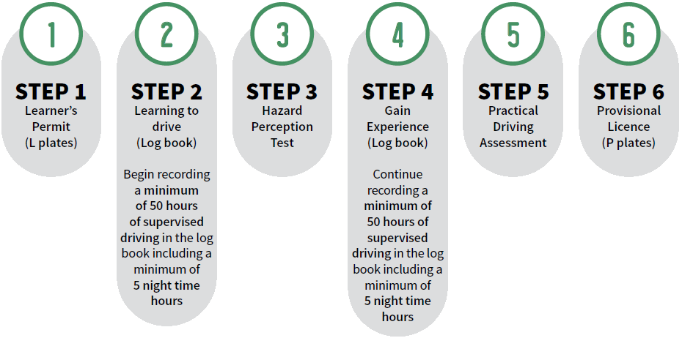
Western Australian Graduated Driver Training and Licensing system
Notes:
Supervisor requirements
hold a current and valid driver’s licence (for the class of vehicle in which they are teaching someone how to drive) for at least four years and carry it with them

Slide 4
Why practice?
Brainstorm when you have had to learn and master a new skill.
What happened when you first started to learn the new skill?
Who helped you to learn the skills?
What skills or characteristics did the person helping you possess?
How did you improve?
What did you do when you had difficulty in mastering the skills?
Complete worksheet -
Supervisor qualities
Be prepared to share your answers.
Notes:
Activity 8.1
Brainstorm (page 168) list of situations where students have had to learn and master new skills (e.g. learning to play a sport, musical instrument or new computer game).
Conduct a graffiti walk (page 169) using a different heading on each sheet of paper. Students to consider each heading a write their thoughts about each.
Benefits of supervised driving practice
Choosing a supervisory
Problems of supervised driving practice
How can you get your hours of supervised driving practice?
Discuss some of the points raised on each of the graffiti sheets.
Brainstorm (page 168) what a driving supervisor needs to be able to do.
Students’ complete worksheet: Supervisor qualities (page 137). Brainstormed skills and qualities, choose their top five and add these to the table
Get students to think about their potential supervisory and rate that person for each of the skills/qualities they have listed.

Slide 5
Discuss the following questions
What are some of the things you will need to discuss with your supervisor before you start learning to drive?
What plans have you already made to help you start the learning to drive process?
If you are able to use a driving school, when do you think you should book some lessons?
Notes:
What are some of the things you will need to discuss with your supervisor before you start learning to drive? (What will happen if a dangerous situation arises? When should the supervisor tell you what you did wrong? Who will plan the lessons? Will you be able to talk to your supervisor if you want to discuss something that is concerning you about driving?)
What plans have you already made to help you start the learning to drive process? (Talked to my supervisor about scheduling lessons, booked a driving school, made sure my supervisor knows what they have to do, found websites with learning to drive tips).
If you are able to use a driving school, when do you think you should book some lessons? (It is not a requirement of the licensing system to have lessons with a registered driving school however an experienced driving instructor can help learner drivers recognise the skills that require practice and provide insight into the testing procedures. Some driving schools will also allow the supervisor to sit in on lessons and learn how to teach certain skills. A lesson with a driving school when first starting to learn will give the learner and supervisor correct information and skills to practise. Lessons closer to sitting the Practical Driving Assessment are also recommended as the instructor will check that the learner has mastered the skills required to pass the assessment).

Slide 6
Straight talking
Complete worksheet -
What are you saying?
Using the communication styles worksheet
Be prepared to share your answers.
Communication styles
Aggressive
Assertive
Passive
In what situation should assertive communication occur?
Notes:
Verbal communication = aggressive, assertive and passive
Activity 8.2
Give each students a copy of Communication styles (page 141) and What are you saying? (page 142)
Using communication styles complete what are you saying?
Guess the reaction, braking and stopping distances for each speed and record these on the activity sheet.

Slide 7
Scenarios
Your supervisor has been trying to teach you how to reverse park the car. You have had at least six goes but can’t get it right and now you are frustrated. Your supervisor says, “Oh for goodness sake. Just get it right and do it!” What should you say?
You live on a farm. Your supervisor thinks that driving your family into town will be good practice but you have to drive on a highway and don’t feel ready to do this just yet. Your supervisor says, “If you can’t drive on that road now, you’ll never be able to.” What should you say?
A little kid has suddenly run out onto the road in front of your car. Your supervisor grabs the steering wheel and yells at you, “Stop the car. You’re going to kill someone.” What should you say?
Notes:
Activity 8.2
Students are to get into pairs.
Students are to practise using assertive statements that would provide a positive outcome for both the learner driver and the supervisor.
Students role-play (page 170) each situation to let students practise using statements that would provide a positive outcome for both the learner driver and the supervisor.
Debrief role-plays

Slide 8
Reflection questions
What can you do to make sure that you and your supervisor feel comfortable to talk about driving lesson issues if they arise?
When might be the best time to talk through problems that happen during driving lessons?

Slide 9
At home tasks
Complete Behind the Wheel:
Task 6 – Check out the conditions (page 7)
Task 7 – Stop! Hazards ahead (page 8)
Encourage students to complete Quiz 8 – Speed (page 28) in Behind the wheel (if not yet completed).
Notes:
Remind students that they must complete all 10 tasks in the Behind the wheel journal to be considered eligible to sit the test at the end of the Keys4Life program.
Encourage students to access the Department of Transport and Major Infrastructure’s road rules theory test quizzes to begin building and consolidating their knowledge of road rules.

