Slide 1
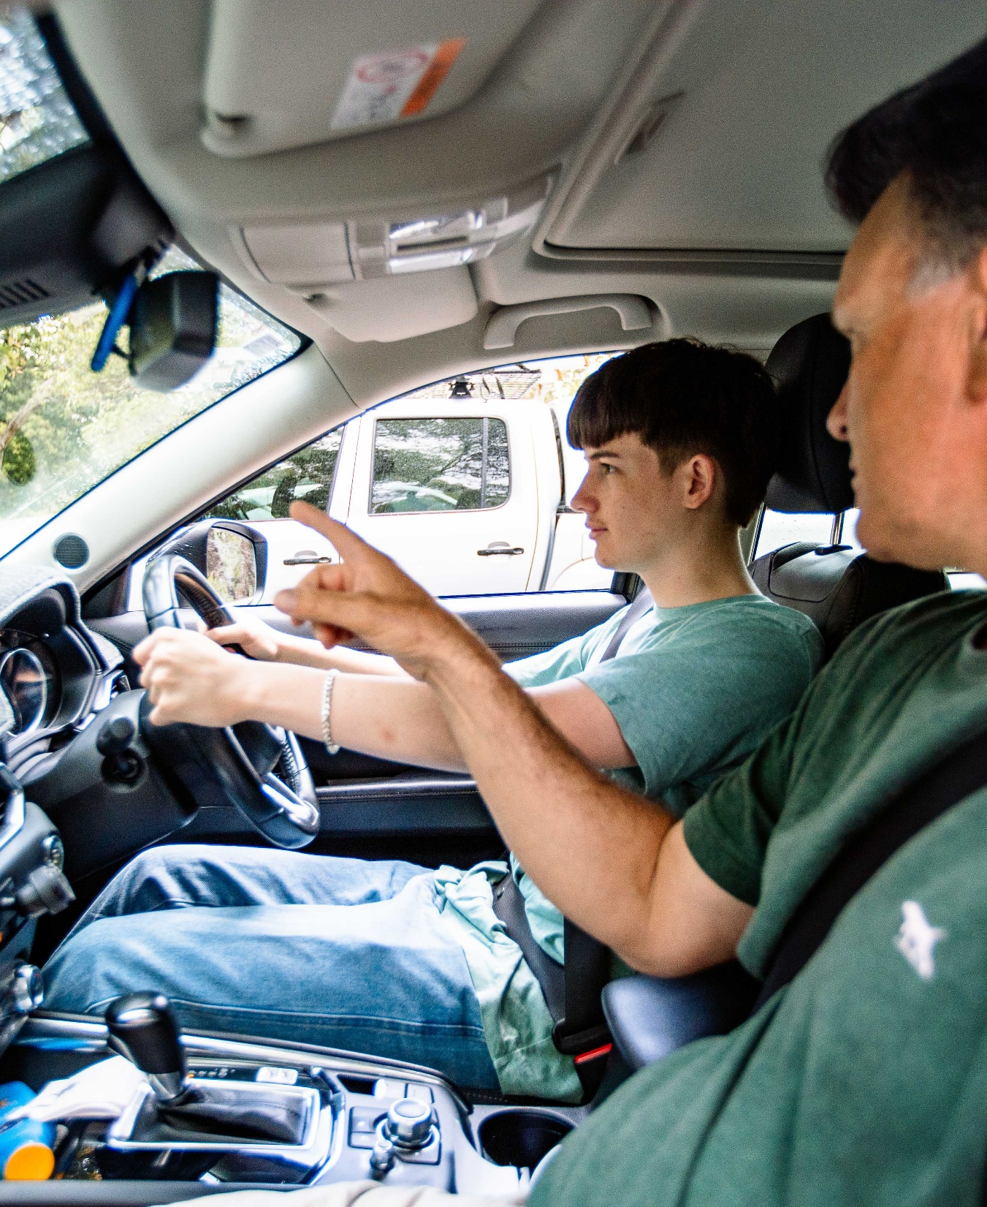
Keys4Life
Lesson 9
Drive safe
Notes:
Planning and Preparation
Activity 9.1 – My safe dream car (page 146)
Activity sheet – Safety ratings (page 148) – photocopy one per student
Strategy sheet – Values continuum (page 175) – one set of signs
Internet access
Activity 9.2 – Making plans (page 149)
Activity sheet – Making plans (page 151) – photocopy one per student
Family information sheet – P plate drivers (page 152) – photocopy one per student
Activity 9.3 – Risky situations (page 153)
Activity sheet – Risky situations (pages 155 and 156) – photocopy and make into cards, one card per group
Strategy sheet – Decision-making model (page 174) – photocopy one per group

Slide 2
Learning Intentions
Explain car safety ratings and why choosing cars with a 5-star rating is the safest choice.
Explore strategies for planning how to get to and home from social activities.
Consider factors that impact decision-making.

Slide 3
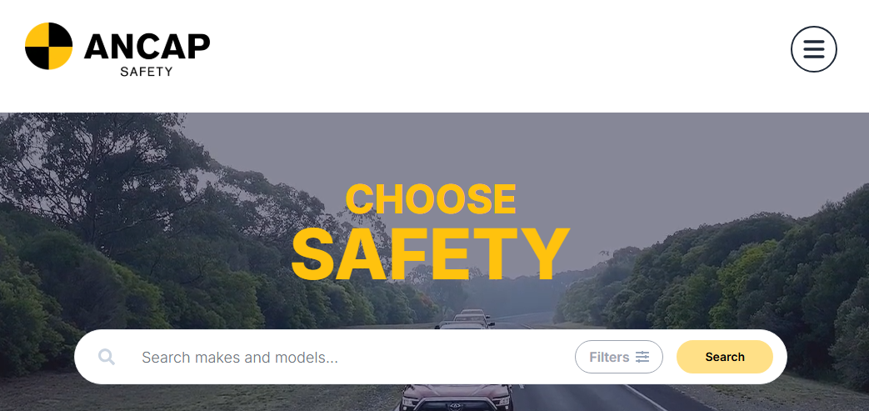
My safe dream car
5 Star safety rating
Crumple zones
Collapsible steering columns
Reinforced door frames
Air bags
Seatbelts designed to work with air bags
Seatbelt reminder systems
Electronic stability system
Anti-lock braking system (ABS)
Complete worksheet -
Safety ratings
Be prepared to share your findings.
Notes:
Activity 9.1 – My safe dream car
Explain to students that manufacturers now produce vehicles with safety features to achieve a 5-star safety rating.
Australian New Car Assessment Program (ANCAP) - New car safety ratings www.ancap.com.au
Used Car Safety Rating (UCSR) system – How safe is your car https://howsafeisyourcar.com.au/Rating-process/What-is-UCSR/
Ask students to imagine that they have won a car of their choice in a competition. However, the rules of the competition state that the vehicle chosen by the winner must have a four of five safety rating, and cost no more that $20,000.
Student complete worksheet: Safety ratings (page 148)
Discuss students’ findings

Slide 4
Discussion questions
Were you surprised about the safety ratings of the cars you chose? Why?
What safety features do manufacturers usually include as standard items?
Which car do you think provides the best price and safety?
Notes:
Conduct a values continuum (page 171) using the following statements and the agree and disagree cards (page 175)
Safety ratings and features will influence young people when buying a vehicle.
Safety features should be standard in all vehicles and not considered as ‘extras’.
Young people will always look at the price before anything else when buying a vehicle.
Young drivers should only be allowed to drive vehicles that have a minimum 4-star rating.
Your first car is always your worst car.
Ask students to write and share their responses to the following statement.
Now I know that some cars are safer than others, I intend to…

Slide 5
Making plans
Planned vs unplanned
Complete worksheet -
Making plans
Be prepared to share your ideas.
Notes:
Activity 9.2
Ask students to define ‘planned’ and ‘unplanned’ (impromptu) in terms of events, parties and gatherings. Planned could include Year 12 balls, graduation ceremonies, weddings and birthday parties. Unplanned could include celebrating winning a grand final and friends dropping over.
Suggest that young people should have strategies in place to ensure they socialise safely and get home safely, for both planned and unplanned events.
Students’ complete worksheet: Making plans (page 151)
Strategies could include:
Staying together
Looking after an unwell person until help arrives
Taking a charged mobile phone
Having a ‘pick up’ plan with parents (e.g. their parents will pick them up at any time or will pay for a taxi when they cant’)
Having a swag in the back of the car to stay somewhere safe.
Decide as a group the strategies that can be used to ensure that a young person does not drink and drive (eg leaving car keys at home, having a designated driver) or travel as a passenger with a person who has been drinking alcohol or using other drugs (eg having a ‘get home safely’ agreement with parents).

Slide 6
Discussion questions
Have you and your parents talked about what you will do and what they will do, to make sure you get home safely?
Do you feel confident to ‘stick’ to your plan and not be influenced by others?
What could you do if a mate tried to talk you into driving after you have had a few drinks (alcoholic)?
What could you do if a mate tried to drive their car under the influence of alcohol or other drugs?
How would you feel if you didn’t try to stop a mate from driving after drinking alcohol and they were involved in a crash?

Slide 7
At home tasks
Complete Behind the Wheel:
Task 2 – Safety Check (page 3)
Encourage students to complete Quiz 7 – Seatbelts (page 27) in Behind the wheel (if not yet completed).
Notes:
Remind students that they must complete all 10 tasks in the Behind the wheel journal to be considered eligible to sit the test at the end of the Keys4Life program.
Encourage students to access the Department of Transport and Major Infrastructure’s road rules theory test quizzes to begin building and consolidating their knowledge of road rules.
Distribute or email the Family information sheet P plate drivers (page 152) to parents/carers.

