Slide 1
On-entry Assessment Program
Administering the assessments
Notes:
Please choose the title slide with or without the public education statement, then click the icon to change the image. Use cropping to position it. Please do not alter the position of the logo.

Slide 2
Purpose
provide information about each student’s skills and understandings at the commencement of the year.
inform the planning and delivery of targeted programs, reflective of each child’s needs and capabilities
identify, early in the school year, students who may require intervention or extension.
provide the opportunity to reflect on the effectiveness of teaching programs
inform whole-school planning and review

Slide 3
Key messages
On-entry is an assessment for learning, rather than of learning.
There is no pass, fail or minimum standard.
Preparation is not required (and not appropriate).
On-entry is not intended to replace teacher judgements and classroom based assessments, rather to support them.
On-entry provides an opportunity to:
observe each student in a one-on-one situation
note any concerns with a student’s emotional/social development
build a trusting, safe and secure relationship with each student.

Slide 4
FAQs
Q. What is assessed in On-entry?
Literacy and numeracy skills and understandings considered critical to early and ongoing educational development. Links to the curriculum can be found in the handbook
Q. Who should administer the assessments?
The classroom teacher.
However, if time is an issue, the EA/support teacher/admin (☺) may be able to administer some tasks, e.g. rhyming words, initial sounds, number sequence.

Slide 5
FAQs
Q. When should the assessment program be implemented?
A. The start of the year.
On-entry is designed as an assessment for learning.
Each module is linked to the curriculum of the year to come. As such, all relevant planning documents can only be accessed if the module is administered by the current teacher.
Median scores are only valid and comparable when assessments are administered at the beginning of the year.

Slide 6
Before

Slide 7
Before you begin
Read the Handbook for principals, teachers and test administrators (available on the website). This is not an option!
Preview the assessments in the application or by downloading the administration instructions and familiarise yourself with the tasks, the administration instructions and the responses available.
Ensure you have all the required resources - those provided in the ‘kit’ and those to be provided by the school, e.g. plastic teddies. *
Design an ‘assessment plan’ in consultation with other teachers in your school.
The better prepared, the smoother the assessment period ☺
* a list of resources can be found in the handbook.

Slide 8
An assessment plan
Ensures the assessments are delivered in the same way, at the same time throughout the school, resulting in comparisons that are valid and reliable.
Some tasks can be integrated into the daily teaching program, e.g. counting, rhyming words.
Use relief time effectively, i.e. for tasks that must be done in a quiet area away from other students.
Note: Delivering an entire assessment to a student, particularly in Pre-primary, is not advisable. The tasks require concentration and developmentally, administering all the tasks (even all the Reading tasks) is not appropriate.
*preferably in an area familiar to the student where they’ll feel comfortable.

Slide 9
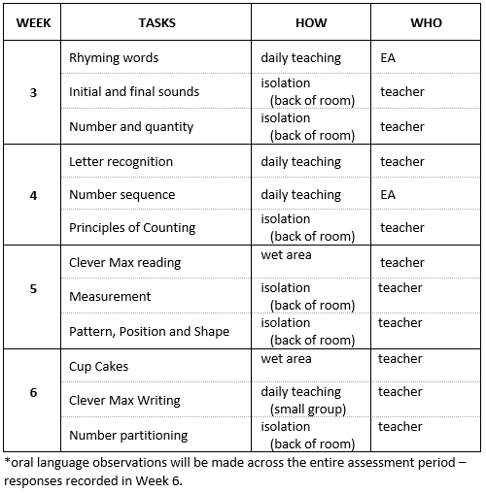
Sample assessment plan – Module 1

Slide 10
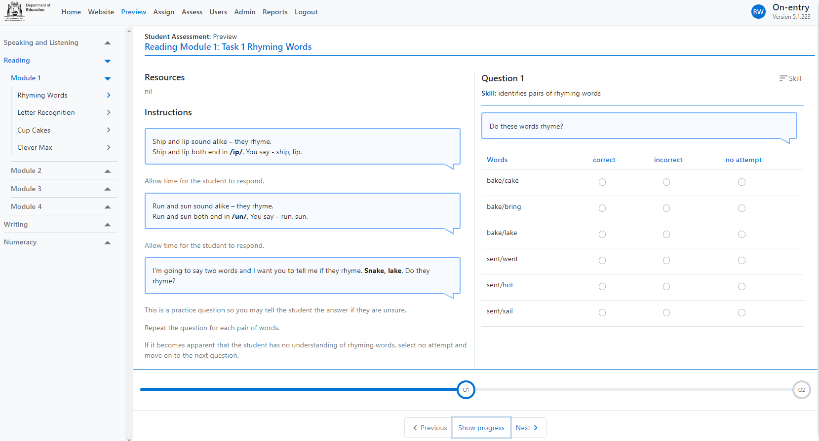
Using the online system directly https://apps.det.wa.edu.au/oeaps
Disadvantages:
Moving from one students to the next and back, can be awkward
requires access to a device
reliant on network connection
Advantages:
responses can be entered immediately
no paper copies required
students’ responses can’t be lost

Slide 11
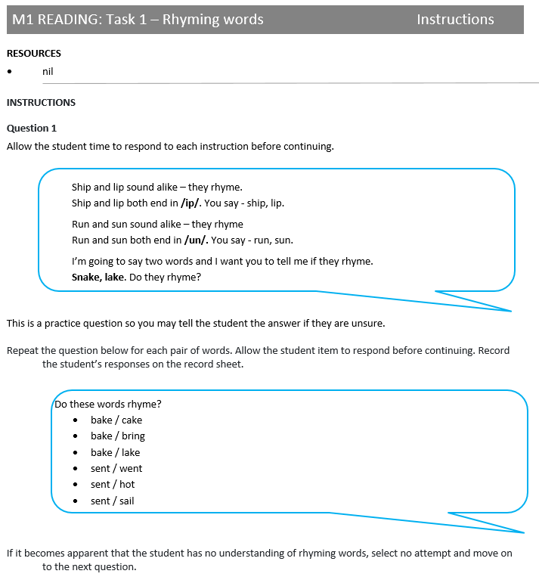
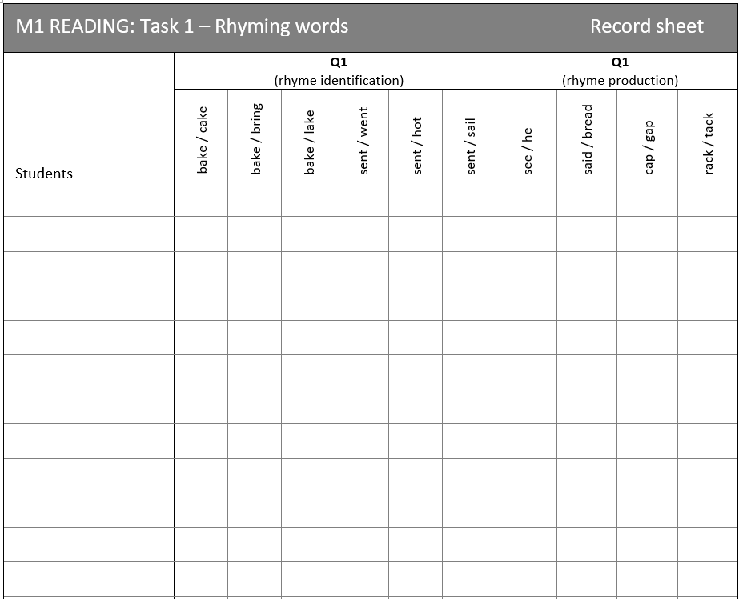
Using the hardcopy version
Advantages:
easy to administer task by task to all students
easy to keep track of who has and has not completed tasks
does not require access to the internet
Disadvantages:
students’ names have to be written/typed onto the record sheets.
double-handling of data, i.e. responses have to be uploaded to the online system.

Slide 12
During

Slide 13
Delivering the tasks
Set up an area in the classroom/wet area where you can leave the resources required for the week.
Follow the instructions provided precisely.
Read the text in the speech bubble as written. Do not change the way a question is asked as this may change the difficulty of an item.
Do not provide additional assistance to students who are struggling.
Give every student the same opportunity to demonstrate their understandings. However, if it becomes apparent that a student does not have the understandings required to answer a set of questions, select no attempt for the rest of the set.
Don’t tell the students whether they answered correctly or incorrectly. Respond with “great/well done/fabulous” even if they answer incorrectly. *
Be encouraging at all times. The time spent with you should be a positive experience, even if the student answers every question incorrectly.
* Students don’t need to know in Week 3 of school that they don’t know something.

Slide 14
After

Slide 15
Reports
Reports are available at the completion of the assessments.
All reports are available for the current year as well as previous years.
Teachers are able to access reports related to their class only.
Principals and ‘school administrators’ are able to access reports related to all classes, groups and cohorts within their school.
The Guide Reporting has been updated is available on the website under Information for Non-Government Schools.
Use the reports! On-entry is wasted time if you don’t do anything with the information provided to you. On-entry gives you a lot more than just a number!

Slide 16
Contact
Catholic schools:
Early years learning and care team – 6380 5200
early-years@cewa.edu.au
AISWA schools:
Deb Martin – 9441 1669
dmartin@ais.wa.edu.au

