Slide 1
Soils as ecosystems

Slide 2
What is soil and why is it important?
This is an easy question, isn’t it?
Soil is that dirty, brown dead-looking material plants grow in …
Or is there more to soil than meets the eye?

Slide 3
Healthy soils in Western Australia
A significant problem for primary producers in Western Australia is that much of our soil has become degraded over time.
Watch the animation on the next slide about soil health to discover what is in soil and why our soils are under threat.

Slide 4

Soil health animation:
What is in soil and what does it do?
Video © Professor Lynette Abbott (UWA), used with permission

Slide 5
Group discussion
After you have watched the soil health animation What is in soil and what does it do? (slide 4 of the PowerPoint Soils as ecosystems) follow the following links:
Soil Science Australia, Soils in food chains (Teachers guide) and read Appendix 1 Background information pages 6 – 8 https://www.soilscienceaustralia.org.au/training/soils-in-schools/teacher-guides/
Food and Agriculture Organization (FAO) of the United Nations article ‘Five reasons why soil is key to the planet’s sustainable future’: http://www.fao.org/sustainable-development-goals/news/detail-news/en/c/277113/
Discuss these focus questions in groups of three or four:
What is soil and why is it important?
How does soil form and what are the components that make up soil?
What does soil do for our food and water supply?
How is healthy soil relevant to food production by primary producers (such as grain and grape and wine producers)?
What problems are faced by Western Australia’s soil?
How is healthy soil essential in adapting to climate change?
Use your student worksheet 1.1 What is soil and why is it important? to record your responses.

Slide 6
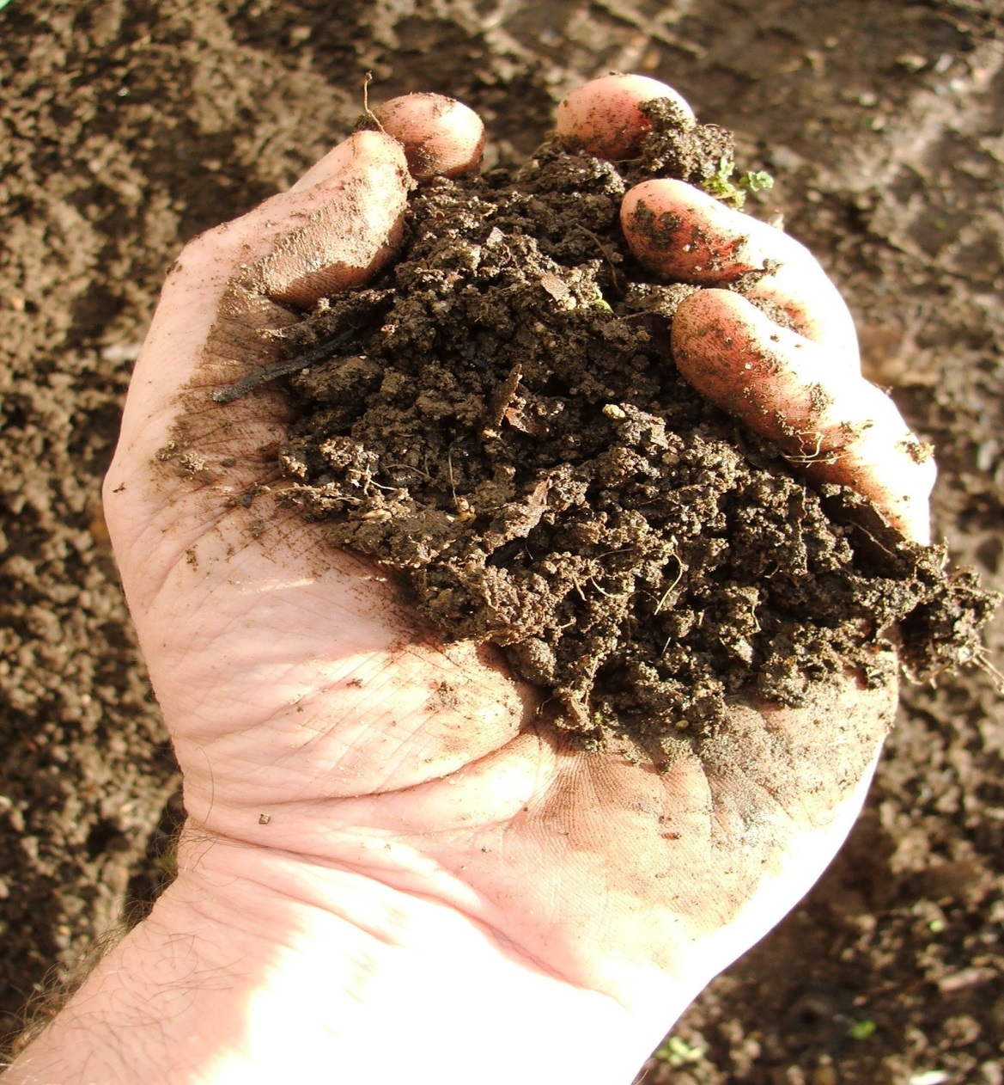
Soils are incredible
Did you know that …
In a single handful of soil there are more microorganisms than there are people on Earth.
A healthy soil contains both biotic and abiotic factors.
A biotic factor is a factor caused by a living organism. In a soil this could include such factors as the amount of soil organic matter, predators, competitors, diseases and parasites.
An abiotic factor is a non-living factor. In a soil this could include factors such as temperature, light, oxygen, soil acidity and water content.
Author – Mouse. Creative Commons 2.0 image, licence available at: https://www.flickr.com/photos/mouse/247137441

Slide 7
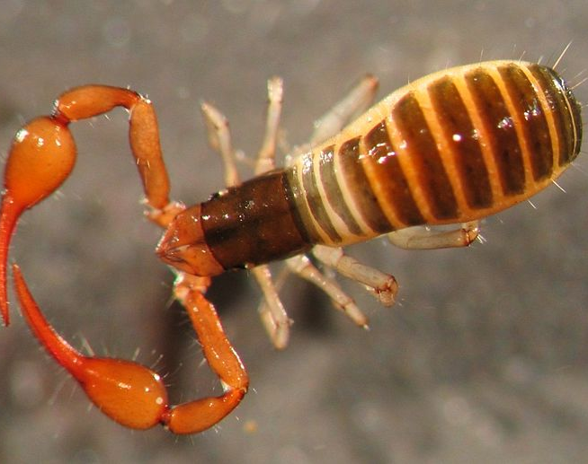
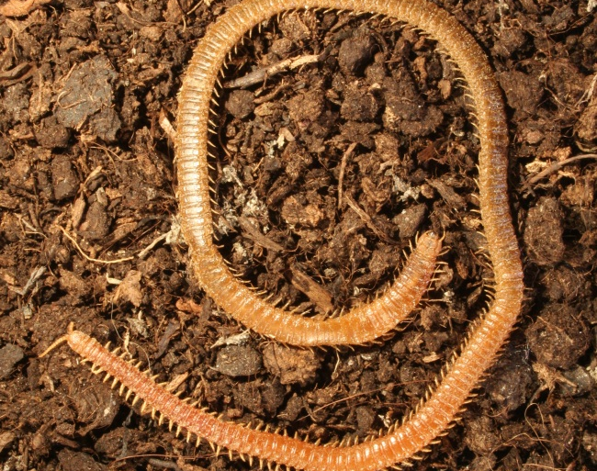
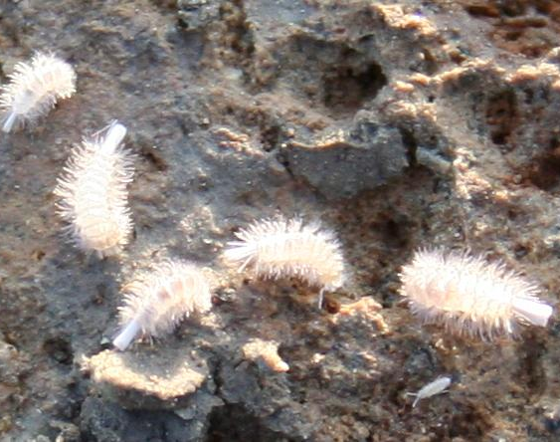
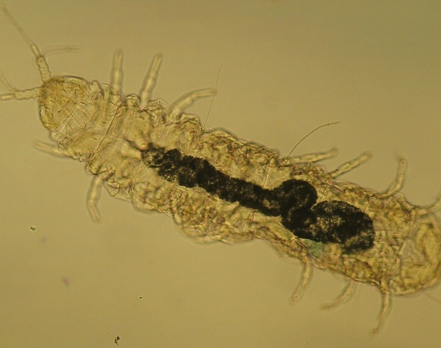
Soils are diverse
Soils host a quarter of the earth’s biodiversity.
A single square metre of Western Australian agricultural soil may contain trillions of individuals and several thousand species of fungi, invertebrates and bacteria.
Author Christiana Menta (2012) ,Creative Commons 3.0 Unported soil fauna images, licences available at:
https://commons.wikimedia.org/wiki/File:Pauropoda_-_Soil_Fauna_Diversity.jpeg https://commons.wikimedia.org/wiki/File:Polyxenida_-_Soil_Fauna_Diversity.jpeg https://commons.wikimedia.org/wiki/File:Pseudoscorpion_-_Soil_Fauna_Diversity.jpeg https://commons.wikimedia.org/wiki/File:Geophilomorpha_-_Soil_Fauna_Diversity.jpeg#/media/File:Geophilomorpha_-_Soil_Fauna_Diversity.jpeg

Slide 8
Soils as ecosystems
One way of looking at life on Earth is to consider it as an ecosystem containing a community of people who play different roles: some people make the world a better place while others are challenging and cause harm; some produce food while others simply consume it. It is essential for people to interact with each other and their surroundings for the world to function well.
A natural ecosystem is a community of living organisms that interact with each other and with their physical surroundings.
Soils are examples of ecosystems that contain both macroscopic (large) and microscopic (very small) organisms interacting with one another.

Slide 9
Soil organism interactions
As with all ecosystems, soils contain many different types of interactions between organisms, including:
  predators
  parasites
  saprophytes.
Discuss with your group members how you think each of these different types of organisms might behave towards other organisms.
Compare your answers with the information in the following five slides about nematodes to see if you are correct

Slide 10
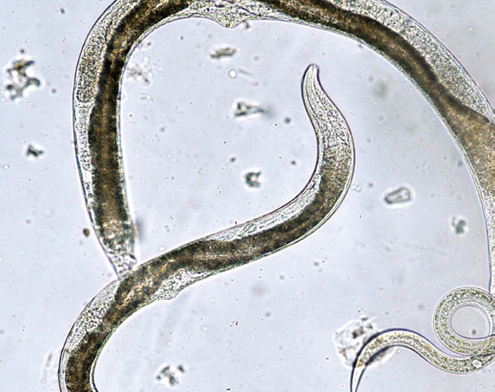
Soil nematodes
A healthy soil contains tens of species of nematodes.
Nematodes are a type of ‘non-segmented’ worm that live in the soil.
When we want to measure the health of an environment or ecosystem, we can look for the presence of certain species of nematodes that should exist if conditions are healthy.
Image © Grains Research and Development Corporation 2016, The Science of Living Soils

Slide 11
Predator nematodes
These nematodes feed on other nematodes.
They also eat bacteria, fungi and small single-celled organisms (protozoa).
The digested parts are then added to the soil organic matter.
Some nematodes have become predators of insects.

Slide 12
Parasitic nematodes
Parasitic nematodes cause problems for Western Australian food production because they feed on plant roots and slow down plant growth.
In some cases they also allow the entry of fungal rots that destroy the roots.
Discuss with your group members what you think the impacts of parasitic nematodes on food production are likely to be and why.

Slide 13
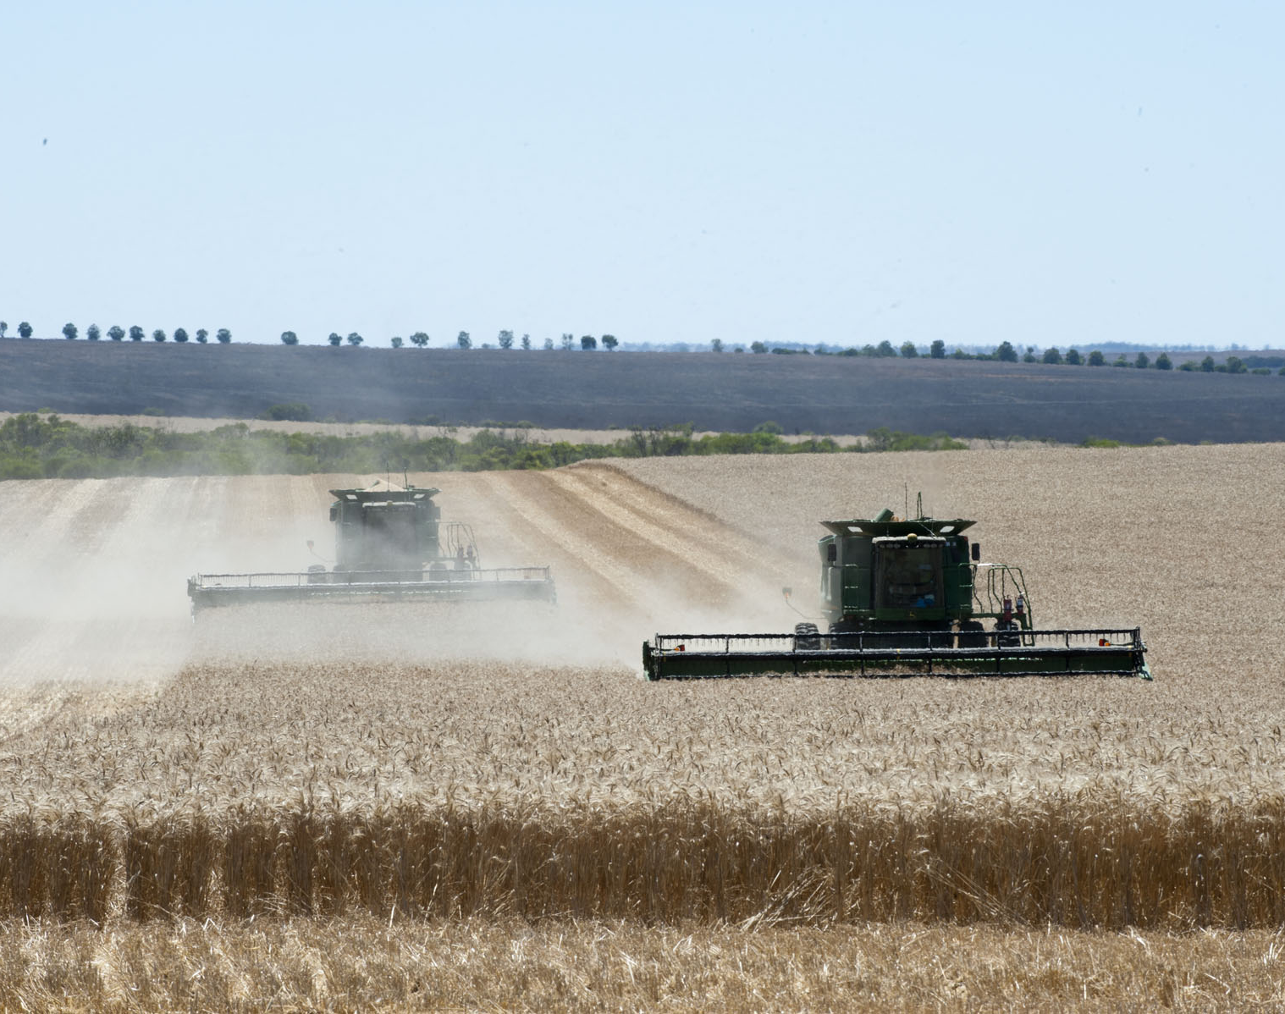
Parasitic nematodes and agriculture
Agriculture tends to encourage an increase in parasitic nematodes over other species because cultivation is more disruptive to larger soil organisms than to smaller ones. This can favour the smaller plant parasitic nematodes. Cultivation also disrupts soil fungi, which are the food source for many beneficial nematodes.
Western Australian primary producers can manage this problem by ensuring that the beneficial nematodes have food (organic matter other soil organisms) and water and that there is minimal disturbance to the soil.
Image used courtesy of Department of Primary Industries and Regional Development, available at: https://www.agric.wa.gov.au/climate-change/how-wheat-yields-are-influenced-climate-change-western-australia

Slide 14
Saprophytic nematodes
Saprophytic nematodes are also known as decomposers because they carry out the beneficial actions of breaking down organic matter in the soil; releasing nutrients for plant use; and improving soil structure, water-holding capacity and drainage.
They are usually the most abundant type of nematode in the soil.

Slide 15
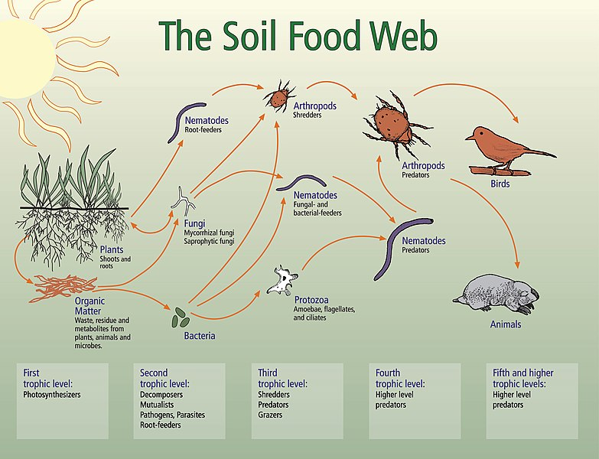
Creative Commons 4.0 image © Soil Biology Primer/USDA-NRCS website (https://www.nrcs.usda.gov/wps/portal/nrcs/main/soils/health/biology/ ) or https://commons.wikimedia.org/wiki/File:Bodennahrungsnetz.jpg

Slide 16
Benefits of the soil food web
Follow the YouTube link below to learn more about how the soil food web works in harmony with plants to produce a number of benefits:
Dr Elaine Ingham’s What is the Soil Food Web?
https://www.youtube.com/watch?v=uAMniWJm2vo

Slide 17
Glossary
Abiotic
Agriculture
Bacteria
Biodiversity
Biotic
Community
Decomposers
Ecosystem
Food web
Fungi
Habitat
Interact
Invertebrates
Macroscopic
Microscopic
Parasites
Predators
Saprophytes
These key words have appeared in bold in this presentation.
Use them to complete your student worksheet 1.2 Glossary activity.

Slide 18
Acknowledgements
Thank you to:
Grains Research and Development Corporation 2016, The science of living soils: Investigating soil characteristics and health by identifying its macro and micro invertebrate populations, <www.grdc.com.au>
Pulses: Can growing pulses feed more people and contribute to their health while having less impact on local food webs?, <https://www.primezone.edu.au>
Food and Agriculture Organization of the United Nations
Soil Science Australia, Soil in food chains (teacher guide), <https://www.soilscienceaustralia.org.au>
Soil Bacteria and Fungi – New South Wales, fact sheet, <http://soilquality.org.au/factsheets/soil-bacteria-and-fungi-nsw>
Professor Lynette Abbott (UWA) for background information and the Soil health animation video

