Slide 1
What are the big issues facing agriculture in Western Australia?

Slide 2
What are the big issues facing agriculture in WA?
Brainstorm this question as a class
Discuss the ideas generated in a small group and try to rank them in order of importance

Slide 3
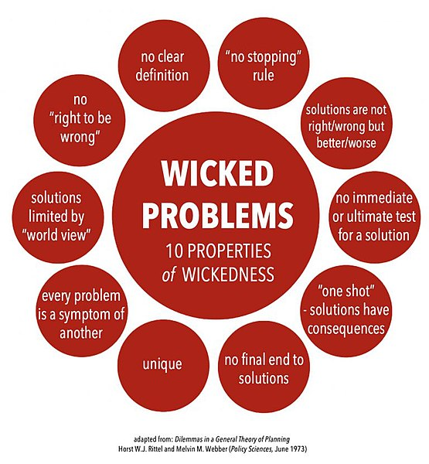
Wicked problems
In 1973, design theorists Horst Rittel and Melvin Webber introduced the term ‘wicked problem’. Wicked problems are issues so complex that it is hard to grasp exactly what the problem is or how to tackle it
Wicked problems include:
Poverty
Climate change
Homelessness
Sustainability
Food security
Biosecurity
Small group activity:
Examine image 1.0.1
Use the ten properties of wickedness to create your own definition of a wicked problem
Image 1.0.1 Wicked problems

Slide 4
Student activity
Watch the video Caring about wicked problems in WA agriculture supplied in this resource
This video can be accessed on the PRIMED landing page.

Slide 5
More on wicked problems
Read the discussion and watch the video at Wicked problems: Problems worth solving to find out more
In this resource we will be focusing on three of these wicked problems facing agriculture in WA and some of the efforts being made to tackle them:
Climate change
Food security
Biosecurity and invasive species

Slide 6
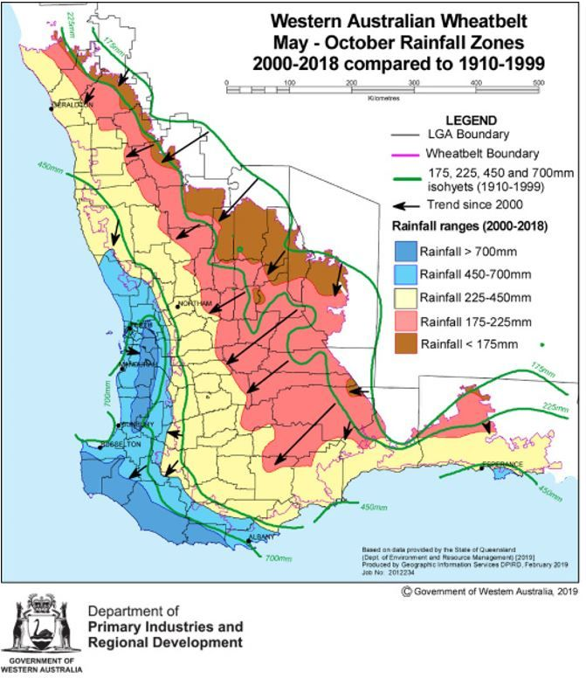
Climate change – trends in Western Australia
Examine this map of southwest WA. It shows rainfall trends in May – October during the periods 2000-2018 and 1910-1999
Discuss the map in your small group
What do you think this map suggests about rainfall trends and our climate in WA?
What might this mean for agricultural food production in WA?
Image 1.0.2 rainfall reductions in the May to October growing period of southwest Western Australia

Slide 7
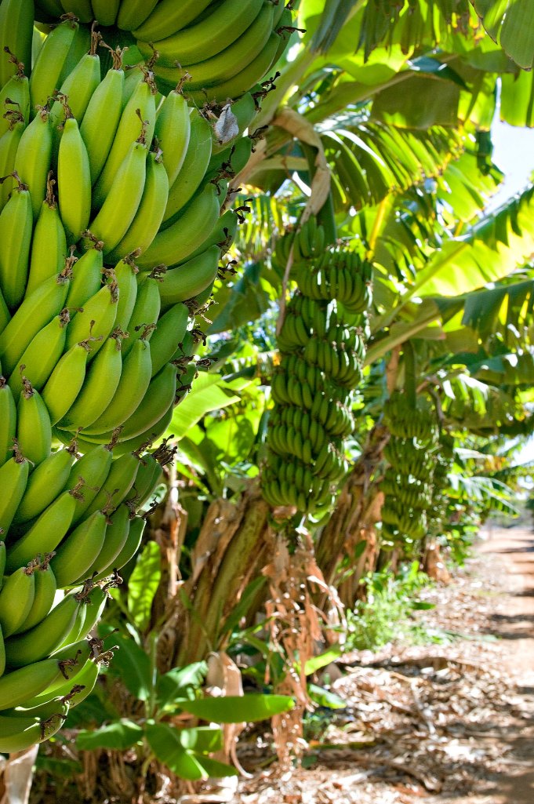
Food security
Food security is defined by the Food and Agriculture Organization (FAO) of the United Nations as:
‘when all people, at all times, have physical, social and economic access to sufficient, safe and nutritious food that meets their dietary needs and food preferences for an active and healthy life’
Do you think we have food security in WA and Australia? Discuss this with your group members
Read the following articles to find out more:
Analysis of Australia’s food security and the COVID-19 pandemic
Food Security Plan For Western Australia
Image 1.0.3 Bananas in the Gascoyne region of Western Australia

Slide 8
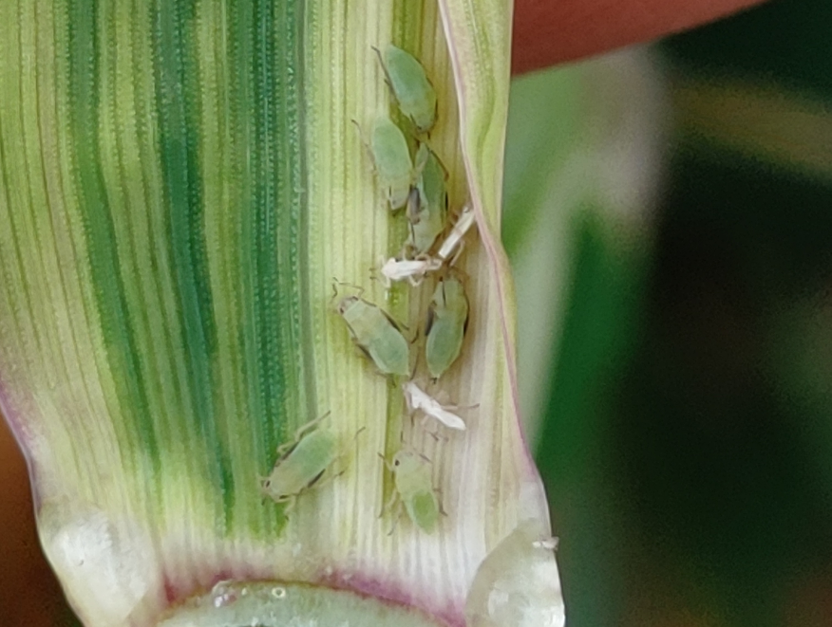
Biosecurity
Biosecurity is the management of the risk of animal and plant pests and diseases entering, emerging, establishing or spreading in WA. The aim is to protect our economy, environment and the community
Biosecurity is fundamental for safeguarding our valuable agricultural resources against the threat and impacts of invasive and feral species, pests, weeds and diseases
Image 1.0.4 Russian wheat aphids – a biosecurity risk to WA agriculture

Slide 9
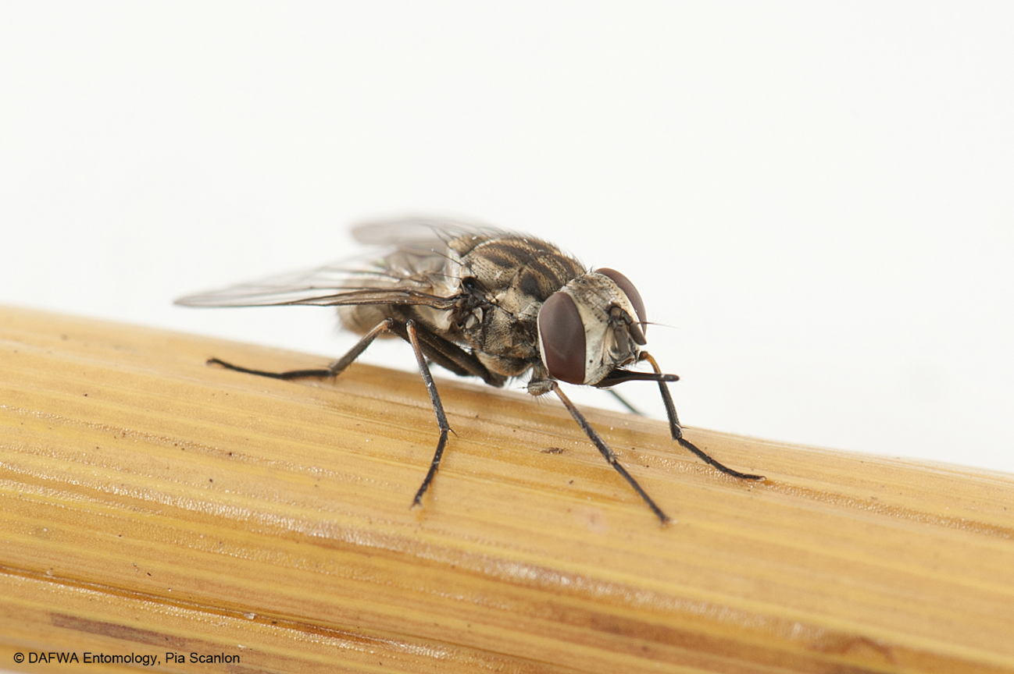
Biosecurity and the management of pests
Animal pests, both vertebrates (backbone) and invertebrates (no backbone), can have an adverse impact on agriculture, the natural environment and even our lifestyle
Animal pests are often exotic animals that are introduced, either accidentally or deliberately
Stable fly (Stomoxys calcitrans) is just one example of an international insect that has become an aggravating pest in WA, particularly on the coastal plain, north and south of Perth
Image 1.0.5 Stable fly

Slide 10
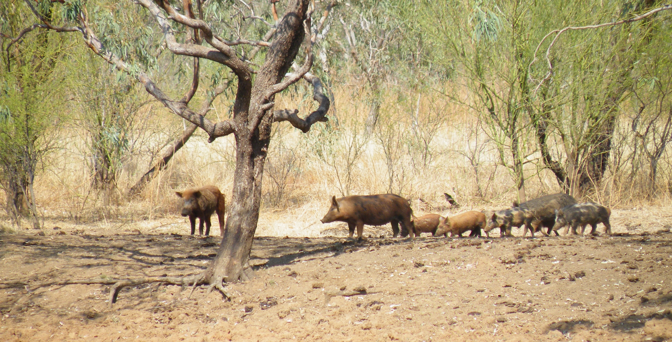
Biosecurity and invasive species
list as many biosecurity threats as you can think of to WA’s agricultural industries. Share your list with others
examine the image of the feral pigs. Feral pigs in WA are descended from pigs that are bred commercially for food
What reasons could be used to classify feral pigs as a biosecurity threat?
Image 1.0.6 Feral pigs at a waterhole in the Kimberley

Slide 11
Student activities
Create a concept map showing how wicked problems facing WA agriculture are linked. If you are unfamiliar with the purpose of a concept map or how to create one, a useful resource is the short video How to make a concept map

Slide 12
Acknowledgements
References
AC4D (nd), ‘Wicked problems: Problems worth solving’ available at: <https://www.wickedproblems.com/1_wicked_problems.php > accessed 28 July 2021
Australian Government, Australian Centre for International Agricultural Research, (2021), ‘Food security and why it matters’ available at:< https://aifsc.aciar.gov.au/food-security-and-why-it-matters.html > accessed 27 July 2021
Government of Western Australia, DPIRD, (2021) ‘Biosecurity’ available at: < https://www.agric.wa.gov.au/biosecurity-quarantine/biosecurity > accessed 18 June 2021
Lucid Chart, (1 June 2018) video ‘How to make a concept map’ available at: < https://www.youtube.com/watch?v=8XGQGhli0I0 > accessed 6 September 2021
Perth NRM, (September 2019), ‘Food security plan for Western Australia’ available at: < https://www.regenwa.com/wp-content/uploads/2019/09/WA-Food-Security-Plan-Situation-Report-Sept-2019.pdf > accessed 27 July 2021
Systems Innovation, (17 September 2019), video ‘Wicked problems’ available at: < https://www.youtube.com/watch?v=Ldza3txPNTA - > accessed 27 June 2021
The Conversation, (18 October 2018) ‘Wicked problems and how to solve them’ available at: < https://theconversation.com/wicked-problems-and-how-to-solve-them-100047 > accessed 27 July 2021
Images
1.0.1 Christian Sarkar, ‘Wicked problems’ CC BY-SA 4.0 available at: < https://commons.wikimedia.org/wiki/File:Wickedproperties.jpg > accessed 27 July 2021
1.0.2 Government of Western Australia, © 2021 DPIRD ‘Rainfall reductions in the May to October growing period of south-west Western Australia’ available at:< https://www.agric.wa.gov.au/climate-change/climate-trends-western-australia > accessed 27 July 2021
1.0.3 Government of Western Australia, © 2021 DPIRD ‘Bananas in the Gascoyne region of Western Australia’ available at: < https://www.agric.wa.gov.au/assessment-agricultural-expansion/gascoyne-food-bowl-initiative > accessed 27 July 2021
1.0.4 Government of Western Australia, © 2021 DPIRD ‘Russian wheat aphid; production pest’ available at: < https://www.agric.wa.gov.au/barley/russian-wheat-aphid-production-pest > accessed 27 July 2021
1.0.5 Government of Western Australia, © 2021 DPIRD ‘Stable fly’ available at: < https://www.agric.wa.gov.au/vegetables/stable-fly-western-australia > accessed 27 July 2021
1.0.6 Government of Western Australia, © 2021 DPIRD ‘Pigs at waterhole - feral pigs in the Kimberley’ available at: < https://www.agric.wa.gov.au/pest-mammals/wild-rabbit-and-feral-pig-survey > accessed 7 September 2021

