Slide 1
An introduction to selective breeding and genetics

Slide 2
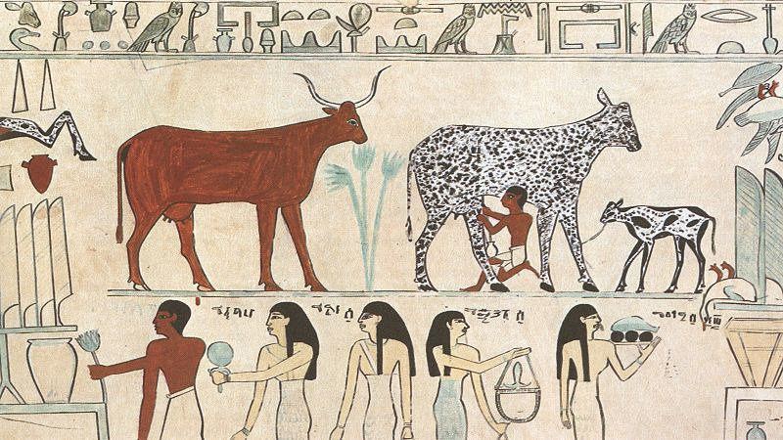
The history of selective breeding
The Neolithic Revolution, also called the Agricultural Revolution, marked the transition in human history from small, nomadic bands of hunter-gatherers to larger, agricultural settlements and early civilization
Current archaeological evidence indicates that the Neolithic revolution began around 10 000 B.C in a region known as the Fertile Crescent – an area that covers present day southern Iraq, Syria, Lebanon, Jordon, Palestine, Israel, Egypt and parts of Turkey and Iran
Since the time humans first domesticated animals and plants, selective breeding has been used to develop better or more useful strains from the genetic biodiversity that naturally exists in the population of a single species
Image 3.0.1 Ancient Egyptian domesticated animals on a hieroglyphic painting

Slide 3
Aboriginal and Torres Strait Islander farming and agriculture
There is strong evidence to suggest that before colonisation of Western Australia, Aboriginal and Torres Strait Islander peoples had sophisticated farming and agricultural systems in place to produce the food and medicines they needed. This deep knowledge of the land enabled harvesting of food sustainably
This agricultural and farming system included planting seeds to create vast farms filled with crops, caring for the soil, harvesting the crops and storing the produce. These agricultural practices selectively produced changes to the native flora and fauna (such as promoting fire resistant species)
Food and Agriculture – Deadly Story provides an excellent overview of the diversity of Aboriginal cultural practices around food and medicine

Slide 4
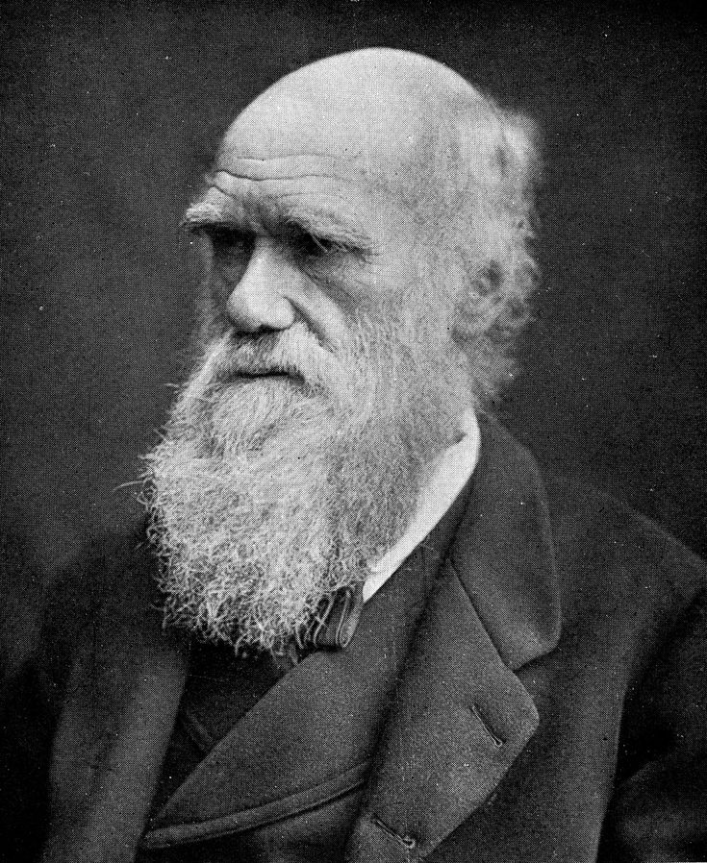
Charles Darwin
Charles Darwin in 1859 was the first person to describe the connection between the domestication of animals and plants, selection and evolution
In his famous book ‘On the origin of species by means of natural selection’ Darwin discussed how domestication had produced significant changes over time in a range of animals and plants
Follow the link to learn more about the important work of Charles Darwin
Image 3.0.2 Portrait of Charles Darwin

Slide 5
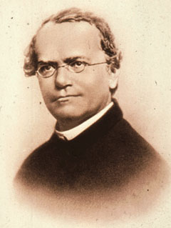
Gregor Mendel
Gregor Mendel in 1854 was the first person to lay the mathematical foundation of the science of genetics
Follow the link to learn more about the important work of Gregor Mendel
When the ideas of Charles Darwin and Gregor Mendel are combined, we see the formation of the beginnings of modern selective breeding and genetics
Image 3.0.3 Portrait of Gregor Mendel

Slide 6
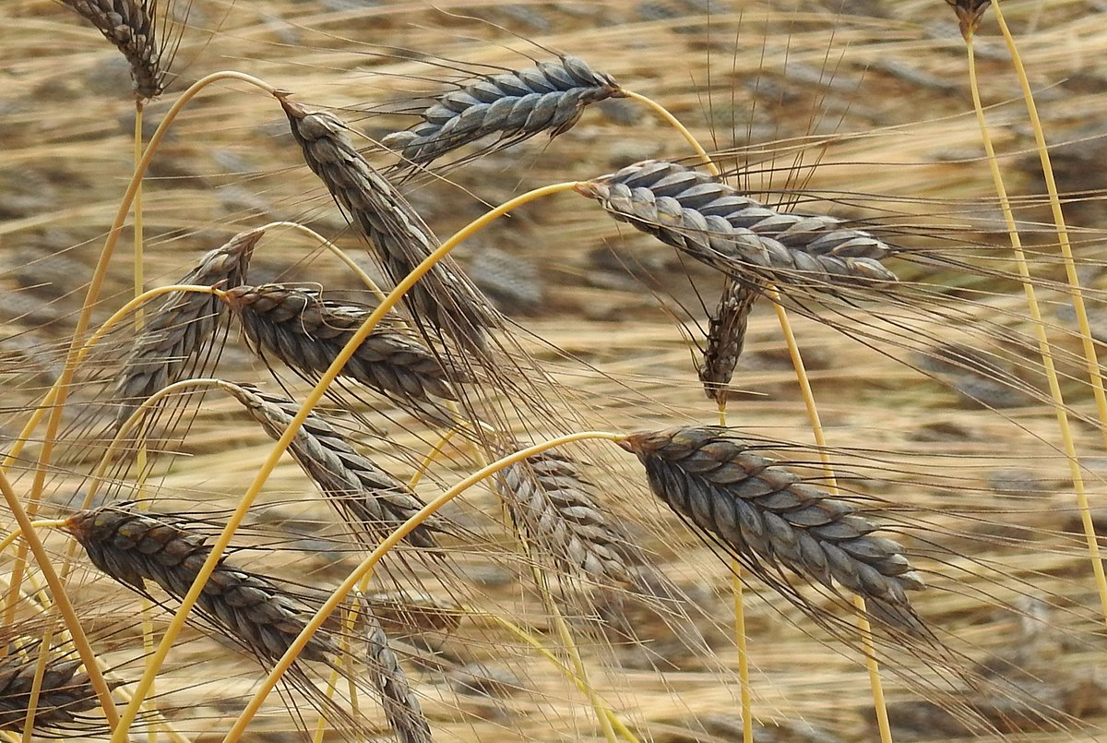
The origin of modern wheat
The food we eat and grow in WA today is in fact very different from the original wild animals and plants from which they originated
For example, modern wheat derives from a strain called Emmer. Emmer evolved as a type of natural hybrid formed by the combination of the genomes of two different wild varieties
Image 3.0.4 Emmer wheat

Slide 7
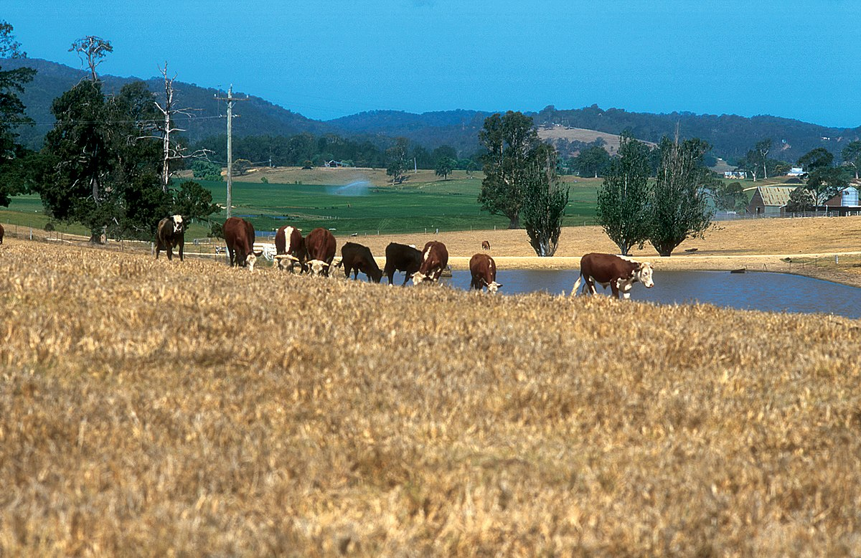
Selective breeding
Selective breeding therefore is the process that has been used by humans for thousands of years to produce breeds of animals or varieties of plants
For example, farmers may choose individual cows to mate that are better at producing more milk or milk that has a particular protein content (such as A2 milk)
Fruit growers may develop varieties of apples (such as Bravo apples) because they have better nutritional value or are superior to export
Image 3.0.5 Cattle grazing pastures – the result of selective breeding

Slide 8
Selective breeding video
To gain an overview of the processes of selective breeding and genetics, watch the video Selective breeding.

Slide 9
Student activities
Use Student worksheet 3.1 to complete the following activities:
Activity 1: Pigeon breeding - genetics at work
Activity 2: Selective breeding for lower GHG emissions
Activity 3: Examining the pros and cons of selective breeding
Activity 4: Career exploration
Extension activity 5: Food for thought – why are some chicken eggshells white and others brown?

Slide 10
Acknowledgements
References
Britannica (19 July 2021) ‘ Gregor Mendel’ available at: <https://www.britannica.com/biography/Gregor-Mendel > accessed 12 August 2021
Britannica (15 April 2021) ‘Charles Darwin’ available at: <https://www.britannica.com/biography/Charles-Darwin > accessed 12 August 2021
Food and Agriculture – Deadly Story (February 2014) available at: <https://www.deadlystory.com/page/culture/Life_Lore/Food#:~:text=Aboriginal%20farming%20and%20agriculture%20suited,of%20water%20for%20our%20crops > accessed 14 September
FuseSchool (11 January 2017) video ‘Selective breeding’ available at: <https://www.youtube.com/watch?v=fHS-OY9XDZc > accessed 12 August 2021
History (23 August 2019) ‘Neolithic Revolution’ available at: < https://www.history.com/topics/pre-history/neolithic-revolution >accessed 12 August 2021
Images
3.0.1 Believe Created (6 April 2008) ‘Egyptian domesticated animals’ CC BY 2.0 , available at: <https://www.flickr.com/photos/chainedreactions/2392901730 > accessed 12 August 2021
3.0.2 Wellcome Images (1 April 2018) ‘Portrait of Charles Darwin’ CC BY 4.0 available at: <https://commons.wikimedia.org/wiki/File:Portrait_of_Charles_Darwin._Wellcome_M0010103.jpg> accessed 11 August 2021
3.0.3 Krithika Nagaraj (3 September 2016) ‘Gregor Mendel’ CC BY-SA 4.0 available at:< https://commons.wikimedia.org/wiki/File:Gregor_mendel.jpg > accessed 12 August 2021
3.0.4 Robert Flogaus-Faust (7 July 2018) ‘Triticum dicoccum var. atratum’, CC BY 4.0 available at: <https://commons.wikimedia.org/wiki/File:Triticum_dicoccum_var_atratum_RF.jpg > accessed 12 August 2021
3.0.5 CSIRO, Gregory Heath (26 July 2007) “Cattle grazing on pastures, with earthen dam for watering in background’ CC BY 3.0 available at: <https://commons.wikimedia.org/wiki/File:CSIRO_ScienceImage_4484_Cattle_grazing_on_pastures_with_earthen_dam_for_stock_watering_in_background_near_Bega_NSW_2002.jpg > accessed 12 August 2021

