Slide 1
Ecosystem interactions

Slide 2
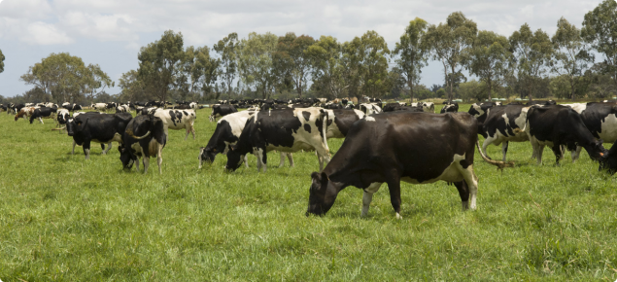
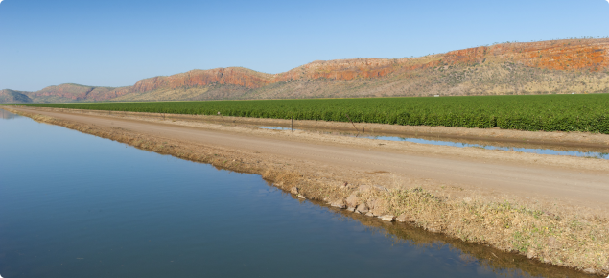
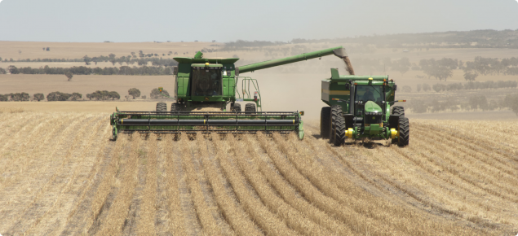
Western Australian ecosystems – what we know so far:
A natural ecosystem is a system formed by organisms interacting with each other and their non-living surroundings in a balanced way.
Urban and agricultural systems are human-made artificial ecosystems of plants, animals and people living together with their surroundings.
Images used courtesy of Department of Primary Industries and Regional Development, available at: https://www.agric.wa.gov.au/western-australias-agriculture-and-food-sector

Slide 3
Habitats
The place where any living thing lives is called its habitat.
An organism’s habitat must provide everything that it needs to survive.
The habitat must provide:
  - food
  - shelter and living space
  - a suitable temperature
  - reproductive opportunities (eg mating partners)
  - gases (eg oxygen, carbon dioxide).

Slide 4
Needs of living things
The needs of living things can be divided into two types:
biotic factors (living factors, such as food, disease, mating partners)
abiotic factors (non-living factors, such as water, light, temperature, gases).

Slide 5
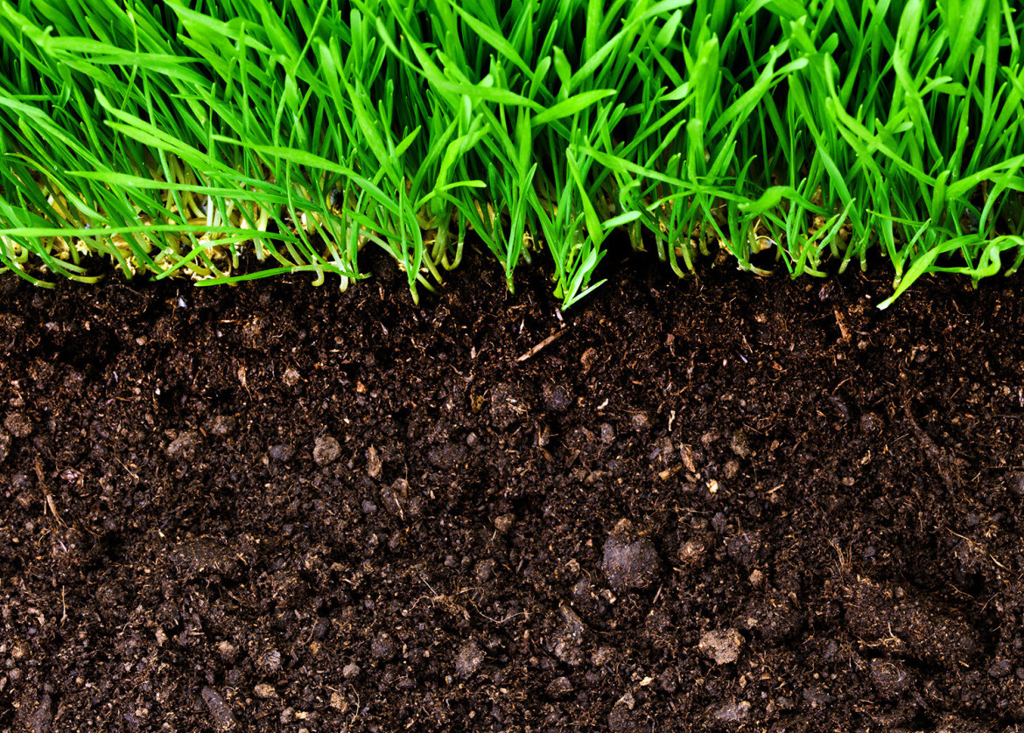
The soil ecosystem
Soil is a complex ecosystem of interacting nutrient and energy cycles, plants, animals and microorganisms.
Image: Author MerileyR, Creative Commons Attribution – Share Alike 4.0 International, available at: https://commons.wikimedia.org/wiki/File:Agriculture_Soil_Image-.jpg

Slide 6

Soil health animation:
Soil organism interactions
Video © Professor Lynette Abbott (UWA), used with permission​

Slide 7
Interdependence
Organisms in an ecosystem are interdependent, which means they depend on each other for survival.
Another term used for two different types of organism that live together is symbiosis.

Slide 8
Symbiosis
The relationship between two different organisms can be positive, negative or have no impact on the individuals.
There are three main types of symbiotic relationships:
mutualism
commensalism
parasitism

Slide 9

Soil health animation:
Symbiotic relationships in soil
Video © Professor Lynette Abbott (UWA), used with permission

Slide 10
Symbiosis video
Watch the YouTube video Symbiosis: Mutualism, Commensalism, and Parasitism:
https://www.youtube.com/watch?v=zSmL2F1t81Q

Slide 11
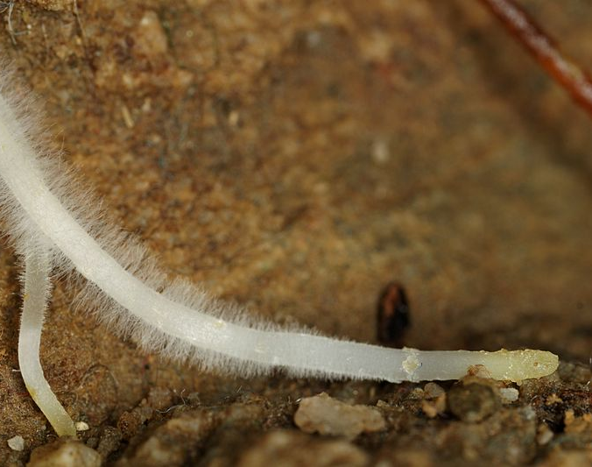
Mutualism
A mycorrhiza is a mutualistic relationship between a soil fungus and a plant:
The fungus grows in or on the plant roots.
The plant benefits because the fungus puts out mycelia that help absorb water and nutrients.
In this symbiotic relationship both organisms benefit.
In many cases neither organism can exist without the other.
Image: Author – Oregon Caves, Creative Commons Attribution 2.0 Generic available at: https://commons.wikimedia.org/wiki/File:Mycorhizae_fungus_(10333483254).jpg

Slide 12
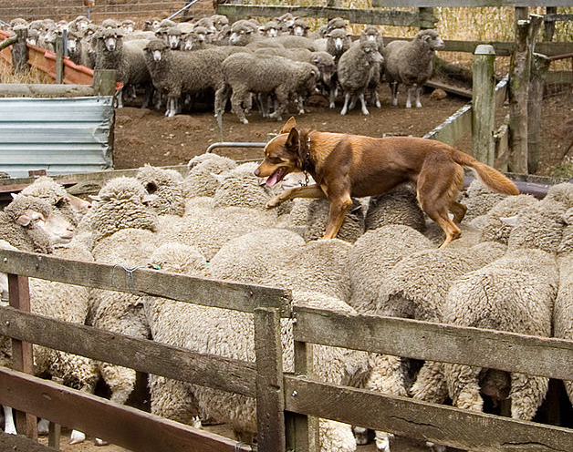
Commensalism
In a commensal relationship, one organism benefits and the other is not harmed or affected significantly.
The close relationship between humans and dogs is believed by scientists to have started as a type of commensalism that preceded the birth of agriculture over 10,000 years ago.
Dogs such as kelpies have become integral in helping Western Australian primary producers to manage the handling of their livestock.
Image: Author Martin Pot, Creative Commons Attribution 3.0 unported available at: https://commons.wikimedia.org/wiki/File:Kelpie_walking_across_the_backs_of_sheep.jpg

Slide 13
Parasitism
In this type of symbiotic relationship one organism (the parasite) lives on or in another organism (the host):
The parasite obtains food and shelter from the host, often harming it in the process.
Parasites that live inside their hosts are called endoparasites.
Parasites that live on the outside of their hosts are called ectoparasites.

Slide 14
A common endoparasite in sheep – sheep worms
Gastrointestinal worm infections in sheep are a major cause of lost productivity to the Western Australian sheep industry.
Often, endoparasites have complicated life cycles, making them difficult and expensive for primary producers to control.

Slide 15
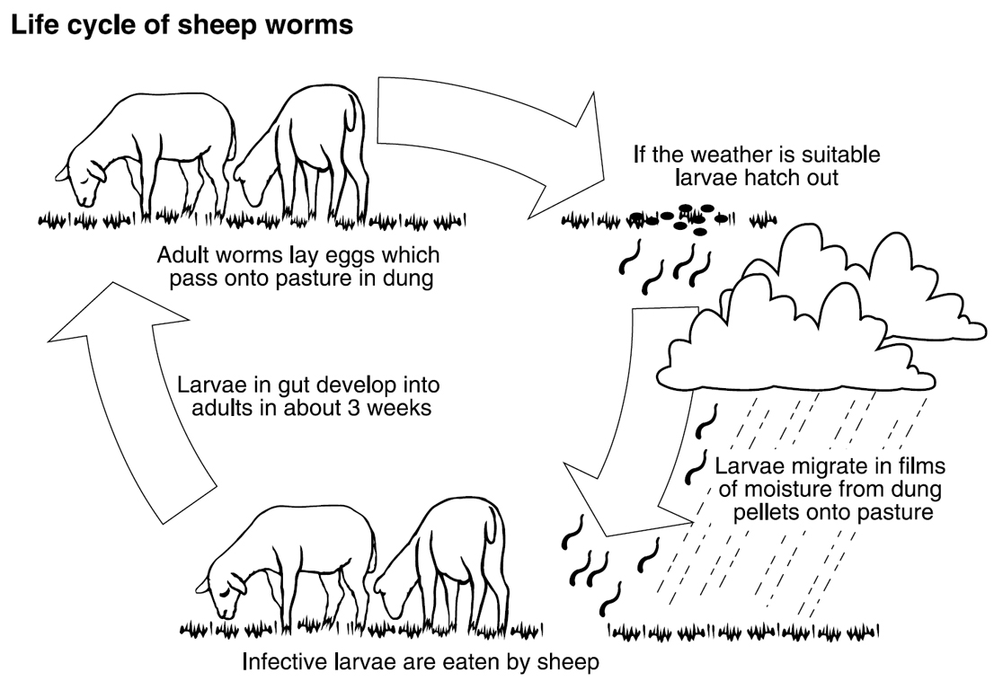
Life cycle of sheep worms
Image used courtesy of Department of Primary Industries and Regional Development, available at:
https://www.agric.wa.gov.au/livestock-parasites/sheep-worm-control-western-australia?page=0%2C0

Slide 16
Summarise your ideas
After you have watched the soil health animation Symbiotic relationships in soil, and the YouTube video video Symbiosis: Mutualism, Commensalism, and Parasitism think about why soil health is so dependent on symbiotic relationships.
Complete Student worksheet 5.1 Symbiotic relationships

Slide 17
What happens to a healthy soil if it is disturbed?
What kinds of things happen to a healthy soil if is disturbed by factors such as:
herbicide and pesticide use
drought, fire or flood, or wind and water erosion
animal and plant community activities
industrial (eg mining) and urban (eg sewage) development?
Do a think/pair/share of your ideas.

Slide 18
Soil health animation:
Soil disturbance effects
Form a small group of three or four students to discuss what can cause soil disturbance and what are some of its possible effects on soil health.
Students need to view this soil health animation before attempting Student worksheet 5.2 What happens when our soils are disrupted by human activity?
Video © Professor Lynette Abbott (UWA), used with permission

Slide 19
Soil health animation:
What are the options for managing soil organisms?
Students need to view this soil health animation before completing the final column of the KWHL chart on Student worksheet 5.5
Video © Professor Lynette Abbott (UWA), used with permission

Slide 20
Acknowledgements
Thank you to:
Professor Lynette Abbott (UWA) for background information and the Soil health animation videos
Images and information used courtesy of Department of Primary Industries and Regional Development, available at: https://www.agric.wa.gov.au/western-australias-agriculture-and-food-sector and https://www.agric.wa.gov.au/livestock-parasites/sheep-worm-control-western-australia?page=0%2C0

