Slide 1
Exploring microscopic life

Slide 2
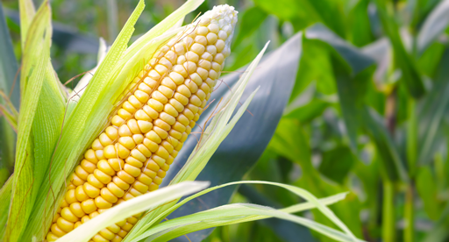
The story so far …
In the previous module, you discovered that all living things used or produced by Western Australian (WA) primary producers are comprised of fundamental building blocks called cells.
The images on this page show:
WA-grown corn
a cross-section (stained) of the cells in the corn roots.
Image 2.0.1: Corn
Image 2.0.2: Corn root cross-section

Slide 3
The cell theory
Current knowledge of cells has been organised into three basic ideas which form the ‘cell theory’. The cell theory states that:
All organisms are composed of one or more cells.
The cell is the basic unit of structure and organisation in organisms.
All cells come from pre-existing cells.

Slide 4
History of the cell theory
Scientific knowledge doesn’t just happen all at once. It takes time for scientific theories to be developed, debated and tested. It also requires the development of useful technologies (like the microscope).
How we came to know about the cell theory is a great example of how scientific knowledge develops – it makes a fascinating story.
Watch The wacky history of cell theory – Lauren Royal-Woods [video] to find out more.
Now see if you can create a timeline or flowchart of the key events and people that eventually led to the cell theory.

Slide 5
Agricultural scientists
WA primary producers rely on work done by agricultural scientists to help maximise their crop and livestock yields and profits.
Image 2.0.3: Testing for pathogens in agricultural soil

Slide 6
Mould
Many of the organisms (like this black mould) that agricultural scientists examine are so small they are described as microscopic.
Image 2.0.4: Black mould spores

Slide 7
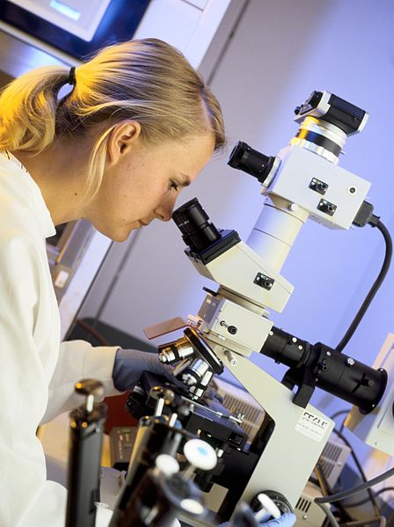
Viewing microscopic cells
In to view cells, WA agricultural scientists use microscopes of various types.
Although they use a variety of different types of microscopes, the most common type is the compound light microscope.
Image 2.0.5: Agricultural scientist using a microscope

Slide 8
Types of compound light microscopes
The monocular (one-eyepiece) light microscope uses light passing through a very thin specimen.
The light then passes through a series of lenses that cause the image to become a larger, two-dimensional (2D) image.
The binocular (two-eyepiece) light microscope also uses light passing through a very thin specimen to create a more magnified image.
The stereo light microscope uses two lenses to magnify the light being reflected off a specimen to produce a three-dimensional (3D) image.
Image 2.0.6: Bresser binocular microscope and a stereo microscope

Slide 9
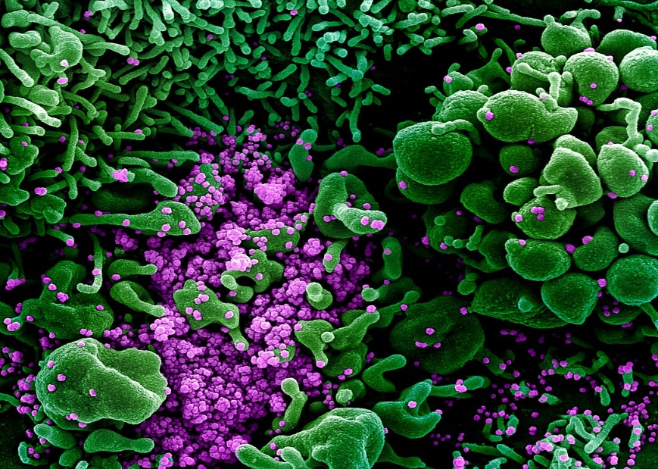
Electron microscopes
An electron microscope is a microscope that uses a beam of accelerated electrons as a source of illumination.
Electron microscopes are used to investigate the structure of a wide range of biological and inorganic specimens including microorganisms, cells, viruses, large molecules, biopsy samples, metals and crystals.
The images on this slide show a transmission electron microscope and a colourised image of scanning electron micrograph of a cell (green) heavily infected with SARS-COV-2 virus particles (purple), isolated from a patient sample.
Image 2.0.7: Transmission electron microscope
Image 2.0.8: Scanning electron micrograph of cell infected by SARS-COV-2 virus particles

Slide 10
Parts of the compound light microscope
In your small group:
Access the Compound microscope parts page of the Microscope.com website to examine a compound light microscope image (or use an image supplied by your teacher). (Don’t look at the descriptions below until step 4!)
Discuss your predictions about the function of each of the labelled parts of the microscope.
Record your group answers on Student worksheet 2.1 Exploring cells under the microscope.
When you have predicted the function of each part, check whether you are correct.

Slide 11
Acknowledgements
References
Bellis M (2020) History of the microscope, ThoughtCo. website https://thoughtco.com/history-of-the-microscope-1992146, accessed 30 April 2021.
Department of Primary Industries and Regional Development (2017) Careers in food and fibre, DPIRD website < https://agric.wa.gov.au/n/1310>, accessed 30 April 2021.
Compound Microscope Parts page of the Microscope.com
Images
slide 2: Image 2.0.1: Corn ‘Garden vegetable’ by Madmad1234. Licensed CC BY-SA 4.0, available at <https://commons.wikimedia.org/wiki/File:Corn_garden.png>
slide 2: Image 2.0.2: Corn root cross-section ‘Monocot root zea’ by Berkshire Community College Bioscience Image Library. Licensed CC0 1.0, available at <https://commons.wikimedia.org/wiki/File:Monocot_Root_Zea_(34745602191).jpg>
slide 5: Image 2.0.3 Testing for pathogens in agricultural soil - Author David McClenaghan, CSIRO, Creative Commons 3.0 Unported available at: https://commons.wikimedia.org/wiki/File:CSIRO_ScienceImage_4124_PhD_candidate_Karen_Schwarz_tests_for_pathogens_in_agricultural_soil_containing_biosolids_Floreat_WA.jpg
slide 6: Image 2.0.4: Black mould spores – Author Ramy algayar Creative Commons 4.0 International available at: File:A picture showing the true color of black mold (rhizopus sp) spores, which is green using Light Microscope, Normal image without any coloring or processing By researcher El sayed Al gayar, Faculty of Agriculture Damietta University.jpg - Wikimedia Commons
slide 7: Image 2.0.5: Agricultural scientist using a microscope – Author Mark Fergus, CSIRO Creative Commons 3.0 Unported available at: https://commons.wikimedia.org/wiki/File:CSIRO_ScienceImage_435_Scientist_using_microscope.jpg
slide 8: Image 2.0.6: Bresser binocular microscope and a stereo microscope – Author labormikro from Deutschland Creative Commons Share Alike 2.0 Generic available at: https://commons.wikimedia.org/wiki/File:Bresser_binocular_microscope_and_a_Stereo_microscope.jpg
slide 9: Image 2.0.7: Transmission electron microscope – Author Oak tree road 1 Creative Commons Share Alike 4.0 International available at: https://commons.wikimedia.org/wiki/File:Hitachi-7100-transmission-electron-microscope-equipped-with-a-gatan-high-resolution-digital-bottom-mount-camera-3-1024x683.jpg
slide 9: Image 2.0.8: Scanning electron micrograph of cell infected by SARS-COV-2 virus particles – Author NIAID Creative Commons 2.0 generic available at: https://commons.wikimedia.org/wiki/File:Novel_Coronavirus_SARS-CoV-2_(49666286236).jpg

