Slide 1
Sustainable ecosystem interactions

Slide 2
Silent card shuffle (Approximately 15 minutes)
Your task in small groups is to carry out a silent card shuffle activity with laminated cards supplied by your teacher to help you classify, understand and analyse information that you already know about ecosystems. Your teacher may choose to vary the steps.
Step 1: Silent Card Shuffle
Spread all laminated cards out on a flat surface without talking
Rearrange the cards in the order you think the labels and descriptions match one another
Step 2: Justify and Refine
As your group completes the task, talk to each other and ask for an explanation or justification for the positioning of certain cards. You may make refinements or changes at this stage

Slide 3
Silent card shuffle (continued)
Step 3: Circle and Observe
When all groups have finished visit the other tables and discuss any similarities or differences. Do not touch any other group’s cards
Step 4: Return and Refine
Return to your home table, and based on what you observed and discussed in the visits to other tables decide whether or not to make any changes
Step 5: Teacher Debriefing
Discuss your findings with other class members

Slide 4
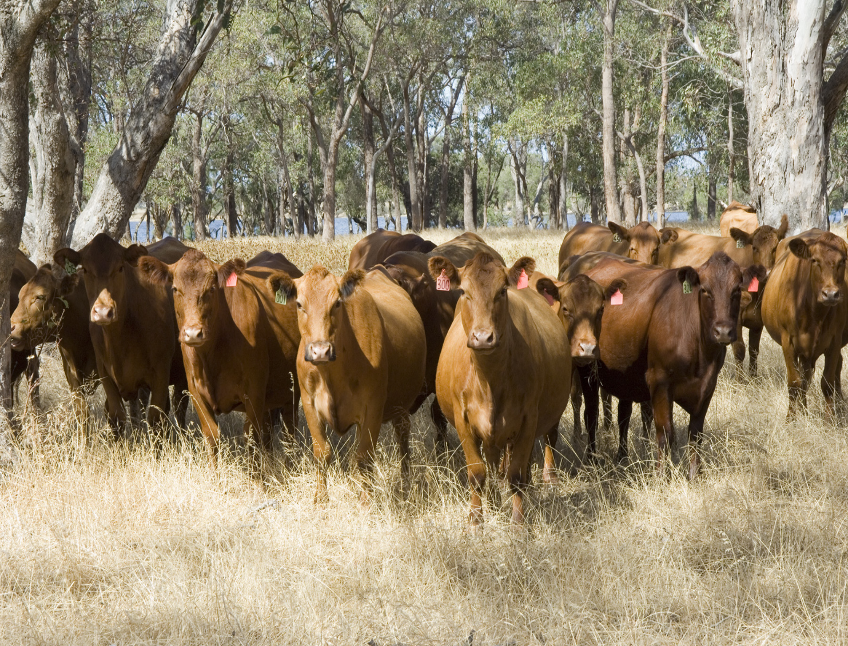
Western Australian ecosystems
A natural ecosystem is a system formed by organisms interacting with each other and their non-living (chemical and physical) surroundings in a balanced way
Agricultural systems are artificial ecosystems of plants, animals and people living together with their surroundings and thus require careful management
In Western Australia (WA), we rely heavily on the responsible and sustainable management of our agricultural ecosystems
Image 1.0.1 Cattle grazing pasture

Slide 5
Factors affecting ecosystems
The major factors which affect the organisms in any ecosystem can be divided into two types:
biotic factors (living factors such as food, disease, competition, symbiotic relationships)
abiotic factors (physical factors such as water, light, temperature, gases, soil conditions)

Slide 6
Ecosystem interactions
Organisms in an ecosystem are constantly interacting with other organisms (biotic factors) as well as with the physical surroundings (abiotic factors) in their environment
To learn more about these interactions watch the video Interactions within an ecosystem

Slide 7
Community relationships
Within any community of organisms, a number of different types of relationships occur
To learn more about these types of relationships watch the videos
Ecological Relationships – Competition – Predator and Prey - Symbiosis
and
Symbiosis: Mutualism, Commensalism and Parasitism
After you have watched the videos, create a summary of ecological relationships within a community using the sub-headings Competition, Predator and Prey, and Symbiosis

Slide 8
Sustainable agricultural ecosystems
Because agricultural ecosystems are artificially created, they must be carefully managed if they are to remain productive, profitable, viable in the long term, and ecologically sustainable
In order for this to occur, primary producers need to have an understanding of the complex biotic and abiotic factors and relationships occurring within their agricultural ecosystems
Various factors need to be managed. These include
pests, weeds and disease
predators and competitors
habitat (eg soil, water, pasture quality, erosion, salinity)
Let's look at some of these in more detail

Slide 9
Management of pests
Animal pests, both vertebrates (backbone) and invertebrates (no backbone), can have an adverse impact on agriculture, the natural environment and even our lifestyle.
Animal pests are often exotic animals which are introduced, either accidentally or deliberately.
Stable fly (Stomoxys calcitrans) is just one example of an international insect that has become an aggravating pest in WA, particularly on the coastal plain, north and south of Perth.
It can attack humans, domestic pets and livestock, seeking to draw blood which is essential to complete its life cycle.
Image 1.0.2 Stable fly

Slide 10
Management of weeds
There are many different weeds which need to be managed and controlled by WA primary producers.
One particularly problematic weed is blackberries (Rubus anglocandicans, R. fruticosus, R. laudatus, R. rugosus, and R. ulmifolius).
Blackberry invades pastures, riverbanks and creek-lines, forming dense thickets that harbour pests such as foxes and rabbits.
Blackberry species are declared pests in WA. Landowners are required to manage and control blackberry on their properties, often with herbicides.
Image 1.0.3 Blackberry leaf

Slide 11
Management of disease
Plant diseases are a significant yield and quality constraint for WA growers of broadacre crops such as wheat, barley, oats, pulses (field pea, chickpea, faba bean), canola and lupins.
Plant diseases can be caused by a variety of different pathogens (fungal, bacterial, viral or nematodes) and can damage plant parts above or below the ground.
The Department of Primary Industries and Regional Development (DPIRD) has a strong research, development and extension focus to assist industry to reduce the impact of crop diseases on all broadacre crops.
Image 1.0.4 Field pea with blackspot disease

Slide 12
Management of predators and competitors
Several different animals have become unwanted predators or competitors on agricultural ecosystems in WA.
One significant animal is the European red fox.
Foxes can cause significant losses to some agricultural producers, often targeting lambs or young goats (kids).
They also prey on many native animals. This has led to the endangerment or extinction of many of our unique WA species.
The best option for land-owners is to work with local and state government authorities to control foxes before they become a problem.
Image 1.0.5 Young red fox sitting

Slide 13
Management of habitat (eg soil health)
Managing soil health in agricultural ecosystems is an essential component of sustainable food production.
Many different factors (both biotic and abiotic) interact to create a healthy soil for agriculture.
One such factor is the symbiotic relationship that occurs between plants such as legumes and rhizobium bacteria. This symbiotic relationship enables legumes (such as the lupin) to capture atmospheric nitrogen and return it to the soil as nitrogen compounds thus reducing the need for additional nitrogen fertilisers.
Image 1.0.6 Harvesting a lupin crop

Slide 14
Management of habitat (eg water)
Water is essential for plant survival and is also the mechanism for root systems to access fertilisers and trace elements in the soil.
When it comes to rainfall, WA is a relatively dry state. Landholders need to consider why they are irrigating, what soil types they have and what irrigation system would be best for their ecosystem.
Soil characteristics will influence the type and timing of irrigation systems.
In WA there are two basic soli types – sandy soil and clay soil.
Sandy soils are lacking in organic matter, allowing water and nutrients to leach down and out of the root zone.
Clay soils are fine textured and may not have enough drainage capacity for good root development. If too much water is applied too often, waterlogged soil can result.
1.0.7 Irrigation of carrots

Slide 15
Student activities – research topics
Choose one of the following topics to research. Discuss with your teacher how you will present your research. Suggested links are provided in Student worksheet 1.3
Integrated Pest Management
Biosecurity in WA
Control of invasive weeds (eg blackberry, Patterson’s curse)
Disease management in WA forestry
Disease management in WA fisheries
Maintaining soil health
Management of fire regimes in WA
Salinity management in WA
Feral animal control in WA
Endangered species in WA

Slide 16
Acknowledgements
References
FuseSchool – Global Education (18 September 2016) ‘Interactions within an ecosystem’ (video) YouTube available at: <https://www.youtube.com/watch?v=UMbrxi_DsXc> accessed 18 June 2021
MooMooMath and Science (2 May 2019) ‘Ecological relationships: Competition, Predator and Prey, Symbiosis’ (video) YouTube available at: <https://www.youtube.com/watch?v=VECARZ-zhKM -> accessed 18 June 2021
StoneAgeMan (16 January 2012) ‘Symbiosis: Mutualism, Commensalism, and Parasitism’ (video) YouTube available at: <https://www.youtube.com/watch?v=zSmL2F1t81Q -> accessed 18 June 2021
Government of Western Australia, DPIRD, (24 October 2019) ‘Stable fly in Western Australia’ available at: <https://www.agric.wa.gov.au/vegetables/stable-fly-western-australia -> accessed 18 June 2021
Government of Western Australia, DPIRD, (24 October 2019) ‘Blackspot in field peas disease forecast’ available at: <https://www.agric.wa.gov.au/field-peas/blackspot-field-peas-disease-forecast> accessed 18 June 2021
Government of Western Australia, DPIRD, (20 July 2020) ‘Blackberry: declared pest’ available at: <https://www.agric.wa.gov.au/declared-plants/blackberry-declared-pest> accessed 18 June 2021
Government of Western Australia, DPIRD, (24 October 2019) ‘Waterwise irrigation – big benefits for small properties’ available at: <https://www.agric.wa.gov.au/small-landholders-western-australia/waterwise-irrigation-big-benefits-small-properties> accessed 18 June 2021
Government of Western Australia, DPIRD, (15 May 2018) ‘Lupin essentials – growing a successful lupin crop’ available at: <https://www.agric.wa.gov.au/lupins/lupin-essentials-%E2%80%93-growing-successful-lupin-crop> accessed 18 June 2021
Images
1.0.1 Government of Western Australia, © 2018 DPIRD, ‘Cattle grazing in pasture’ available at: <https://www.agric.wa.gov.au/animalwelfare/animal-welfare-codes-practice> accessed 18 June 2021
1.0.2 Government of Western Australia, © 2021 DPIRD ‘Stable fly is found around the world’ available at: <https://www.agric.wa.gov.au/vegetables/stable-fly-western-Australia> accessed 18 June 2021
1.0.3 Government of Western Australia, © 2021 DPIRD ‘Blackberry leaf’ available at: <https://www.agric.wa.gov.au/declared-plants/blackberry-declared-pest> accessed 18 June 2021
1.0.4 Government of Western Australia, © 2021 DPIRD ‘Field pea with blackspot disease’ available at: <https://www.agric.wa.gov.au/field-peas/blackspot-field-peas-disease-forecast> accessed 18 June 2021
1.0.5 ‘Young red fox sitting’ (18 February 2015) Evas-naturfotografie CC BY-SA 4.0 CC BY-SA 3.0 CC BY-SA 2.5 CC BY-SA 2.0 CC BY-SA 1.0 available at: <https://commons.wikimedia.org/wiki/File:Young_Red_Fox_sitting.jpg> accessed 18 June 2021
1.0.6 Government of Western Australia, © 2021 DPIRD ‘Lupin harvesting’ available at: <https://www.agric.wa.gov.au/lupins/lupin-essentials-%E2%80%93-growing-successful-lupin-crop> accessed 18 June 2021
1.0.7 Government of Western Australia, © 2021 DPIRD ‘Irrigation of carrots’ available at: <https://www.agric.wa.gov.au/small-landholders-western-australia/waterwise-irrigation-big-benefits-small-properties> accessed 18 June 2021

