Slide 1
Matter and energy in ecosystems

Slide 2
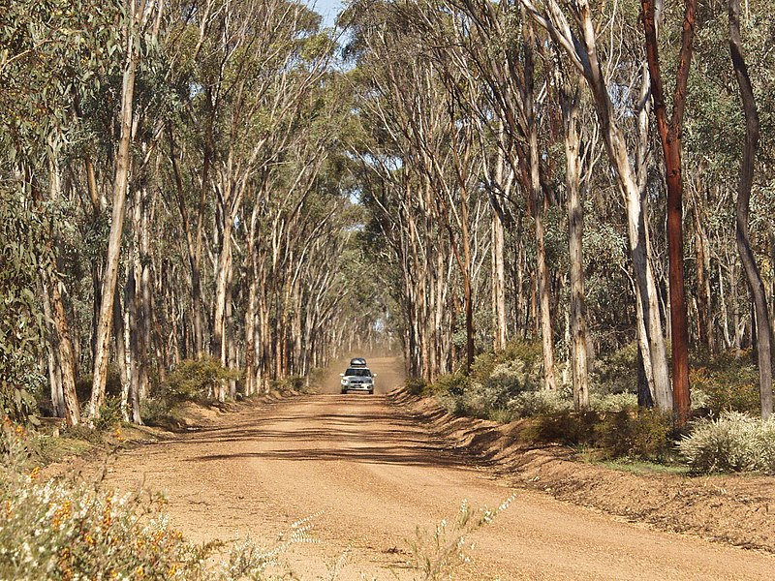
Sustainable natural ecosystems
Natural ecosystems are usually sustainable
Sustainability means that an ecosystem has the ability to maintain suitable living conditions for the community of living things
For a natural ecosystem to be sustainable it needs:
a supply of essential elements necessary for survival and growth (eg carbon, nitrogen, hydrogen, oxygen)
an input of energy, usually sunlight
the elements in the system are involved in complex nutrient (biogeochemical) cycles
biodiversity (a wide range of species living in the ecosystem)
Image 3.0.1 Dryandra woodland

Slide 3
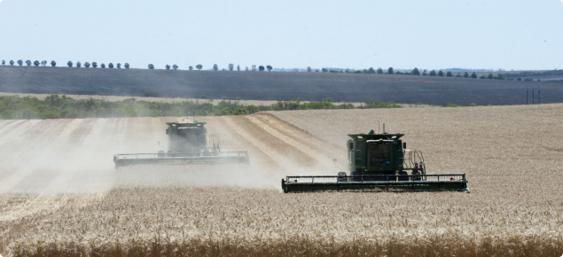
Sustainable agricultural ecosystems
Agricultural ecosystems also require:
a supply of inputs of elements such as carbon, nitrogen and water
an input of energy
Because agricultural systems are artificial ecosystems a significant proportion of material is removed from the ecosystem as farm produce (eg grain, meat)
Agricultural ecosystems therefore must be carefully managed if they are to be sustainable
This careful management is closely aligned to the United Nations Sustainable Development Goal (SDG2) to “End hunger, achieve food security and improved nutrition and promote sustainable agriculture”
Image 3.0.2 Harvesting wheat in Mingenew

Slide 4
Food in ecosystems
In any ecosystem, food is vital. It contains the matter and energy required by living organisms
Every community of organisms must have a source of food. This source of food is manufactured by organisms (such as wheat plants) in the process of photosynthesis. They are therefore known as producers or autotrophs
Other organisms (such as plants and fungi) require a ready made source of food. They are therefore known as consumers or heterotrophs

Slide 5
Food chains
In both natural and agricultural ecosystems, matter is passed from producers to consumers along food chains.
The arrows in a food chain show the direction of the movement of food materials from one organism to another.
In this way the matter and energy needed by organisms pass along food chains.
Image 3.0.3 Marine food chain

Slide 6
Food webs
There are many different food chains within communities and the are all interconnected. Connected food chains are called food webs
To learn more about food chains and food webs watch the video Food chains and food webs

Slide 7
Recycling in nature
A vital group of organisms in any ecosystem is the decomposers.
Decomposers are bacteria and fungi.
Decomposers break down dead bodies and wastes and recycle matter for the producers to re-use.
Image 3.0.4 Recycling in nature – the carbon cycle

Slide 8
Sustainable marine ecosystems
Our marine ecosystems are fragile. Because we take fish and other seafood from the ecosystem for food, they must be carefully managed if they are to remain productive, profitable, viable in the long term, and ecologically sustainable.
Image 3.0.5 Fremantle fishing boat harbour

Slide 9
Western Australian marine food webs
Visit at least one of the following Western Australian marine food webs
Cocos Islands Food Web
Christmas Islands Food Web
South Coast Food Web

Slide 10
A food pyramid
Image 3.0.6 Diagram of trophic layers and energy transfer in an ecosystem

Slide 11
Aboriginal and Torres Strait Islander management of food webs
The introduction to Australia of invasive species (such as the cane toad) have impacted negatively on food webs
Many Aboriginal and Torres Strait Islander communities rely on these food webs for food and other resources
Aboriginal and Torres Strait Islander peoples have responded to these impacts in an effort to restore traditional ecosystems
To learn more about the management of their environment go to:
Deadly story
Indigenous hunters vital to robust food webs in Australia

Slide 12
Acknowledgements
References
FuseSchool – Global Education (26 July 2016) ‘Food chains and food webs’ (video) YouTube available at: <https://www.youtube.com/watch?v=2lqhJNgn_Wg> accessed 21 June 2021
Government of Western Australia, DPIRD, ‘Marine Waters learning resources – explore Western Australia’s amazing marine environment’ available at: <https://marinewaters.fish.wa.gov.au/> accessed 21 June 2021
Images
3.0.1 ‘Dryandra woodland’ (24 September 2004) Charles, England CC BY-SA 4.0 available at: <https://commons.wikimedia.org/wiki/File:Dryandra_Woodland.jpg> accessed 21 June 2021
3.0.2 Government of Western Australia, © 2021 DPIRD ‘Harvesting wheat in Mingenew’ available at: <https://www.agric.wa.gov.au/grains-research-development/western-australian-wheat-industry> accessed 21 June 2021
3.0.3 ‘Marine food chain’ Zappy’s Technology Solutions’ CC BY 2.0 available at: <https://www.flickr.com/photos/102642344@N02/10018930285> accessed 21 June 2021
3.0.4 ‘Figure 22 03 01’ (27 May 2016) CNX OpenStax CC BY 4.0 available at: <https://commons.wikimedia.org/wiki/File:Figure_22_03_01.jpg> accessed 21 June 2021
3.0.5 ‘Fremantle fishing boat harbour’ Gnangarra CC BY 2.5 AU available at: <https://commons.wikimedia.org/wiki/File:Fremantle_Fishing_Boat_Harbour_gnangarra_5291.JPG> accessed 21 June 2021
3.0.6 ‘Diagram of trophic layers & energy transfer in an ecosystem’ WDiment CC BY-SA 4.0 available at: <https://commons.wikimedia.org/wiki/File:Diagram_of_Trophic_Layers_%26_Energy_Transfer_in_an_Ecosystem.svg> accessed 21 June 2021

