Slide 1
3.0 Western Australian food production

Slide 2
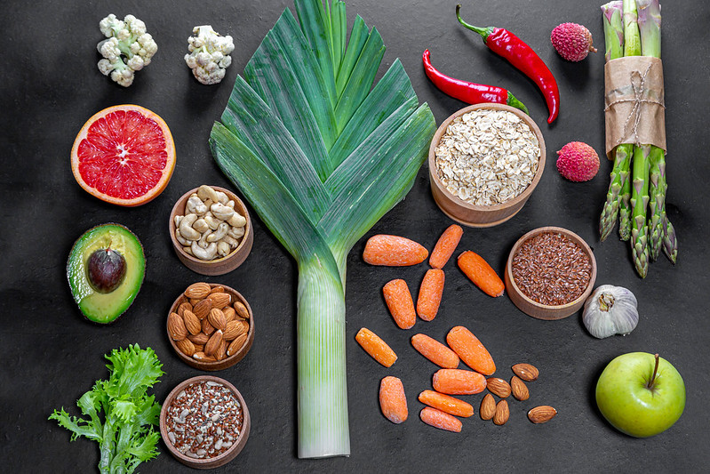
Raw commodity
The Oxford University Press dictionary (Lexico.com) (2021) defines
commodity as a raw material or primary agricultural product that can be bought and sold, such as copper or coffee.
Image 3.0.1

Slide 3
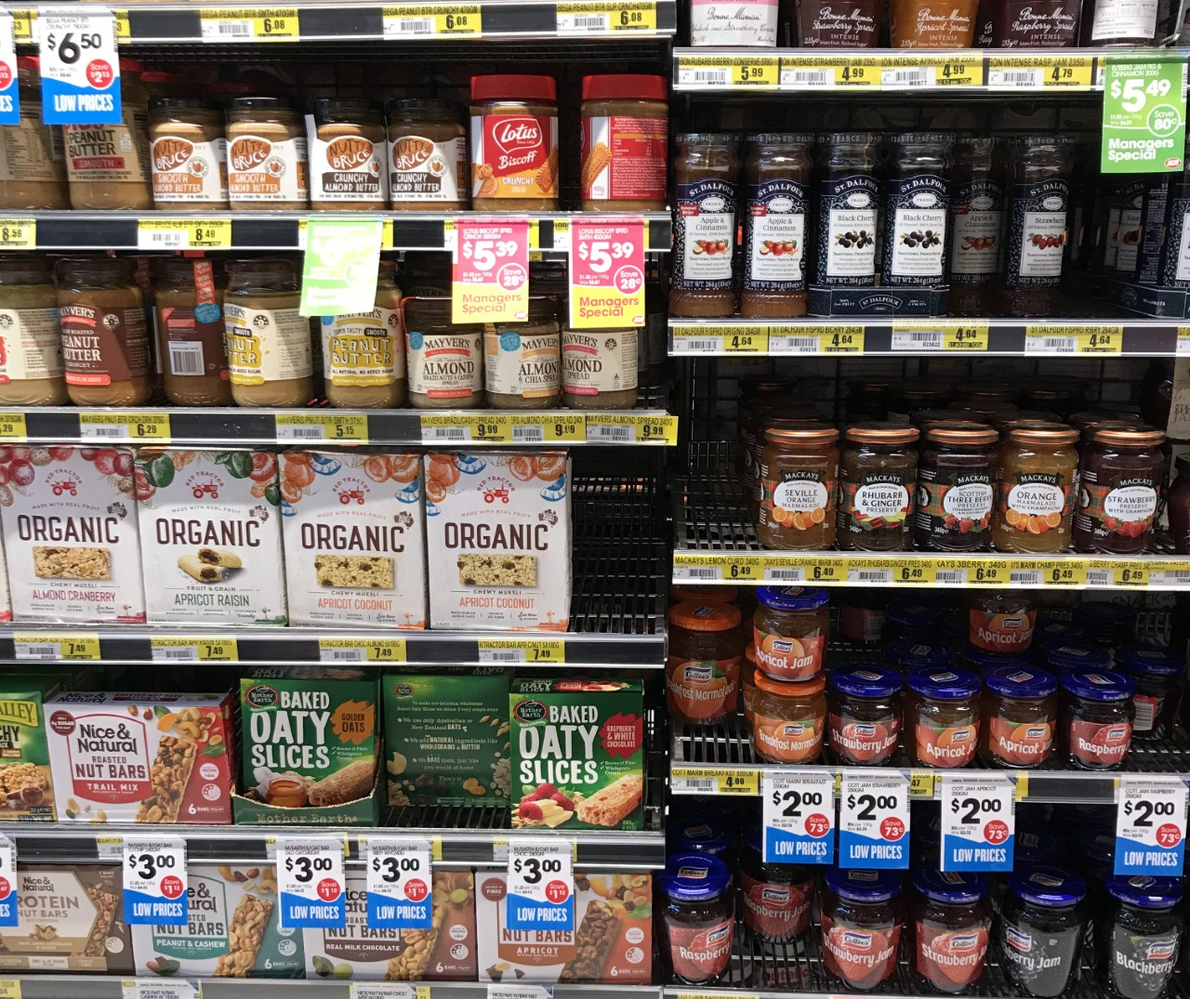
Value-added
The US Department of Agriculture defines
value-added agriculture as a change in the physical state or form of the product (such as milling wheat into flour or making strawberries into jam).
Image 3.0.2

Slide 4
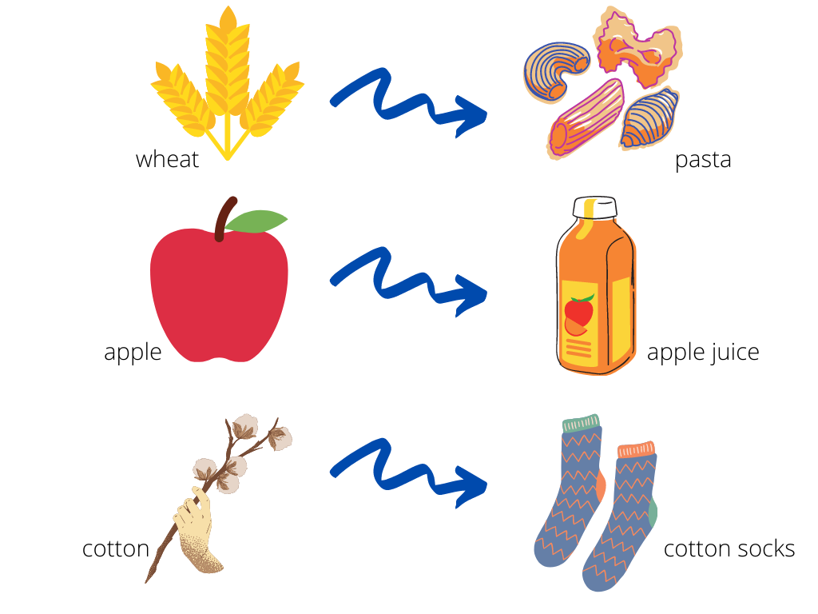
Raw commodity vs Value-added product
Image 3.0.3

Slide 5
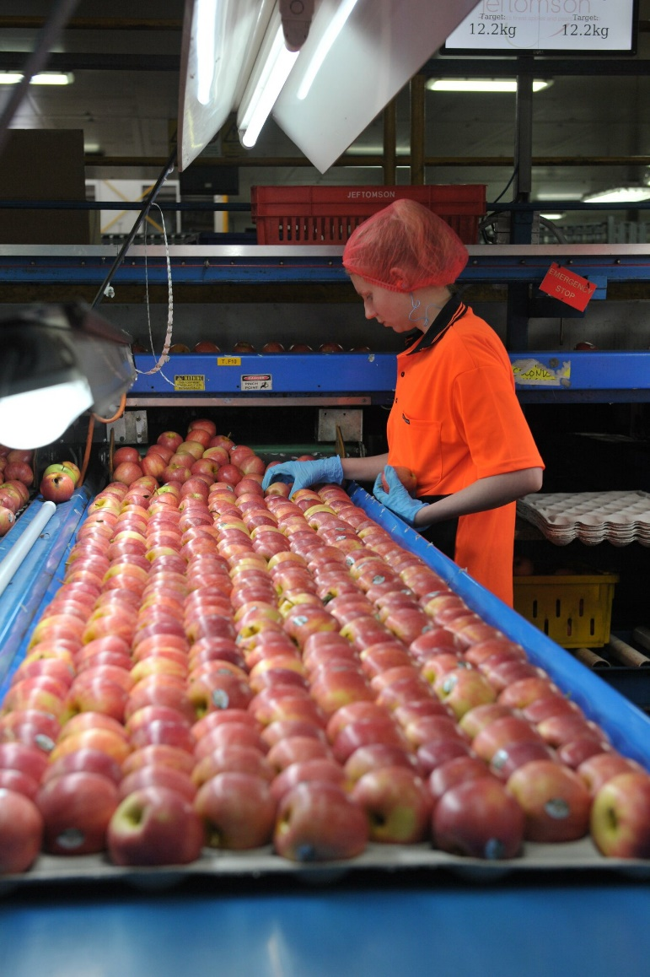
Primary processing The processes that take place to make food safe to eat and ready for market. For example:
Harvesting
Picking
Washing
Grading
Sorting
Milling
Packaging
Weighing
Distribution
Image 3.0.4

Slide 6
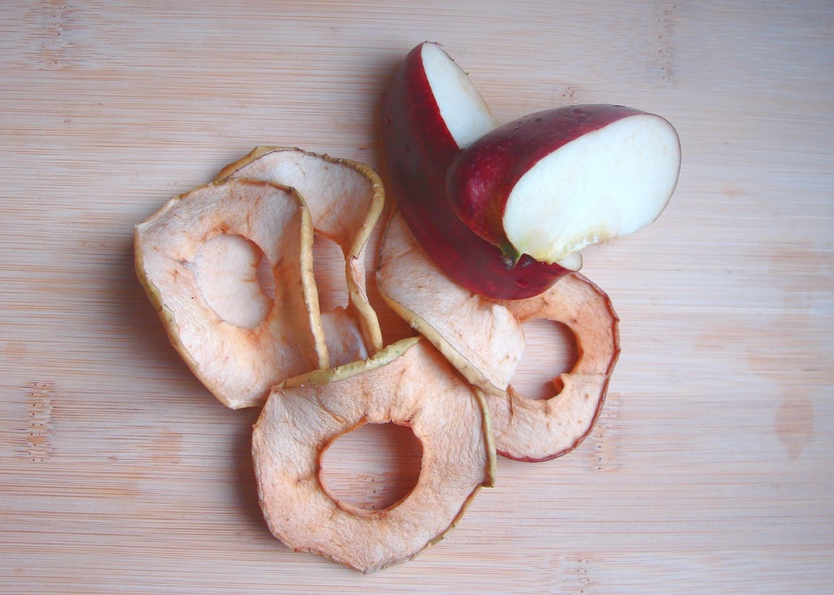
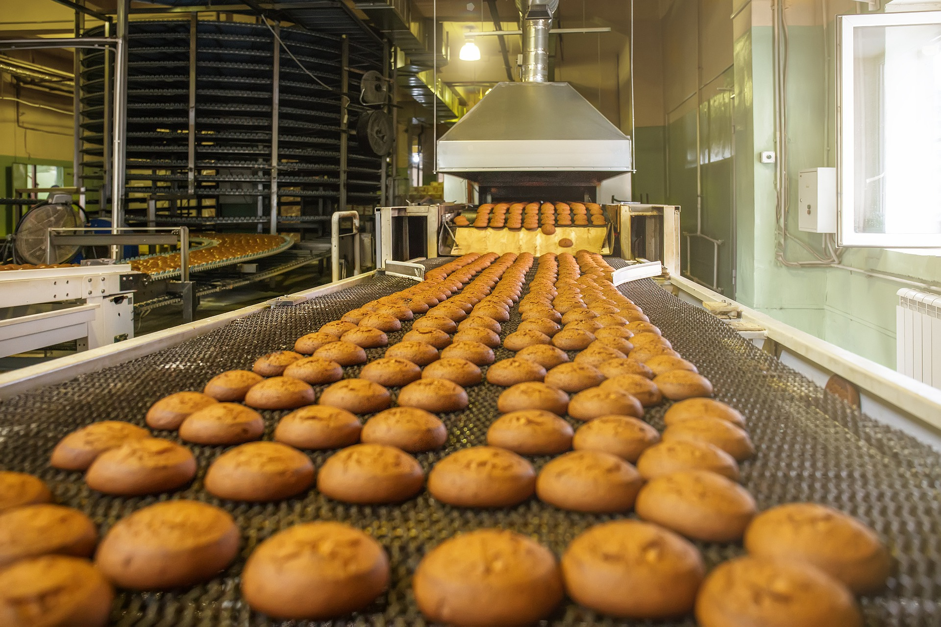
Secondary processing The processes used to change the physical form of raw commodities into other food products. For example:
Cooking
Juicing
Peeling
Dicing/cutting
Mixing
Canning
Kneading
Drying
Image 3.0.5
Image 3.0.6

Slide 7
Image 3.0.7

Slide 8
Image 3.0.8

Slide 9
Image 3.0.9

Slide 10
Acknowledgements
Image 3.0.1 ‘Different fresh products for healthy food. Vegetarianism and raw food concept’ by Marco Verch Professional Photographer, Licenced CC BY 2.0, available at https://www.flickr.com/photos/30478819@N08/48788808182
Image 3.0.2. 3.0.3 Department of Education
Image 3.0.4 ‘180227_Jeftomson pack house 34_photo Rosalea Ryan’ by Apple and Pear Australia Ltd, Licenced CC BY 2.0, available at < https://www.flickr.com/photos/applesnpearsau/40307018075 >
Image 3.0.5 by Monfocus from Pixabay
Image 3.0.6 by 荣泽 胡 from Pixabay
Image 3.0.7, 3.0.8 and 3.0.9 <https://www.agric.wa.gov.au/WAindustrysnapshots>, accessed on 1June 2021.

