Slide 1
Rethinking timber waste
Re-using timber by-products and scrap

Slide 2
Learning objectives
During this project, students will:
Gain an understanding of the ways in which timber is produced
Identify opportunities for innovation and improvement
Devise solutions based on research and evidence

Slide 3
The IPO model
Distribute Student worksheet 1.1
Production processes can be organised using the Input-Process-Output (IPO) model:
Input
what's going in - everything that’s needed.
Process
all the activities that happen, the steps taken to make a product.
Output
what's coming out (everything resulting from production)

Slide 4
The IPO model
When using the IPO model to describe a production process, first consider:
What are the main steps involved?
What are the inputs for each step? (Input)
What actually happens in each step? (Process)
What is the result of each step? (Output)

Slide 5
By-products and waste
by-product (noun)
a secondary or incidental product, as in a process of manufacture.
waste (noun)
anything unused, unproductive, or not properly utilised.
anything left over or superfluous, as excess material, by-products, etc., not of use for the work in hand.
left over or superfluous
Source: Macquarie Dictionary Publishers

Slide 6
The timber production process
Distribute Student worksheet 1.2
Watch the video “The timber production process”.
Record as many key steps as possible on your worksheet.

Slide 7
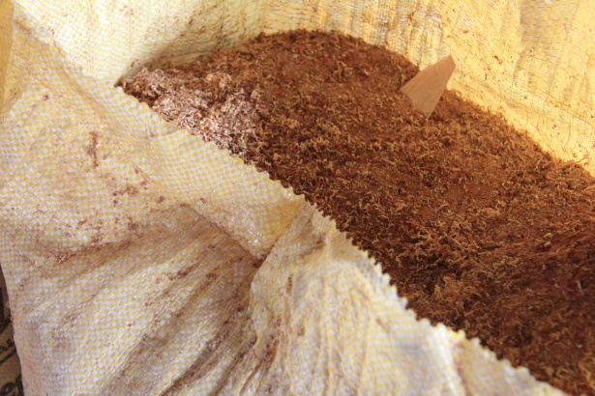
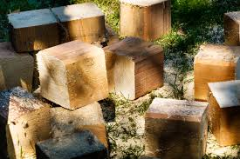
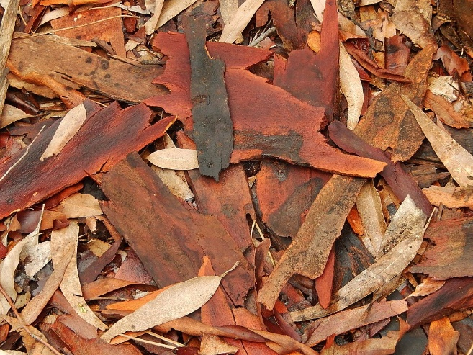
By-products and waste
The process of converting sawlogs to dimensional timber produces three main waste products:
Sawdust
Offcuts
Bark
Images 1.1-1.3 – Timber waste from the industrial production of timber

Slide 8
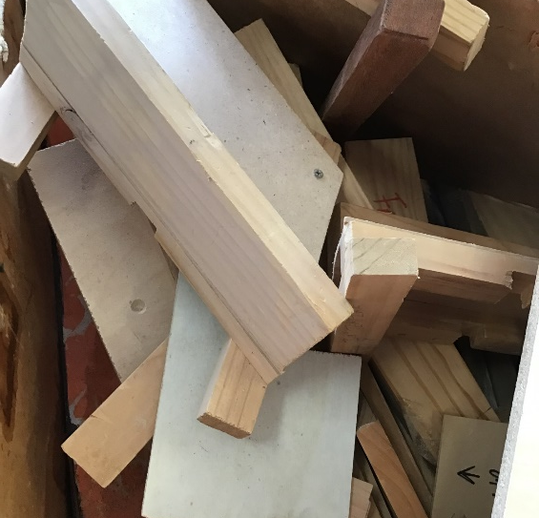
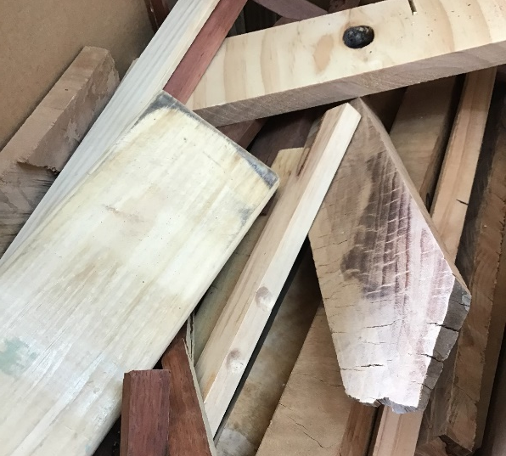
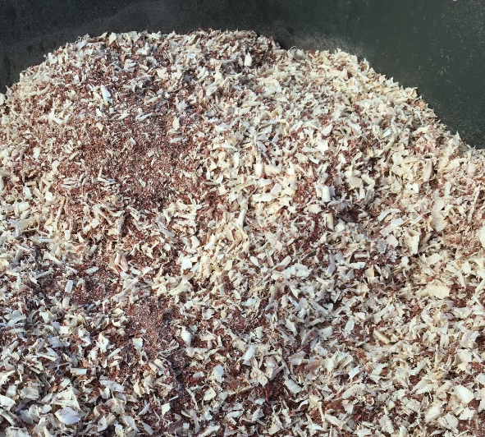
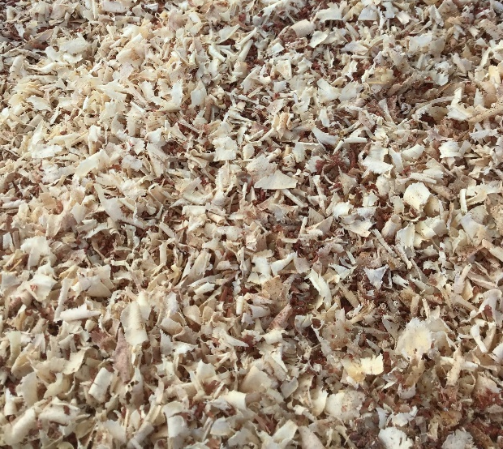
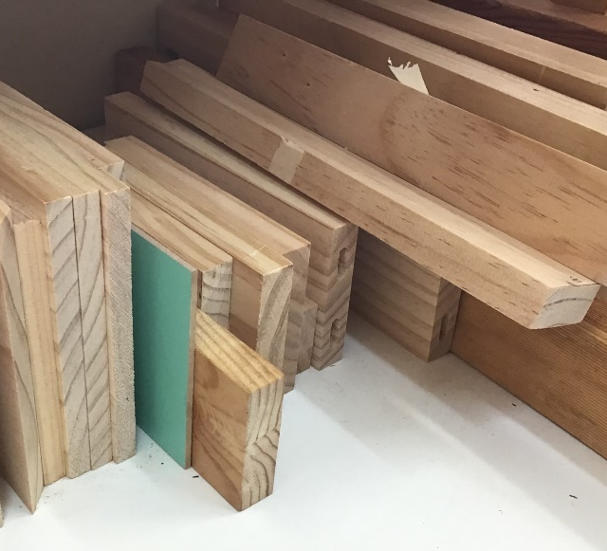
Closer to home...
Your school woodwork workshop produces similar waste products.
Images 1.4-1.9 – Timber waste in a school workshop

Slide 9
Your task
Design a solution to your school’s timber waste problem!

Slide 10
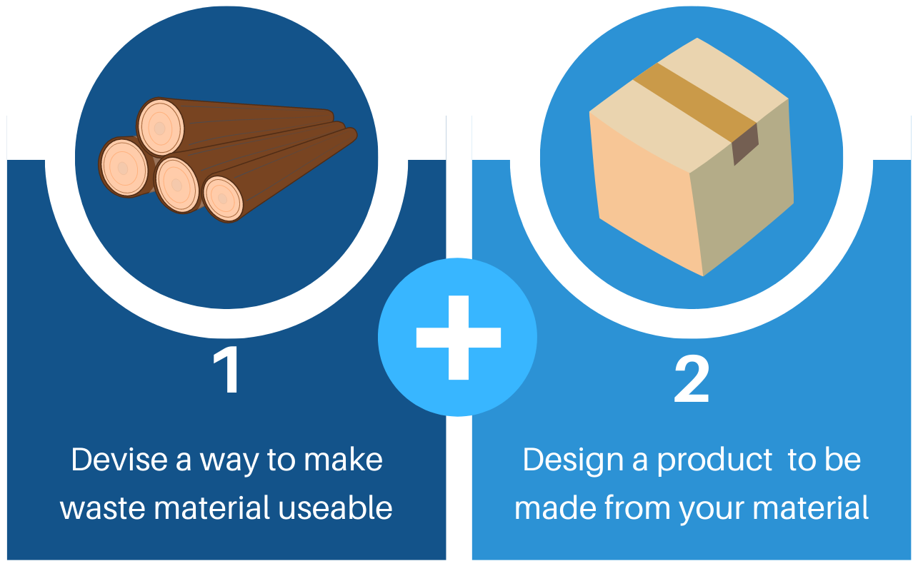
Your task
Distribute Student worksheet 1.3
Image 1.9 Your task

Slide 11
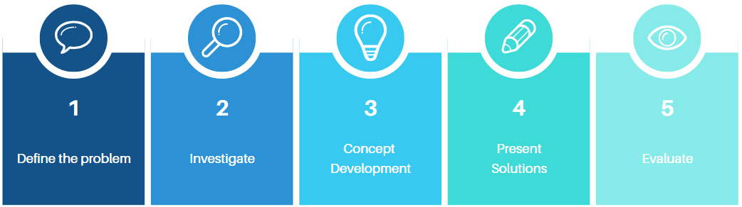
The design process

Slide 12

Defining a problem
Before trying to come up with solutions, we need to be very clear on exactly what our problem is.
What is the main issue?
Why do we
need to address the issue?
Who is experiencing the problem?
Where is it happening?
What do we stand to gain?

Slide 13
Group activity
In your groups, discuss these questions
Record ideas in the organiser in Student worksheet 1.2

Slide 14
Success criteria
How will we know if our solution is a good one?
We first need to identify some characteristics of a successful solution.
Think about the following aspects:

Slide 15

Success criteria - examples
Cost
Aesthetics
Efficiency
Time
Function
Processes involved
Client Needs
Material
properties
Usefulness of material
Equipment required

Slide 16
Acknowledgements
Images
Image 1.1 Kevin Casper (nd) ‘Bag of sawdust’ CC0 available at: < https://www.publicdomainpictures.net/en/view-image.php?image=293110&picture=bag-of-sawdust > accessed 26 October 2021 (Note: If the link above does not work, try copying the link into the address bar of your browser).
Image 1.2 (17 December 2020) ‘Off cuts’ CC0 available at: <https://pxhere.com/en/photo/1635133> accessed 26 October 2021
Image 1.3 Michael Coghlan (26 May 2014), ‘Bits of Bark’ CC BY-SA 2.0 available at: <https://www.flickr.com/photos/mikecogh/14357568544 > accessed 26 October 2021
Images 1.4-1.9 “Timber waste in a school workplace” by the Department of Education
Image 1.10 “Your task” Free Media License Agreement, available at: <https://www.canva.com>

