Slide 1
Exploring food and fibre
Know your products

Slide 2
Where do the products we use daily come from?
Supermarket aisle

Slide 3
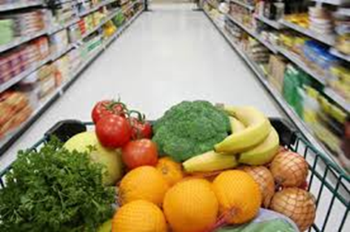
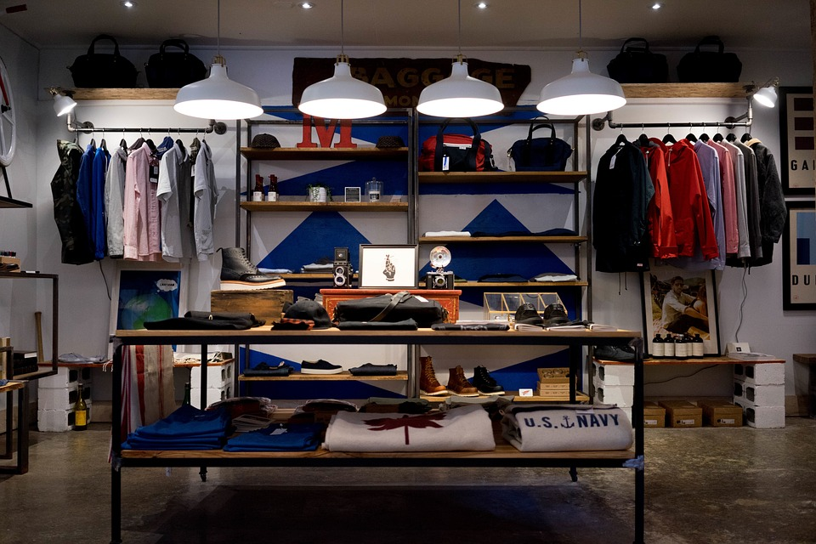
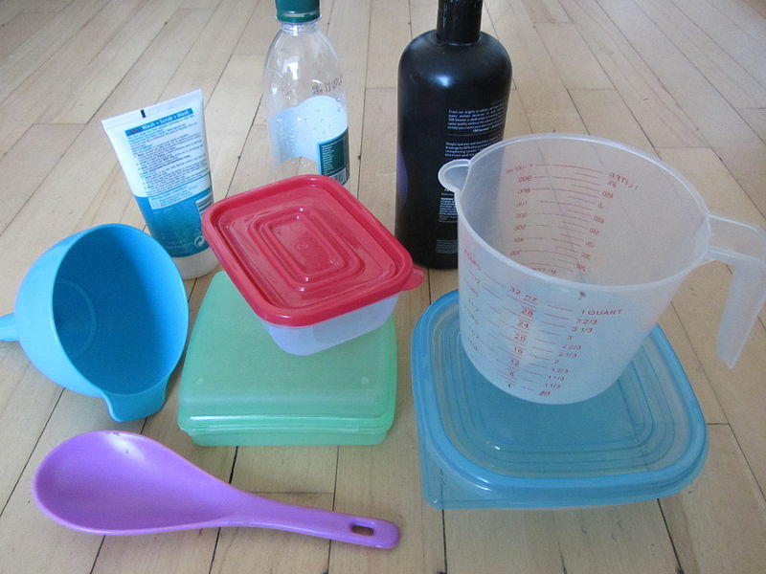
We can classify the products we use every day into many different categories
Sort the product images you have into:
Food
2. Fibre
3. Other

Slide 4
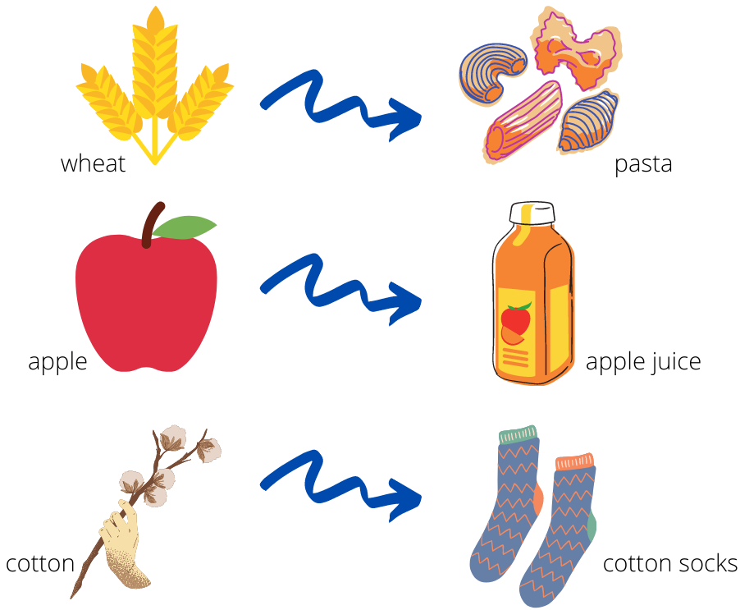
Commodity vs value-added product
Now sort the product images you have into:
Commodity
Value-added product

Slide 5
Food products can be sorted into different food groups
Sort the food products into different groups:
Grain (cereal) foods
Lean meats
Dairy and alternatives
Fruit
Vegetables
Discretionary foods
Oils and fats

Slide 6
Fibre products can also be classified

Slide 7
Acknowledgements
For use of the following images:
Slide 2: ‘Coles South City aisle’ by Bidgee. Licensed CC BY-SA 2.5 AU, available at: https://commons.wikimedia.org/wiki/File:Coles_South_City_aisle.jpg
Slide 3: 1. Food image: ‘Healthy groceries’ by Greg Gavedon. Licensed CC BY-ND 2.0, available at https://www.flickr.com/photos/54851530@N04/5080593765/
Slide 3: 2. Fibre image by Free-Photos, available at https://pixabay.com/photos/store-clothing-shop-bouique-984393/\
Slide 3: 3. Other image: ‘Various plastic products’ by Meganbeckett27. Licensed CC BY-SA 3.0, available at https://commons.wikimedia.org/wiki/File:Various_plastic_products.JPG
Slide 5: Image of the ‘Australian guide to healthy eating’: National Health and Medical Research Centre (2017). Licensed CC BY 4.0, available at https://www.eatforhealth.gov.au/guidelines/australian-guide-healthy-eating

