Slide 1
The triple bottom line
Sustainable food and fibre production

Slide 2
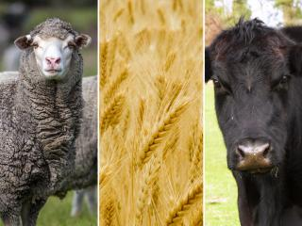
Meeting the needs of our future population
To meet future population needs, our food and fibre production systems need to protect:
biodiversity and ecosystems
human wellbeing, social equity and cultural diversity
economic viability.
Image 1

Slide 3
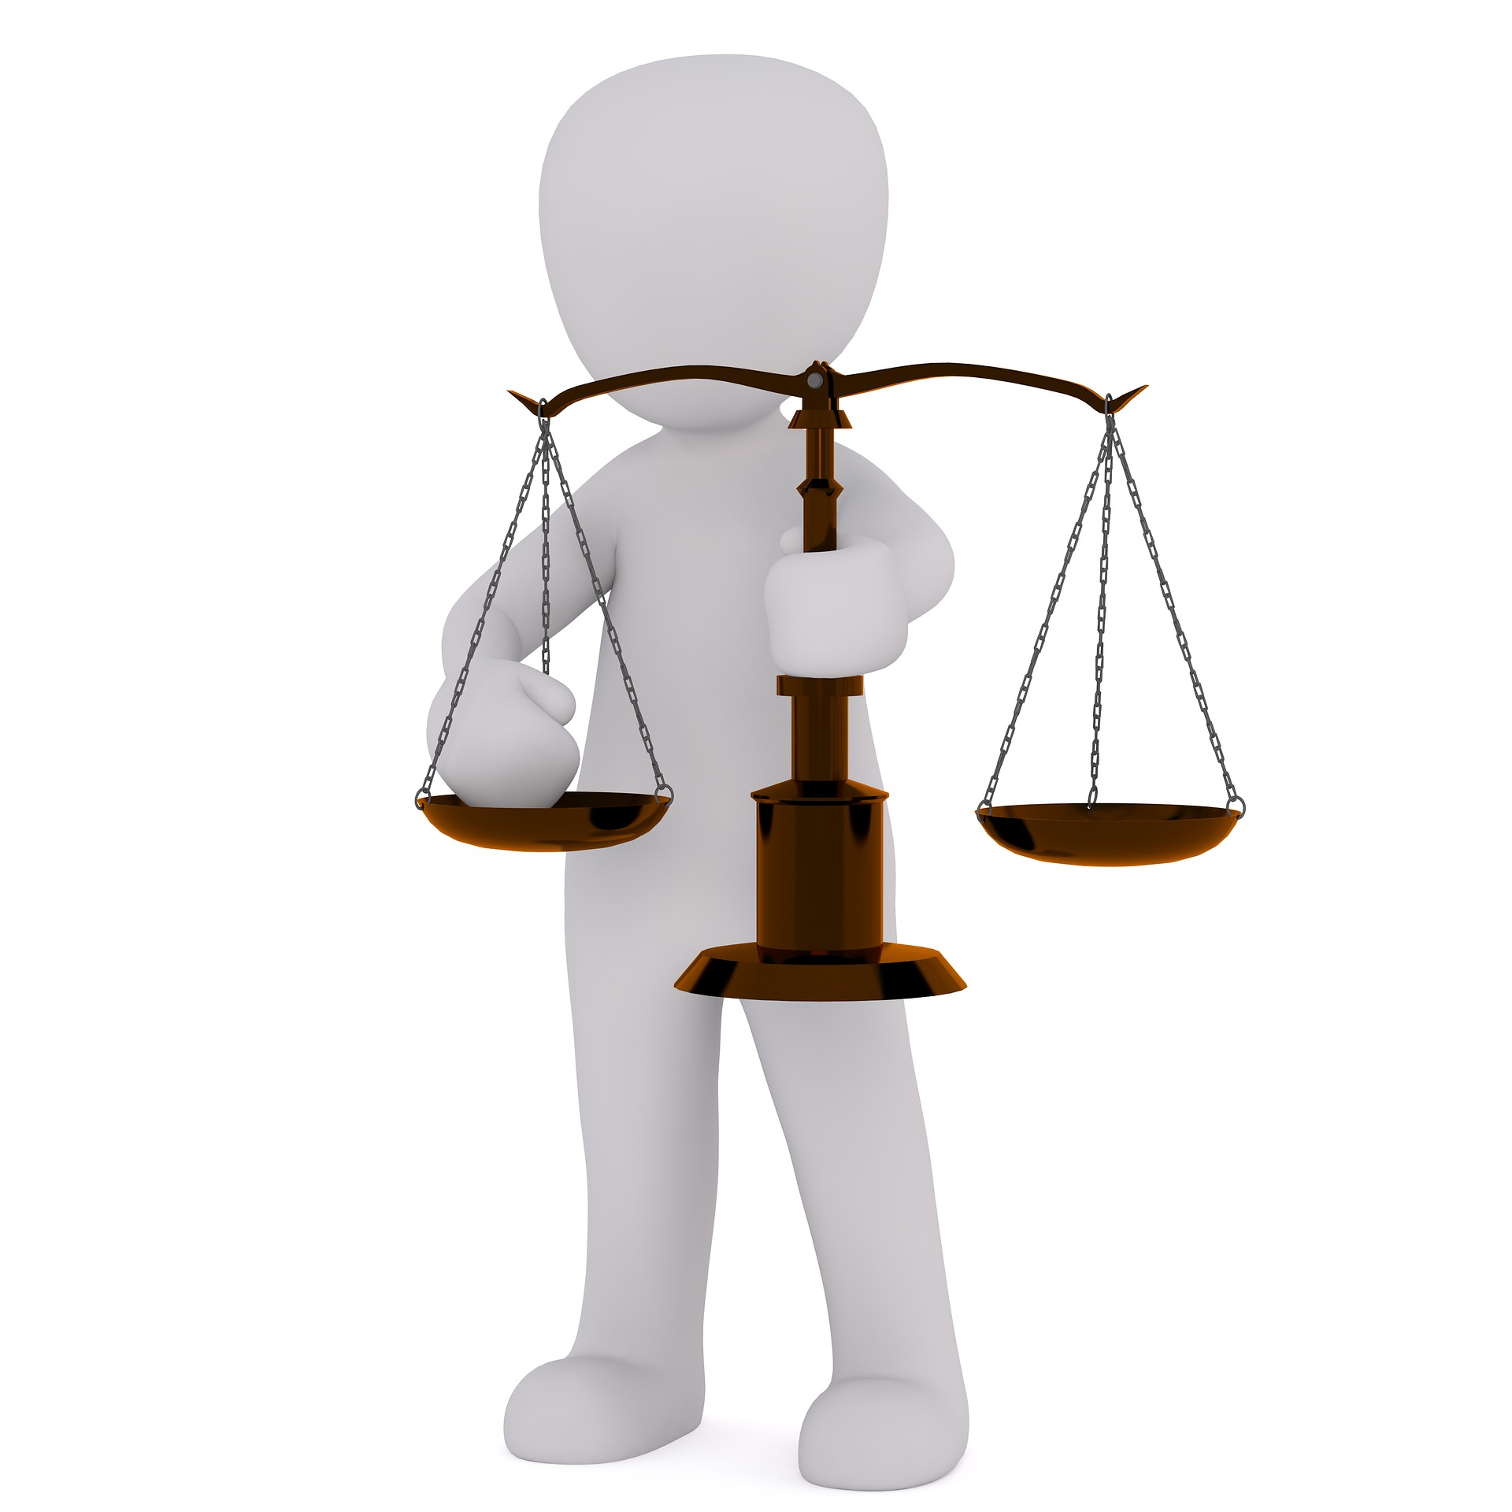
How can food and fibre primary industries be sustainable?
The triple bottom line framework encourages businesses to consider three elements:
1. Social – people
2. Economic – profit
3. Environmental – planet
When all of these elements are considered, businesses demonstrate sustainability.
Image 2

Slide 4
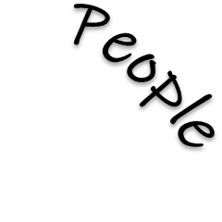
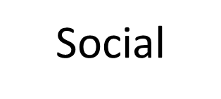
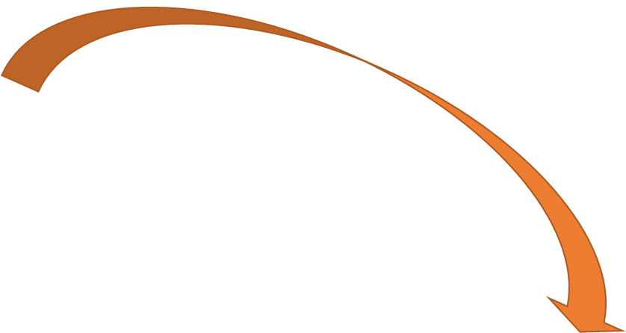
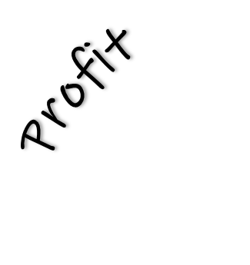
Triple bottom line
Understanding the balance
Planet
Image 3

Slide 5
Acknowledgements
For use of the following images:
Slide 2: ‘Sheep/Wheat/Cattle’ Source DPIRD, available at https://www.agric.wa.gov.au/news/media-releases/submissions-sought-review-industry-funding-scheme-regulations
Slide 3 – Scales image by Peggy Marco, available at < https://pixabay.com/illustrations/horizontal-pan-weigh-kitchen-scale-2071302/ >
Slide 4 – People image available at < https://www.freepik.com/free-vector/character-illustration-people-holding-user-account-icons_3226077.htm#query=people-icon&position=11 >
Slide 4 – Wallet image available at < https://pixabay.com/vectors/wallet-money-finance-cash-currency-3721156/>
Slide 4 – Earth image available at < https://pixabay.com/illustrations/earth-care-earth-supported-hands-1889652/ >
References
Gupta, SK (n.d.) What is triple bottom line (TBL)? (Explained with examples) – The future benchmark, Business Strategy Hub website, accessed on 15 March 2021
Sustainability Illustrated (8 April 2014) Triple bottom line (3 pillars): sustainability in business, [video], Sustainability Illustrated, YouTube <https://www.youtube.com/watch?v=2f5m-jBf81Q>, accessed on 28 March 2021

