Slide 1
Department of Primary Industry and Regional Development
Pathways to Competitiveness Report
A Summary
Notes:
The Department of Agriculture and Food, WA (DAFWA) commissioned global consultancy Coriolis, to produce an independent, data-driven report called the Pathways to Competitiveness report. The report identifies opportunities, constraints and drivers for growth and investment of Western Australian agrifood businesses. (NOTE: DPIRD since 2017)
The Pathways to Competitiveness report is a key part of the Agricultural Sciences Research and Development Fund - a four year, project with investment from Royalties for Regions to generate growth and productivity improvements for the Western Australian economy.
Pathways to Competitiveness looks at key drivers, practices and mechanisms which characterise international competitiveness, and draws lessons from peer regions that have transformed relevant industry sectors over a relatively short time period. For example, dairy activity in New Mexico, pork industry growth in Chile, and agrifood growth in Peru, all highlight what is possible. (NOTE: case studies not included in this PPT)
What questions does it answer
What is required to become globally competitive?
How did peer countries or industries transform their industries?
What is the Pathway to Competitiveness?
What is required for Western Australia to expand beyond a handful of key sectors?

Slide 2
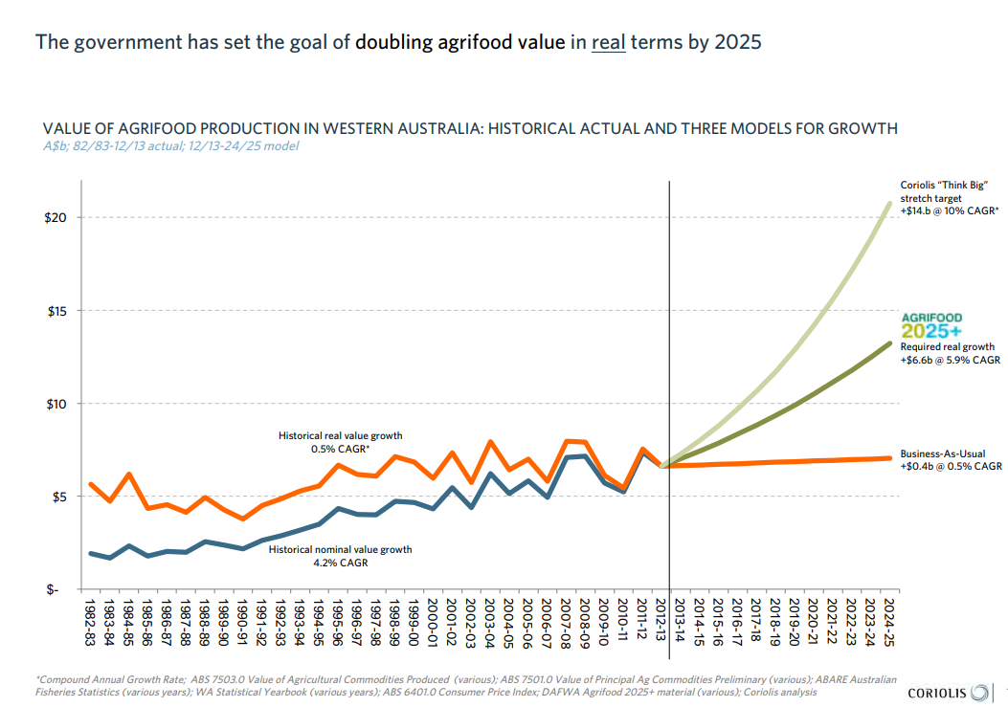
Notes:
The results of this project will:
Inform state government policy
Improve state government co-investment in the agrifood sector
Create wider awareness of the competitiveness challenge facing WA agrifoods
Empower agrifood leaders to drive change
Inform industry investment and strategy

Slide 3
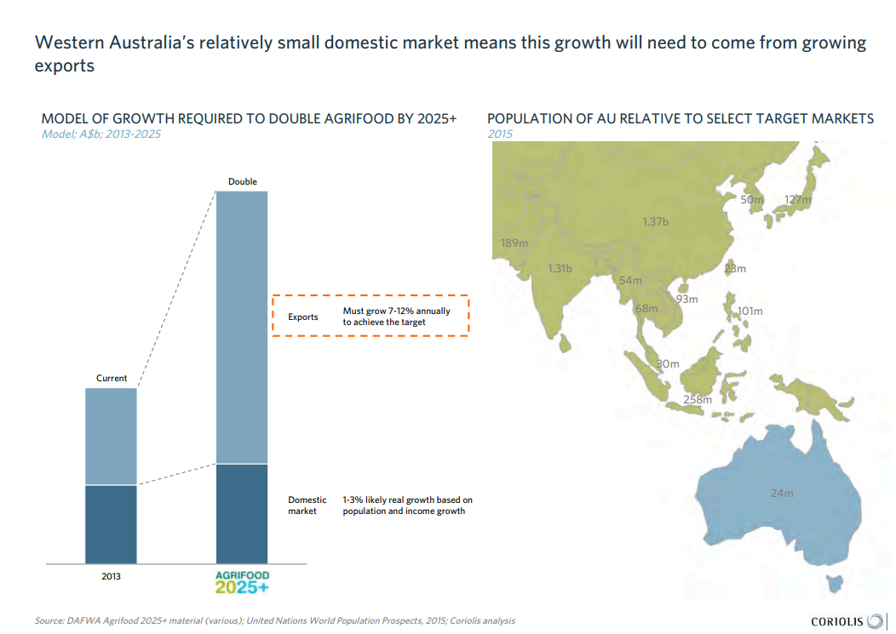
Notes:
Ideas to discuss with class:
the implications of a relatively small population in WA.
the opportunities for businesses based on the populations of neighbouring Asian countries.
What if….
The population of WA increased more than expected?

Slide 4
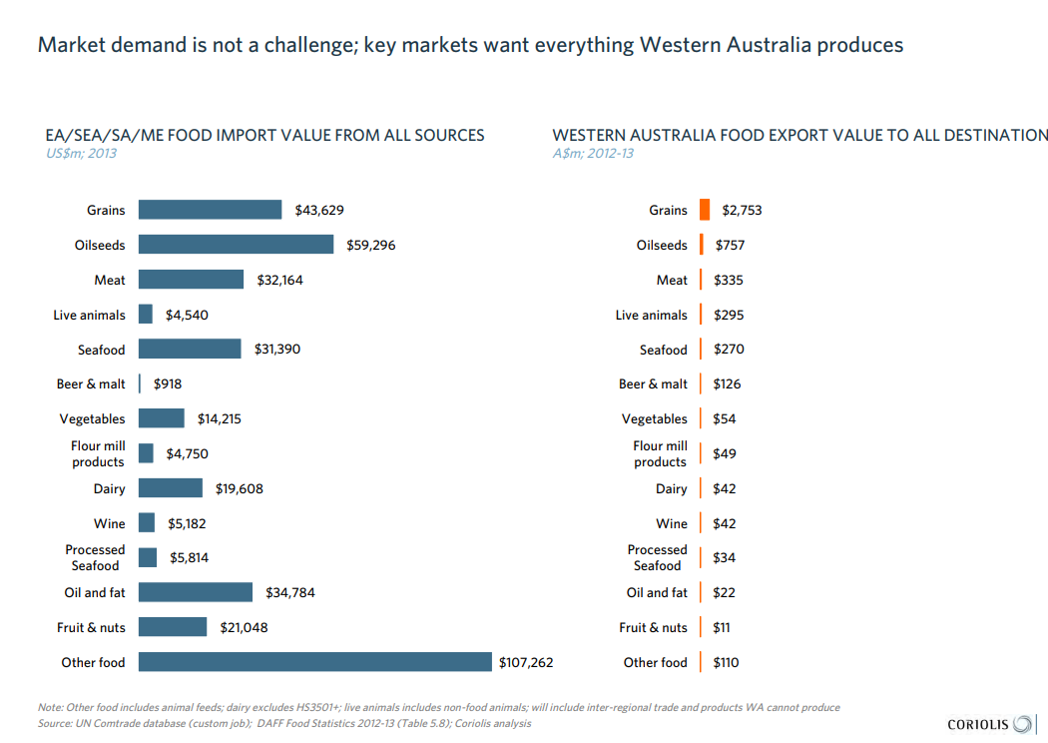
Notes:
Discuss market share and how businesses can increase their %.
Discuss Scale of operations – the report gives examples of scale if further information required.

Slide 5
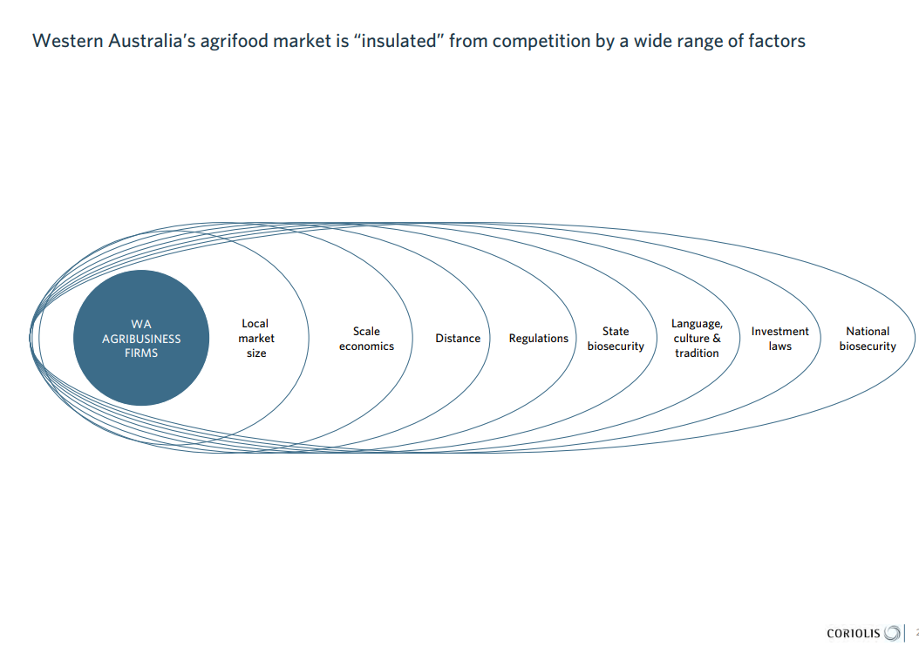
Notes:
The ‘WHY’ our market is insulated
Consider PMI of this situation.

Slide 6
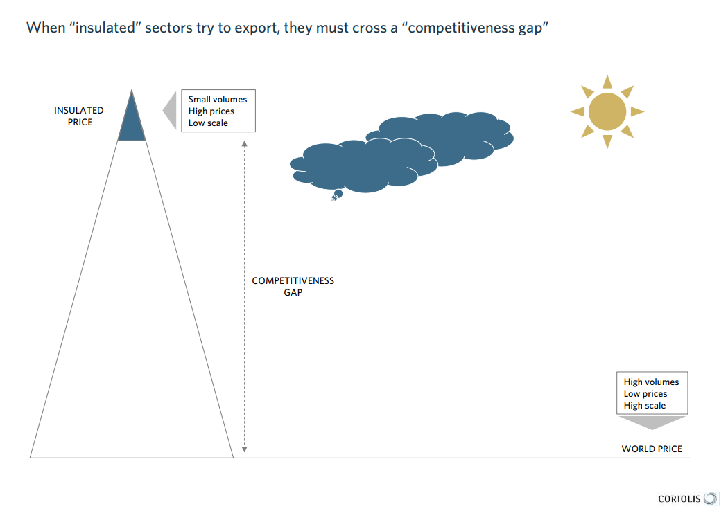
Notes:
The ‘WHAT’ of being insulated
Discuss - SWOT of this scenario

Slide 7
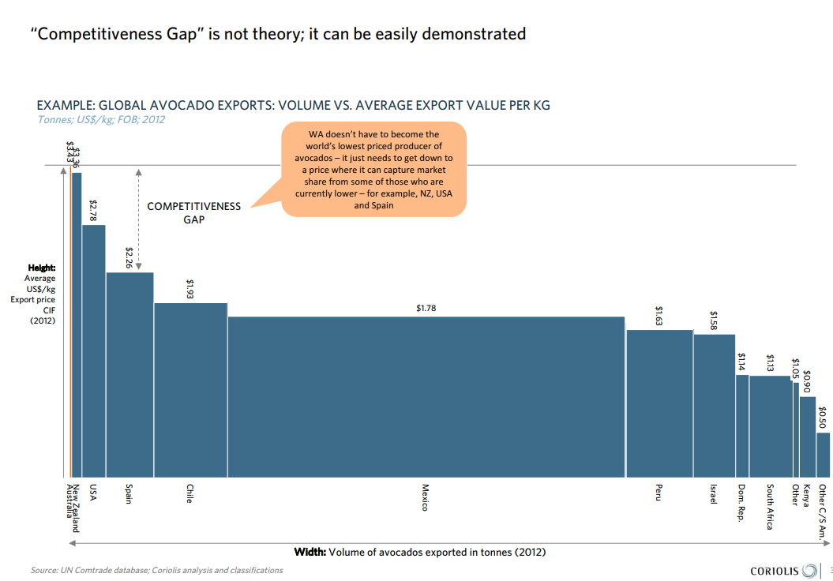

Slide 8
Notes:
Discuss consequences of each scenario in terms of
Political
Economic
Social
Environmental

Slide 9
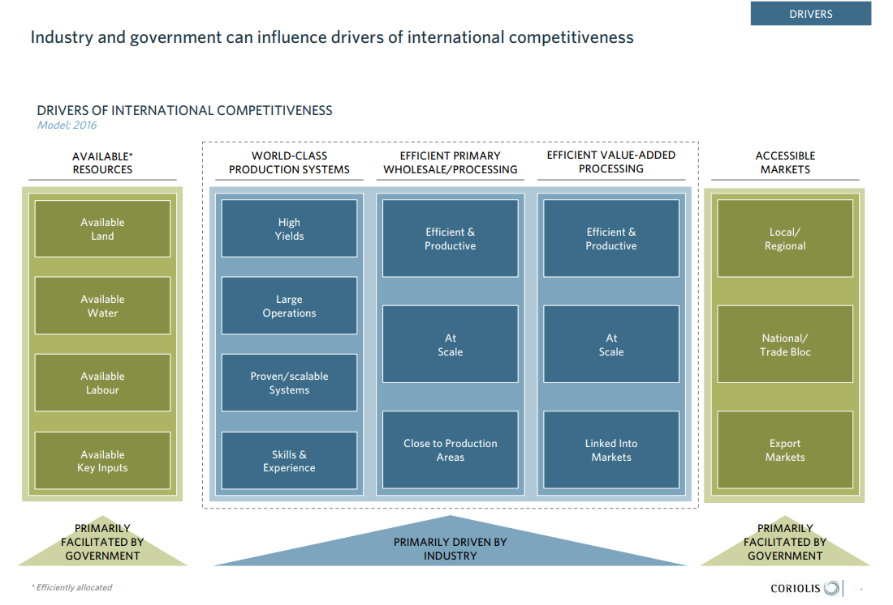
Notes:
Discuss – How government, industries and businesses can influence international competitiveness

Slide 10
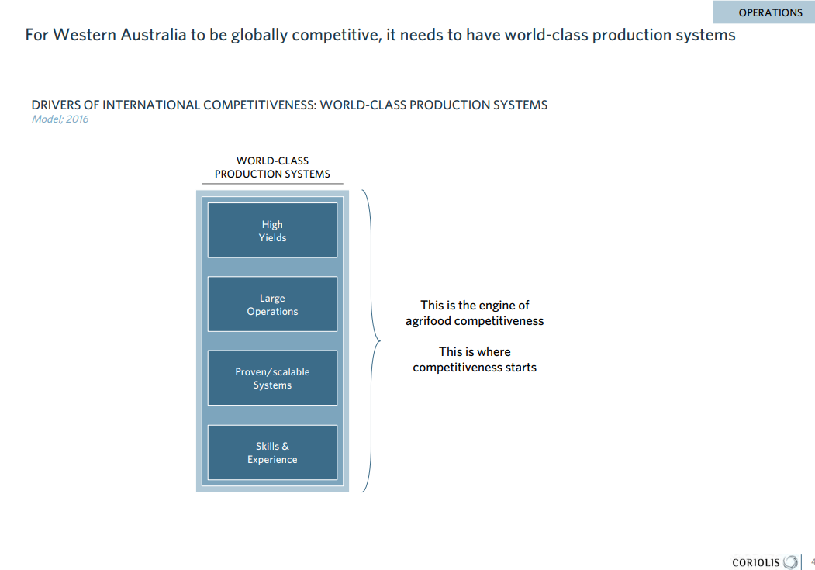

Slide 11
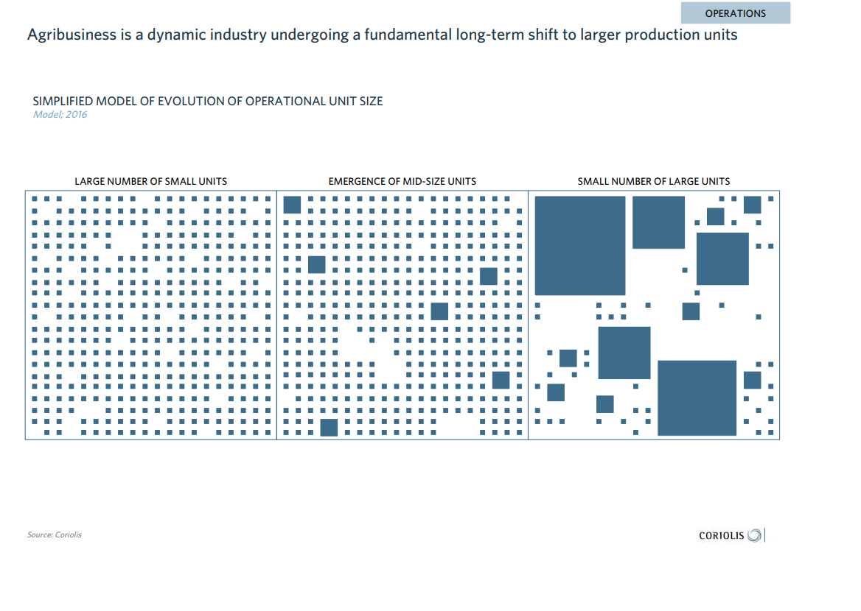
Notes:
Discuss consequences of small operations evolving to large operations producing food and beverages

Slide 12
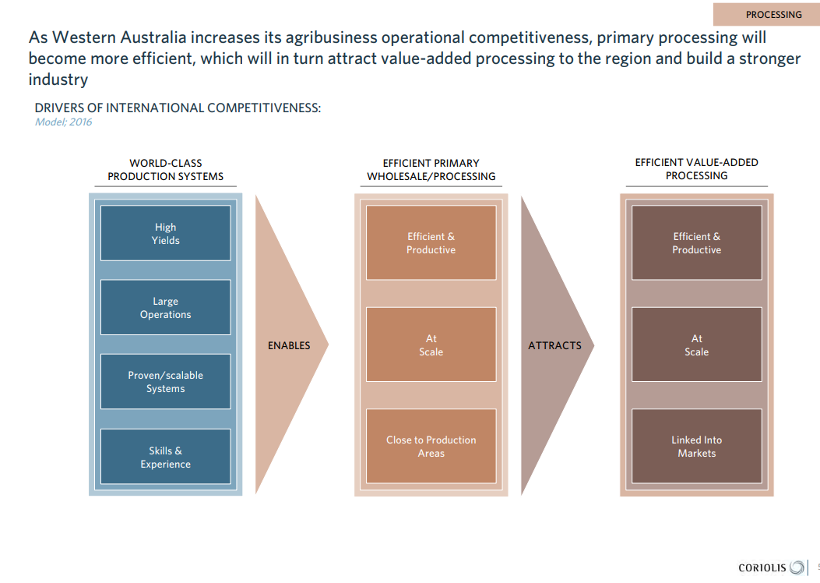

Slide 13
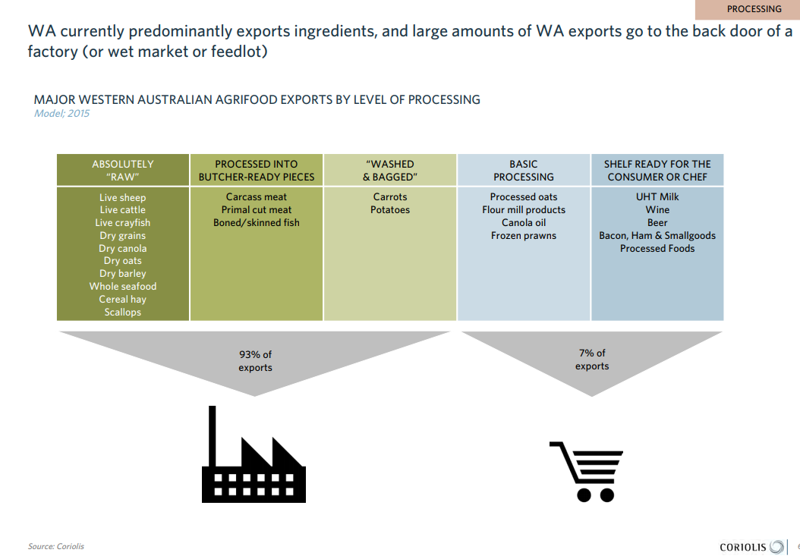
Notes:
This was the situation at the time of the study
SEE, THINK, WONDER

Slide 14
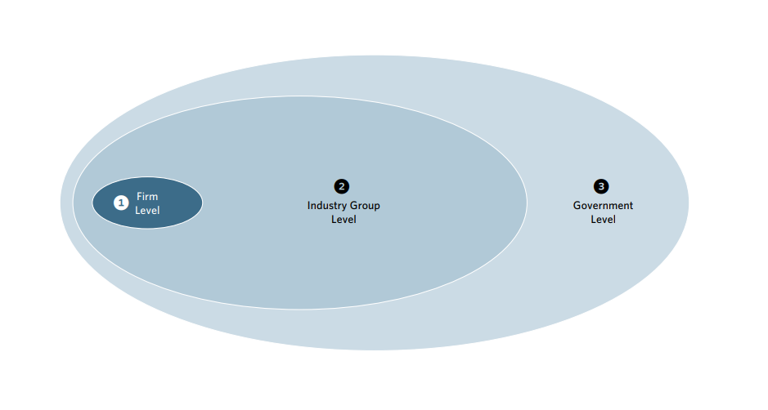
Notes:
What can each group do to help increase competitiveness?

Slide 15
Notes:
Locate examples of businesses that demonstrate these characteristics
What are the challenges and risks for each pathway? (suggestions on the next slide)

Slide 17
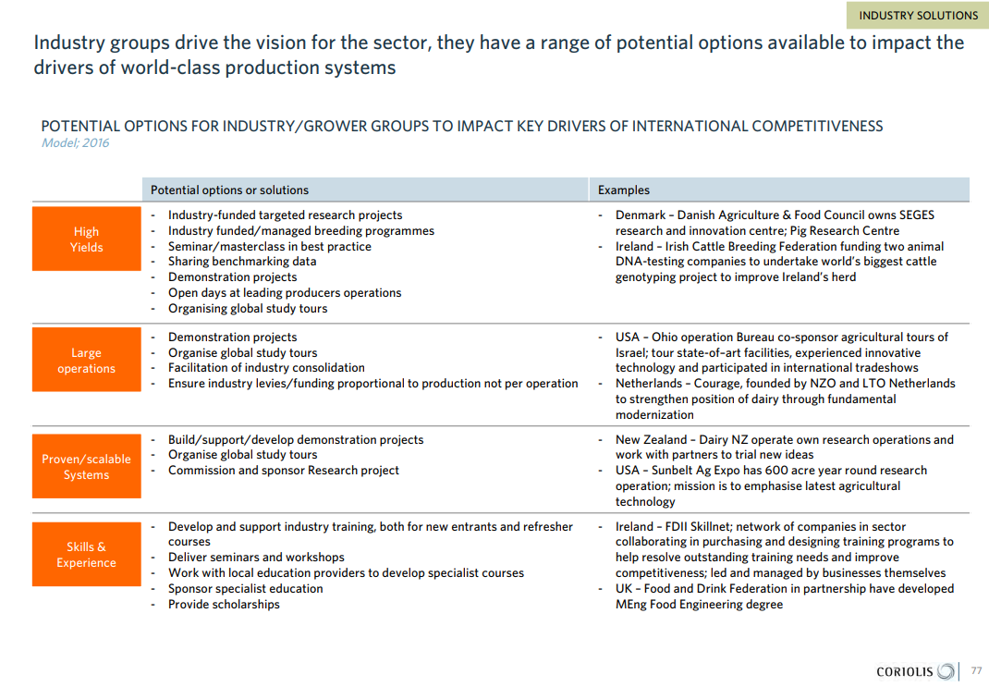

Slide 19
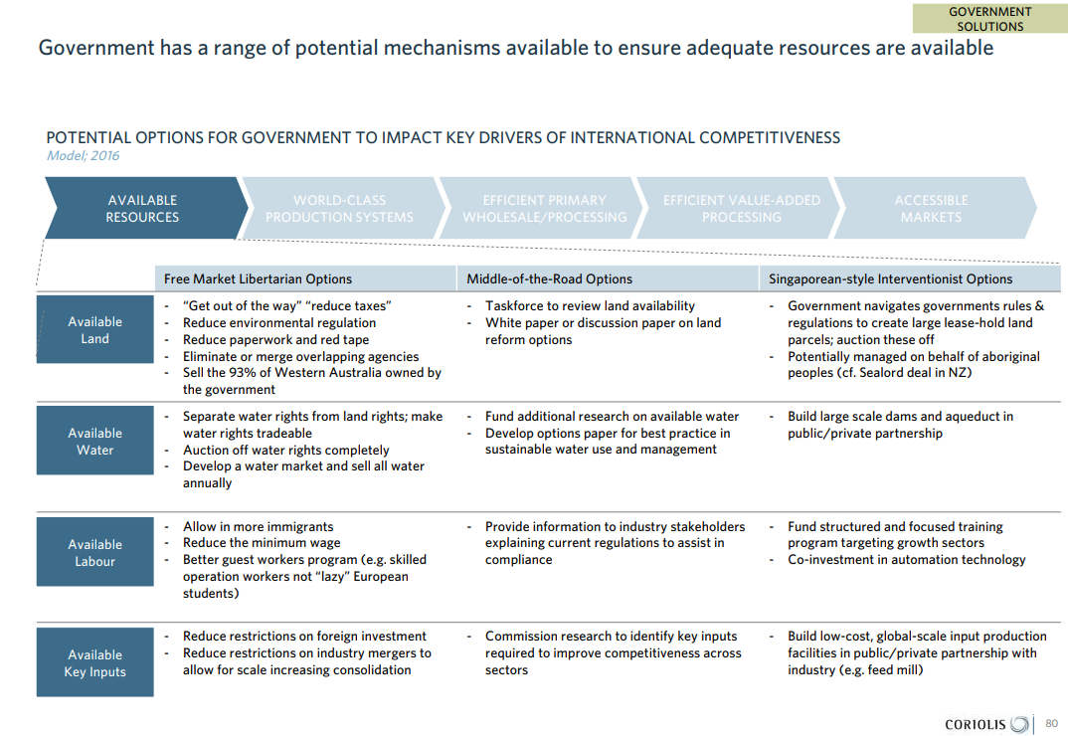
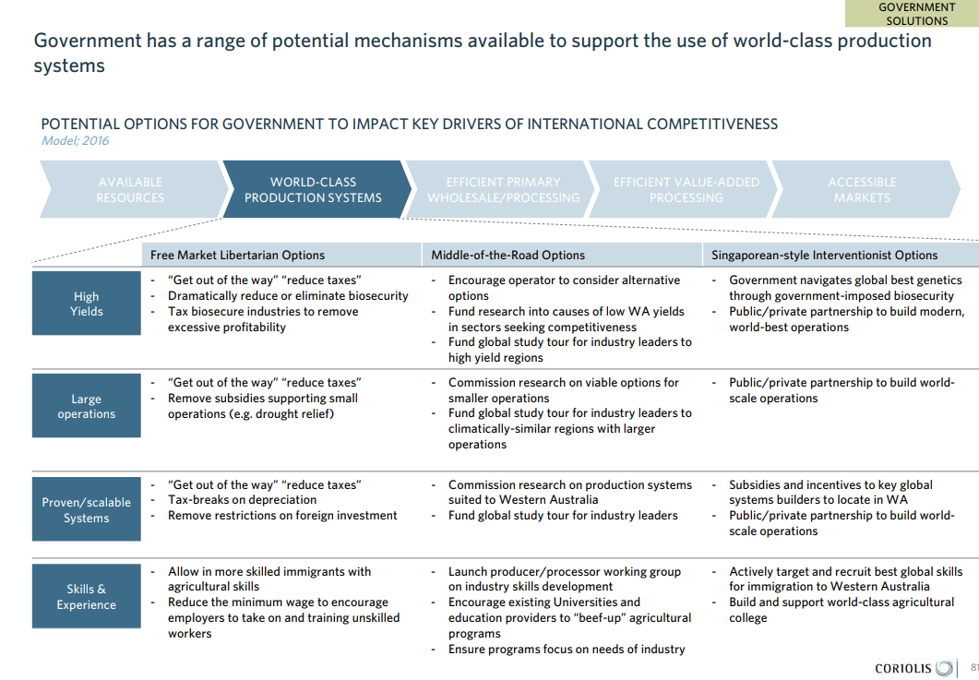
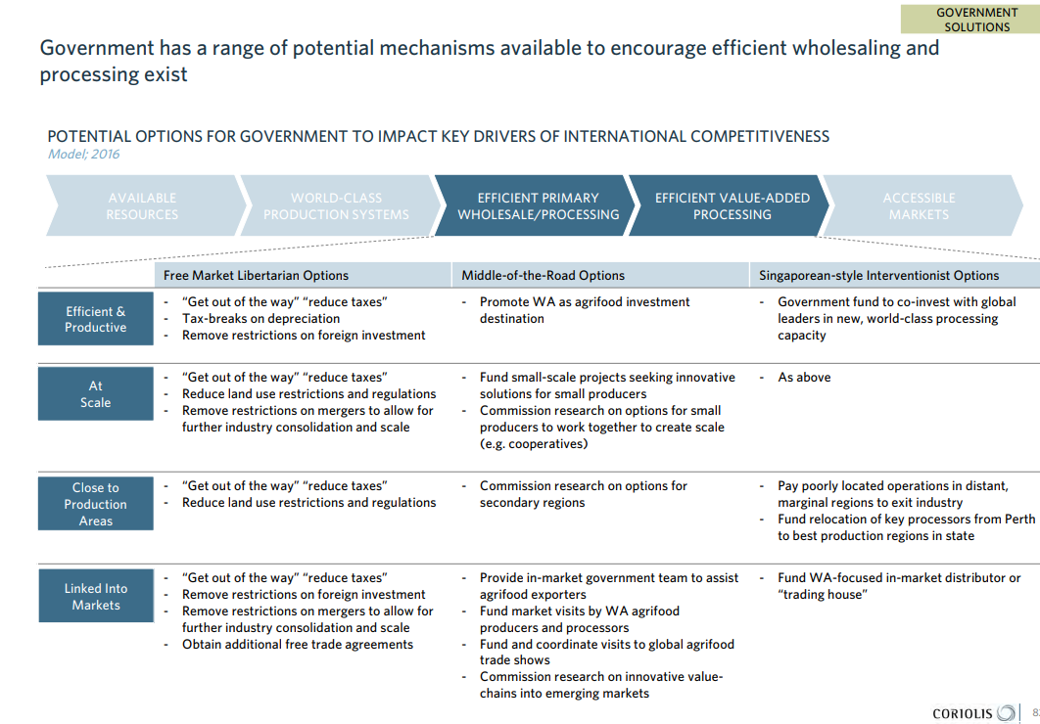
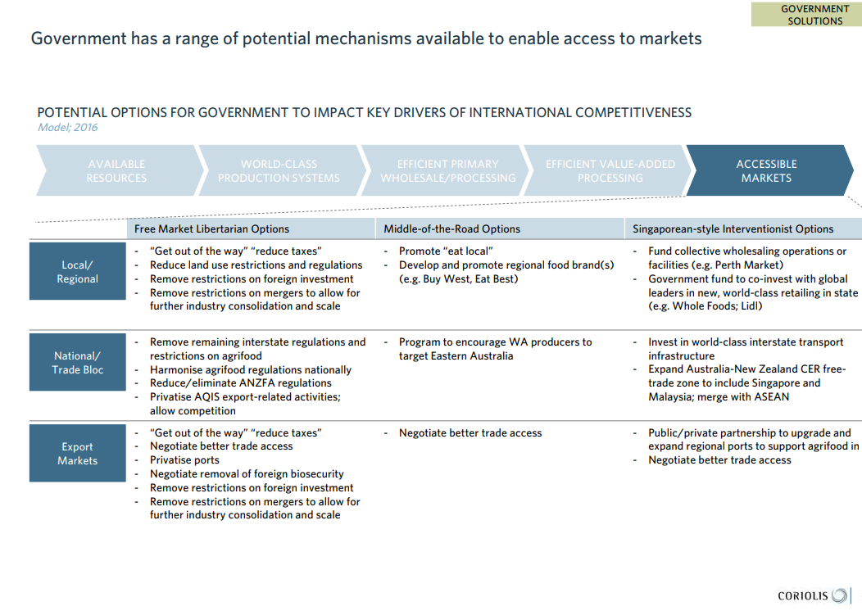

Slide 20
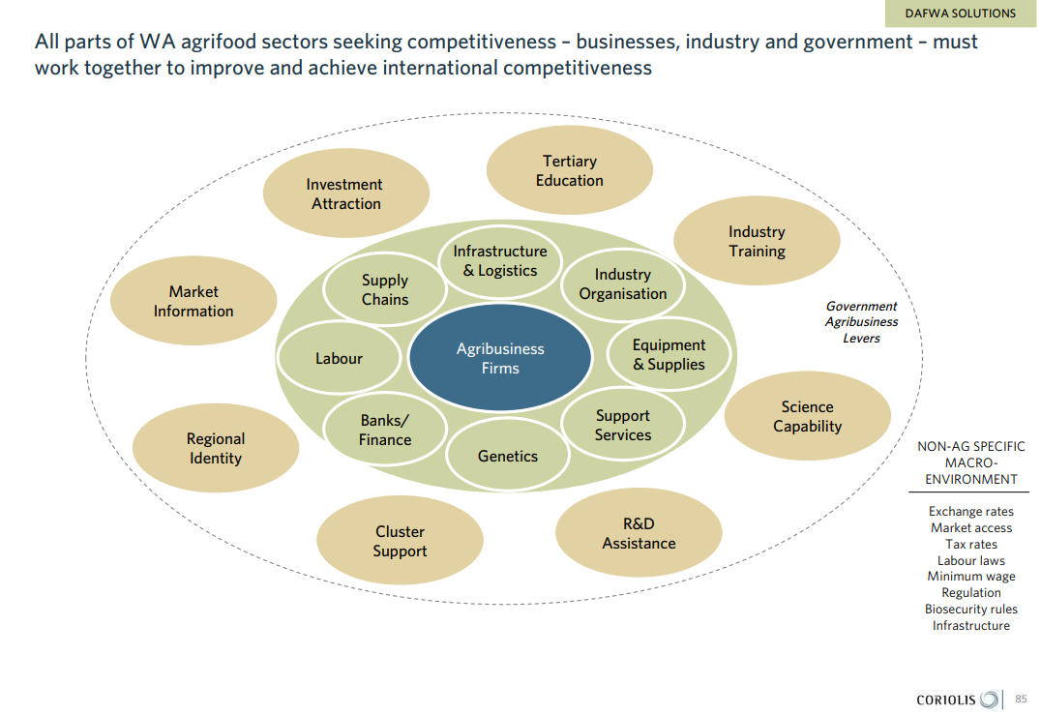
Notes:
Conclusion: All sectors must work together

Slide 21
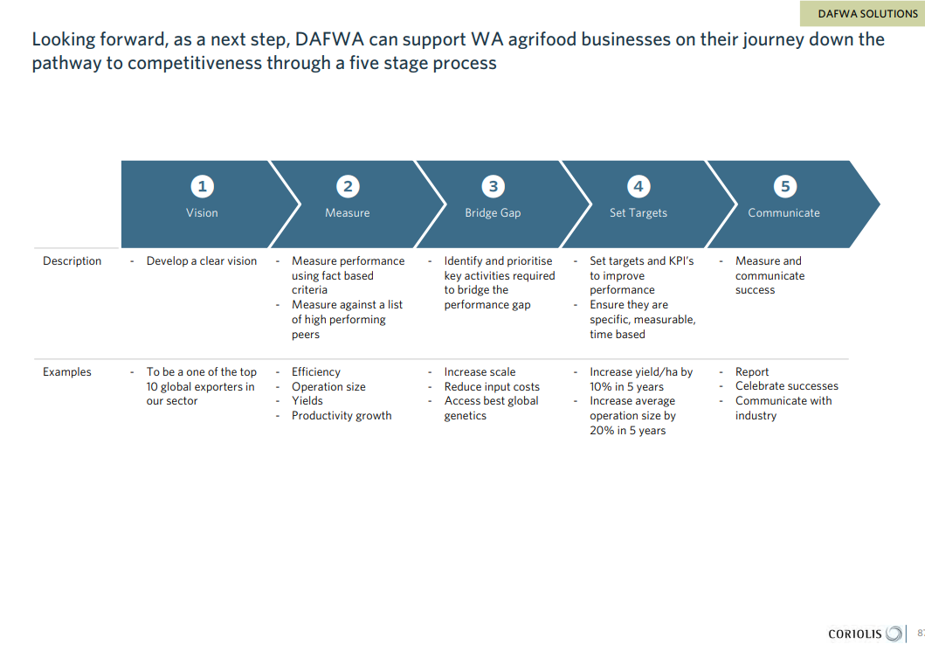
Notes:
What DAFWA/DPIRD can do to provide opportunities for businesses.

Slide 22
Acknowledgements
https://www.agric.wa.gov.au/agricultural-exports/pathways-competitiveness-report
https://agric.wa.gov.au/n/5807

