Slide 1
Department of Primary Industry and Regional Development
Premium Agri-Food market Opportunity
A project under the Food Industry Innovation Project
December 2016

Slide 2
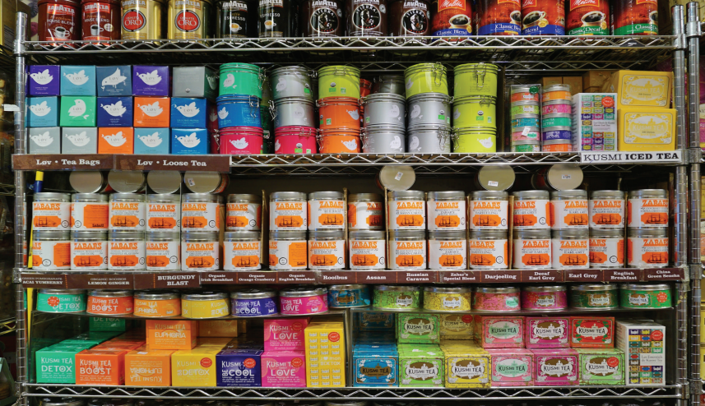
Scope of the project
Identify market opportunities for premium Western Australian agri-food products.

Slide 3
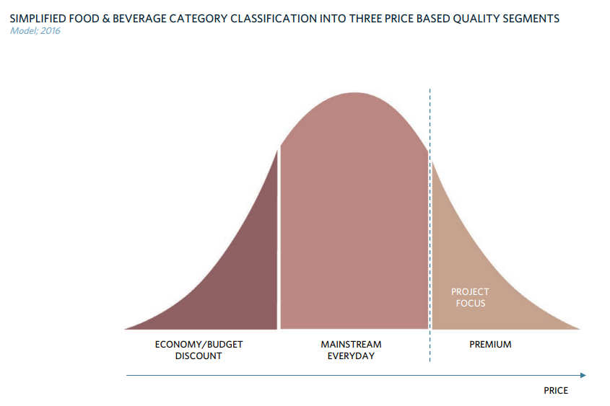
Premium products
PREMIUM PRODUCT
Brand/logo
Packaging
Product features
Story (Provenance)

Slide 4
An example

Slide 5
Product selection

Slide 6
Products identified

Slide 7
Next steps

Slide 8
Acknowledgements
Reference
Department of Primary Industries and Regional Development (26 July 2021) ‘Food Industry Innovation’ accessed at: <https://www.agric.wa.gov.au/r4r/food-industry-innovation> accessed 9 August 2021
Images
Images courtesy of Department of Agriculture and Food (December 2016) CC-BY-3.0-AU 'Premium Agri-food Market Opportunity: A project under the Food Industry Innovation Project' available at: <https://www.progressmidwest.com.au/Profiles/progressmidwest/Assets/ClientData/Documents/GGG_Library_2019/Agriculture_and_food/Premium_AgriFood_Market_Opportunity_Report_DAFWA.pdf> [12.5 MB] accessed 9 August 2021

