Slide 1
Department of Primary Industry and Regional Development
Primary Industries Development Research Highlights 2021
A Summary

Slide 2
Western Australian Government supports primary industries
The Western Australian Government delivers knowledge, policy, regulation and industry development capability to support the State’s primary industries to grow and prosper. They:
Protect – manage and provide for sustainable use of our natural resources, water and soils, and to protect Western Australia’s brand and reputation as a reliable producer of premium, clean and safe food, products and services.
Grow – enable the primary industries sector and regions to increase international competitiveness and grow in value and social amenity, strengthening these key pillars of the State’s economy.
Innovate – support a culture of scientific inquiry, innovation and adaptation across primary industries and regions to boost industry transformation, sustainability, economic growth and employment.

Slide 3
areas of the organisation associated with Agrifood/agribusiness

Slide 4
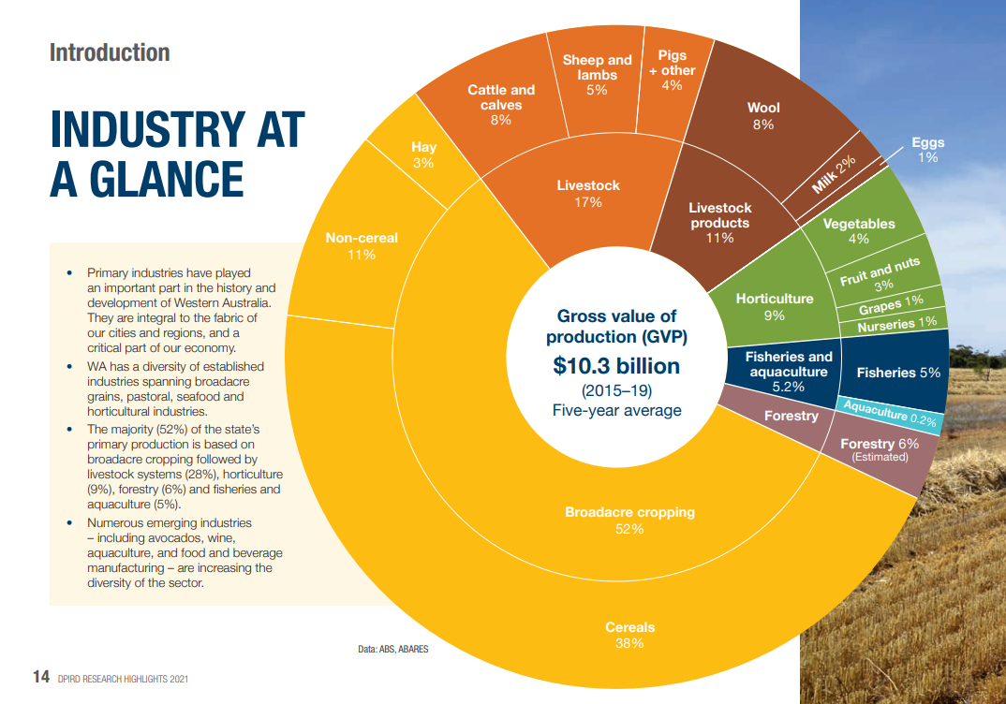

Slide 5
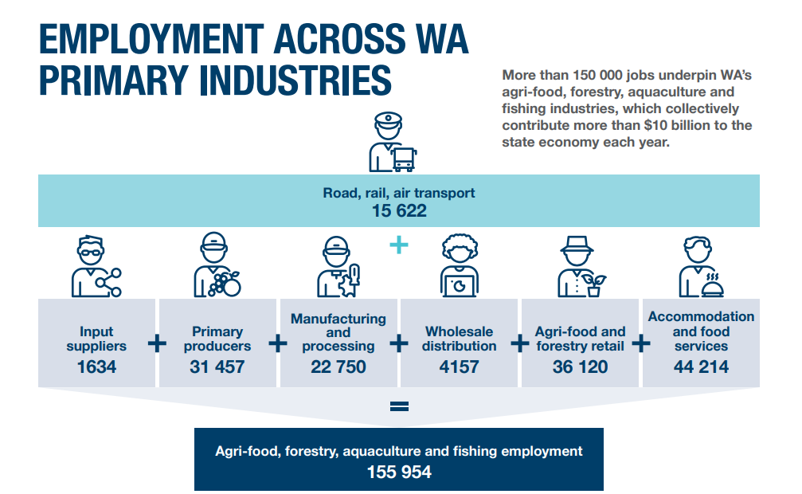
Primary Industries employment figures

Slide 6
Primary Industries Development Research Highlights 2021

Slide 7
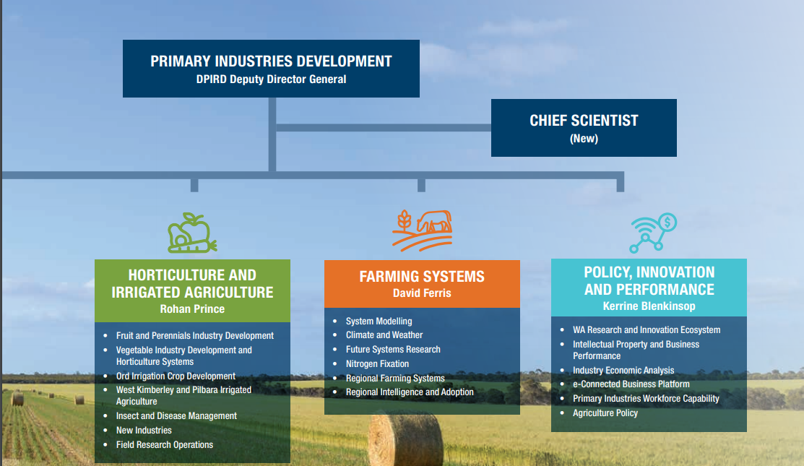
Titles and explanations

Slide 8
Aquaculture
Six DPIRD sites.
Marine fish hatcheries supply commercial quantities of juvenile fish, oysters and mussels to businesses.
DPIRD carry out research on fish species, abalone and pearl oysters.
DPIRD support recreational trout fishing in the southwest.

Slide 9
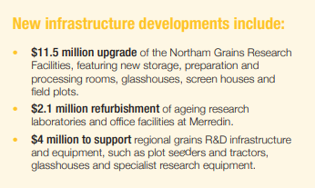
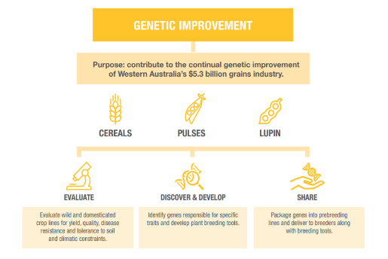
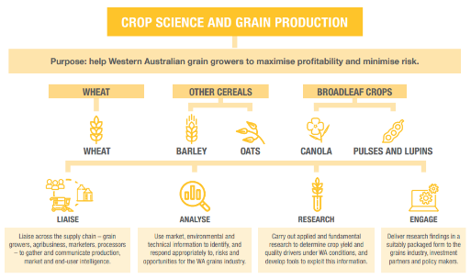
Grains
The grains industry needs to adopt farming systems with the ability to manage climate and market risk and improve resilience and sustainability.
Increased productivity will be driven by advances in robotics, remote sensing, data analytics and digital platforms, genetic tools and soil research.
Consumer demands impact growers as they demand specialised grain for udon noodles, biscuit wheats, healthy oat and barley products.
Challenges include: -
Climate change
Competition from other producers eg Black Sea area
Changing international trade flows due to politics and the Covid-19 pandemic
Consumer expectations about sustainability, animal welfare, food safety and health.

Slide 10
Livestock
Livestock has a gross value of $3 billion
60% exported
Approximately 7 700 people directly employed in livestock production, 4 300 employed in processing sectors.
Meat exported to over 50 countries
Wool production is one of Australia’s largest and oldest agricultural sectors.
To sustain the industry, productivity needs to grow by 2% per year

Slide 11
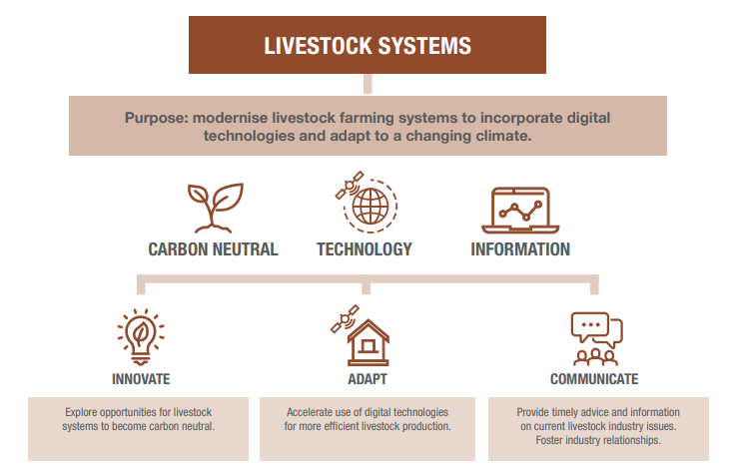
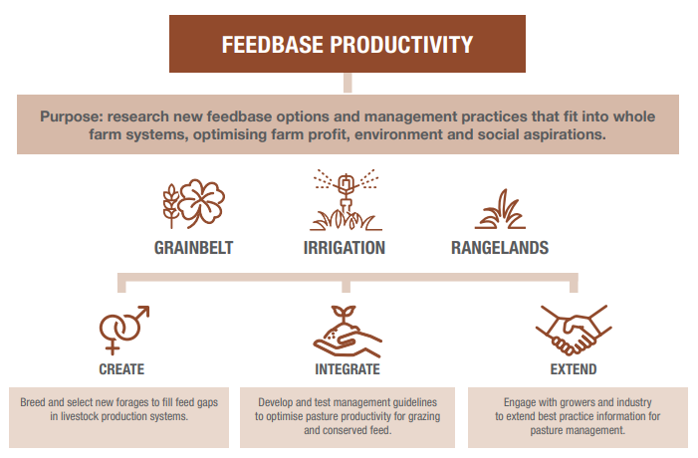
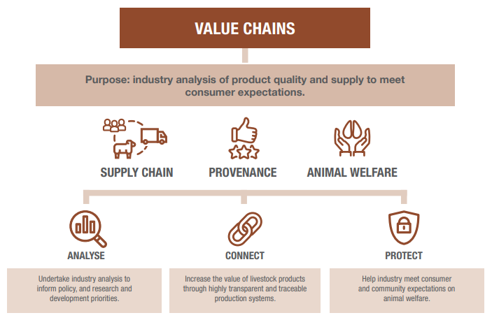
Livestock
Improving pastures
Genetic selection
Automation of processes
Reducing livestock greenhouse gas emissions
Creating a carbon neutral red meat industry by 2030
Developing traceability systems
Adding value along the WA supply chains
Developing onshore processing
Developing new markets

Slide 12
Horticulture and irrigated agriculture
Approximately 90 000 hectares of land used
600 gigalitres of licensed water required
Carrot industry is established and was worth $126 million in 2018-19
DPIRD apple breeding program is world renowned
Sector spans over 3500km
Research to increase productivity, profitability and sustainability of businesses across the state
Research covers genetics, agronomy, production systems, environmental stewardship and delivery of safe, quality products.

Slide 13
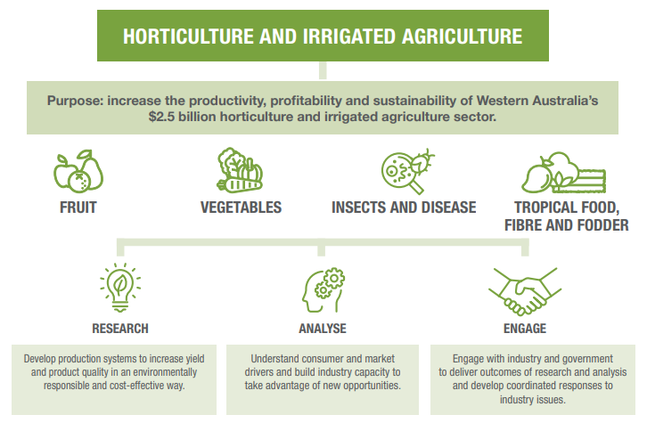
Horticulture and irrigated agriculture
Improve productivity through modern and efficient production systems and technology
Understand consumer and market influences
Implement environmentally responsible production systems
Manage pests and disease
Increase competiveness in global markets
Develop new varieties to match market needs
Generate value-adding opportunities along the value chain

Slide 14
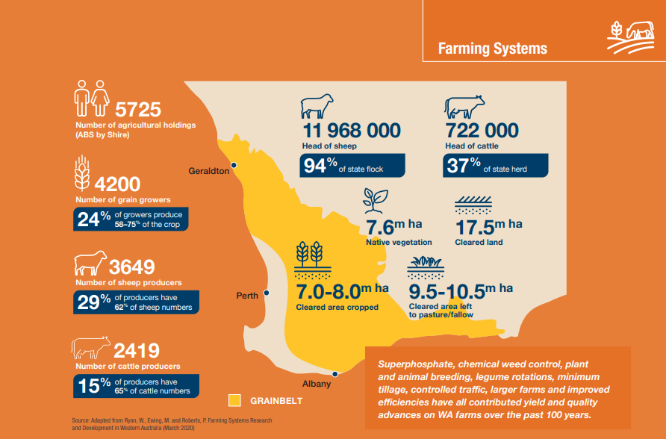
Farming systems
Gathering, analysing and sharing data to facilitate extension and adoption of new technologies.
Systems and economic modelling to inform decision making.
Research and evaluate dryland farming systems.

Slide 15
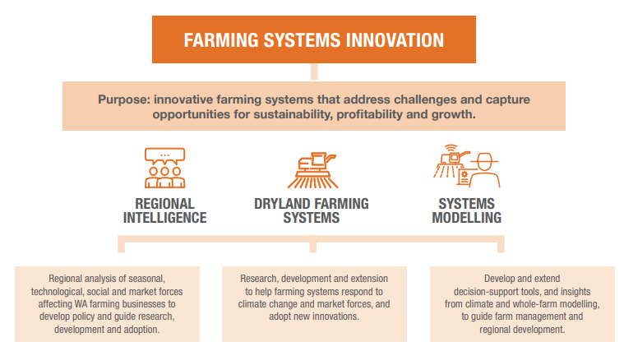

Slide 16
Policy, Innovation and Performance (PIP)
The PIP team collaborates across government, industry, researchers and the private sector to develop and enhance DPIRD activities.
Provides specialised skills in economic analysis, policy development, intellectual property, funds management and workforce development.
Administers the statutory requirements of the Agricultural Produce Commission (APC), the cereal breeding company InterGrain and the Australian Export Grains Innovation Centre (AEGIC).

Slide 17
Acknowledgements
Images
All images courtesy of the Department of Primary Industries and Regional Development (18 August 2021) CC-BY-3.0 ‘Primary Industries Development Research Highlights 2021’ available at: <https://www.agric.wa.gov.au/primary-industries-development-research-highlights-2021> accessed 31 August 2021

